Slide 1
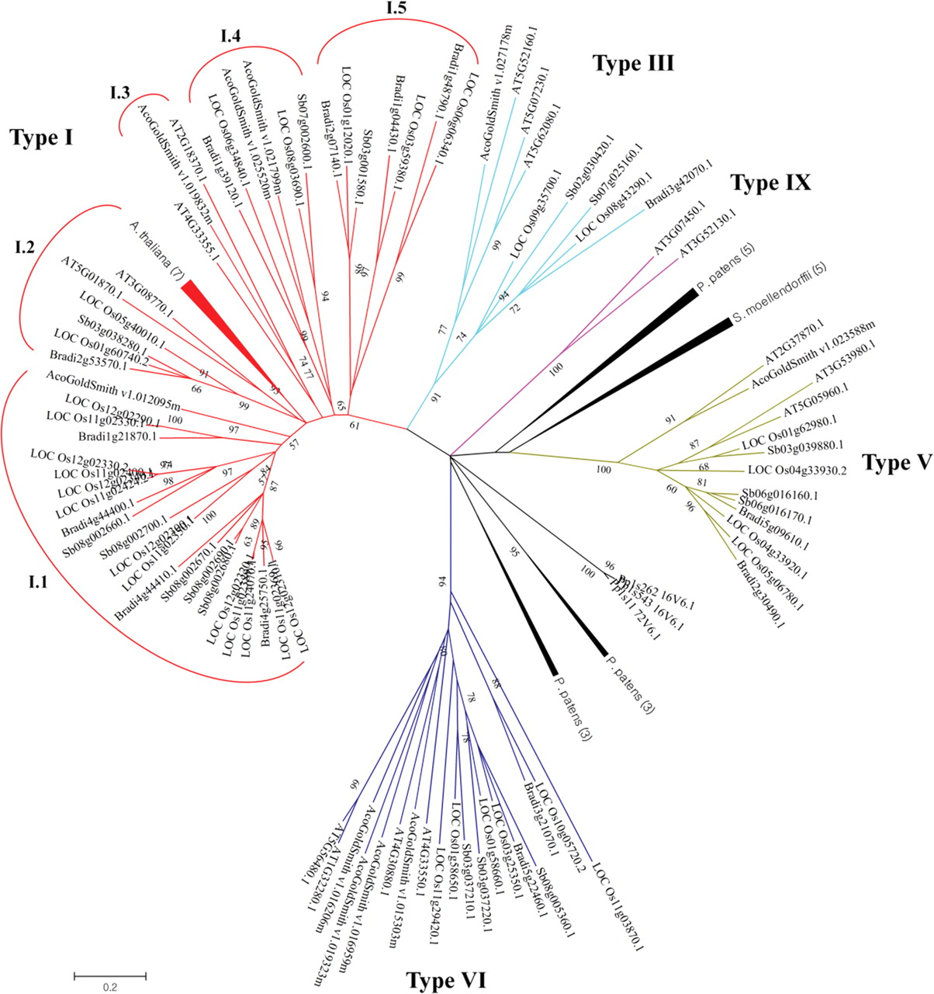
Figure 1. Unrooted phylogenetic tree of plant nsLTP family. The 9 kDa related nsLTP genes identified from seven land ...
Notes:
Figure 1. Unrooted phylogenetic tree of plant nsLTP family. The 9 kDa related nsLTP genes identified from seven land plant species were employed for pairwise alignment. The amino acids of the 8 CM region were used for phylogenetic tree construction using the maximum-likelihood algorithm with 1000 bootstrap replicates. Bootstrap values of <50 were hidden. Compressed branches were noted by species name followed by the gene number included in the branch.
Unless provided in the caption above, the following copyright applies to the content of this slide: © The Author 2012. Published by Oxford University Press on behalf of Kazusa DNA Research InstituteThis is an Open Access article distributed under the terms of the Creative Commons Attribution Non-Commercial License (http://creativecommons.org/licenses/by-nc/3.0/), which permits unrestricted non-commercial use, distribution, and reproduction in any medium, provided the original work is properly cited.

Slide 2
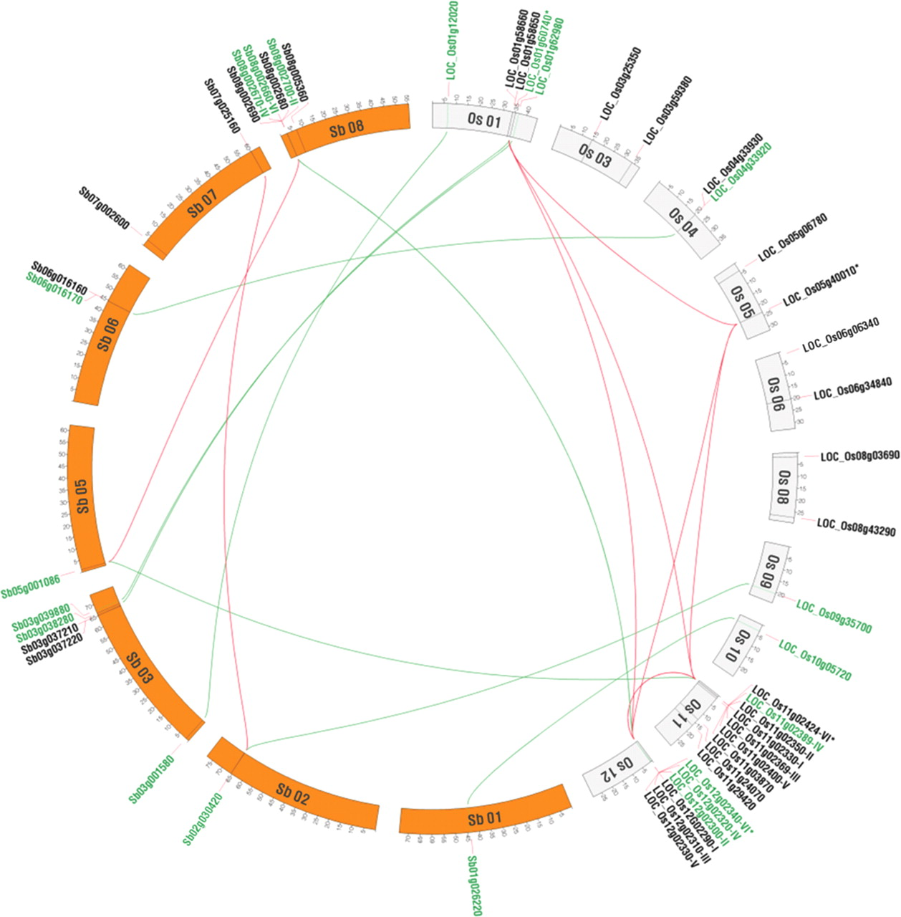
Figure 2. Genomic organization and colinearity of the nsLTPs genes in rice and sorghum. Chromosomal localization of ...
Notes:
Figure 2. Genomic organization and colinearity of the nsLTPs genes in rice and sorghum. Chromosomal localization of nsLTP genes was indicated in each species. The orthologous pairs between rice and sorghum were connected in green. The collinear paralogs detected in synteny blocks were connected in red. Detailed information for gene pairs is indicated after the gene locus name.
Unless provided in the caption above, the following copyright applies to the content of this slide: © The Author 2012. Published by Oxford University Press on behalf of Kazusa DNA Research InstituteThis is an Open Access article distributed under the terms of the Creative Commons Attribution Non-Commercial License (http://creativecommons.org/licenses/by-nc/3.0/), which permits unrestricted non-commercial use, distribution, and reproduction in any medium, provided the original work is properly cited.

Slide 3
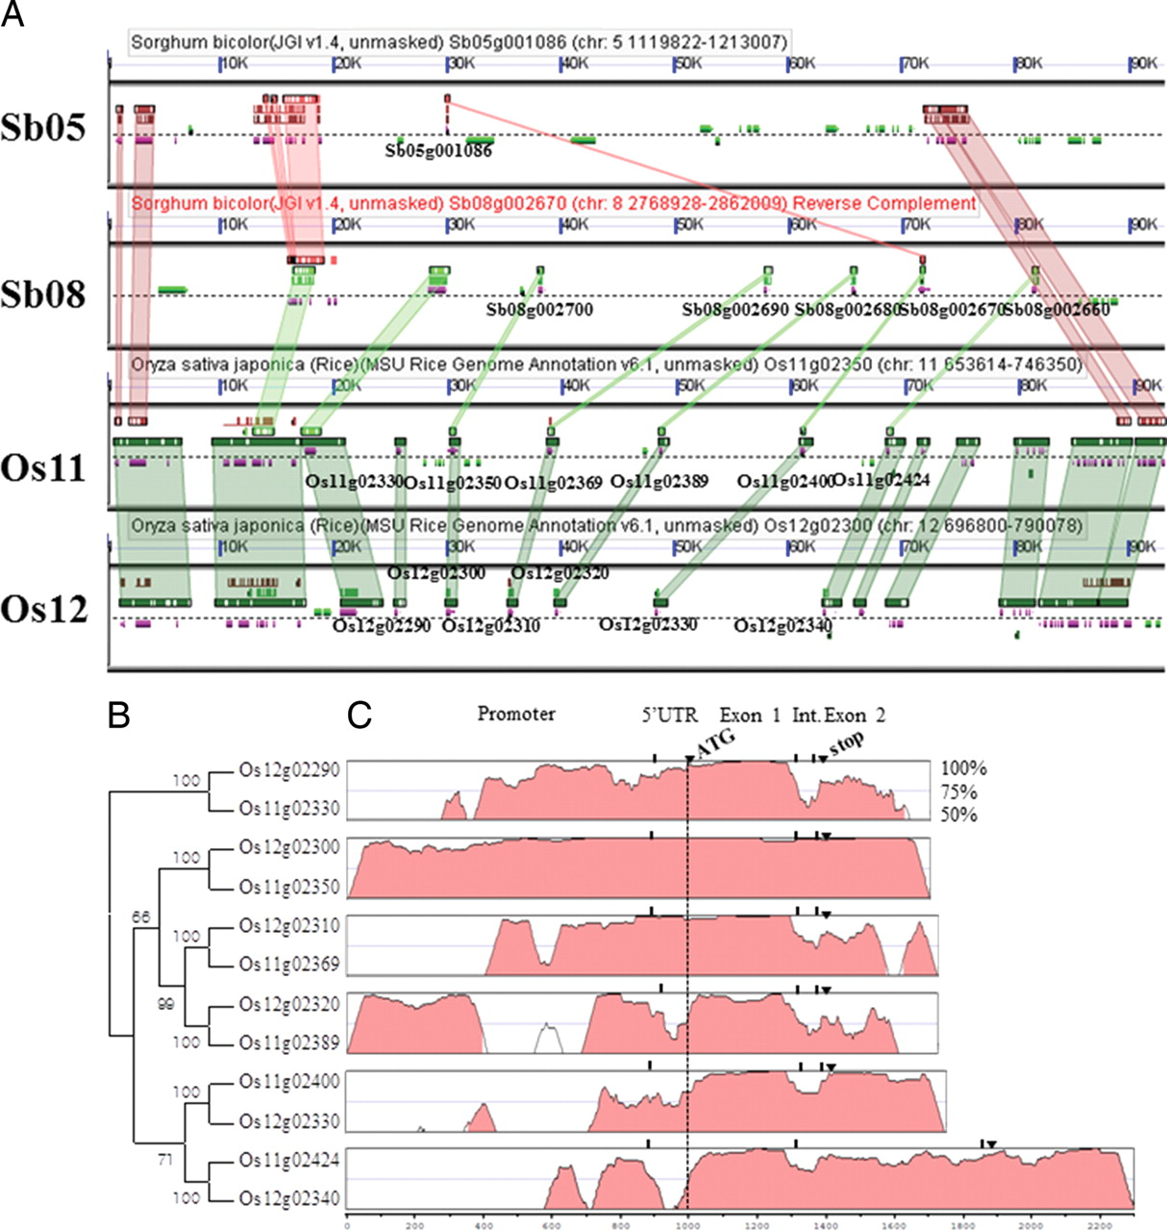
Figure 3. Collinearity and sequence similarity of OsLTPs on the distal region of rice chromosome 11 and 12. (A) ...
Notes:
Figure 3. Collinearity and sequence similarity of OsLTPs on the distal region of rice chromosome 11 and 12. (A) Comparison of orthologous and paralogous genomic regions including nsLTP tandem repeats in rice and sorghum. Sorghum bicolor chromosome 8 is displayed in reverse (red). Gene models with collinearity are coloured in purple, while those without collinearity are coloured in grey. The nsLTP gene names are indicated under the gene models. The high gene sequence similarity is depicted in rectangles up or under genes and connecting the collinear genes. This experiment can be reproduced with distance, algorithm changes from database (http://synteny.cnr.berkeley.edu/CoGe/GEvo.pl). (B) Neighbour-joining tree of OsLTP genes at the nucleotide level. The branch containing Os12g02290 and Os11g02330 was selected as a root. One thousand repeats were used for bootstrap evaluation. (C) Similarity of the OsLTP genomic and surrounding sequences between each collinear gene pair. VISTA conservation tracks were generated using the region 1000 bp upstream of the start codon, OsLTP gene exon 1, intron, exon 2 and 300 bp downstream stop codon. The gene pair names for each alignment were shown in phylogeny. The nsLTPs on chromosome 12 were used as a reference for each VISTA alignment. The criterion for sequence similarity is 75%.
Unless provided in the caption above, the following copyright applies to the content of this slide: © The Author 2012. Published by Oxford University Press on behalf of Kazusa DNA Research InstituteThis is an Open Access article distributed under the terms of the Creative Commons Attribution Non-Commercial License (http://creativecommons.org/licenses/by-nc/3.0/), which permits unrestricted non-commercial use, distribution, and reproduction in any medium, provided the original work is properly cited.

Slide 4
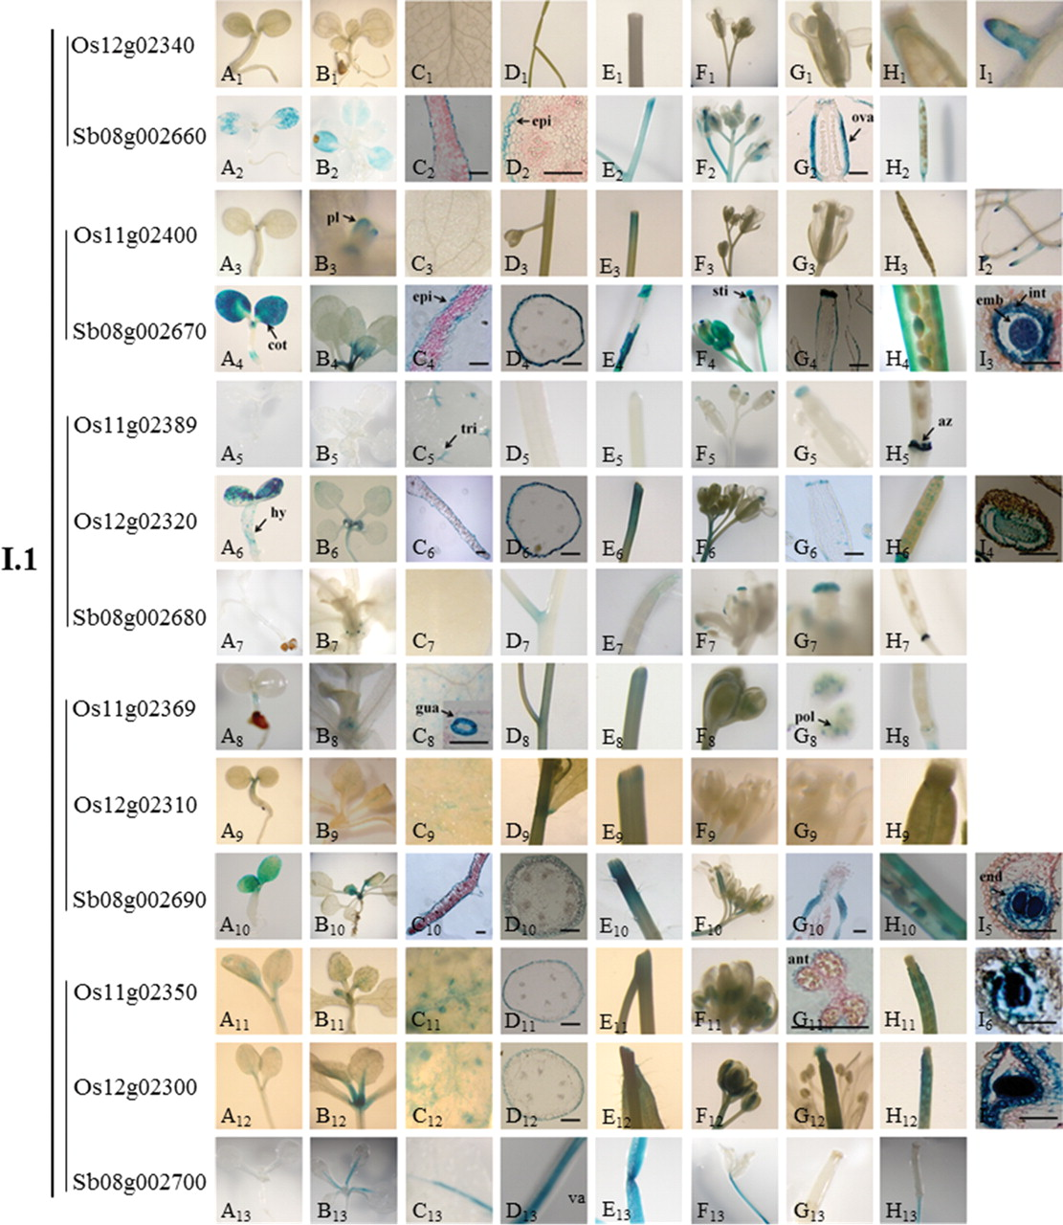
Figure 4. Tissue-specific expressions of rice and sorghum nsLTP promoter::uidA fuisions in clade I.1. T₂ ...
Notes:
Figure 4. Tissue-specific expressions of rice and sorghum nsLTP promoter::uidA fuisions in clade I.1. T2 plants of transgenic Arabidopsis were used for activity observation during the plant whole life cycle. The collinear gene pairs are indicated by a vertical line before the gene names. A1–13, germinated seedling; B1–13, 10-day to 2-week-old seedling; C1–13, leaf and leaf sections; D1–13, shoot and sections; E1–13, wound shoot; F1–13, flower bud; G1–13, flower and sections; H1–13, silique; I1–2, root tip; I3–7, seed section. Abbreviations: cot, cotyledon; pI, primary leaf, Hy, hypocotyls; tri, thricom; epi, epidermis; gua, guard cell; sti, stigma; ant, anther; ova, ovary; az, abscission zone; emb, embryo; end, endosperm; int, integument; pol, pollen; va, vascular. Bar = 50 μm.
Unless provided in the caption above, the following copyright applies to the content of this slide: © The Author 2012. Published by Oxford University Press on behalf of Kazusa DNA Research InstituteThis is an Open Access article distributed under the terms of the Creative Commons Attribution Non-Commercial License (http://creativecommons.org/licenses/by-nc/3.0/), which permits unrestricted non-commercial use, distribution, and reproduction in any medium, provided the original work is properly cited.

Slide 5
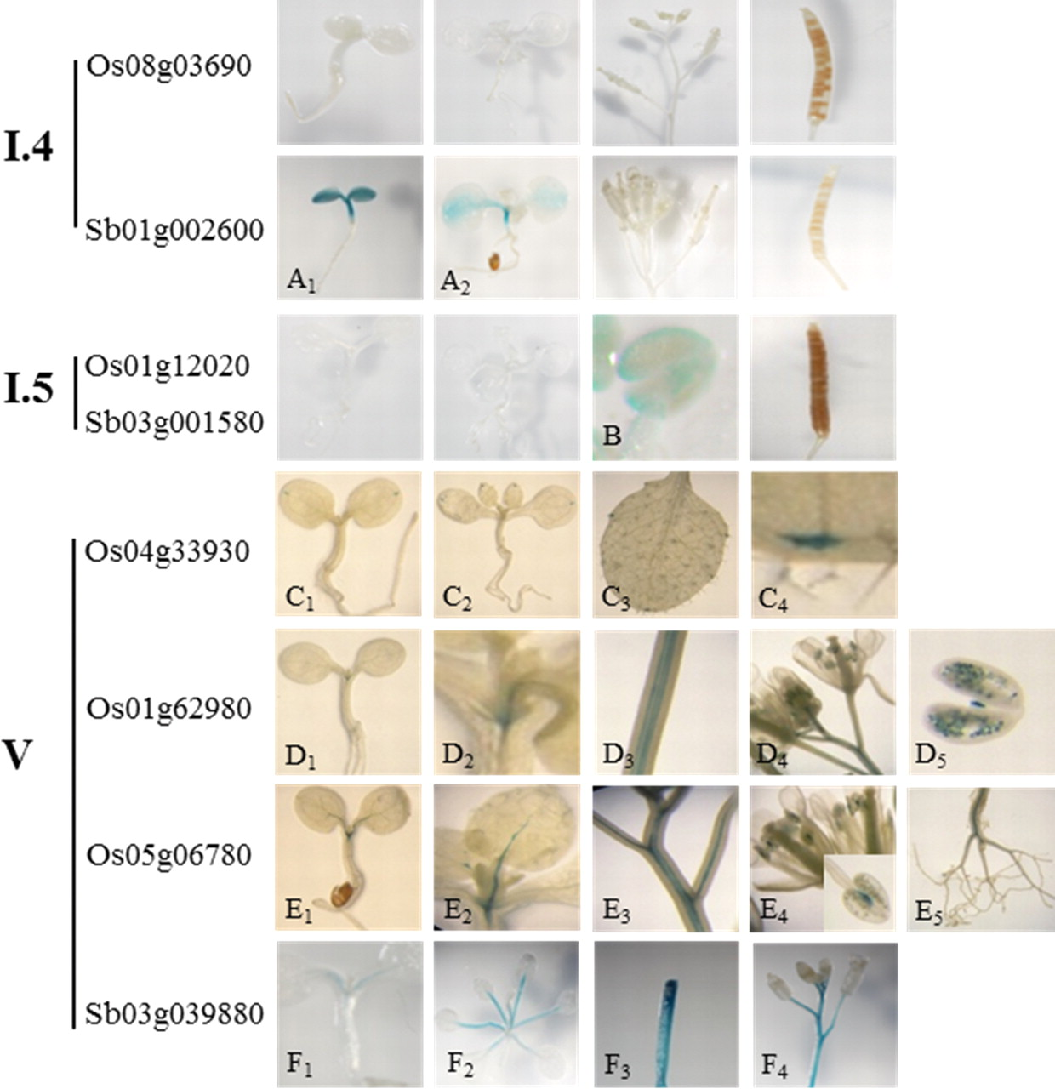
Figure 5. Tissue-specific expressions of rice and sorghum nsLTP promoter::uidA fusions in clade I.3, I.4, and type V. ...
Notes:
Figure 5. Tissue-specific expressions of rice and sorghum nsLTP promoter::uidA fusions in clade I.3, I.4, and type V. T2 transgenic Arabidopsis was used for activity observation during the whole plant life cycle.
Unless provided in the caption above, the following copyright applies to the content of this slide: © The Author 2012. Published by Oxford University Press on behalf of Kazusa DNA Research InstituteThis is an Open Access article distributed under the terms of the Creative Commons Attribution Non-Commercial License (http://creativecommons.org/licenses/by-nc/3.0/), which permits unrestricted non-commercial use, distribution, and reproduction in any medium, provided the original work is properly cited.

Slide 6
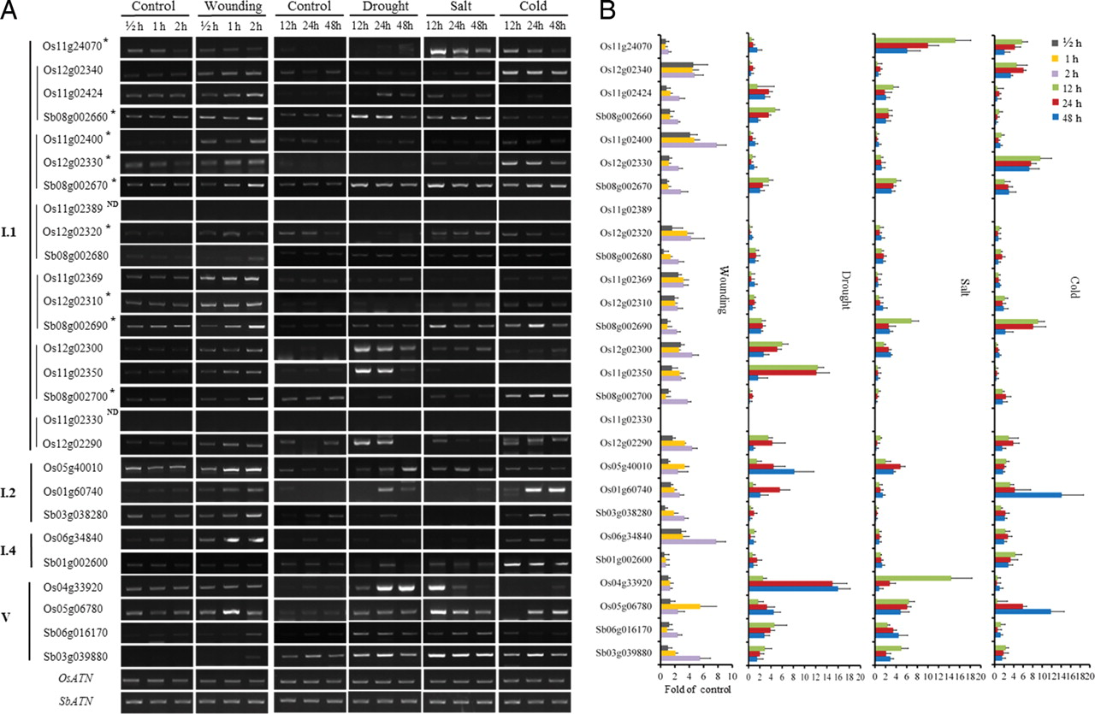
Figure 6. RT–PCR analysis of the expressions of nsLTP genes against abiotic stresses. The stress treatments were ...
Notes:
Figure 6. RT–PCR analysis of the expressions of nsLTP genes against abiotic stresses. The stress treatments were applied by subjecting 10-day-old seedlings to wounding, drought (polyethylene glycol, 25%), salt (NaCl, 250 mM), or cold (4°C) stresses for variable time periods from 0 to 48 h. (A) Representative semi-quantitative RT–PCR analysis. The collinear nsLTP gene pairs were indicated by a vertical line before the gene names. OsATN, Oryza sativa actin gene; SbATN, Sorghum bicolor actin gene. *Highly expressed genes amplified with <28 PCR cycles. ND, not detected. (B) Statistical analysis of the semi-quantitative RT–PCR shown as mean ± SEM for three to four independent experiments.
Unless provided in the caption above, the following copyright applies to the content of this slide: © The Author 2012. Published by Oxford University Press on behalf of Kazusa DNA Research InstituteThis is an Open Access article distributed under the terms of the Creative Commons Attribution Non-Commercial License (http://creativecommons.org/licenses/by-nc/3.0/), which permits unrestricted non-commercial use, distribution, and reproduction in any medium, provided the original work is properly cited.

