Slide 1
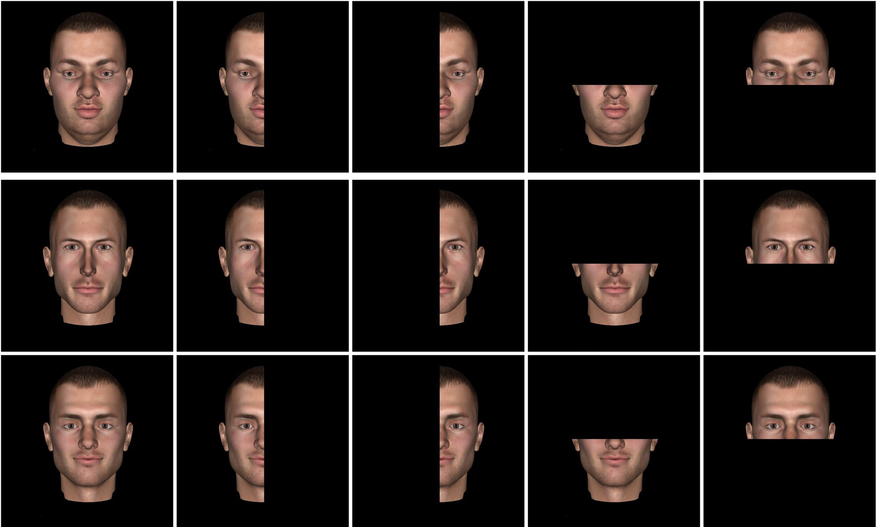
Figure 1. Images of the target faces (top row) and the distractors faces (bottom 2 rows). For each identity, images of ...
Notes:
Figure 1. Images of the target faces (top row) and the distractors faces (bottom 2 rows). For each identity, images of the whole face and of 4 different face halves were used. Images were generated with DAZ-3D to control for low-level differences.
Unless provided in the caption above, the following copyright applies to the content of this slide: © The Author 2015. Published by Oxford University Press. All rights reserved. For Permissions, please e-mail: journals.permissions@oup.com

Slide 2
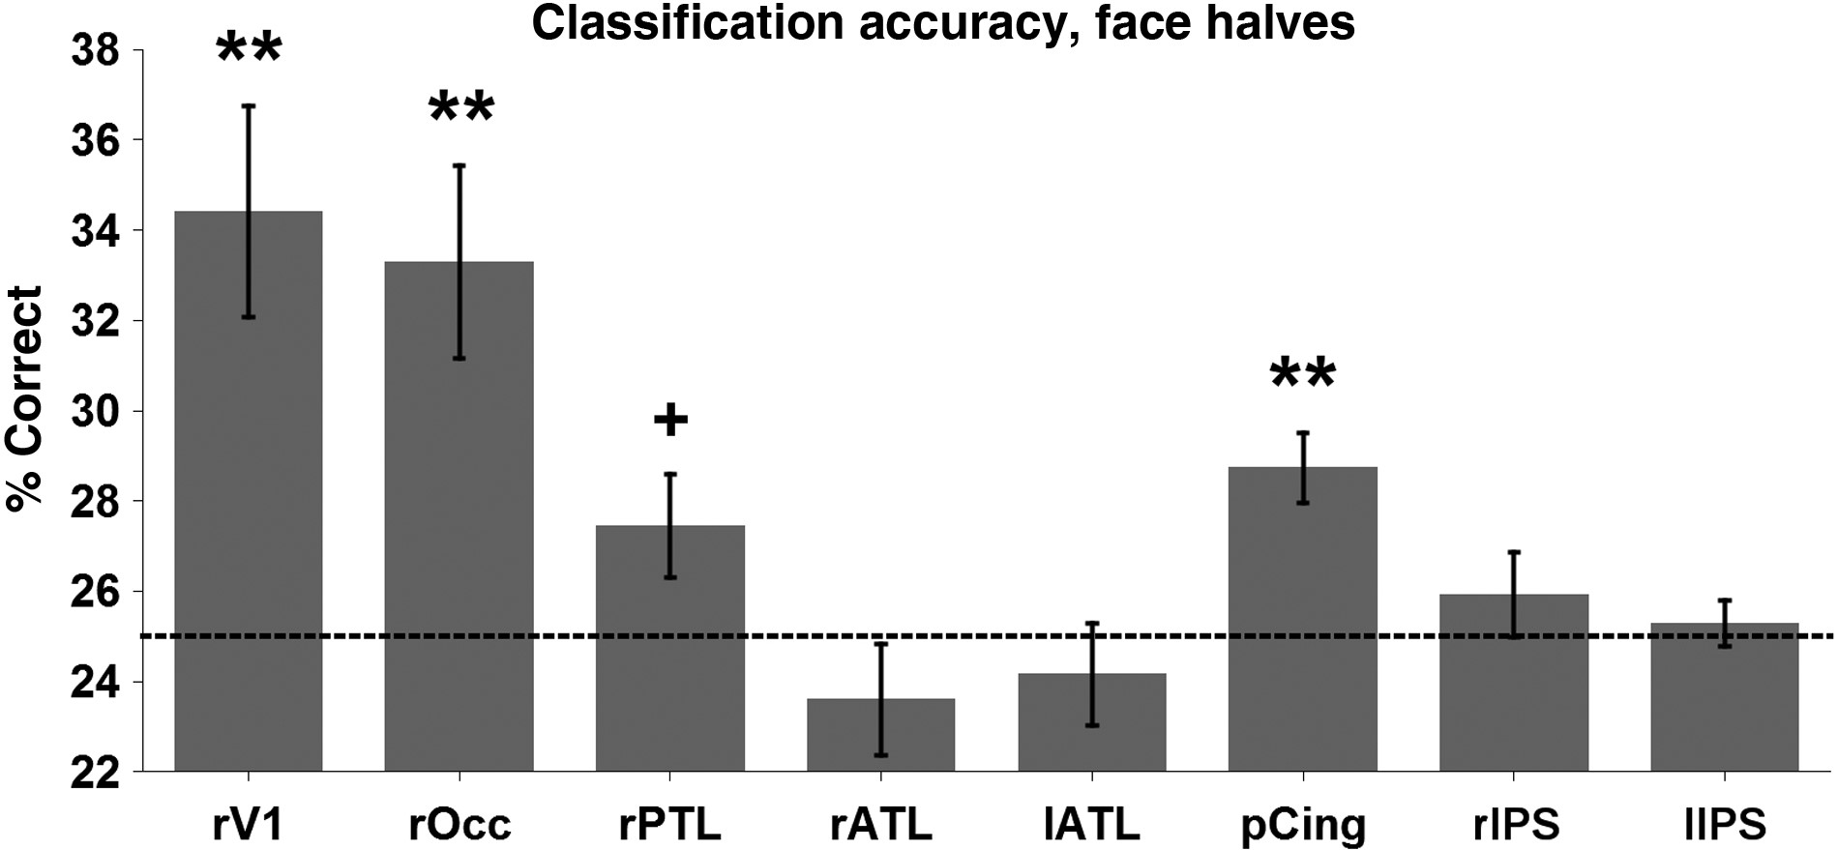
Figure 6. Accuracy of the classification between the 4 halves, collapsing across identity. Chance is at 25%. Accuracy ...
Notes:
Figure 6. Accuracy of the classification between the 4 halves, collapsing across identity. Chance is at 25%. Accuracy significantly above chance was found in primary visual cortex (accuracy = 34.42%, t(12) = 4.02, P < 0.005), ventral occipital cortex (accuracy = 33.29%, t(12) = 3.87, P < 0.005), and posterior cingulate (accuracy = 28.73%, t(12) = 4.86, P < 0.005). A trend was observed in the posterior temporal lobe (accuracy = 27.44%, t(12) = 2.14, P = 0.053).
Unless provided in the caption above, the following copyright applies to the content of this slide: © The Author 2015. Published by Oxford University Press. All rights reserved. For Permissions, please e-mail: journals.permissions@oup.com

Slide 3
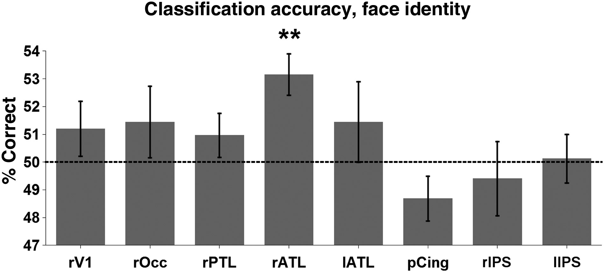
Figure 5. Accuracy of the classification between the 2 distractor identities, generalizing across different face ...
Notes:
Figure 5. Accuracy of the classification between the 2 distractor identities, generalizing across different face halves. Chance is at 50%. The classifier (SVM) was trained to discriminate between the 2 distractor identities using data from 3 of the halves, and was tested to discriminate between those identities on data from the fourth half. This procedure was iterated for all choices of the test half. Only the right ATL performed significantly above chance (accuracy = 53.13%, t(12) = 4.16, P < 0.005).
Unless provided in the caption above, the following copyright applies to the content of this slide: © The Author 2015. Published by Oxford University Press. All rights reserved. For Permissions, please e-mail: journals.permissions@oup.com

Slide 4
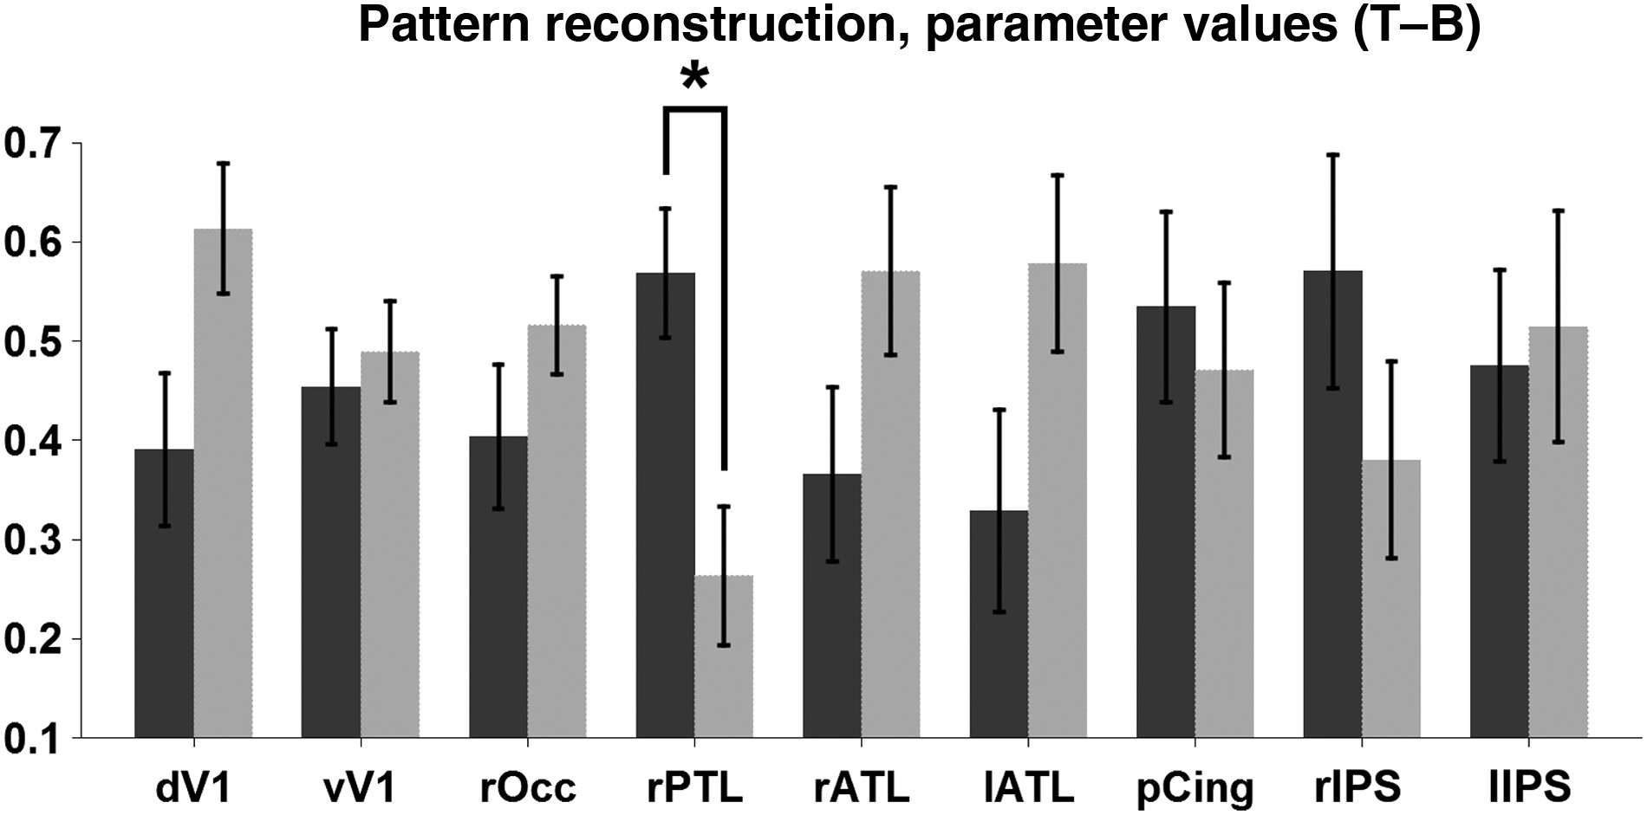
Figure 4. Parameter values for the reconstruction of the response pattern to the whole face as a linear combination of ...
Notes:
Figure 4. Parameter values for the reconstruction of the response pattern to the whole face as a linear combination of the response patterns to the top and bottom face halves. The parameter for the top face is shown in dark gray, the parameter for the bottom face in light gray. A significantly greater contribution of the response pattern to the top half was found in the right posterior temporal lobe (t(12) = 2.41, P < 0.05).
Unless provided in the caption above, the following copyright applies to the content of this slide: © The Author 2015. Published by Oxford University Press. All rights reserved. For Permissions, please e-mail: journals.permissions@oup.com

Slide 5
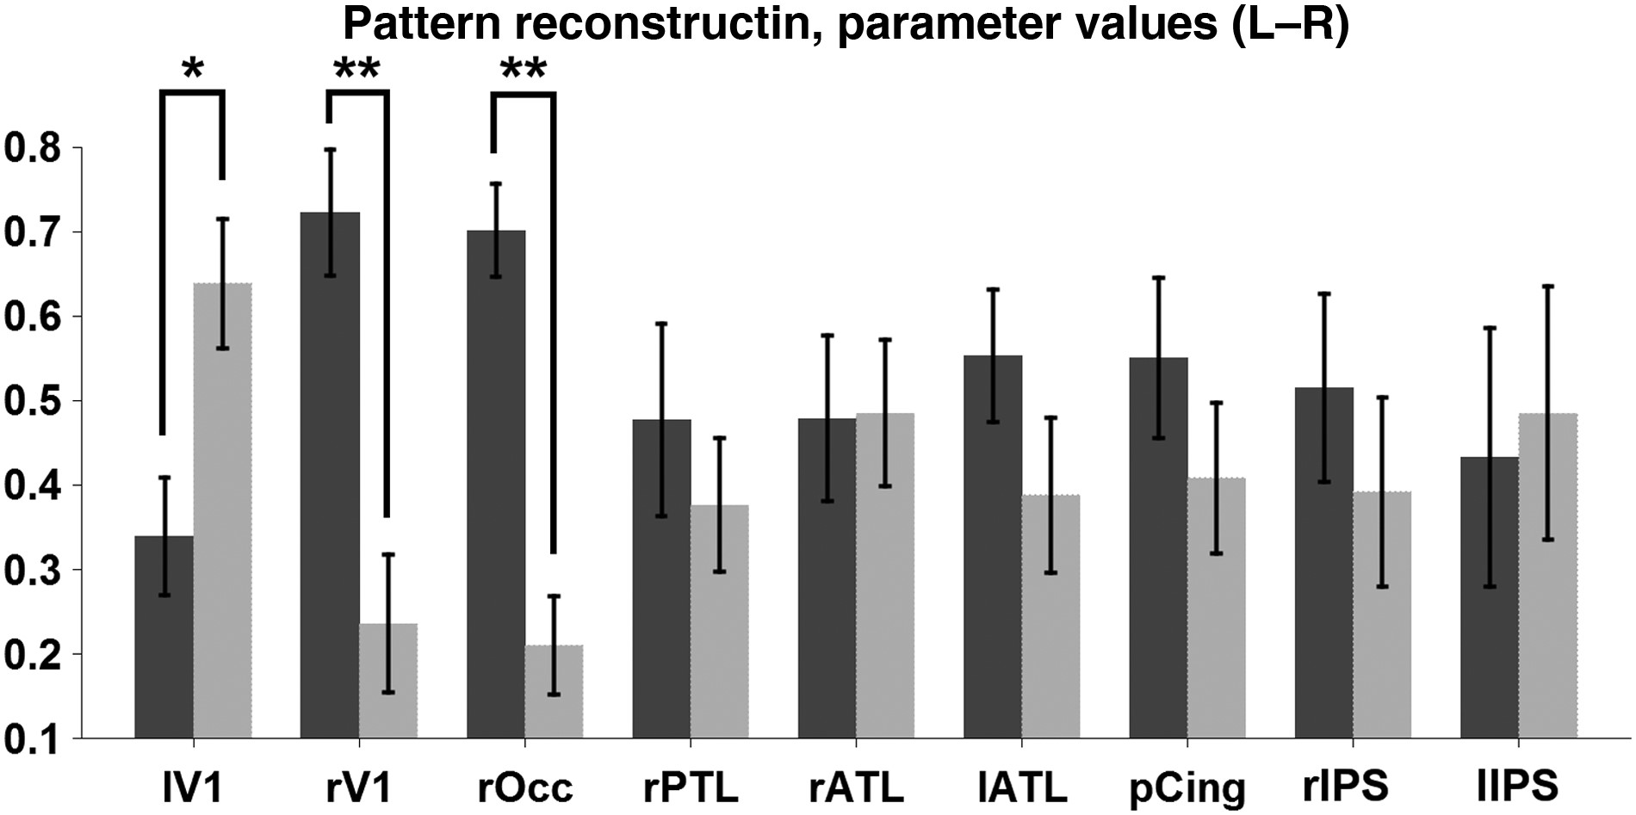
Figure 3. Parameter values for the reconstruction of the response pattern to the whole face as a linear combination of ...
Notes:
Figure 3. Parameter values for the reconstruction of the response pattern to the whole face as a linear combination of the response patterns to the left and right face halves. The parameter for the left face is shown in dark gray, the parameter for the right face in light gray. A significantly greater contribution of the response pattern to the contralateral half was found in V1 (right V1: t(12) = 3.27, one tailed P < 0.005; left V1: t(12) = −2.1415, one tailed P < 0.05) and right ventral occipital cortex (t(12) = 4.87, one tailed P < 0.005).
Unless provided in the caption above, the following copyright applies to the content of this slide: © The Author 2015. Published by Oxford University Press. All rights reserved. For Permissions, please e-mail: journals.permissions@oup.com

Slide 6
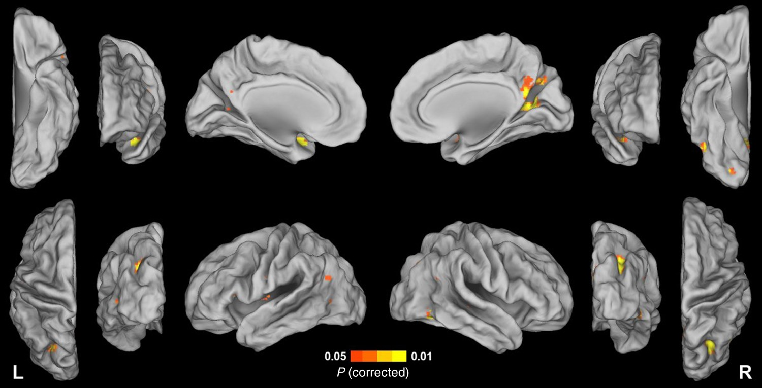
Figure 2. Map of the most informative voxels for classifying between the whole faces of the distractor identities (P < ...
Notes:
Figure 2. Map of the most informative voxels for classifying between the whole faces of the distractor identities (P < 0.05 corrected). Informative voxels were found in a right ventral occipital region (peak Montreal Neurological Institute [MNI] coordinates 21 −84 −9), a right ventral fusiform region (peak MNI coordinates 45 −59 −8), the anterior temporal lobe (ATL) bilaterally (peak MNI coordinates 41 6 −22 and −37 6 −25), the right posterior cingulate (peak MNI coordinates 12 −59 14), and the intraparietal sulcus bilaterally (peak MNI coordinates 32 −65 34 and −20 −67 37).
Unless provided in the caption above, the following copyright applies to the content of this slide: © The Author 2015. Published by Oxford University Press. All rights reserved. For Permissions, please e-mail: journals.permissions@oup.com

Slide 7
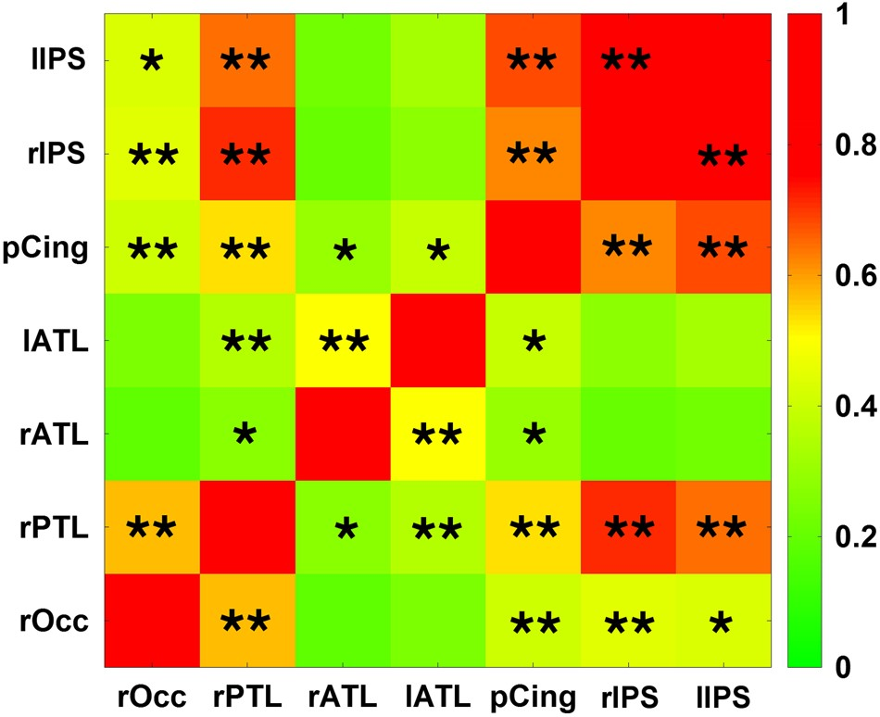
Figure 7. Functional connectivity between regions containing the most informative voxels for classifying between the ...
Notes:
Figure 7. Functional connectivity between regions containing the most informative voxels for classifying between the whole faces of the distractor identities. Significant functional connectivity is marked with *P < 0.05 and with **P < 0.005.
Unless provided in the caption above, the following copyright applies to the content of this slide: © The Author 2015. Published by Oxford University Press. All rights reserved. For Permissions, please e-mail: journals.permissions@oup.com

