Slide 1
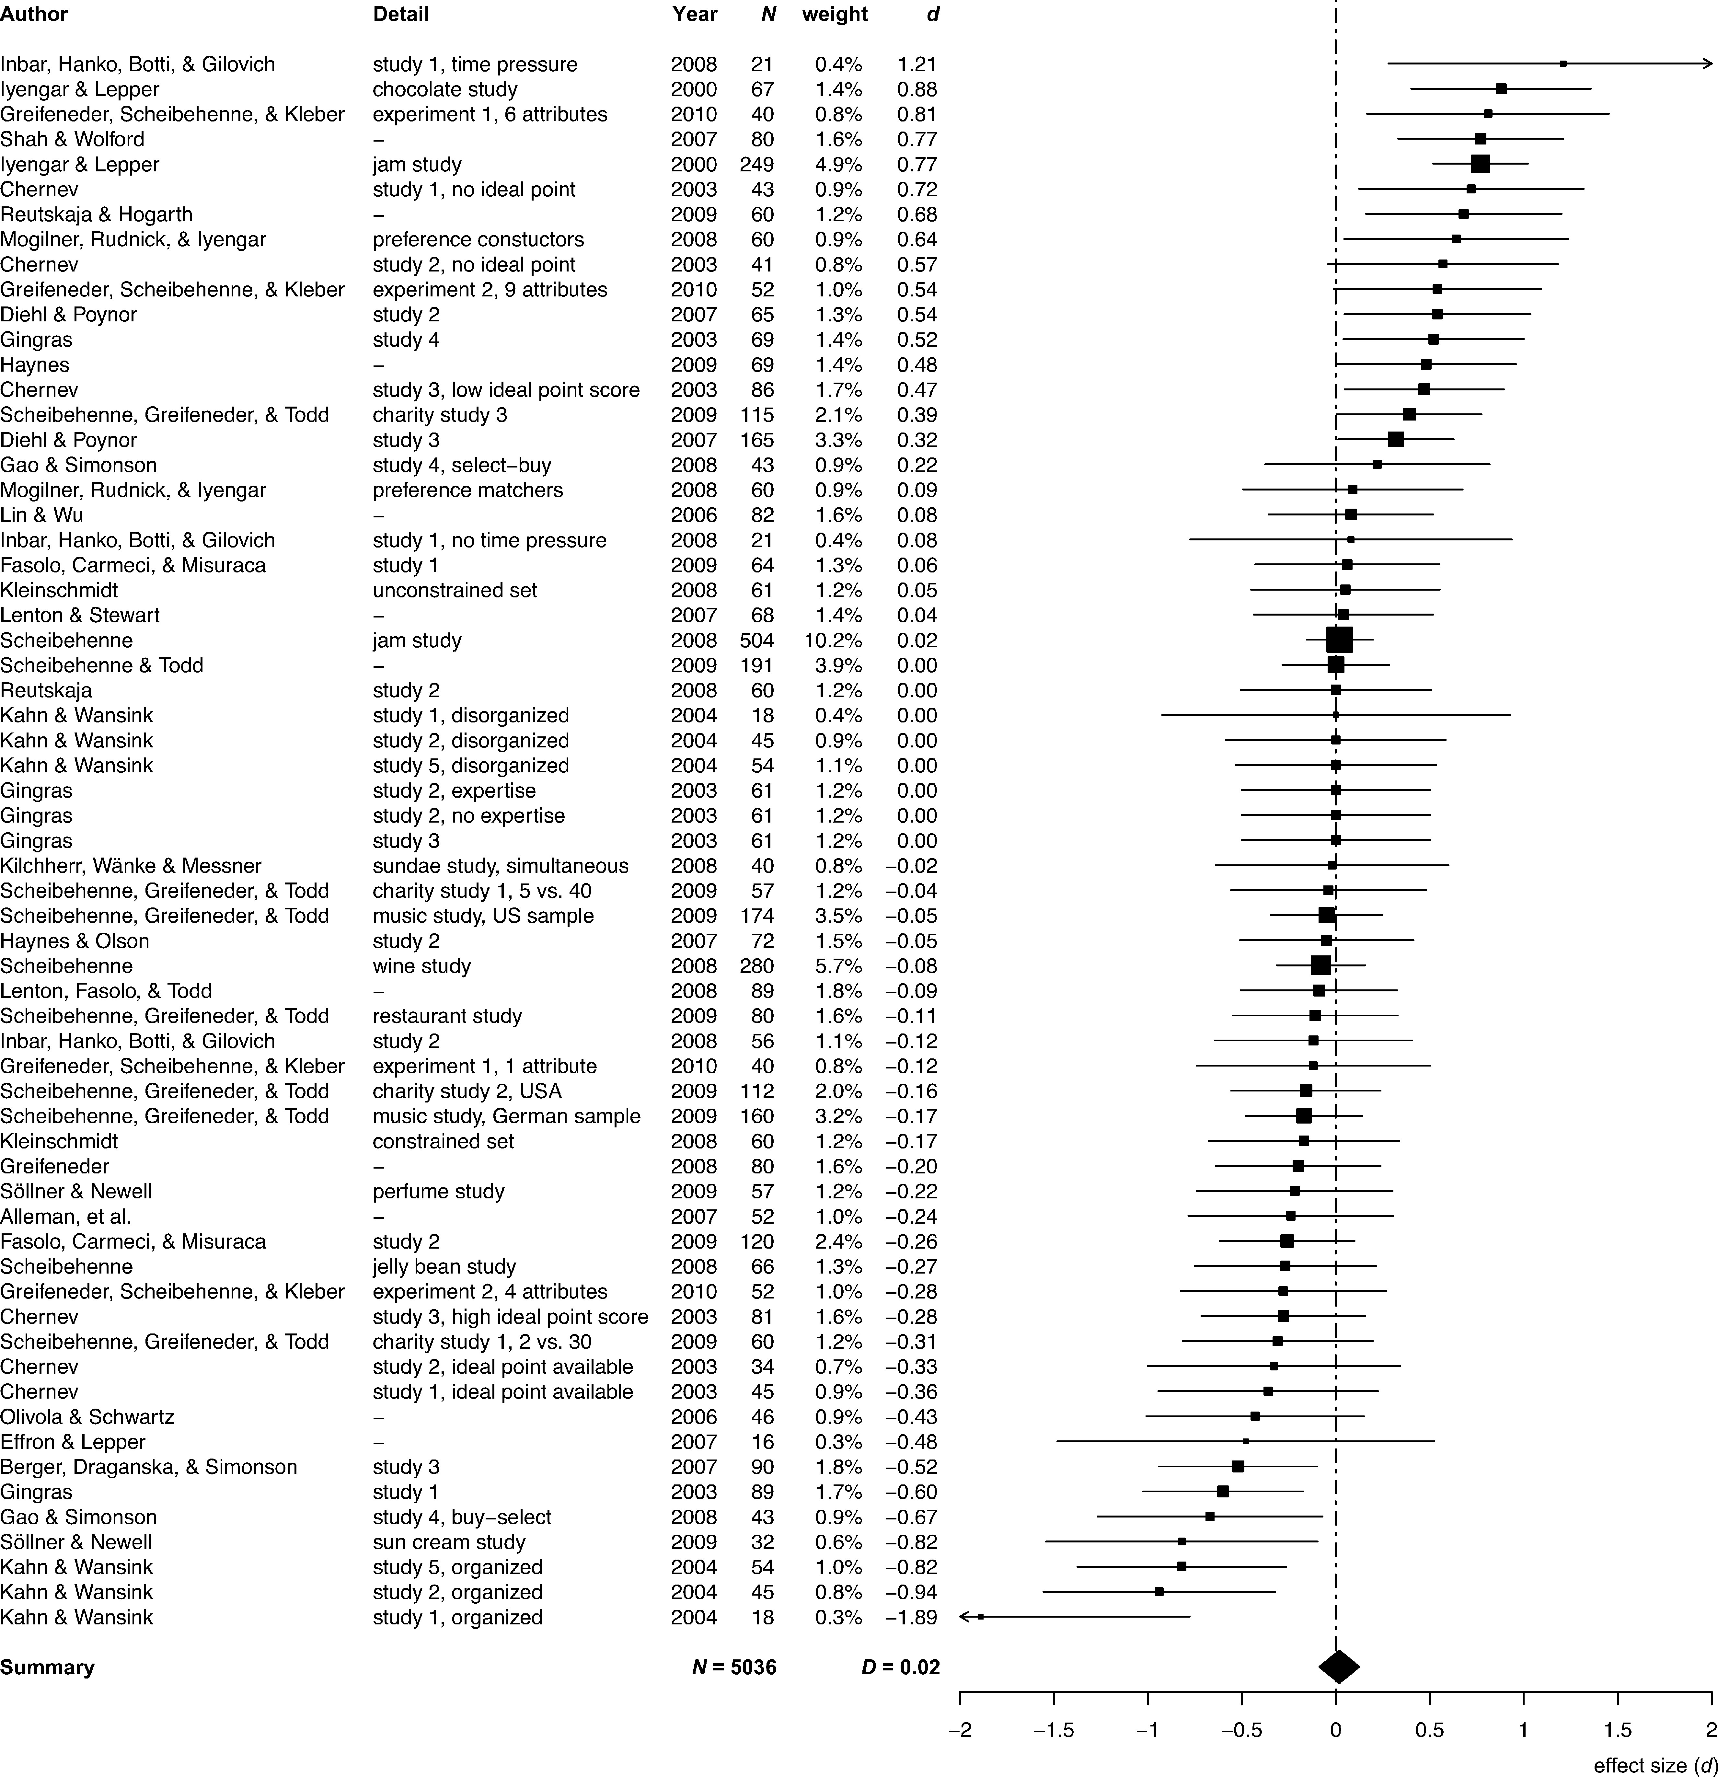
Figure 1 Overview of the data as a forest plot Note.—The positions of the squares on the x-axis indicate effect sizes ...
Notes:
Figure 1 Overview of the data as a forest plot Note.—The positions of the squares on the x-axis indicate effect sizes of each data point. The bars indicate the 95% confidence intervals of the effect sizes. The sizes of the squares are inversely proportional to the respective standard errors (i.e., larger squares indicate smaller standard errors).
Unless provided in the caption above, the following copyright applies to the content of this slide: © 2010 by JOURNAL OF CONSUMER RESEARCH, Inc.

Slide 2
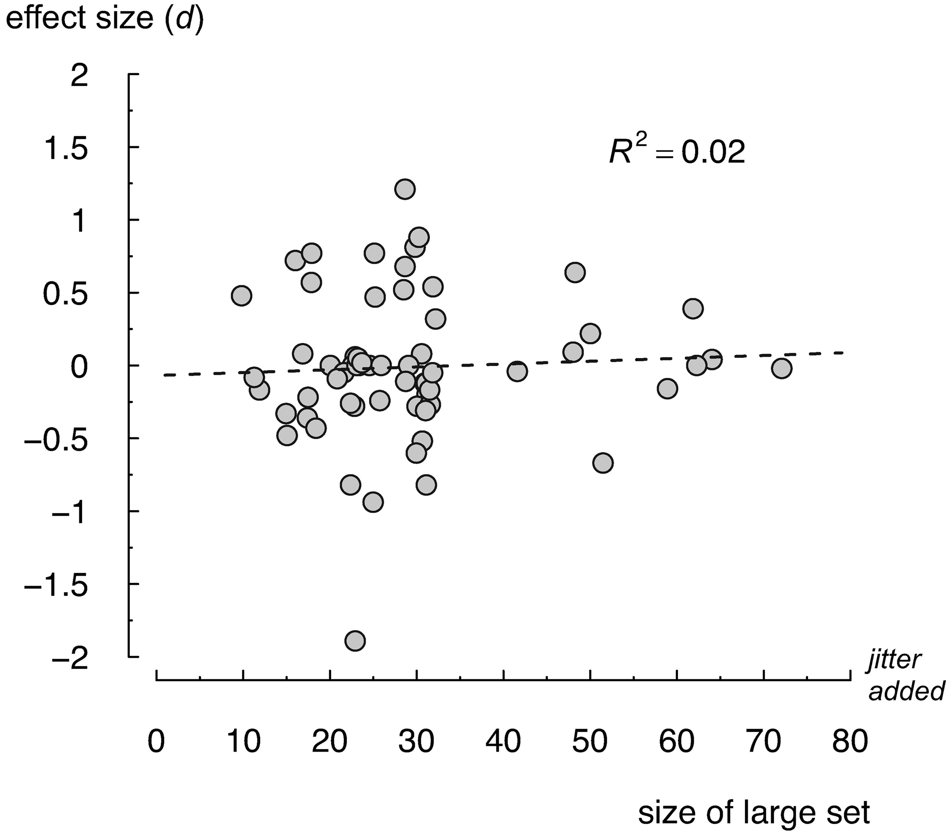
Figure 2 Relationship between the effect size and the size of the large set Note.—The dotted line indicates the ...
Notes:
Figure 2 Relationship between the effect size and the size of the large set Note.—The dotted line indicates the best-fitting quadratic regression curve. To improve presentation, jitter was added to the x-coordinate values and the x-axis was truncated at 80, omitting one data point representing a set size of 300 options.
Unless provided in the caption above, the following copyright applies to the content of this slide: © 2010 by JOURNAL OF CONSUMER RESEARCH, Inc.

Slide 3
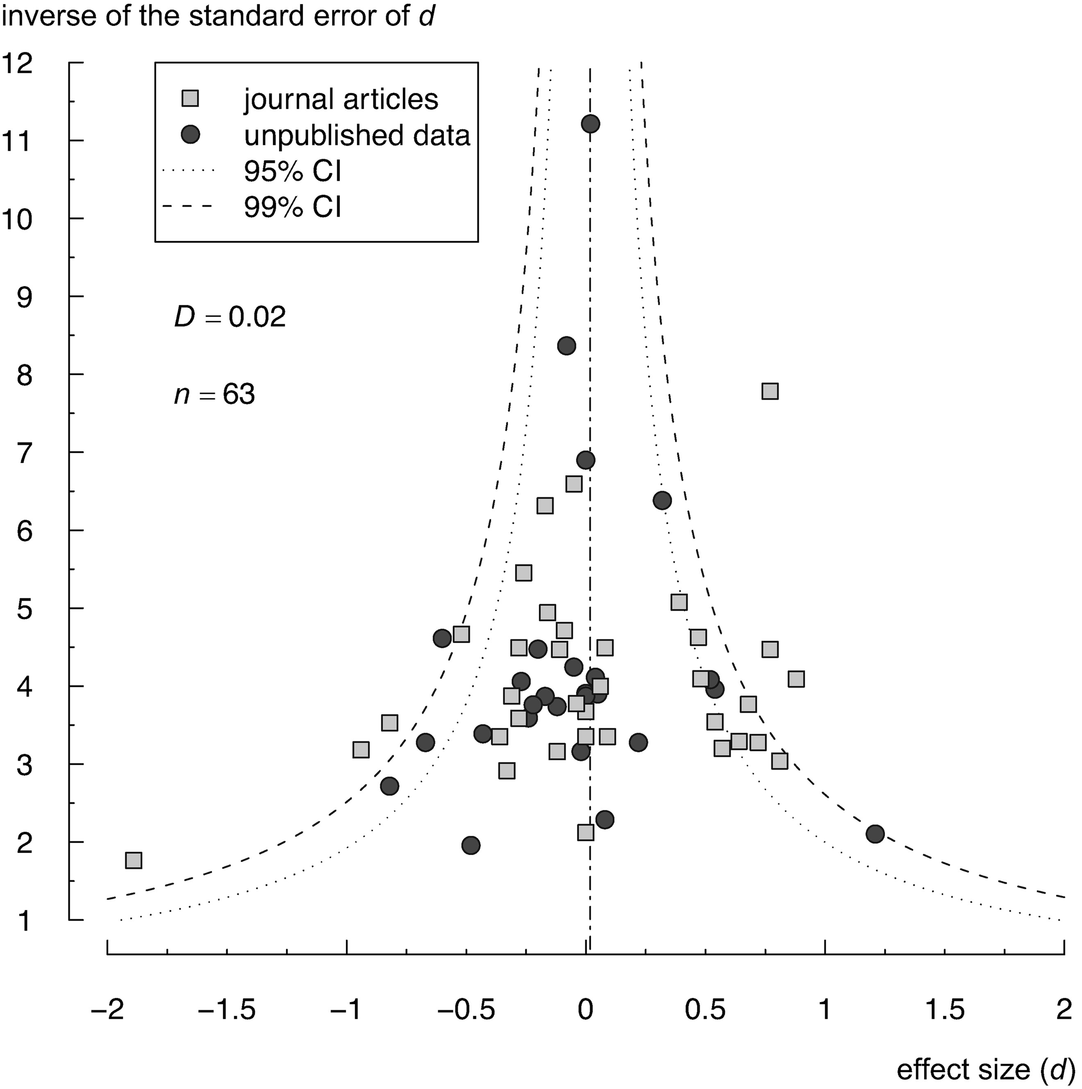
Figure 3 Funnel plot of all data Note.—The dotted and dashed lines indicate confidence intervals under the assumption ...
Notes:
Figure 3 Funnel plot of all data Note.—The dotted and dashed lines indicate confidence intervals under the assumption that the data set is homogeneous and normally distributed around the mean effect size.
Unless provided in the caption above, the following copyright applies to the content of this slide: © 2010 by JOURNAL OF CONSUMER RESEARCH, Inc.

