Slide 1
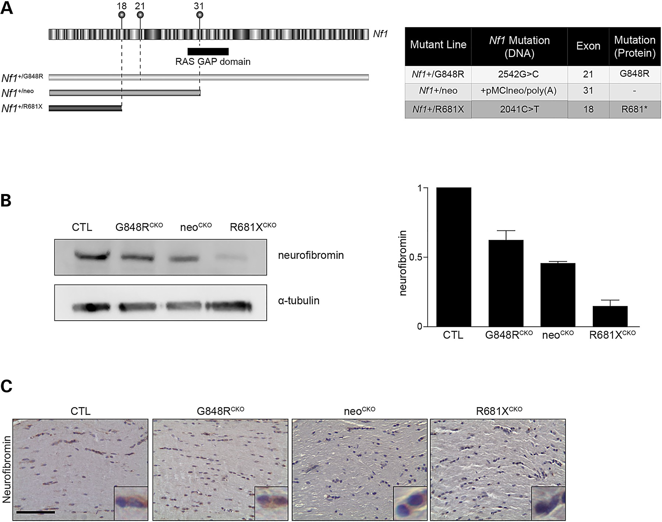
Figure 1. The germline Nf1 gene mutation determines the level of neurofibromin expression. (A) Schematic illustration ...
Notes:
Figure 1. The germline Nf1 gene mutation determines the level of neurofibromin expression. (A) Schematic illustration of the mouse Nf1 gene, with the alternate exons and RAS-GAP domain indicated. The positions of the three germline Nf1 gene mutations are depicted above exons 18, 21 and 31. (B) Neurofibromin expression was reduced in the brainstem of mice with Cre-mediated Nf1flox inactivation and G848RCKO and R681XCKO or null KO (neoCKO) alleles by 38, 77 and 47%, respectively, relative to control mice following normalization to α-tubulin. (C) The effect of these germline Nf1 gene mutations on neurofibromin expression was examined in the optic nerve by immunohistochemistry. At least three mice were used per genotype.
Unless provided in the caption above, the following copyright applies to the content of this slide: © The Author 2016. Published by Oxford University Press. All rights reserved. For Permissions, please email: journals.permissions@oup.com

Slide 2
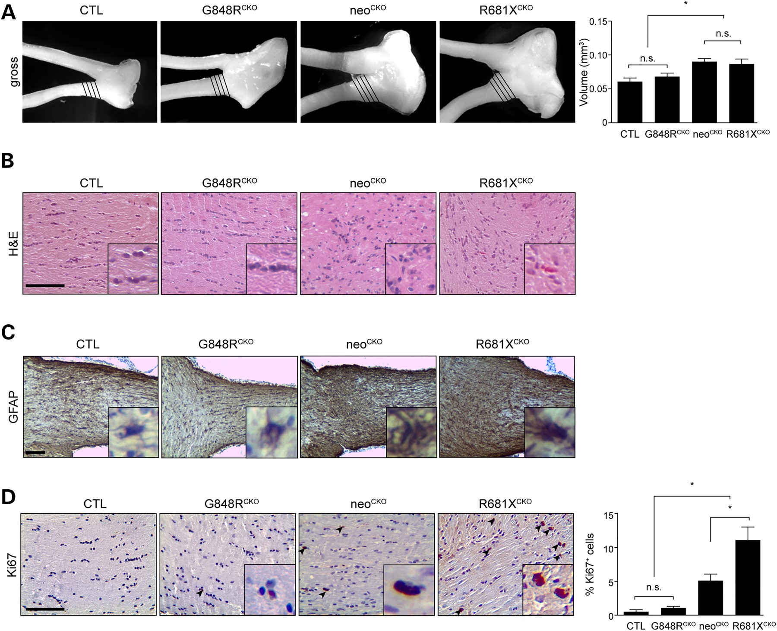
Figure 2. The germline Nf1 gene mutation dictates optic glioma formation and proliferation. (A) Increased optic nerve ...
Notes:
Figure 2. The germline Nf1 gene mutation dictates optic glioma formation and proliferation. (A) Increased optic nerve volumes were observed in conditional knockout (neoCKO) (1.49-fold) and R681XCKO (1.43-fold) optic nerves relative to Nf1flox/flox control littermates (CTL), while no significant changes were detected between G848RCKO mice (mean = 0.07 ± 0.005 mm3) and controls (mean = 0.062 ± 0.005 mm3). (n = 6 mice per genotype). (B) Haematoxylin and eosin staining of the optic nerves revealed hypercellularity and nuclear atypia in neoCKO and R681XCKO optic nerves (n = 6 mice per genotype). (C) Increased GFAP immunoreactivity is observed in neoCKO and R681XCKO compared with no increase seen between G868RCKO and controls. (D) R681XCKO mice exhibited increased Ki67 immunoreactivity (14-fold; 2.2-fold) compared with control and neoCKO mice, respectively (n = 5 mice per genotype). Scale bars: 100 µm. All data are represented as means ± s.e.m. (*P < 0.05; one-way ANOVA with Bonferroni post-test).
Unless provided in the caption above, the following copyright applies to the content of this slide: © The Author 2016. Published by Oxford University Press. All rights reserved. For Permissions, please email: journals.permissions@oup.com

Slide 3
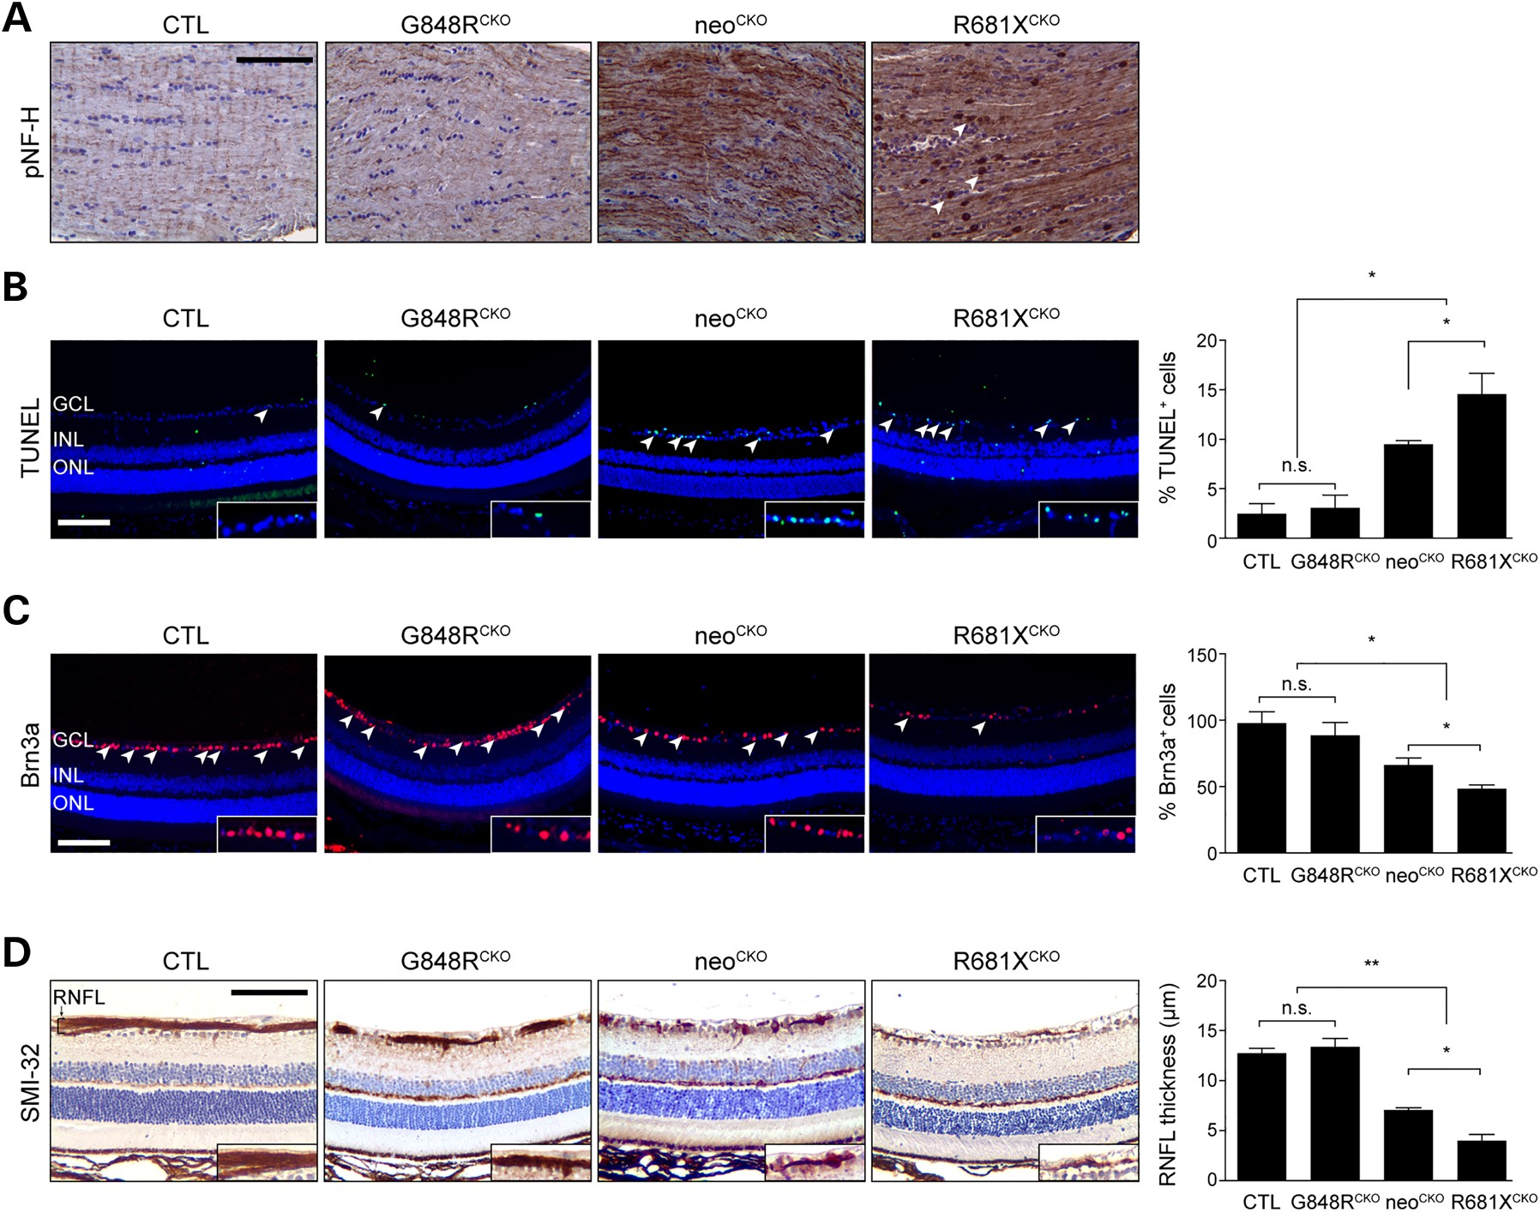
Figure 3. The germline Nf1 gene mutation dictates the degree of optic glioma-induced retinal dysfunction. (A) pNF-H ...
Notes:
Figure 3. The germline Nf1 gene mutation dictates the degree of optic glioma-induced retinal dysfunction. (A) pNF-H immunostaining in the optic nerves of control, G848RCKO, neoCKO and R681XCKO mice revealed increased immunoreactivity in neoCKO and R681XCKO mice, with R681XCKO mice exhibiting additional punctate staining (arrowheads). (B) The retinae of R681XCKO and neoCKO mice had increased percentages of TUNEL+ cells (5.9- and 4.8-fold increase, respectively) compared with control mice (n = 5 mice per genotype). (C) The retinae of R681XCKO and neoCKO mice had lower percentages of Brn3a+ cells (50 and 41% decrease, respectively) compared with control mice (n = 5 mice per genotype). (D) The retinae of R681XCKO and neoCKO mice had RNFL thinning as revealed by SMI-32 immunostaining (3.4-and 3.2-fold decrease, respectively) compared with control mice (n = 5 mice per genotype). GCL, ganglion cell layer; INL, inner nuclear layer; ONL, outer nuclear layer; RNFL, retinal nerve fiber layer. Scale bars: 100 µm. All data are represented as means ± s.e.m. (**P < 0.01; *P < 0.05; one-way ANOVA with Bonferroni post-test). n.s., not significant.
Unless provided in the caption above, the following copyright applies to the content of this slide: © The Author 2016. Published by Oxford University Press. All rights reserved. For Permissions, please email: journals.permissions@oup.com

Slide 4
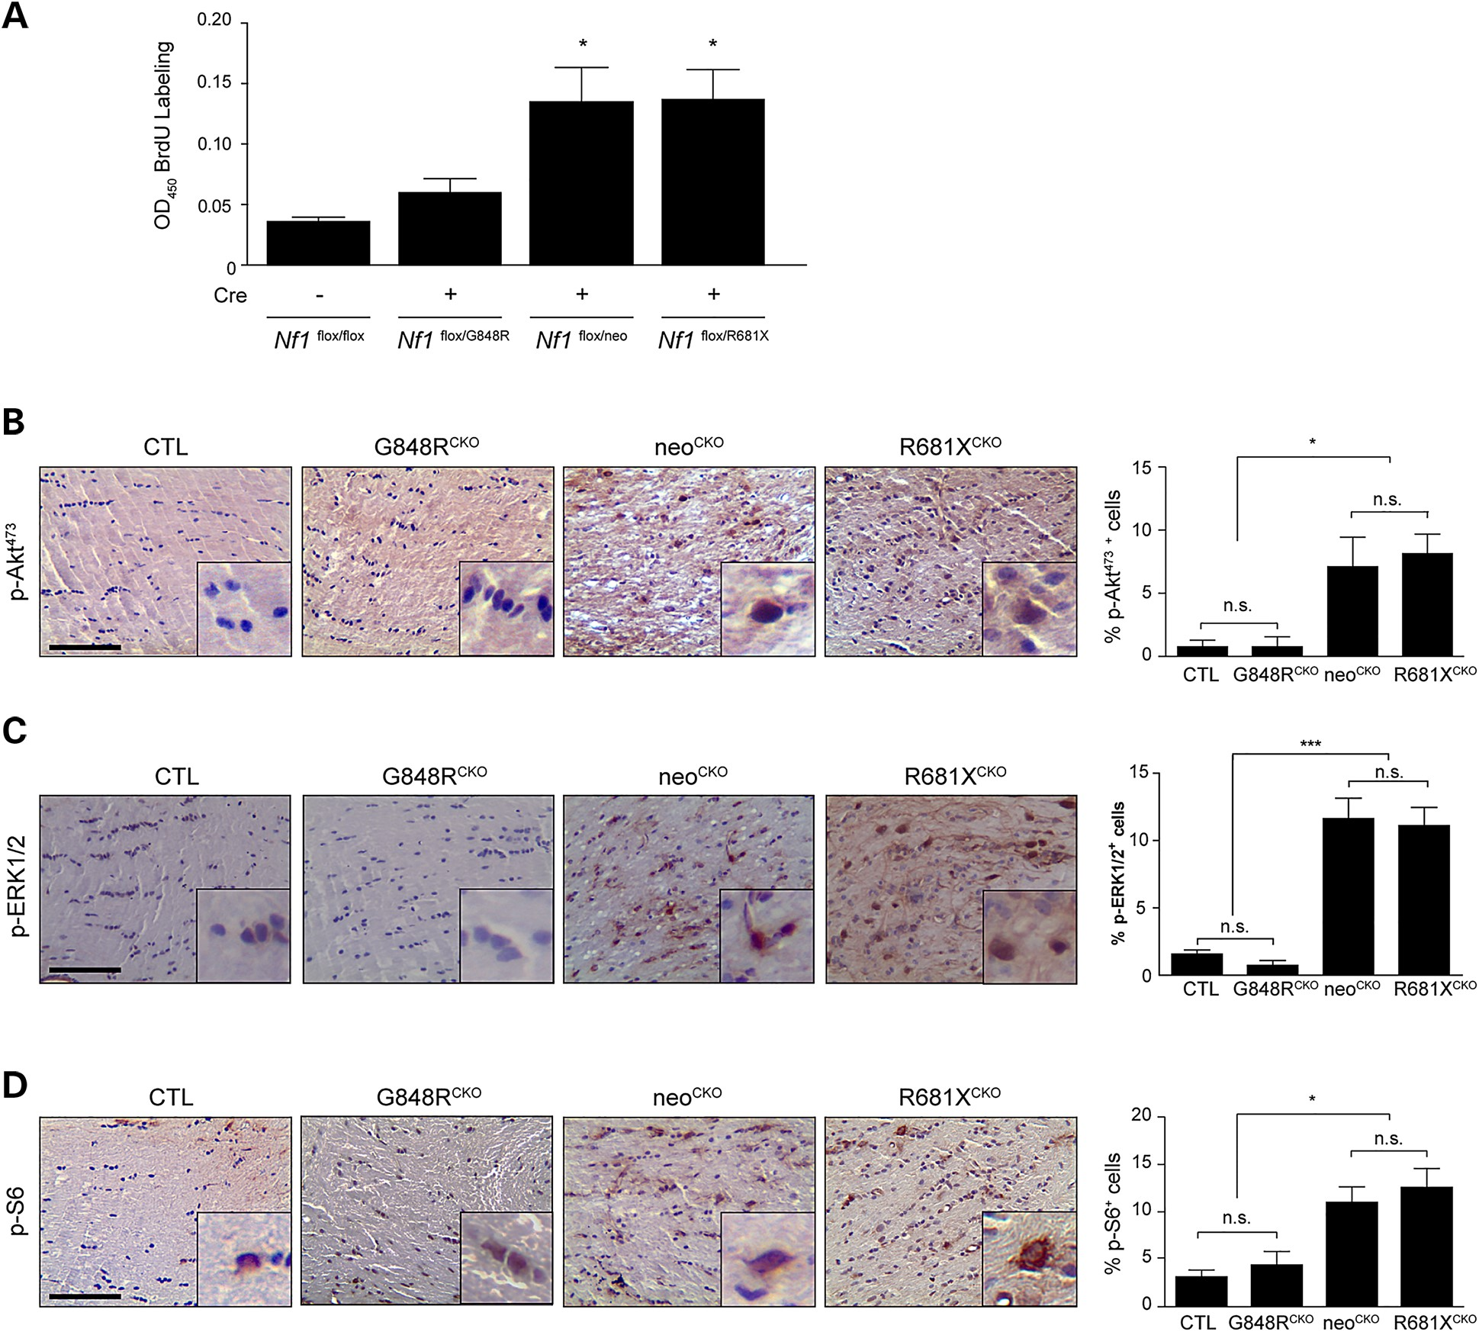
Figure 4. Optic glioma formation and growth is partly determined by the effect of the germline Nf1 gene mutation on ...
Notes:
Figure 4. Optic glioma formation and growth is partly determined by the effect of the germline Nf1 gene mutation on astrocyte RAS effector activation and proliferation. (A) Astrocyte proliferation was increased by 3.2- to 4.0-fold following Cre-mediated Nf1flox inactivation (Cre) in Nf1G681X/flox and Nf1neo/flox astrocytes, but only by 1.3-fold in Nf1G848R/flox astrocytes. Normalization is relative to control Nf1flox/flox astrocytes (LacZ infection) (n > 3 samples per genotype). Data are represented as means ± s.e.m. (*P < 0.05; one-way ANOVA with Dunn's multiple comparison test). Immunostaining with pAktSer473 (B) pERKThr202/Tyr204 (C) and pS6Ser240/244 (D) antibodies revealed a greater percentage of pAktSer473, pERKThr202/Tyr204 and pS6Ser240/244-immunoreactive cells in the optic nerves of neoCKO (pAktSer473: 9-fold increase, pERKThr202/Tyr204: 7.4-fold increase, pS6Ser240/244: 2.8-fold increase) and R681XCKO (pAktSer473: 10.4-fold increase, pERKThr202/Tyr204: 7.1-fold increase, pS6Ser240/244: 3.3-fold increase) optic nerves relative to Nf1flox/flox littermate controls (CTL). A minimum of four animals per genotype was assayed. n.s., not significant. Scale bars: 100 µm. Data are represented as means ± s.e.m. (*P < 0.05, ***P < .001; one-way ANOVA with Bonferroni post-test).
Unless provided in the caption above, the following copyright applies to the content of this slide: © The Author 2016. Published by Oxford University Press. All rights reserved. For Permissions, please email: journals.permissions@oup.com

Slide 5
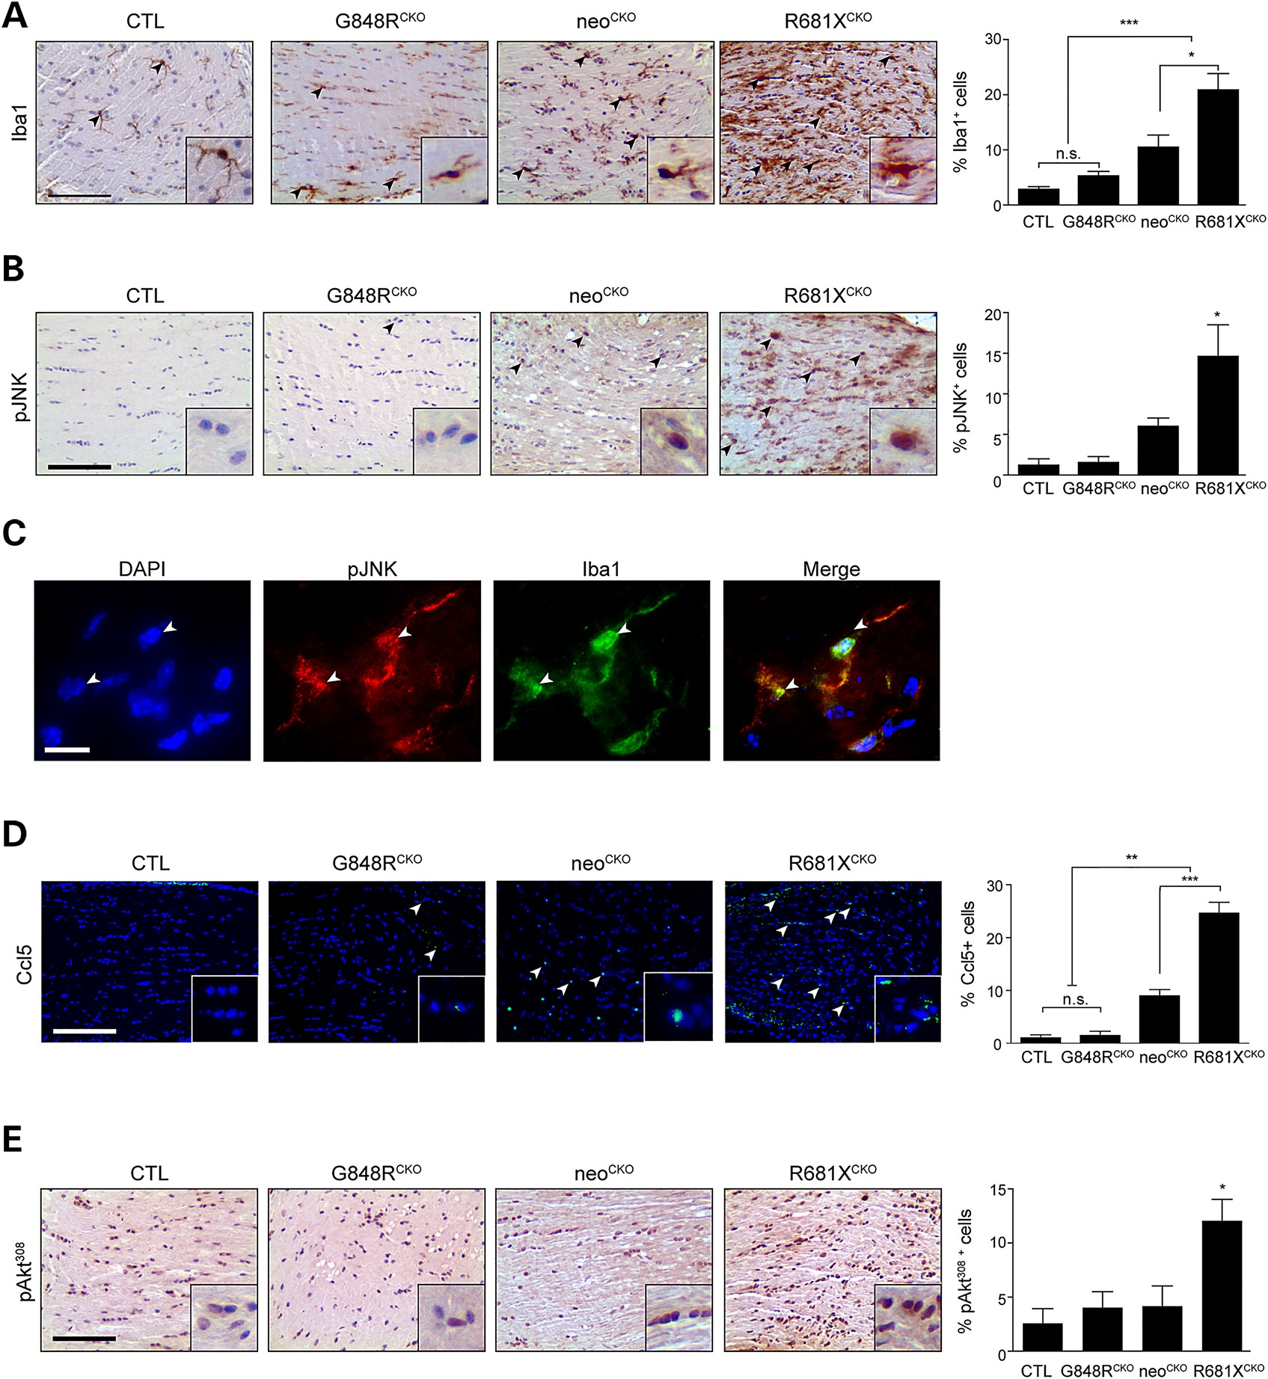
Figure 5. Optic glioma formation and growth is partly determined by the effect of the germline Nf1 gene mutation on ...
Notes:
Figure 5. Optic glioma formation and growth is partly determined by the effect of the germline Nf1 gene mutation on microglia number and function. (A) Iba1 immunostaining demonstrates increased numbers of microglia in the optic nerves of neoCKO (3.6-fold) and R681XCKO (7.1-fold) mice relative to controls (CTL). Whereas R681XCKO mice have more microglia than neoCKO mice (2-fold), no increase in microglia numbers was detected in G848RCKO mice relative to controls (n = 5 mice per genotype). (B) Increased percentages of pJNK+ cells were observed in neoCKO (4.66-fold) and R681XCKO (11.28-fold) optic nerves relative to control optic nerves (n = 4 mice per genotype). (C) Immunofluorescence revealing pJNK staining in Iba1+ cells (microglia) within the optic nerves of R681XCKO mice. White arrowheads depict two independent cells positively labeled with both pJNK and Iba1. (D) Increased percentages of CCL5+ cells were observed in neoCKO (14.56-fold) and R681XCKO (27.37-fold) optic nerves compared with control mice (n = 5 mice per genotype). (E) A greater percentage of pAktThr308-immunoreactive cells was found in R681XCKO mice relative to control (4.68-fold), and neoCKO (2.88-fold) optic nerves (n = 4 mice per genotype). Scale bars: 100 µm. All data are represented as means ± s.e.m. (***P < 0.001; **P < 0.01; *P < 0.05; one-way ANOVA with Bonferroni post-test).
Unless provided in the caption above, the following copyright applies to the content of this slide: © The Author 2016. Published by Oxford University Press. All rights reserved. For Permissions, please email: journals.permissions@oup.com

Slide 6
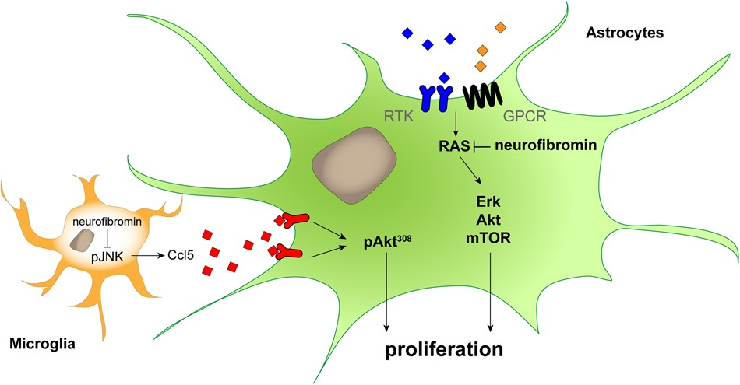
Figure 6. The germline Nf1 gene mutation independently determines astrocyte and microglia dysfunction relative to optic ...
Notes:
Figure 6. The germline Nf1 gene mutation independently determines astrocyte and microglia dysfunction relative to optic glioma formation and growth. Proposed model of the cell-autonomous (astrocytes) and non-cell-autonomous (microglia) effects of the germline Nf1 gene mutation on murine optic glioma growth. In microglia, the germline Nf1 gene mutation differentially impacts on JNK activation and Ccl5 expression, which results in varying levels of chemokine (Ccl5)-mediated AktThr308 activation in neoplastic astrocytes to increase optic glioma growth in vivo. Similarly, the germline Nf1 gene mutation differentially determines neurofibromin-regulated downstream signaling pathway activation and glial cell proliferation, leading to differing levels of cell-intrinsic astrocyte growth in the tumor.
Unless provided in the caption above, the following copyright applies to the content of this slide: © The Author 2016. Published by Oxford University Press. All rights reserved. For Permissions, please email: journals.permissions@oup.com

