Slide 1
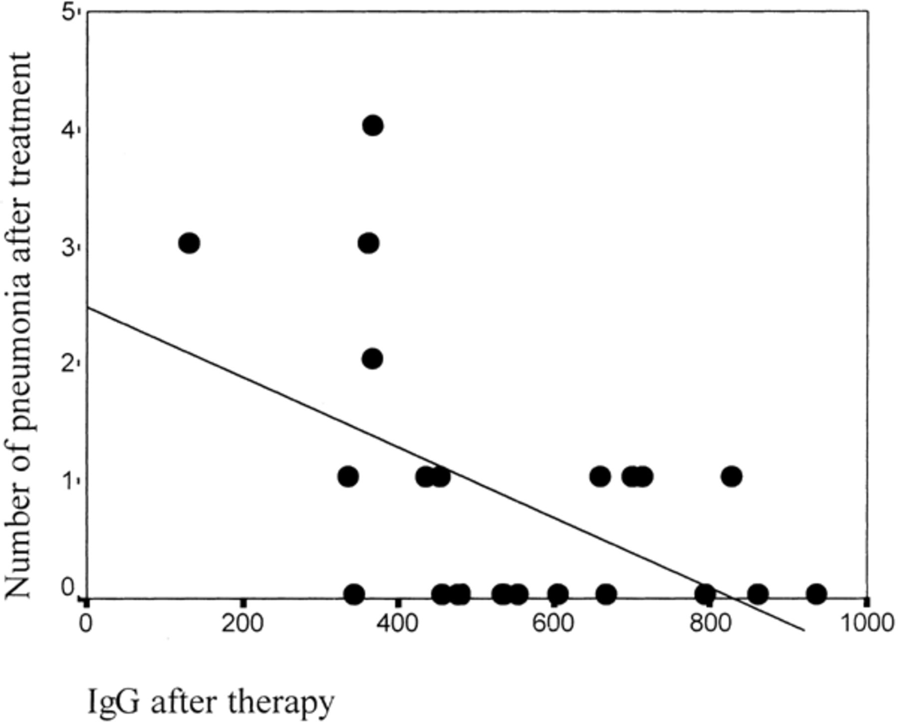
Figure 1 Association between the incidence of pneumonia and IgG serum levels after IVIG therapy.
Notes:
Figure 1 Association between the incidence of pneumonia and IgG serum levels after IVIG therapy.
Unless provided in the caption above, the following copyright applies to the content of this slide: © 2003 Federation of European Microbiological Societies.

