Slide 1
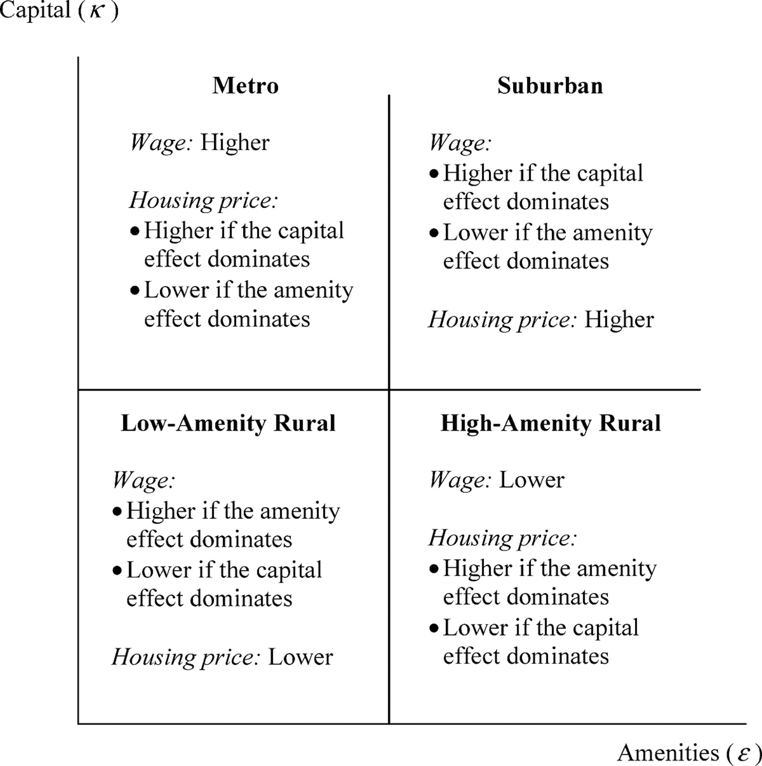
Figure 3 Amenities, capital, and the spatial variation in wage and housing price
Notes:
Figure 3 Amenities, capital, and the spatial variation in wage and housing price
Unless provided in the caption above, the following copyright applies to the content of this slide: Copyright 2007 American Agricultural Economics Association

Slide 2
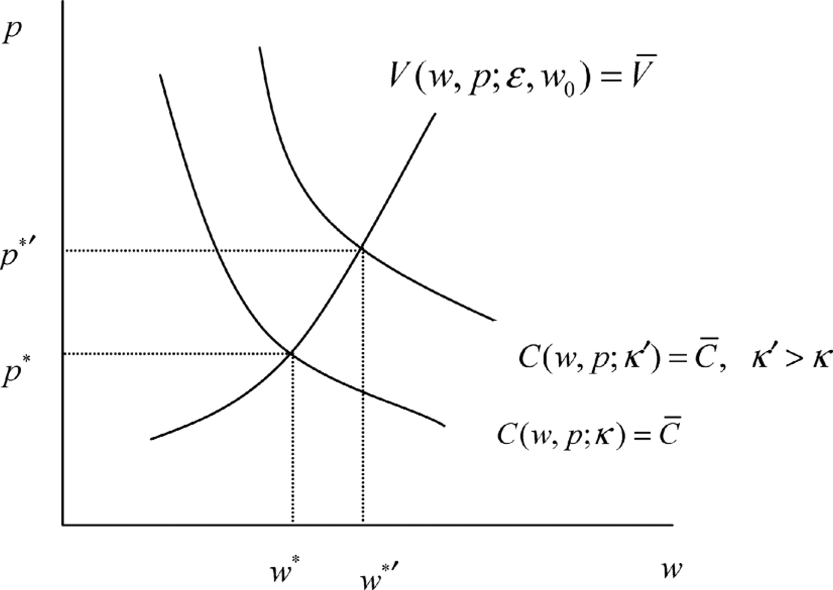
Figure 2 The equilibrium level of wage and housing price in two locations with the same level of amenities but ...
Notes:
Figure 2 The equilibrium level of wage and housing price in two locations with the same level of amenities but different levels of capital
Unless provided in the caption above, the following copyright applies to the content of this slide: Copyright 2007 American Agricultural Economics Association

Slide 3
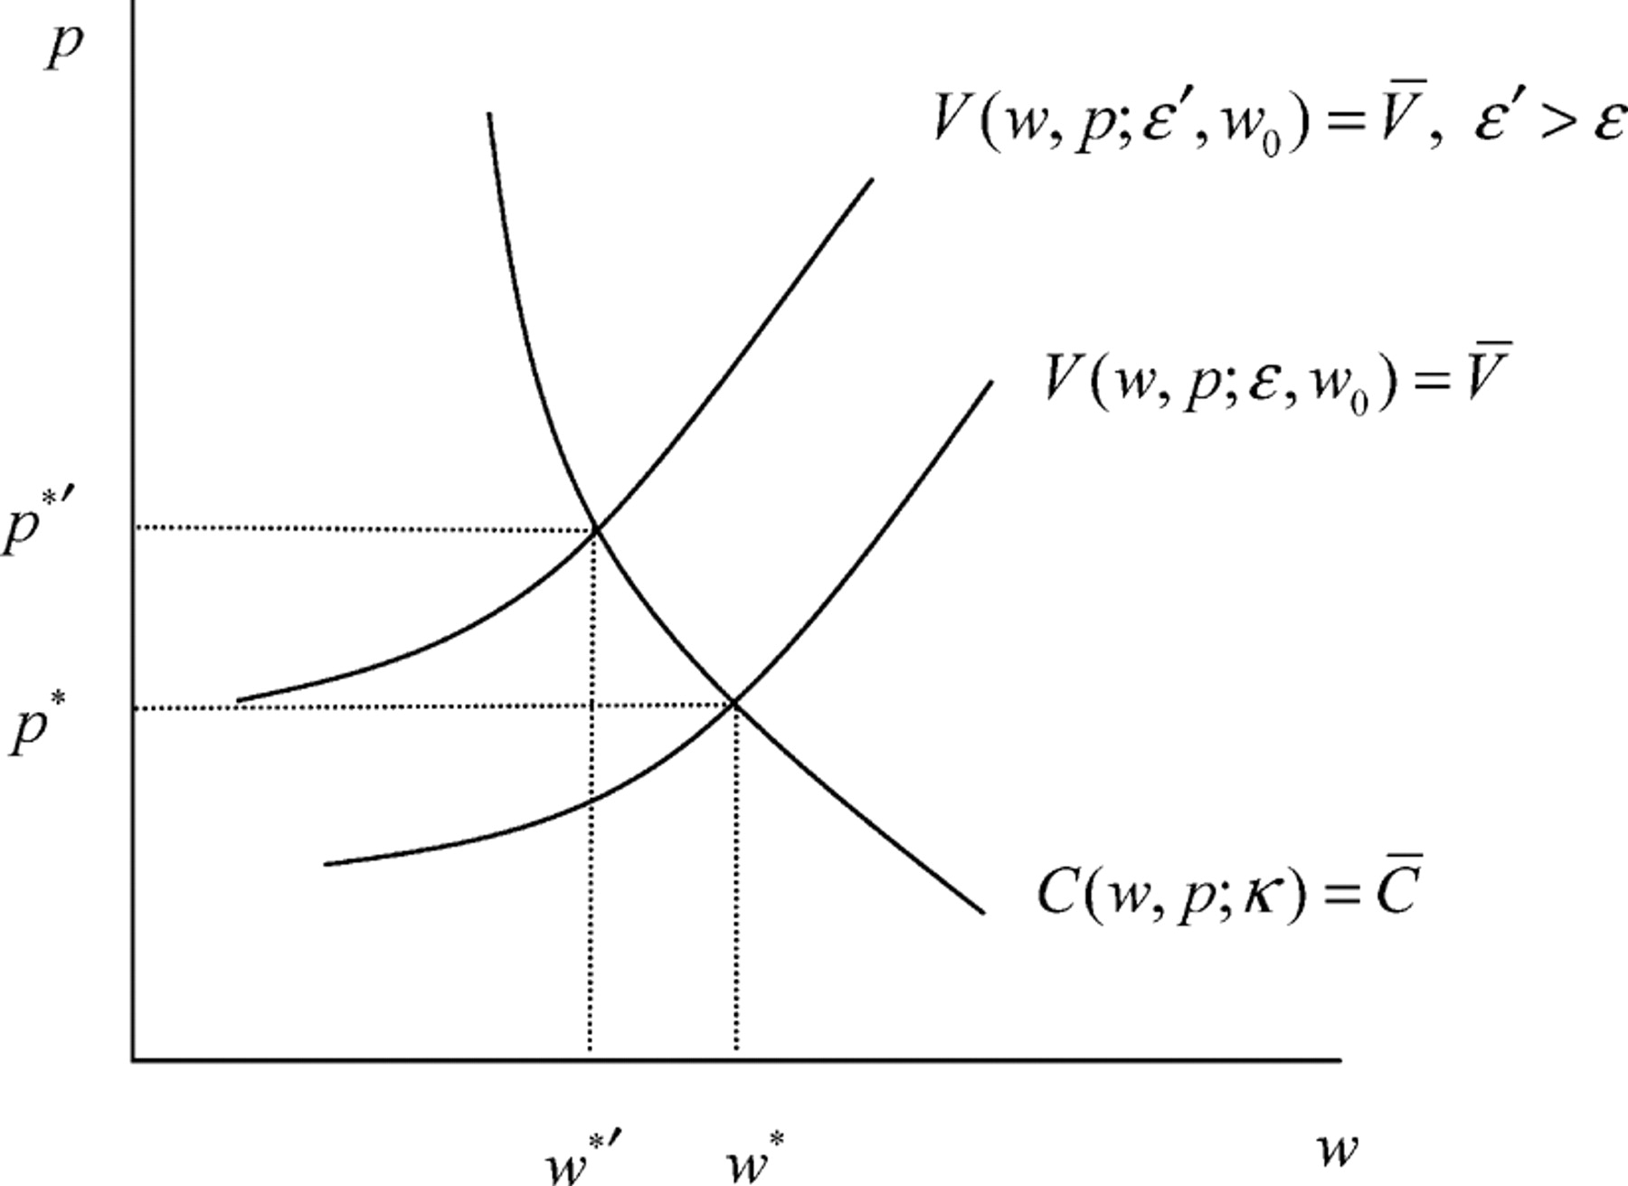
Figure 1 The equilibrium level of wage and housing price in two locations with the same level of capital but different ...
Notes:
Figure 1 The equilibrium level of wage and housing price in two locations with the same level of capital but different levels of amenities
Unless provided in the caption above, the following copyright applies to the content of this slide: Copyright 2007 American Agricultural Economics Association

