Slide 1
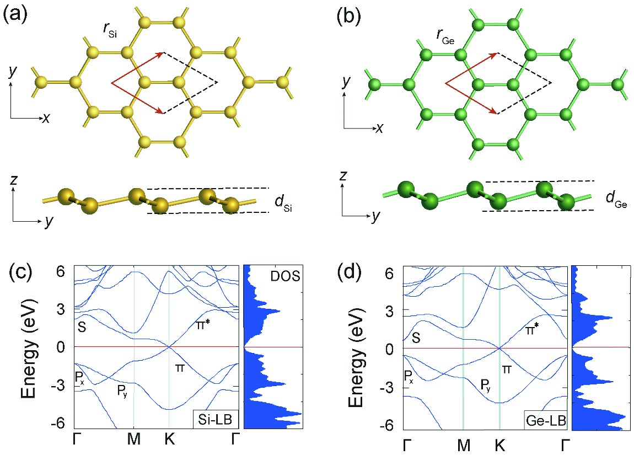
Figure 3. Atomic and electronic structures of (a, c) silicene and (b, d) germanene [17] (Copyright 2009 The American ...
Notes:
Figure 3. Atomic and electronic structures of (a, c) silicene and (b, d) germanene [17] (Copyright 2009 The American Physical Society).
Unless provided in the caption above, the following copyright applies to the content of this slide: © The Author(s) 2015. Published by Oxford University Press on behalf of China Science Publishing & Media Ltd. All rights reserved. For Permissions, please email: journals.permissions@oup.comThis is an Open Access article distributed under the terms of the Creative Commons Attribution License (http://creativecommons.org/licenses/by/4.0/), which permits non-commercial reuse, distribution, and reproduction in any medium, provided the original work is properly cited. for commercial re-use, please contact journals.permissions@oup.com

Slide 2
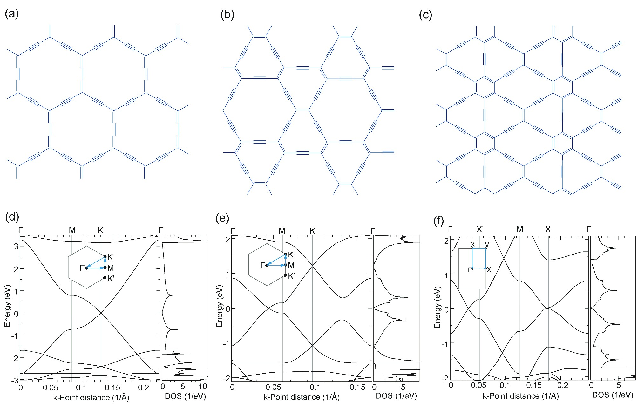
Figure 5. Atomic and band structures of (a, d) α-graphyne, (b, e) β-graphyne, and (c, f) 6,6,12-graphyne [18] ...
Notes:
Figure 5. Atomic and band structures of (a, d) α-graphyne, (b, e) β-graphyne, and (c, f) 6,6,12-graphyne [18] (Copyright 2012 American Physical Society).
Unless provided in the caption above, the following copyright applies to the content of this slide: © The Author(s) 2015. Published by Oxford University Press on behalf of China Science Publishing & Media Ltd. All rights reserved. For Permissions, please email: journals.permissions@oup.comThis is an Open Access article distributed under the terms of the Creative Commons Attribution License (http://creativecommons.org/licenses/by/4.0/), which permits non-commercial reuse, distribution, and reproduction in any medium, provided the original work is properly cited. for commercial re-use, please contact journals.permissions@oup.com

