Slide 1
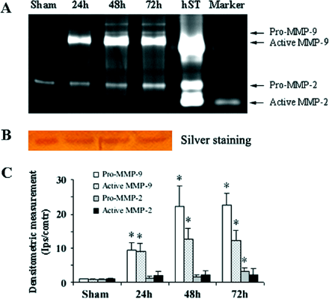
Fig. 1 ICH increased pro-MMP-9, pro-MMP-2 and active MMP-9 levels. (A) Zymography gel showing elevation of pro- and ...
Notes:
Fig. 1 ICH increased pro-MMP-9, pro-MMP-2 and active MMP-9 levels. (A) Zymography gel showing elevation of pro- and active MMP-9, and pro-MMP-2 after ICH. Human MMP-9 and MMP-2 were loaded as standards (hST). (B) Silver staining shows protein loading. (C) Densitometric measurements, plotting the ratio of band intensities of the ipsilateral to the contralateral sides, confirm the increase in pro- and active-MMP-9 and pro-MMP-2 induced by ICH (n = 8/group; *P < 0.001). Ips = ipsilateral; Contr = contralateral. Marker: SeeBlue plus2 pre-stained protein standard.
Unless provided in the caption above, the following copyright applies to the content of this slide: © The Author (2005). Published by Oxford University Press on behalf of the Guarantors of Brain. All rights reserved. For Permissions, please email: journals.permissions@oupjournals.org

Slide 2
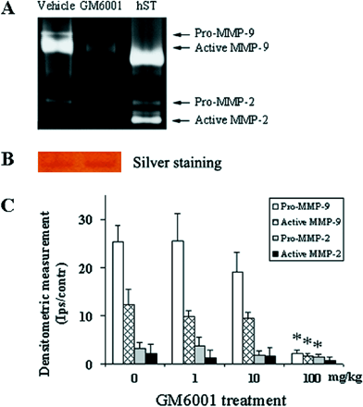
Fig. 2 GM6001 decreased pro- and active-MMP-9 and pro-MMP-2 activity. GM6001 was administered intraperitoneally 2 h ...
Notes:
Fig. 2 GM6001 decreased pro- and active-MMP-9 and pro-MMP-2 activity. GM6001 was administered intraperitoneally 2 h after ICH. (A) GM6001 at 100 mg/kg markedly reduced pro- and active-MMP-9 and pro-MMP-2 activities 72 h later. (B) Silver staining indicates protein loading. (C) Densitometric measurements, plotting the ratio of band intensities of the ipsilateral to the contralateral sides, confirm that GM6001 at 100 mg/kg can markedly reduce MMP activity (n = 8/group, *P < 0.01 versus vehicle).
Unless provided in the caption above, the following copyright applies to the content of this slide: © The Author (2005). Published by Oxford University Press on behalf of the Guarantors of Brain. All rights reserved. For Permissions, please email: journals.permissions@oupjournals.org

Slide 3
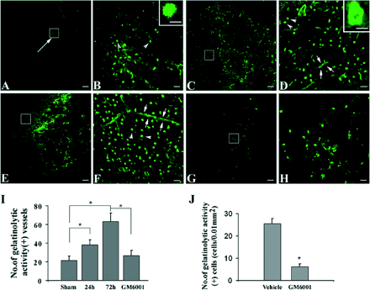
Fig. 3 Increased in situ gelatinolytic activity after ICH. (A–H) Gelatinolytic activity (green) developed after ...
Notes:
Fig. 3 Increased in situ gelatinolytic activity after ICH. (A–H) Gelatinolytic activity (green) developed after incubation of sections (20 µm thick) with the substrate DQ gelatin. The images in B, D, F and H (scale bar: 20 µm) represent higher magnification of the boxed area in A, C, E and G (scale bar: 150 µm). Limited activity (single arrow) was detected at 24 h in PBS-injected mice (A). Gelatinolytic activity-positive cells (arrowheads) are present in the peri-injury area (B). Gelatinolytic activity-positive cell (scale bar, 10 µm). Robust activity was detected after ICH at 24 (C and D) and 72 h (E and F). D and F show activity in blood vessels (arrows) and cells (arrowheads). (D) Activity in a blood vessel cut in cross-section (scale bar, 10 µm). Decreased gelatinolytic activity was detected at 72 h in GM6001 (100 mg/kg)-treated mice (G and H). (I) Quantification of gelatinolytic activity-positive blood vessels after ICH. Values are the mean ± SD. Asterisks indicate a significant increase in activity-positive blood vessels compared with sham-operated mice (n = 6/group, *P < 0.001). GM6001 (100 mg/kg)-treated mice had fewer labelled vessels than vehicle-treated control mice (n = 6/group, *P < 0.001). (J) GM6001 (100 mg/kg)-treated mice had fewer labelled cells than control mice (n = 6/group, *P < 0.001). Values are means ± SD.
Unless provided in the caption above, the following copyright applies to the content of this slide: © The Author (2005). Published by Oxford University Press on behalf of the Guarantors of Brain. All rights reserved. For Permissions, please email: journals.permissions@oupjournals.org

Slide 4
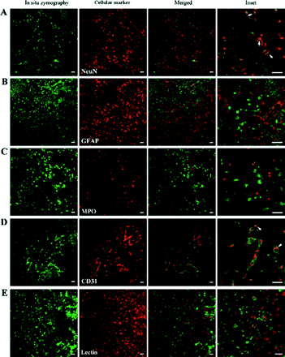
Fig. 4 Increased gelatinolytic activity within the vascular matrix, neurons and endothelial cells after ICH. (A–E) ...
Notes:
Fig. 4 Increased gelatinolytic activity within the vascular matrix, neurons and endothelial cells after ICH. (A–E) Double fluorescence of gelatin-cleaving activity (green) and cells identified with specific markers: neurons, NeuN; astrocytes, GFAP; neutrophils, myeloperoxidase (MPO); endothelial cells, CD31; microglia/macrophages, IB4. Cell markers were visualized (red) by Cy3-conjugated secondary antibodies or by TRITC-conjugated IB4. Areas from merged confocal images (merged) are shown at higher magnification. Sections were obtained 24 or 72 h after ICH, as in the experiment described in Fig. 3. Arrows point to areas showing co-localization. Scale bar: 30 µm.
Unless provided in the caption above, the following copyright applies to the content of this slide: © The Author (2005). Published by Oxford University Press on behalf of the Guarantors of Brain. All rights reserved. For Permissions, please email: journals.permissions@oupjournals.org

Slide 5
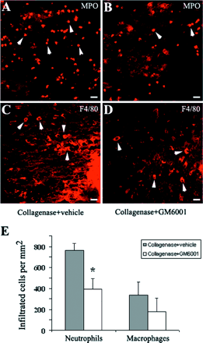
Fig. 5 GM6001 decreased leucocyte recruitment after ICH. Infiltrated neutrophils (arrowheads, MPO+, A) and mature ...
Notes:
Fig. 5 GM6001 decreased leucocyte recruitment after ICH. Infiltrated neutrophils (arrowheads, MPO+, A) and mature macrophages (arrowheads, F4/80+, C) are present near the haematoma on day 3. After GM6001 treatment, neutrophil and macrophage infiltration was inhibited on day 3 (B and D). The numbers of neutrophils and macrophages were quantified in the peri-ICH region on day 3 after GM6001 treatment (E). GM6001 (100 mg/kg)-treated mice had fewer infiltrated neutrophils than control mice (n = 6/group, *P 0.05). Values are means ± SD. Scale bar, 20 µm.
Unless provided in the caption above, the following copyright applies to the content of this slide: © The Author (2005). Published by Oxford University Press on behalf of the Guarantors of Brain. All rights reserved. For Permissions, please email: journals.permissions@oupjournals.org

Slide 6
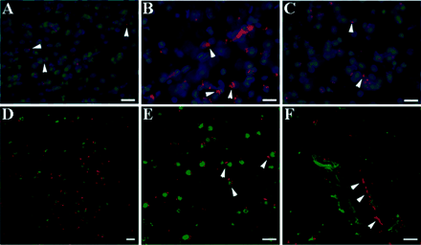
Fig. 6 GM6001 decreased the production of ROS after ICH. (A) A few ethidium signals (red) were detected on the ...
Notes:
Fig. 6 GM6001 decreased the production of ROS after ICH. (A) A few ethidium signals (red) were detected on the uninjected side and were confined to the perinuclear area (arrowheads) on day 3 after ICH. (B) The peri-ICH region (injected side) showed significantly increased ethidium signals (arrowheads). (C) In the GM6001 (100 mg/kg)-treated mice, fewer ethidium signals in the cytosol were detected (arrowheads). (D) Increased ethidium signals were detected in gelatinolytic activity-positive cells (green). A higher magnification picture is provided in E (arrowheads, perinuclear location of ethidium signials). (F) Increased ethidium signals (arrowheads) were also observed in the endothelial cells of blood vessels, which were gelatinolytic activity positive (green). Scale bar, 20 µm.
Unless provided in the caption above, the following copyright applies to the content of this slide: © The Author (2005). Published by Oxford University Press on behalf of the Guarantors of Brain. All rights reserved. For Permissions, please email: journals.permissions@oupjournals.org

Slide 7
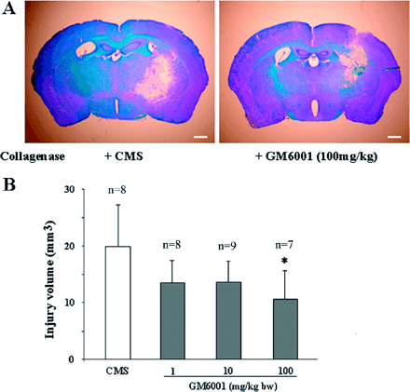
Fig. 7 GM6001 reduced injury volume after ICH in mice. (A) Coronal sections were collected 3 days after ICH and ...
Notes:
Fig. 7 GM6001 reduced injury volume after ICH in mice. (A) Coronal sections were collected 3 days after ICH and stained for Luxol fast blue/Cresyl violet. Left, control mice (left); right, GM6001 (100 mg/kg)-treated mice. (B) GM6001-treated mice had smaller injury volumes than control mice (n = 7–9/group, *P < 0.05). Values are means ± SD. Scale bar, 1 mm.
Unless provided in the caption above, the following copyright applies to the content of this slide: © The Author (2005). Published by Oxford University Press on behalf of the Guarantors of Brain. All rights reserved. For Permissions, please email: journals.permissions@oupjournals.org

Slide 8
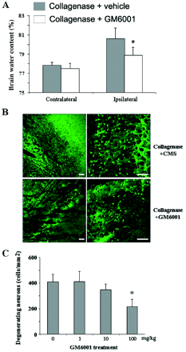
Fig. 8 GM6001 reduced brain oedema and the number of degenerating neurons after ICH. (A) Brain oedema was expressed ...
Notes:
Fig. 8 GM6001 reduced brain oedema and the number of degenerating neurons after ICH. (A) Brain oedema was expressed as percentage water content (wet − dry/wet) of brain weights. GM6001 treatment reduced brain oedema in the lesioned hemisphere 3 days after ICH, compared with control mice (n = 6/group, *P = 0.01). Values are means ± SD. (B) Fluoro-Jade B histological staining of neurons 3 days after ICH. Evenly distributed, intensely labelled neurons and processes are observed in the peri-ICH region. Scale bar, 50 µm. (C) Quantification of the numbers of degenerating neurons in control and GM6001-treated mice (n = 8/group, *P < 0.001). Values are means ± SD.
Unless provided in the caption above, the following copyright applies to the content of this slide: © The Author (2005). Published by Oxford University Press on behalf of the Guarantors of Brain. All rights reserved. For Permissions, please email: journals.permissions@oupjournals.org

Slide 9
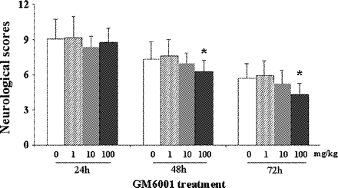
Fig. 9 GM6001 improved neurological functional outcome after ICH in mice. GM6001 (100 mg/kg) improved ...
Notes:
Fig. 9 GM6001 improved neurological functional outcome after ICH in mice. GM6001 (100 mg/kg) improved neurobehavioural performance after ICH with a trend beginning at day 1 but reaching statistical significance at day 2 and day 3 after ICH (n = 17 for GM6001 group; n = 18 for vehicle group; *P < 0.001 versus vehicle).
Unless provided in the caption above, the following copyright applies to the content of this slide: © The Author (2005). Published by Oxford University Press on behalf of the Guarantors of Brain. All rights reserved. For Permissions, please email: journals.permissions@oupjournals.org

