Slide 1
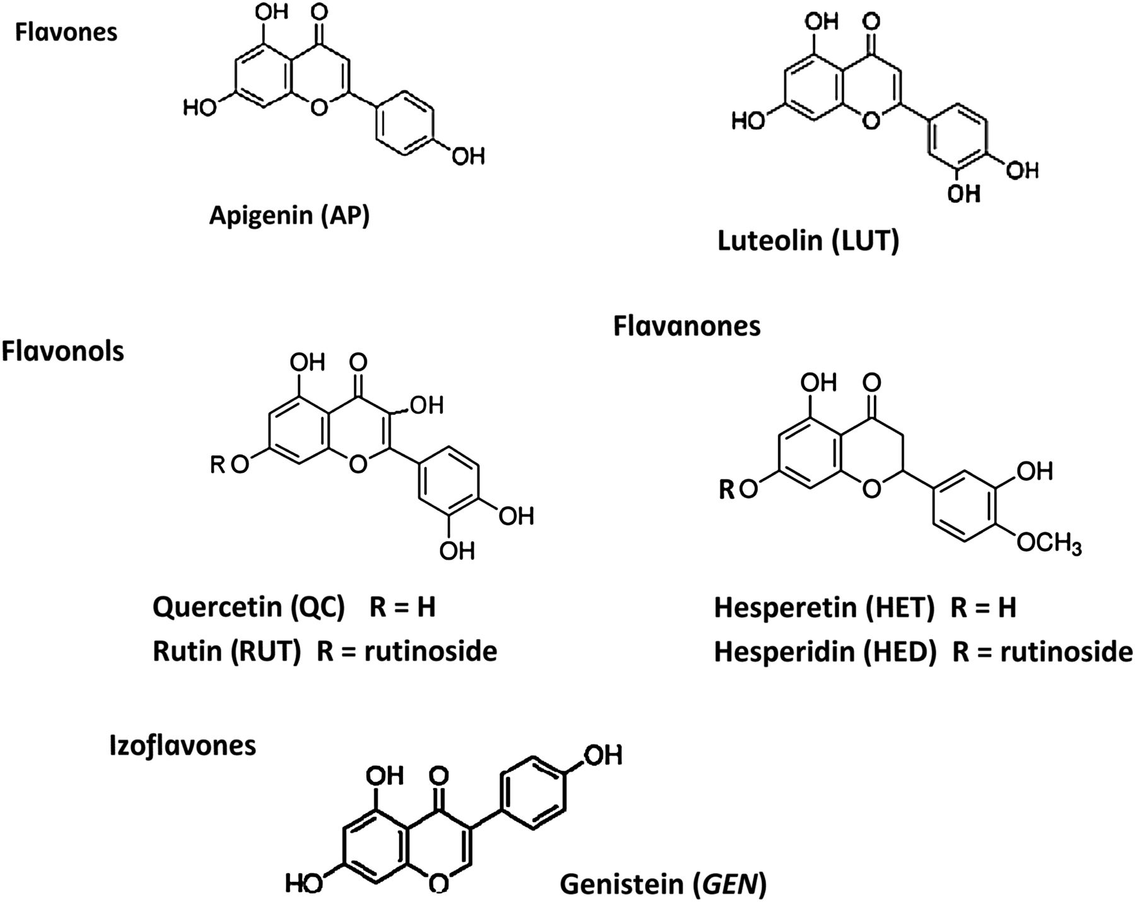
Figure 1. The chemical structures of the studied flavonoids.
Notes:
Figure 1. The chemical structures of the studied flavonoids.
Unless provided in the caption above, the following copyright applies to the content of this slide: © The Author 2015. Published by Oxford University Press. All rights reserved. For Permissions, please email: journals.permissions@oup.com

Slide 2
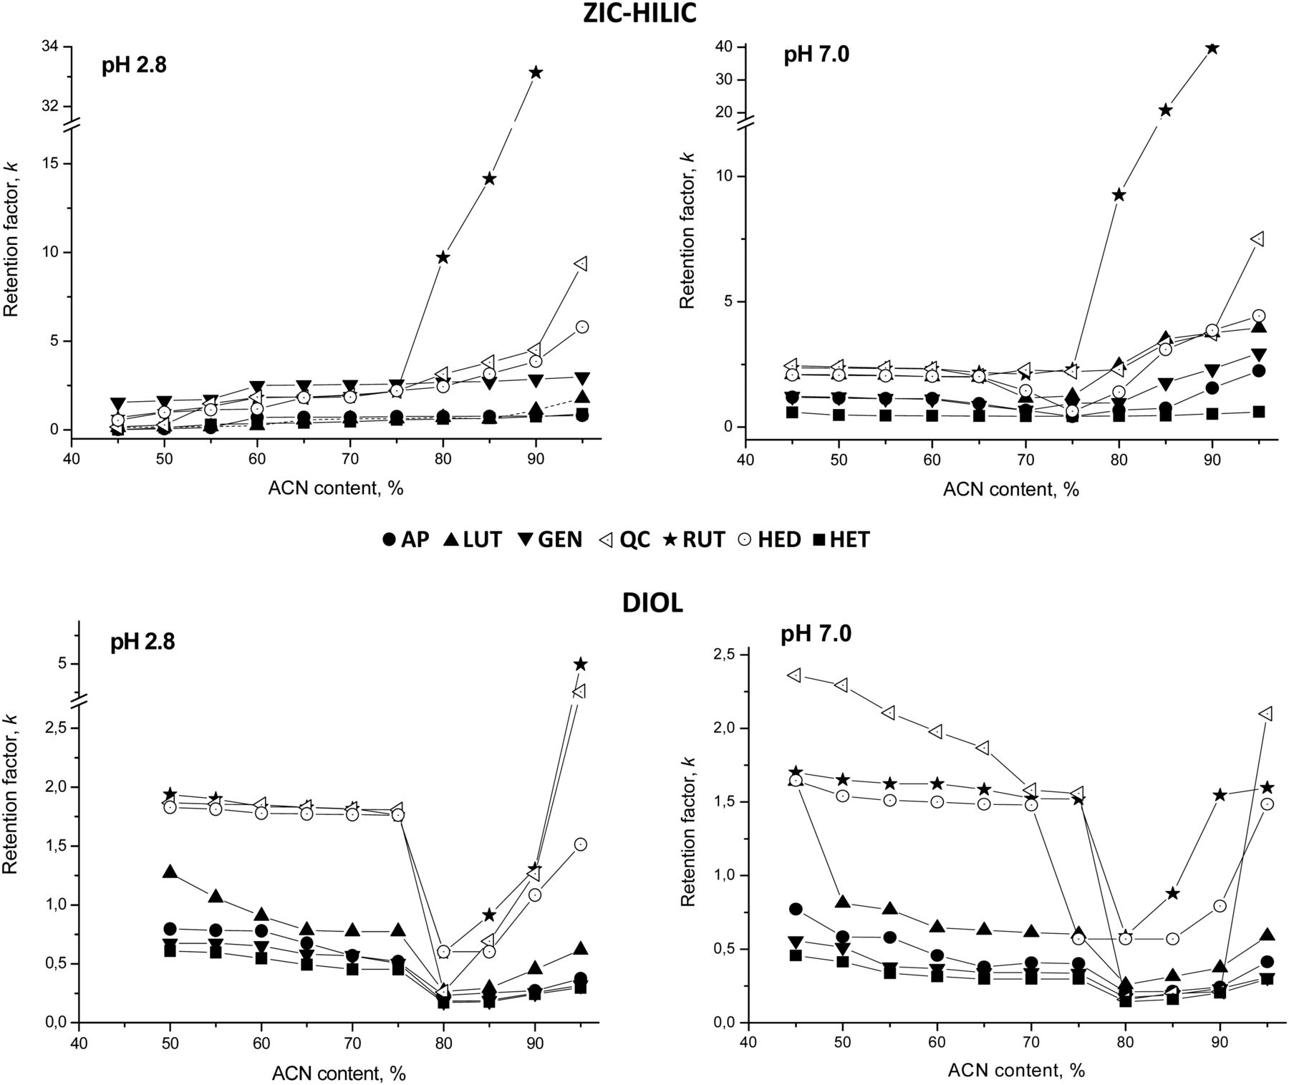
Figure 2. The retention factor as a function of acetonitrile content and pH of the mobile phase for ZIC and DIOL ...
Notes:
Figure 2. The retention factor as a function of acetonitrile content and pH of the mobile phase for ZIC and DIOL columns.
Unless provided in the caption above, the following copyright applies to the content of this slide: © The Author 2015. Published by Oxford University Press. All rights reserved. For Permissions, please email: journals.permissions@oup.com

Slide 3
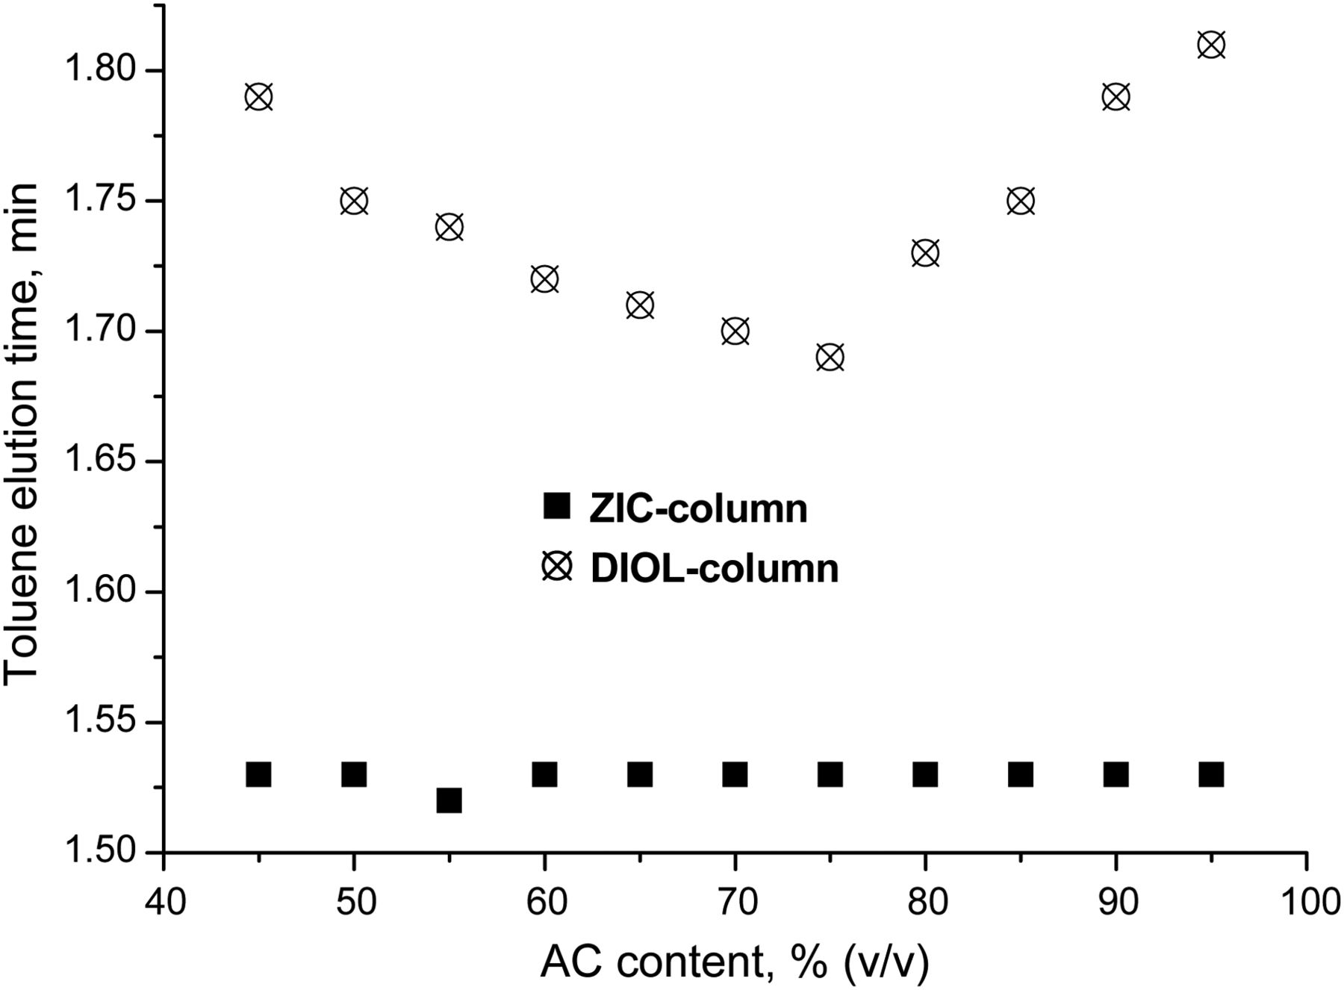
Figure 3. The elution time of toluene on ZIC and DIOL columns as a function of acetonitrile content. Detection at 245 ...
Notes:
Figure 3. The elution time of toluene on ZIC and DIOL columns as a function of acetonitrile content. Detection at 245 nm.
Unless provided in the caption above, the following copyright applies to the content of this slide: © The Author 2015. Published by Oxford University Press. All rights reserved. For Permissions, please email: journals.permissions@oup.com

Slide 4
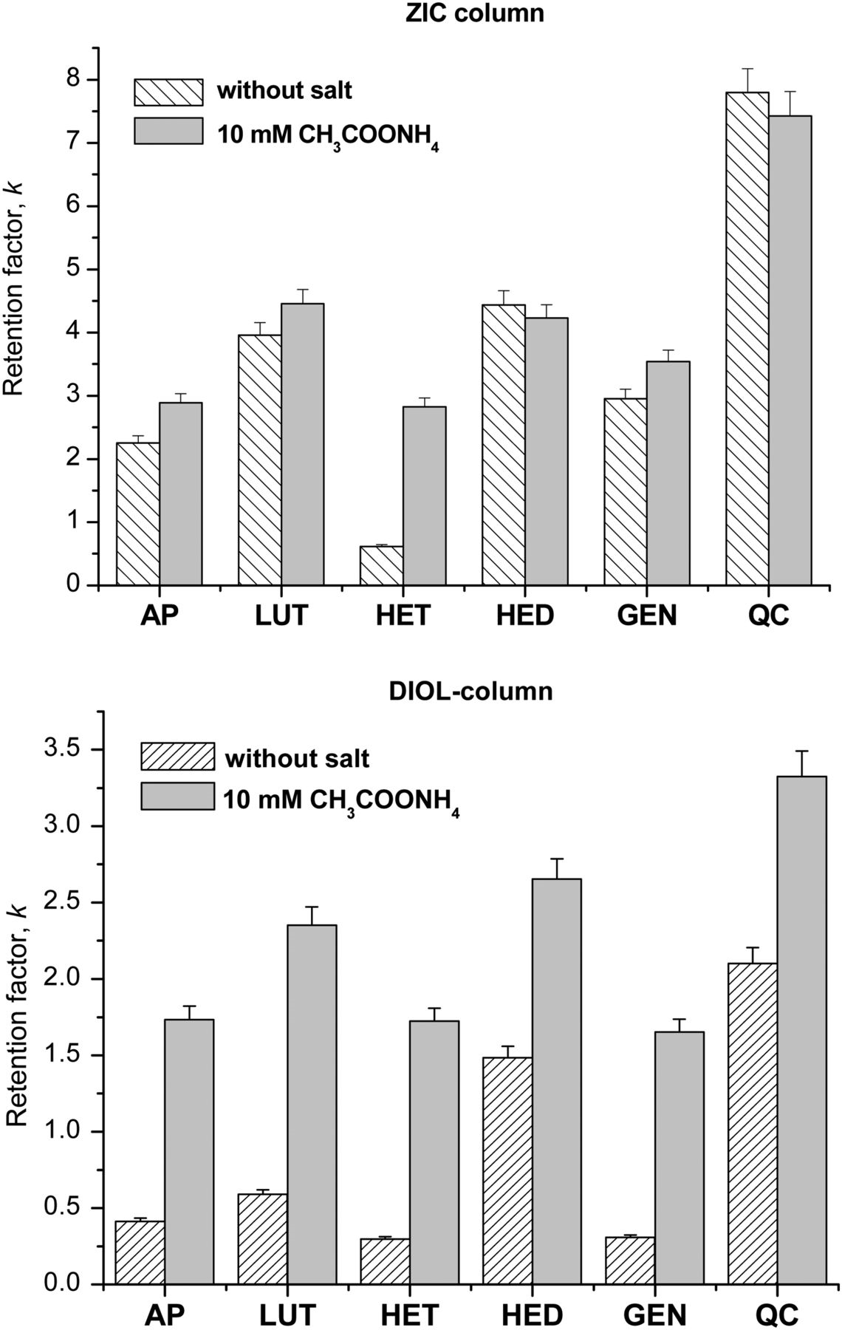
Figure 4. The effect of the presence of ammonium acetate on the retention factors for flavonoids on ZIC and DIOL ...
Notes:
Figure 4. The effect of the presence of ammonium acetate on the retention factors for flavonoids on ZIC and DIOL columns. Eluent: 95% ACN (v/v), pH 7.0.
Unless provided in the caption above, the following copyright applies to the content of this slide: © The Author 2015. Published by Oxford University Press. All rights reserved. For Permissions, please email: journals.permissions@oup.com

Slide 5
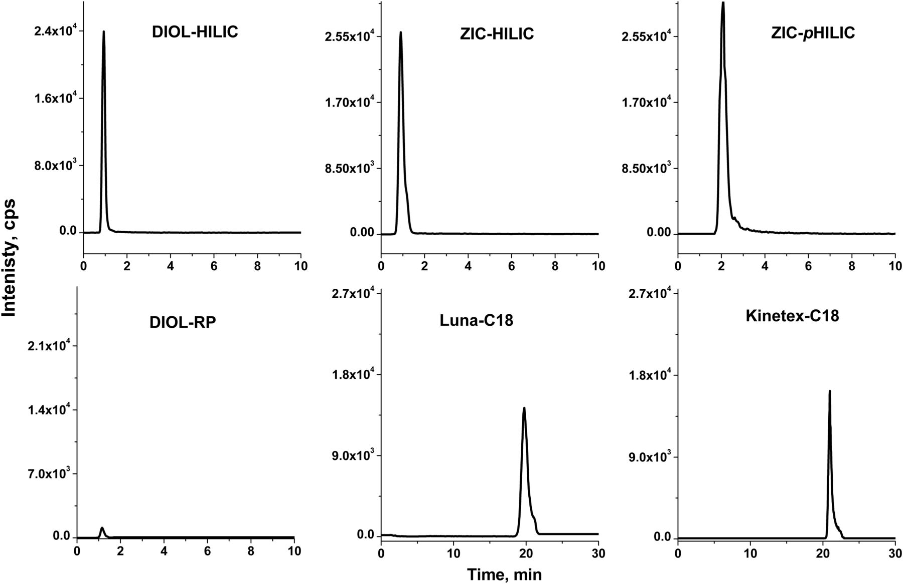
Table II. Separation Parameters for Flavonoid Analysis Under Isocratic Conditions with ACN/Water (95%, v/v) as an ...
Notes:
Table II. Separation Parameters for Flavonoid Analysis Under Isocratic Conditions with ACN/Water (95%, v/v) as an Eluent Extracted ion chromatograms of apigenin on HILIC and RP columns under isocratic elution. Eluent for the HILIC column—ACN/H2O (95/5%, v/v), for DIOL-RP—ACN/H2O (45/55%, v/v) and for C18—ACN/H2O (20/80%, v/v).
Unless provided in the caption above, the following copyright applies to the content of this slide: © The Author 2015. Published by Oxford University Press. All rights reserved. For Permissions, please email: journals.permissions@oup.com

