Slide 1
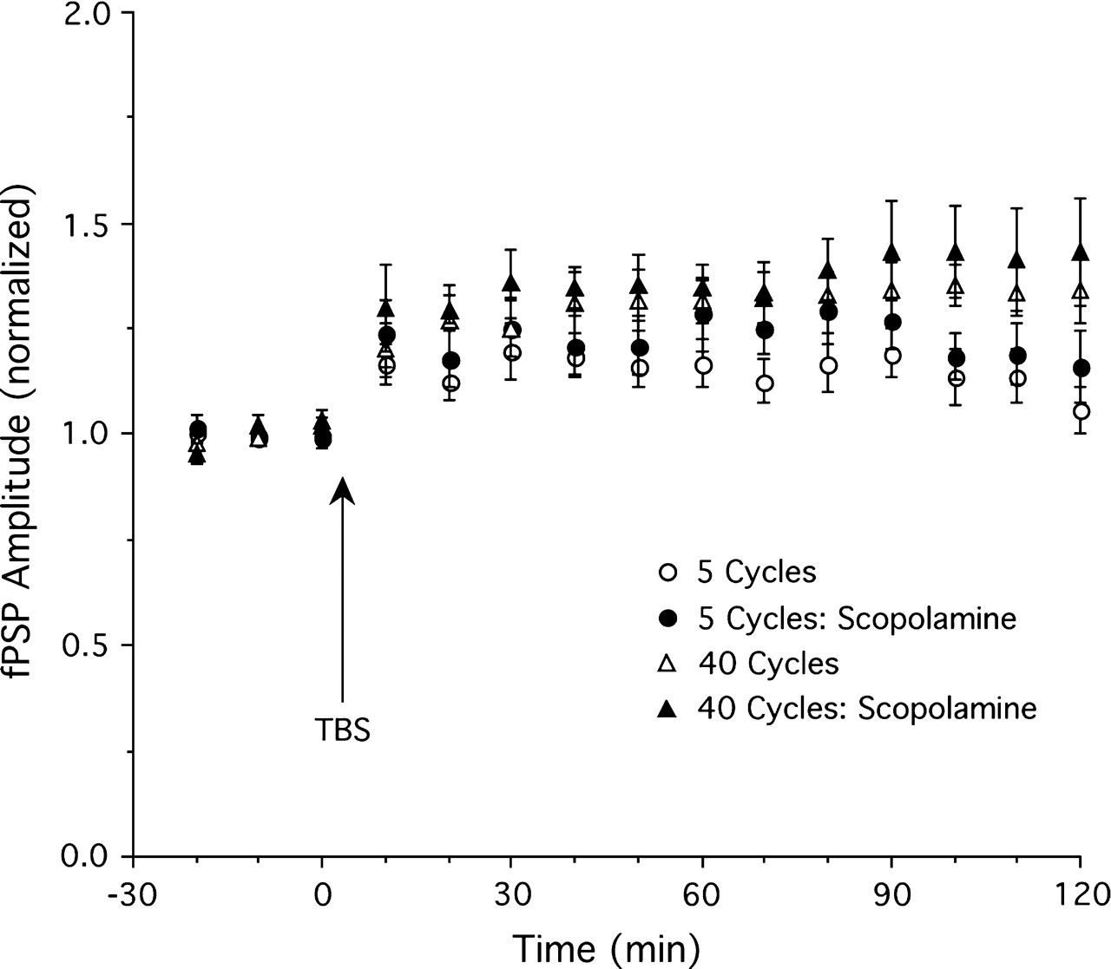
Figure 5. The effect of scopolamine (5 mg/kg, i.p.) on LTP in the absence of basal forebrain stimulation. Scopolamine ...
Notes:
Figure 5. The effect of scopolamine (5 mg/kg, i.p.) on LTP in the absence of basal forebrain stimulation. Scopolamine had no effect on LTP induced by either 5 (n = 8) or 40 cycle (n = 5) TBS (other groups as in Fig. 2).
Unless provided in the caption above, the following copyright applies to the content of this slide: © The Author 2006. Published by Oxford University Press. All rights reserved. For permissions, please e-mail: journals.permissions@oxfordjournals.org

Slide 2
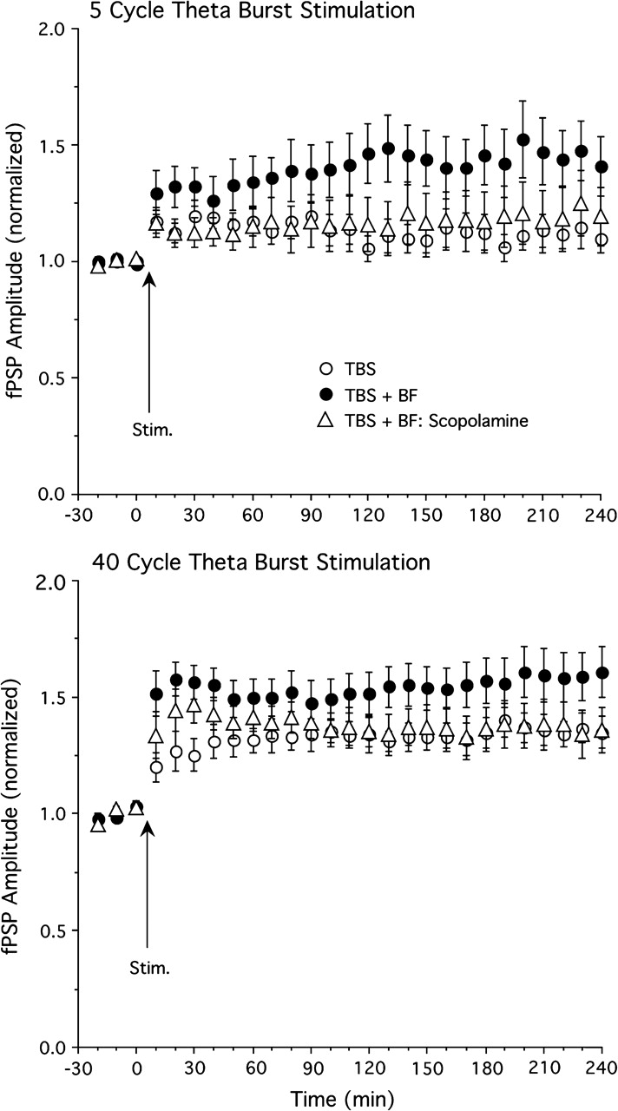
Figure 4. The effect of scopolamine (5 mg/kg, i.p.) on LTP enhancement induced by basal forebrain (BF) stimulation. The ...
Notes:
Figure 4. The effect of scopolamine (5 mg/kg, i.p.) on LTP enhancement induced by basal forebrain (BF) stimulation. The BF-induced enhancement of LTP induced by 5 cycle TBS (top) and 40 cycle TBS (bottom) was reversed by scopolamine (n = 11 and 9 for scopolamine groups; other groups identical to those in Fig. 2).
Unless provided in the caption above, the following copyright applies to the content of this slide: © The Author 2006. Published by Oxford University Press. All rights reserved. For permissions, please e-mail: journals.permissions@oxfordjournals.org

Slide 3
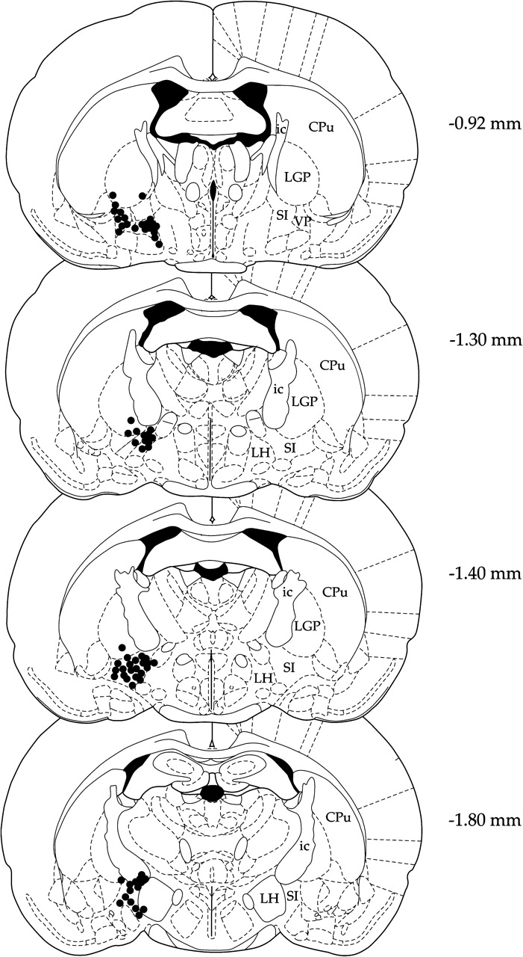
Figure 3. Placements of stimulation electrodes in the basal forebrain. Numbers indicate distance from bregma in ...
Notes:
Figure 3. Placements of stimulation electrodes in the basal forebrain. Numbers indicate distance from bregma in millimeters. CPu, caudate putamen; LGP, lateral globus pallidus; ic, internal capsule; LH, lateral hypothalamus; SI, substantia innominata; VP, ventral pallidum. Adapted from the atlas by Paxinos and Watson (1998).
Unless provided in the caption above, the following copyright applies to the content of this slide: © The Author 2006. Published by Oxford University Press. All rights reserved. For permissions, please e-mail: journals.permissions@oxfordjournals.org

Slide 4
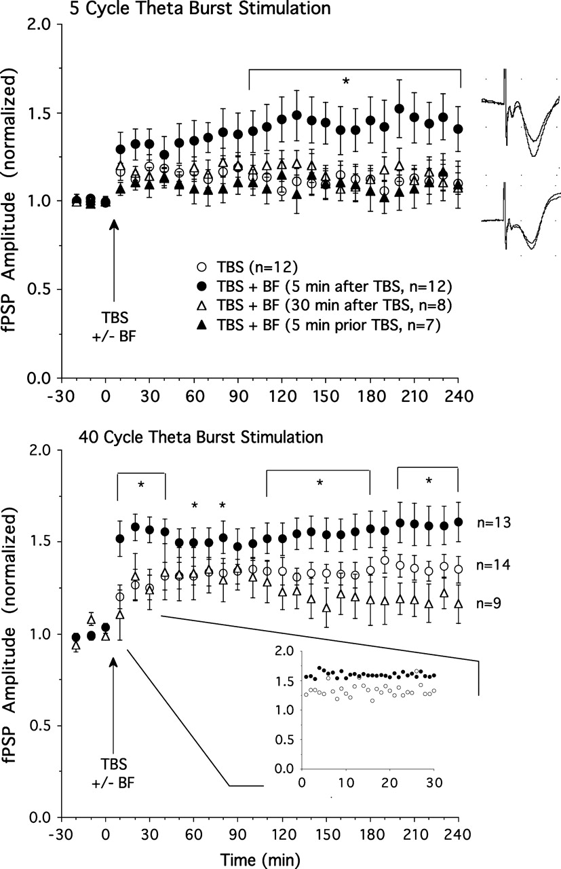
Figure 2. Top: Amplitude of the fPSP before and after thalamic TBS with 5 theta cycles. TBS alone (n = 12) produced ...
Notes:
Figure 2. Top: Amplitude of the fPSP before and after thalamic TBS with 5 theta cycles. TBS alone (n = 12) produced moderate potentiation. Additional stimulation of the basal forebrain (BF) 5 min after (n = 12), but not 30 min (n = 8) after, or 5 min prior to (n = 7) TBS resulted in greater LTP relative to TBS alone. Examples of fPSPs (averages of 10 sweeps) showing LTP in a rat given 5 cycle TBS plus BF stimulation (top) and minimal potentiation in a rat receiving only 5 cycle TBS (bottom). Bottom: Thalamic TBS consisting of 40 theta cycles (n = 14) produced stable LTP which was further enhanced by BF stimulation applied 5 min (n = 13), but not 30 min (n = 9), after TBS. *P < 0.05 for simple effect comparisons of TBS only and TBS plus BF stimulation (5 min after TBS) groups. The insert depicts fPSP amplitude for the TBS plus BF and TBS only groups using smaller (1 min) time bins for the 30-min time window immediately following BF stimulation. Note that rats receiving BF stimulation showed an enhanced fPSP amplitude right from the onset of this 30-min sampling period.
Unless provided in the caption above, the following copyright applies to the content of this slide: © The Author 2006. Published by Oxford University Press. All rights reserved. For permissions, please e-mail: journals.permissions@oxfordjournals.org

Slide 5
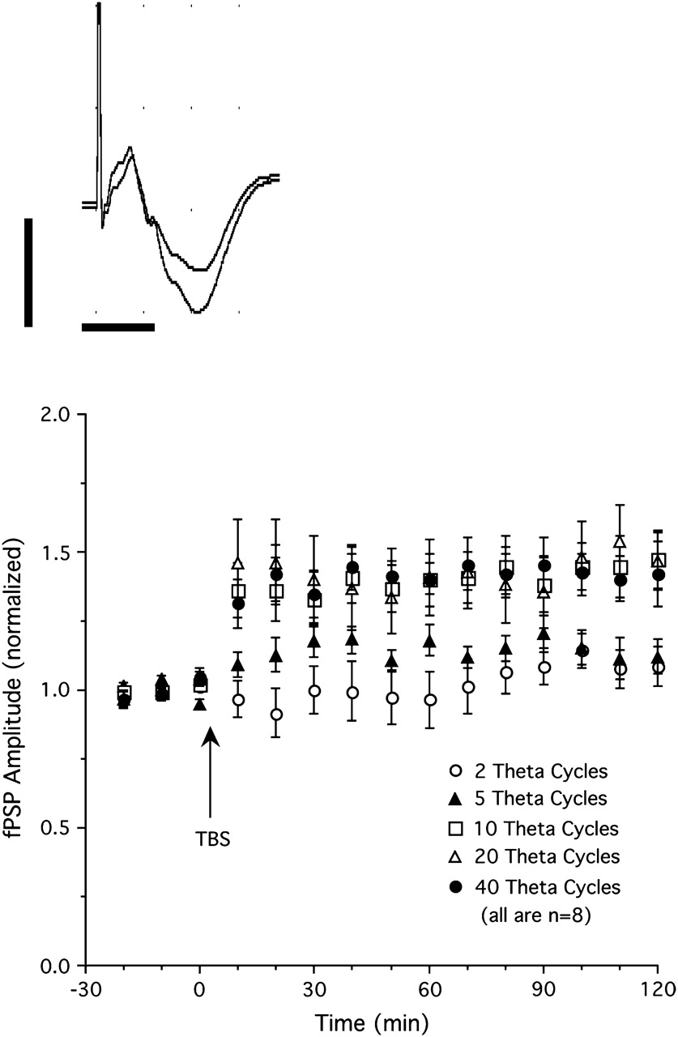
Figure 1. Top: fPSPs recorded in V1 in response to single-pulse stimulation of the LGN before (smaller amplitude fPSP) ...
Notes:
Figure 1. Top: fPSPs recorded in V1 in response to single-pulse stimulation of the LGN before (smaller amplitude fPSP) and after thalamic TBS (20 theta cycles, larger amplitude fPSP). Each trace is an average of 20 individual sweeps (calibrations are 1 mV and 10 ms). Bottom: Changes in fPSP amplitude produced by different theta burst protocols. Stimulation using 2 theta cycles (5 pulses at 100 Hz, repeated at 5 Hz) failed to induce synaptic potentiation. Five theta cycle stimulation induced moderate potentiation, whereas stimulation consisting of 10, 20, or 40 theta cycles induced strong, stable potentiation of fPSP amplitude (n = 8 per group).
Unless provided in the caption above, the following copyright applies to the content of this slide: © The Author 2006. Published by Oxford University Press. All rights reserved. For permissions, please e-mail: journals.permissions@oxfordjournals.org

Slide 6
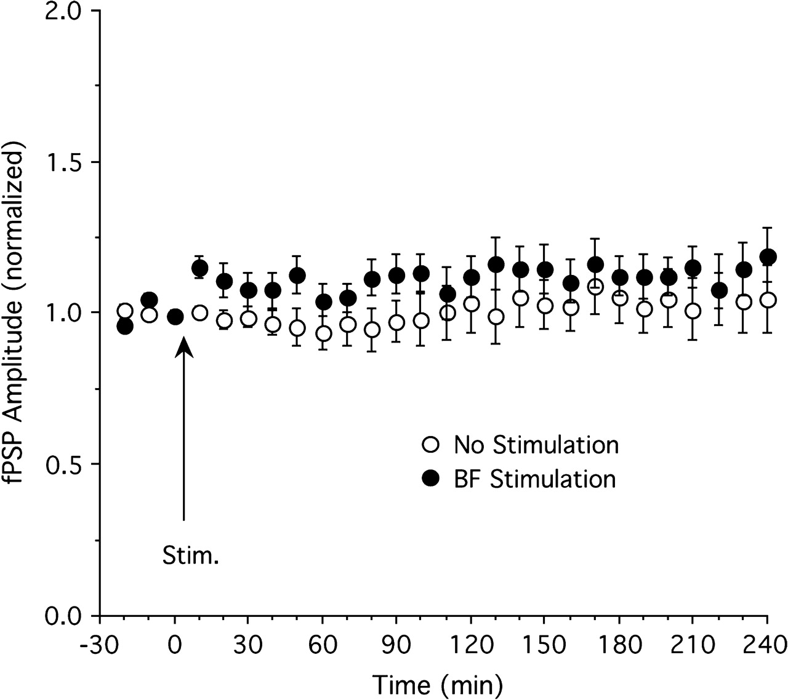
Figure 6. The effect of basal forebrain (BF) stimulation on fPSP amplitude in the absence of thalamic TBS. BF ...
Notes:
Figure 6. The effect of basal forebrain (BF) stimulation on fPSP amplitude in the absence of thalamic TBS. BF stimulation (n = 11) resulted in a transient, statistically insignificant increase of fPSP amplitude relative to control animals (n = 11).
Unless provided in the caption above, the following copyright applies to the content of this slide: © The Author 2006. Published by Oxford University Press. All rights reserved. For permissions, please e-mail: journals.permissions@oxfordjournals.org

Slide 7
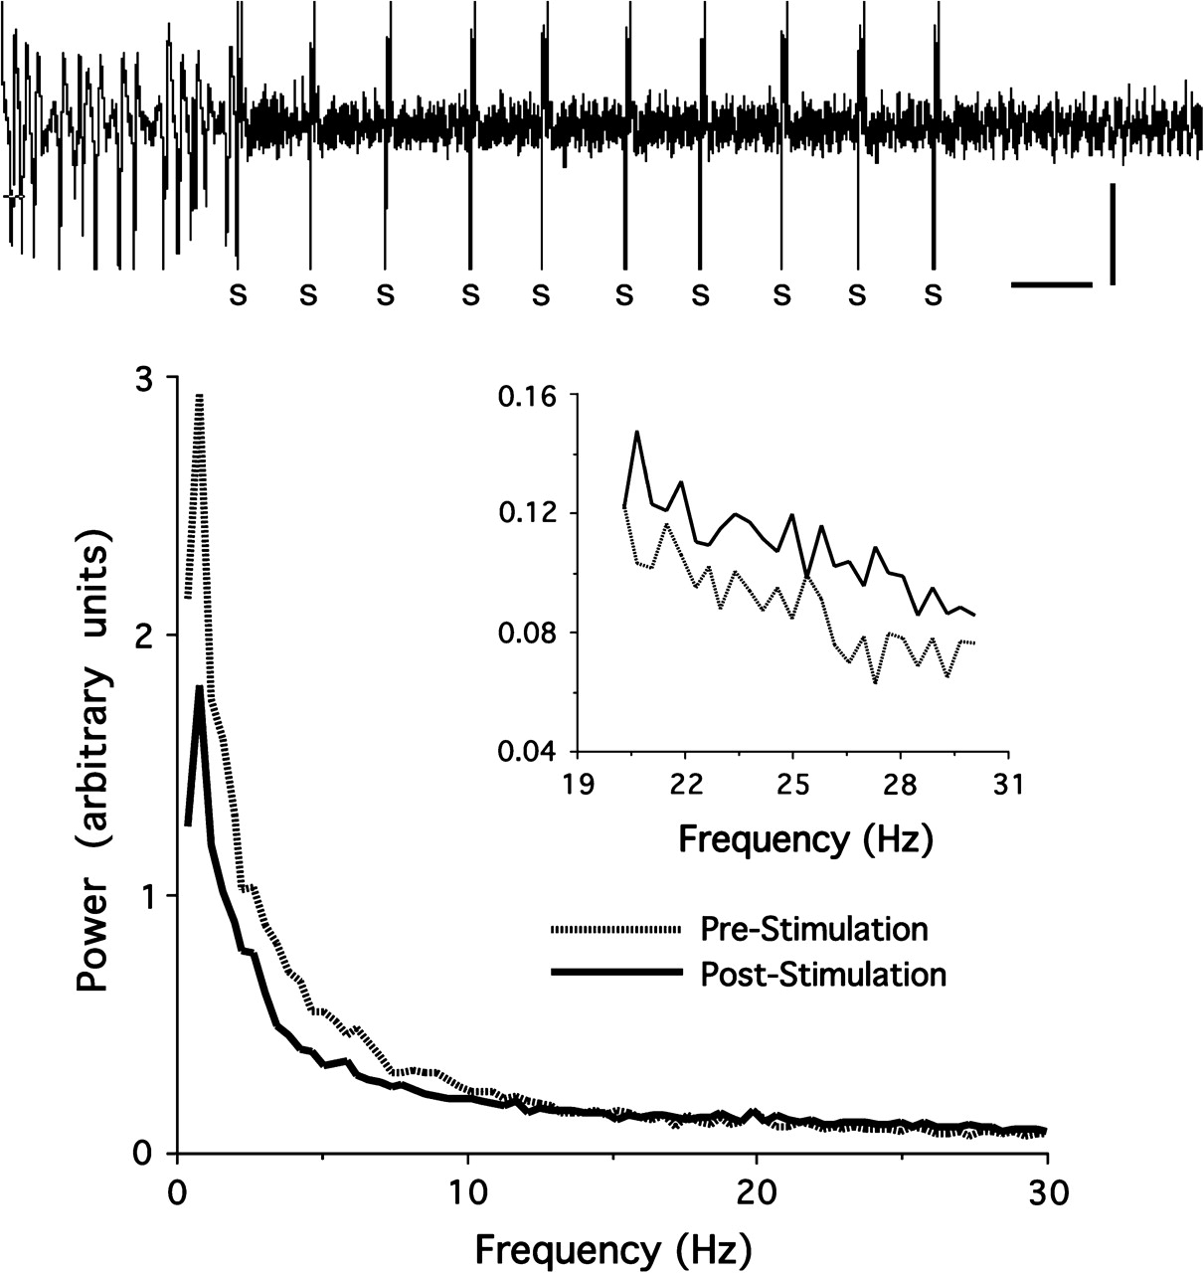
Figure 7. The effect of basal forebrain (BF) stimulation on ECoG activity in V1. Top: Stimulation of the BF (indicated ...
Notes:
Figure 7. The effect of basal forebrain (BF) stimulation on ECoG activity in V1. Top: Stimulation of the BF (indicated by S) suppressed slow, large-amplitude oscillations present in urethane anesthetized rats prior to the stimulation (calibration: 10 s, 0.5 mV). Bottom: Power spectral analyses for 10-s epochs recorded before and (Pre-Stimulation) and after (Post-Stimulation) BF stimulation. Stimulation suppressed power in the lower frequency bands, particularly delta (0.5–3.9 Hz) and theta (4–7.9 Hz) power, whereas higher frequency beta power (20–30 Hz, shown in the insert) was enhanced following BF stimulation. Power spectra shown are averages of 23 rats and are based on 10 s of continuous ECoG activity recorded immediately prior to the first and immediately after the last of 10 stimulation trains applied to the BF.
Unless provided in the caption above, the following copyright applies to the content of this slide: © The Author 2006. Published by Oxford University Press. All rights reserved. For permissions, please e-mail: journals.permissions@oxfordjournals.org

Slide 8
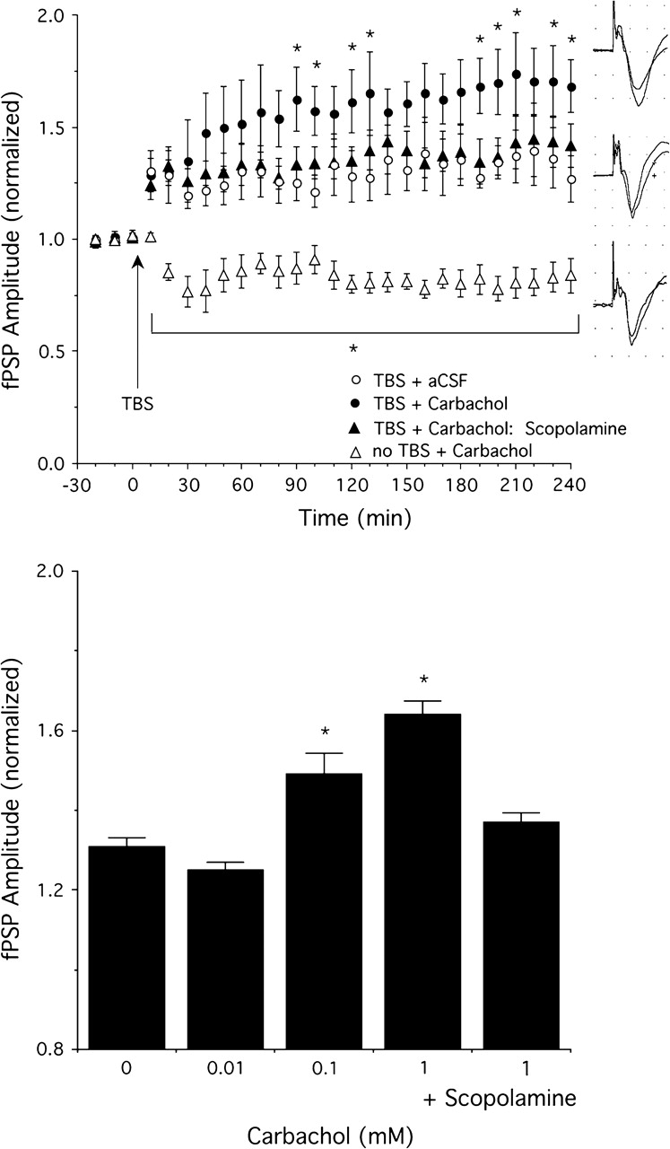
Figure 8. The effect of cortical carbachol application on fPSP amplitude with and without 5 cycle TBS. Top: ...
Notes:
Figure 8. The effect of cortical carbachol application on fPSP amplitude with and without 5 cycle TBS. Top: Potentiation of fPSP amplitude by TBS was enhanced by carbachol (1 mM, n = 8) relative to animals receiving continuous aCSF application (n = 8). Pretreatment with scopolamine (5 mg/kg, i.p., n = 6) blocked the carbachol-induced LTP enhancement. Carbachol suppressed fPSP amplitude in animals that did not receive thalamic TBS (n = 6). Examples of fPSPs (averages of 10 sweeps each before and after TBS) in a rat given 5 cycle TBS plus carbachol (1 mM, top), only TBS (middle), and carbachol (1 mM) without thalamic TBS (bottom). Bottom: Concentration response data (n = 8 except n = 4 for 0.01 mM) for the effect of carbachol to enhance thalamocortical LTP. Scopolamine (5 mg/kg, i.p., n = 6) blocked the carbachol (1 mM)-induced LTP facilitation. Data shown are the average fPSP amplitudes between 2 and 4 h after TBS. *P < 0.05 relative to 0 mM carbachol.
Unless provided in the caption above, the following copyright applies to the content of this slide: © The Author 2006. Published by Oxford University Press. All rights reserved. For permissions, please e-mail: journals.permissions@oxfordjournals.org

