Slide 1
Figure 1. Increased oxidative lesions in Abcd1⁻ spinal cord and in human X-ALD fibroblasts. Proteins from ...
Notes:
Figure 1. Increased oxidative lesions in Abcd1− spinal cord and in human X-ALD fibroblasts. Proteins from Abcd1− samples and wild-type littermates show significant increases in the amounts of oxidation markers as quantified by GC/MS. We measured GSA, AASA, CML, CEL and MDAL in Abcd1− mice and controls at 12 months (A), 3.5 months (B) and 18 days (C). Same oxidative lesion markers were quantified in human control and X-ALD fibroblasts (n = 4 per genotype and condition) (D). Statistical analysis was done by Student’s t-test: *P < 0.05, **P < 0.01, ***P < 0.001.
Unless provided in the caption above, the following copyright applies to the content of this slide: © The Author 2008. Published by Oxford University Press. All rights reserved. For Permissions, please email: journals.permissions@oxfordjournals.org

Slide 2
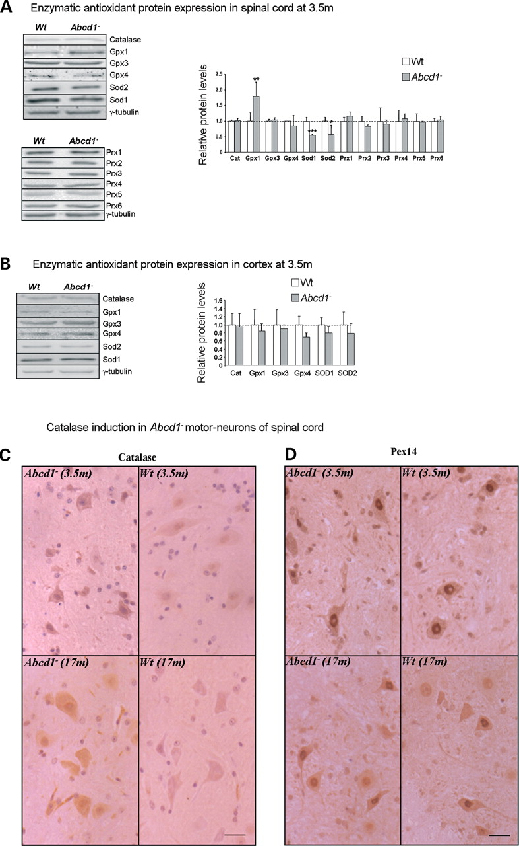
Figure 2. Enzymatic antioxidant protein expression in mouse spinal cord (A) and cortex (B) at 3.5 months of age. ...
Notes:
Figure 2. Enzymatic antioxidant protein expression in mouse spinal cord (A) and cortex (B) at 3.5 months of age. Western blots to monitor levels of catalase, Gpx, Sod and Prx proteins have been performed on whole spinal cord lysates in wild type and Abcd1− mice (n = 6/genotype). Representative blots are shown. Protein level is expressed as a percentage of control, and referred to γ-tubulin as loading marker; quantification has been performed using Versadoc equipment. Statistical analysis was done by Student’s t-test: *P < 0.05, **P < 0.01, ***P < 0.001. Catalase is induced in Abcd1− neurons of spinal cord in the absence of peroxisome proliferation. Transversal sections of spinal cords in wild-type and Abcd1− mice at the age of 3.5 and 17 months were stained for catalase (C) and the peroxisomal membrane protein Pex14 (D), showing increase of catalase immunoreactivity in absence of peroxisomal proliferation.
Unless provided in the caption above, the following copyright applies to the content of this slide: © The Author 2008. Published by Oxford University Press. All rights reserved. For Permissions, please email: journals.permissions@oxfordjournals.org

Slide 3
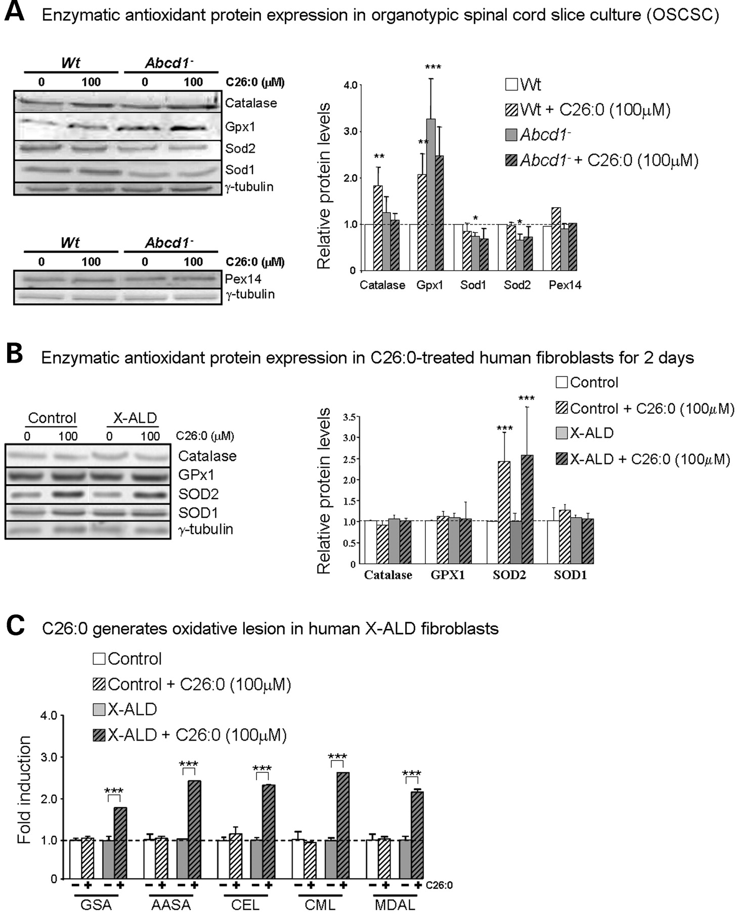
Figure 3. Enzymatic antioxidant expression in organotypic spinal cord slice culture (OSCSC) (A) and in human ...
Notes:
Figure 3. Enzymatic antioxidant expression in organotypic spinal cord slice culture (OSCSC) (A) and in human fibroblasts (B). Western blots to monitor levels of catalase, Gpx and Sod have been performed on whole protein extracts from OSCSC (n = 3–9 cultures per genotype, Abcd1− or wild-type littermates) and in human fibroblasts, control (n = 4) and X-ALD (n = 5) incubated for 2 days with BSA-conjugated C26:0 (100 µm) or BSA alone as control, in serum-free medium. Representative western blots are shown. Protein levels are expressed as a percentage of control and referred to γ-tubulin as internal loading control. C26:0 produces oxidative lesion in X-ALD fibroblasts (C). Oxidative lesion markers were quantified in human control and X-ALD fibroblasts (n = 4) treated for 7 days with BSA-conjugated C26:0 (100 µm) or BSA as control in a serum-free medium. Significant differences have been determined by ANOVA followed by Tukey HSD post hoc test (*P ≤ 0.05, **P ≤ 0.01 and ***P ≤ 0.001).
Unless provided in the caption above, the following copyright applies to the content of this slide: © The Author 2008. Published by Oxford University Press. All rights reserved. For Permissions, please email: journals.permissions@oxfordjournals.org

Slide 4
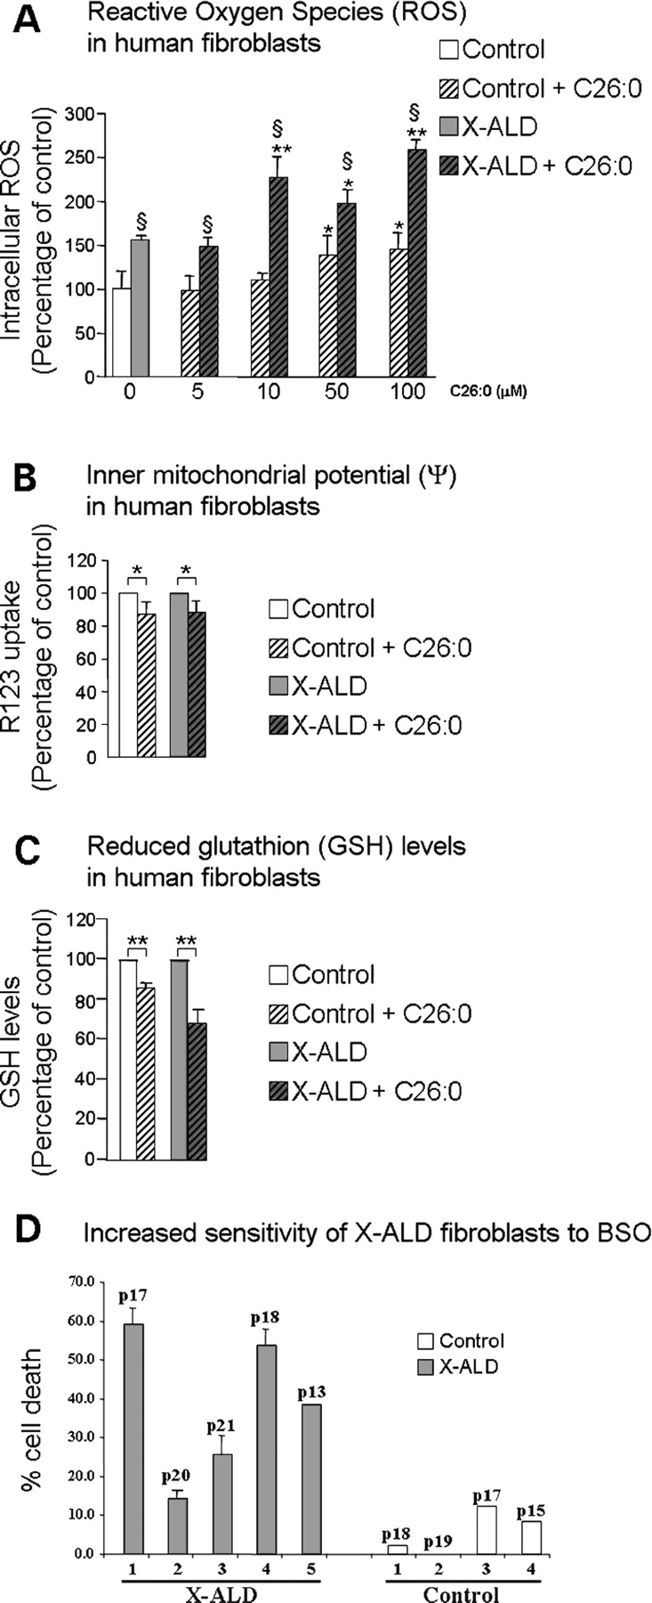
Figure 4. C26:0 produces reactive oxygen species (ROS), decreases levels of reduced glutathione and diminishes (ΔΨ) in ...
Notes:
Figure 4. C26:0 produces reactive oxygen species (ROS), decreases levels of reduced glutathione and diminishes (ΔΨ) in human fibroblasts. Intracellular ROS (A), inner membrane mitochondria potential (ΔΨ) (B) and reduced glutathione (GSH) levels (C) have been measured in control (n = 4) and X-ALD human fibroblasts (n = 4) after 24 h with BSA-conjugated C26:0 (n = 4) or BSA as control (n = 4) in serum-free medium. Significant differences have been determined by ANOVA followed by Tukey HSD post hoc. Significant differences between C26:0-treated and control BSA are shown as *P < 0.05 and **P < 0.01, and significant differences between control and X-Ald fibroblasts are shown as §P < 0.05. Increased sensitivity to death by buthionine sulfoximine (BSO) of X-ALD fibroblasts (D). Human control (n = 4) and X-ALD fibroblasts (n = 5) have been cultured in presence of BSO (500 µm) for 24 h. Lactate dehydrogenase (LDH) activity has been measured to quantify cell death. The number of passages is indicated on the figure.
Unless provided in the caption above, the following copyright applies to the content of this slide: © The Author 2008. Published by Oxford University Press. All rights reserved. For Permissions, please email: journals.permissions@oxfordjournals.org

Slide 5
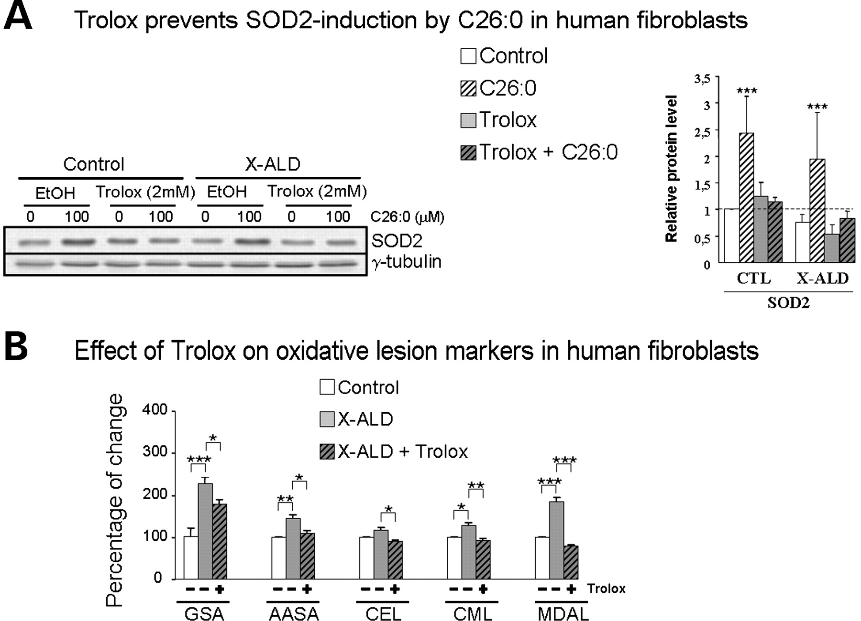
Figure 5. (A) Trolox prevents C26:0 dependent-induction of SOD2. Human fibroblasts (n = 4) have been pre-treated (2 ...
Notes:
Figure 5. (A) Trolox prevents C26:0 dependent-induction of SOD2. Human fibroblasts (n = 4) have been pre-treated (2 days) with Trolox (2 mm) and then cultured for 2 days in presence of BSA-conjugated C26:0 (100 µm) and/or Trolox (2 mm) in serum-free medium. (B) Trolox corrects levels of oxidative lesion markers in patients’ fibroblasts. GC/MS analysis of protein carbonylation (AASA, GSA), glycoxidation and lipoxidation [CML and CEL) and lipoxidation (MDAL) lesion markers, quantified in human control and X-ALD fibroblasts (n = 3 per genotype and condition after 4 days treatment with Trolox (2 mm)]. Significant differences have been determined by ANOVA followed by Tukey HSD post-test (*P≤0.05, **P ≤ 0.01 and ***P ≤ 0.001).
Unless provided in the caption above, the following copyright applies to the content of this slide: © The Author 2008. Published by Oxford University Press. All rights reserved. For Permissions, please email: journals.permissions@oxfordjournals.org

