Slide 1
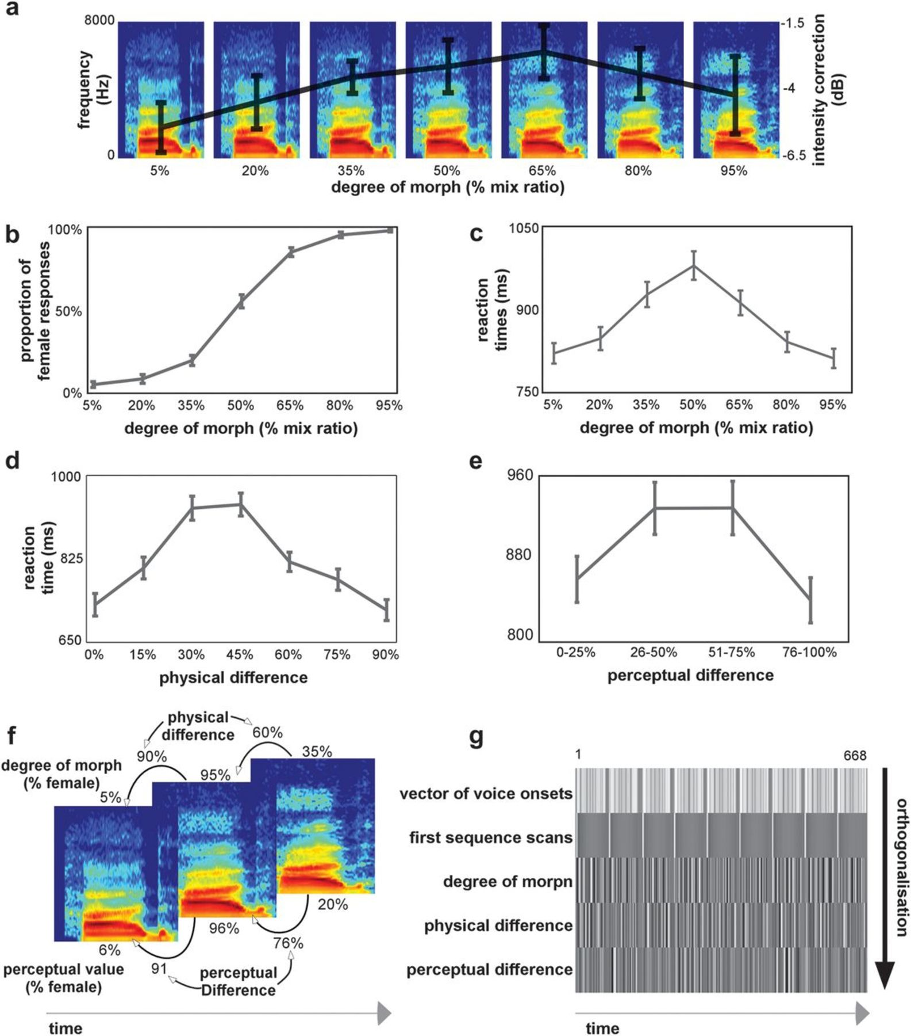
Figure 1. (a) Stimuli were voices derived from male-to-female voice gender continua. Example of a continuum where the ...
Notes:
Figure 1. (a) Stimuli were voices derived from male-to-female voice gender continua. Example of a continuum where the physical interpolation was done with mix ratios increasing by 15%. Superimposed on the continua is the average intensity level correction for each degree of morph derived from the pilot study on perceived loudness. The error bars show the standard error computed from the average variation in intensity correction between the 9 different continua. (b) Voice gender psychophysical function: the group-average proportion of female responses is shown as a function of the degree of morph. For panels b–e, the error bars show the standard error computed from the individual subject's classifications. (c) Reaction times: the group-average reaction times as a function of the voices' degree of morph. (d) Reaction times: the group average reaction times as a function of the physical difference with the previously heard stimulus. (e) Reaction times: the group average reaction times as a function of the perceptual difference with the previously heard stimulus. (f) Illustration example for the definition of the parametric regressors: Spectrogram examples of 3 consecutive voices in the stimulation sequence. Shown above the spectrogram is the voice's respective degree of morph value and the physical difference with the previous stimulus. Shown below the spectrogram is the voice's perceptual value (for a given subject) and the perceptual difference with the previous stimulus. (g) Design matrix: the first row of the design matrix defines the stimulus onsets for the 9 continua (each continuum separated by baseline trials). The following rows represent the parametric regressors included in the general linear model. The first regressor models the first stimulation in a sequence. Since this stimulus is not preceded by another voice, we model it out of the regression. The second regressor models the voice's degree of morph. The third regressor models the physical difference between consecutive voices, and finally, the fourth regressor models the perceptual difference between consecutive voices.
Unless provided in the caption above, the following copyright applies to the content of this slide: © The Authors 2012. Published by Oxford University Press.This is an Open Access article distributed under the terms of the Creative Commons Attribution Non-Commercial License (http://creativecommons.org/licenses/by-nc/3.0), which permits unrestricted non-commercial use, distribution, and reproduction in any medium, provided the original work is properly cited.

Slide 2
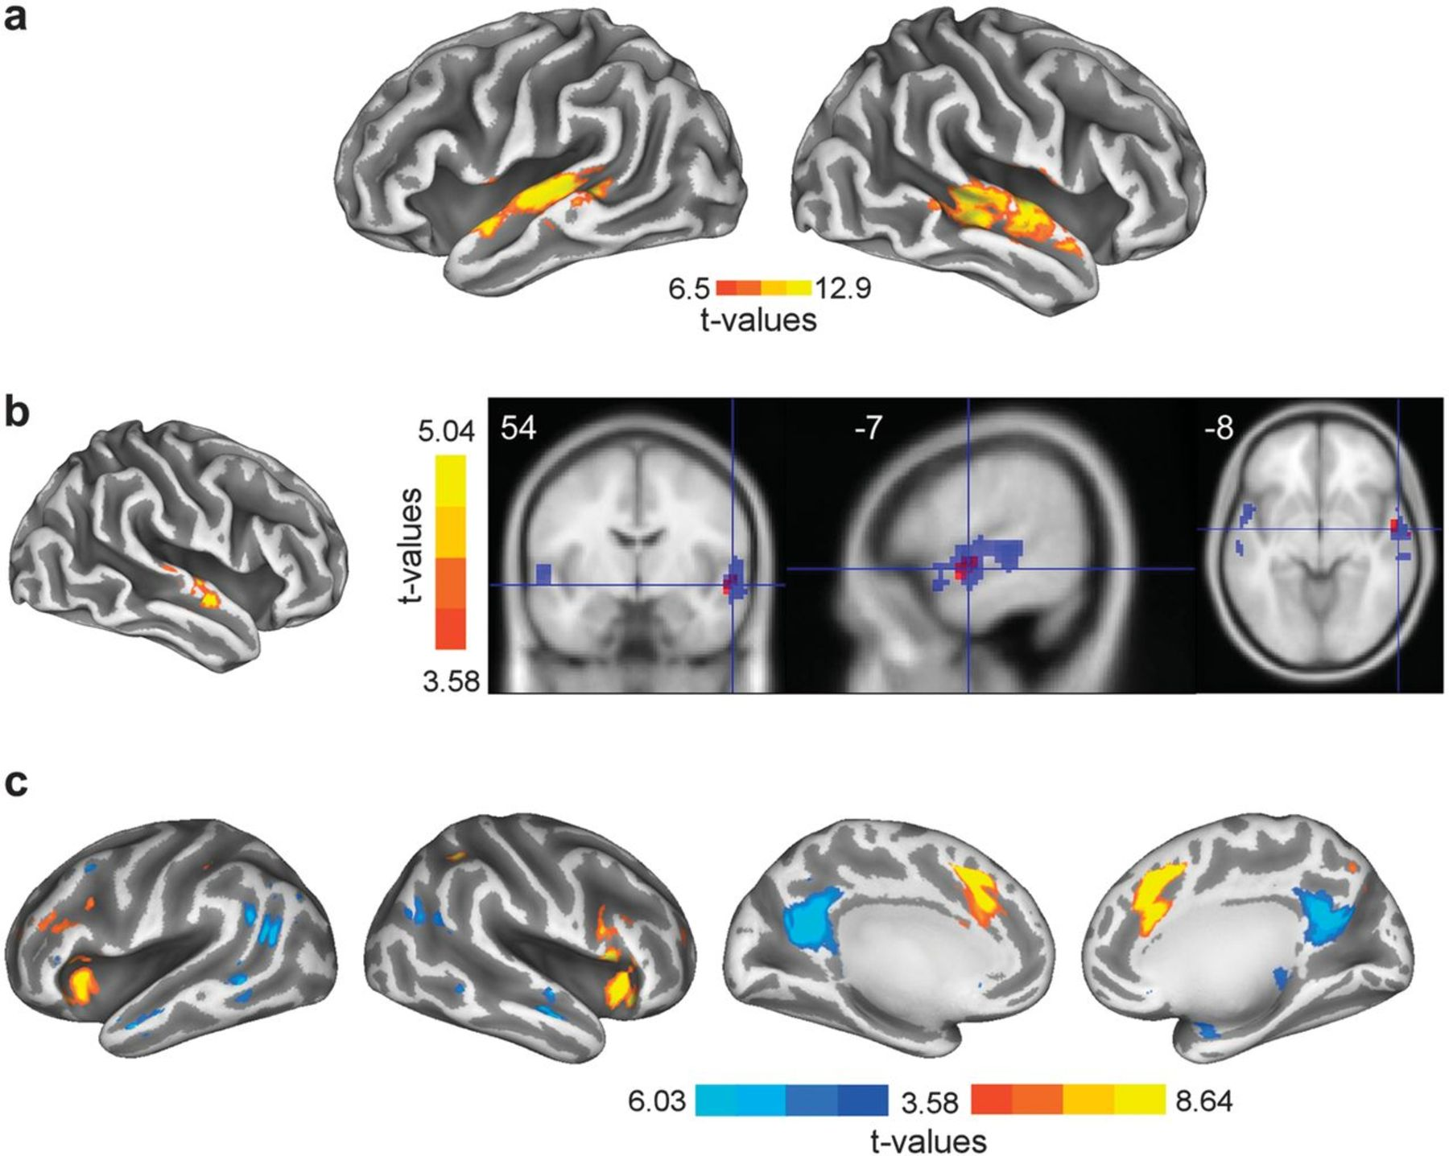
Figure 2. (a) Inflated cortical surface depicting the TVAs in both hemispheres. Throughout Figure 2, the color bar ...
Notes:
Figure 2. (a) Inflated cortical surface depicting the TVAs in both hemispheres. Throughout Figure 2, the color bar depicts the statistical lower boundary and global maxima. (b) Left: inflated cortical surface showing the activation map obtained with the physical difference regressor. Right: axial, sagittal, and coronal slices showing the TVAs (in blue) and the effect of physical difference (in red). Note how the effect of physical difference overlaps with the anterior parts of the TVAs. (c) Inflated cortical surfaces showing the activation maps for the perceptual difference regressor. On the 2 inflated cortical surfaces on the left, are shown the activity maps in the bilateral inferior frontal gyrus/insulae (positive; color map red-to-yellow) and middle temporal gyrus (negative; color map dark-to-light blue). On the 2 right most inflated cortical surfaces is depicted the bilateral activity maps for the anterior cingulate gyrus (positive; color map red-to-yellow) and precuneus (negative; color map dark blue-to-light blue).
Unless provided in the caption above, the following copyright applies to the content of this slide: © The Authors 2012. Published by Oxford University Press.This is an Open Access article distributed under the terms of the Creative Commons Attribution Non-Commercial License (http://creativecommons.org/licenses/by-nc/3.0), which permits unrestricted non-commercial use, distribution, and reproduction in any medium, provided the original work is properly cited.

Slide 3
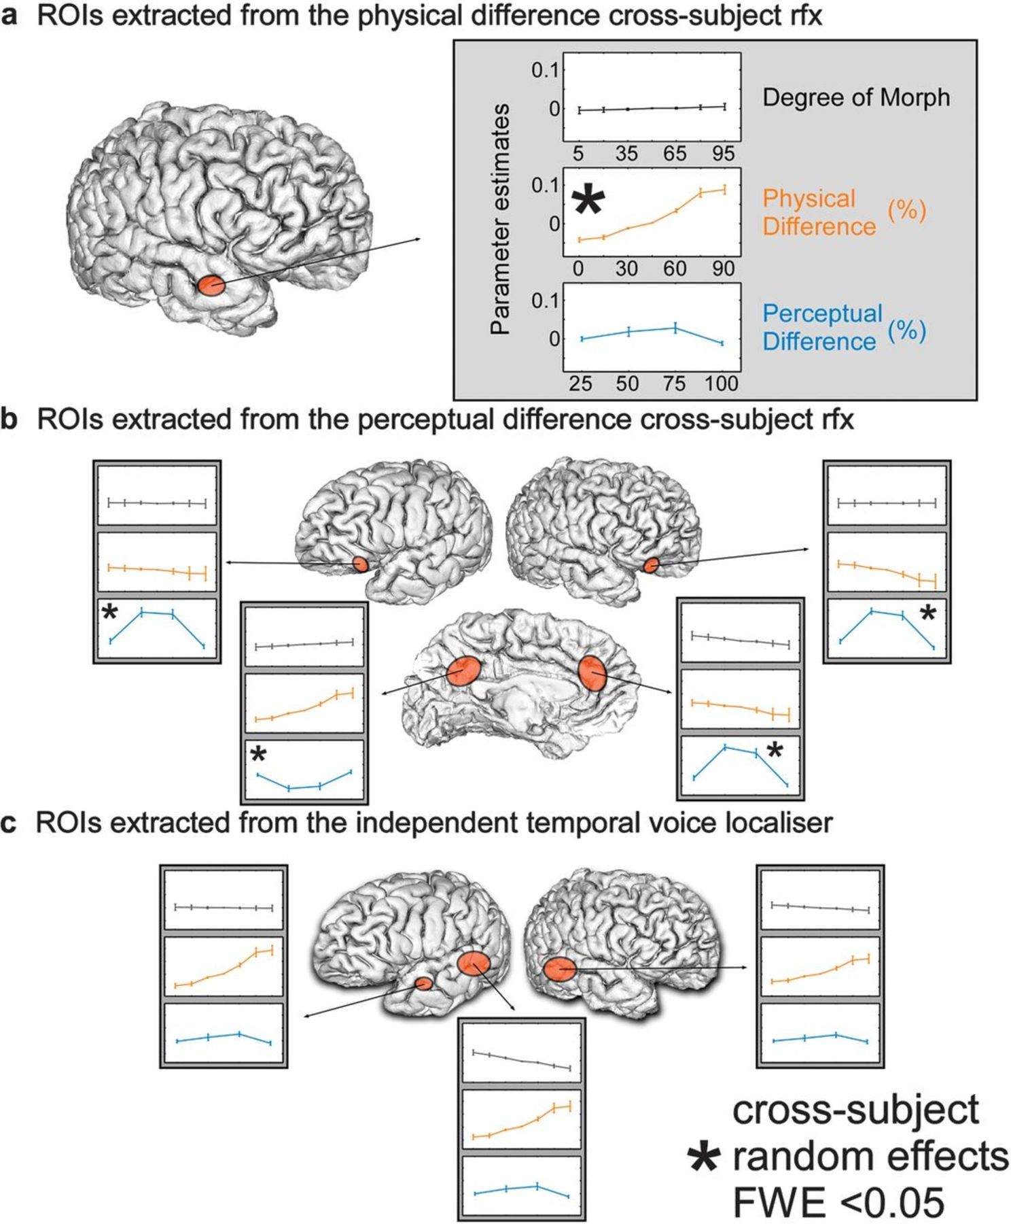
Figure 3. Parameter estimates and standard error for the contrasts investigated with the parametric regressors. (a) The ...
Notes:
Figure 3. Parameter estimates and standard error for the contrasts investigated with the parametric regressors. (a) The parameter estimates for the anterior STS ROI in the right hemisphere that we obtained from the physical difference regressor. (b) The parameter estimates for the bilateral inferior frontal gyrus, precuneus, and ACC that we obtained from the perceptual difference regressor. (c) The parameter estimates for the left hemisphere posterior and anterior and right hemisphere posterior regions that we obtained from the functional voice localizer.
Unless provided in the caption above, the following copyright applies to the content of this slide: © The Authors 2012. Published by Oxford University Press.This is an Open Access article distributed under the terms of the Creative Commons Attribution Non-Commercial License (http://creativecommons.org/licenses/by-nc/3.0), which permits unrestricted non-commercial use, distribution, and reproduction in any medium, provided the original work is properly cited.

