Slide 1
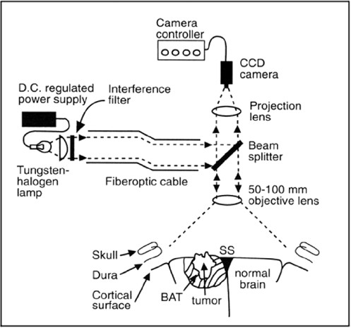
Figure 1. Diagram of the optical imaging apparatus demonstrating the light source (tungsten/halogen) powered by a ...
Notes:
Figure 1. Diagram of the optical imaging apparatus demonstrating the light source (tungsten/halogen) powered by a regulated direct current power supply. The light travels through a longpass interference filter, allowing light of wavelengths of more than 690 nm to pass and reflect onto the cortical surface or into the cavity after the tumor has been resected. The light is reflected back onto the faceplate of a charge-coupled device (CCD) camera (COHU), and the video signals are sent to the imaging computer (Imaging Technology Inc.) for further analysis. ss, sagittal sinus; D.C., direct current; BAT, brain around the tumor.
Unless provided in the caption above, the following copyright applies to the content of this slide:

Slide 2
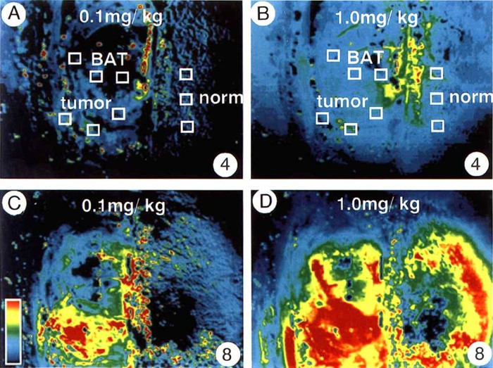
Figure 2. Optical changes during the infusion of 0.1 mg/kg (A and C) and 1.0 mg/kg (B and D). The number in the lower ...
Notes:
Figure 2. Optical changes during the infusion of 0.1 mg/kg (A and C) and 1.0 mg/kg (B and D). The number in the lower right is the time in seconds after the injection of the dye, and the color bar in Panel C shows the magnitude of the relative optical change (see Materials and Methods for how relative percentage difference was calculated), with black being near 0% and red being above 4% in Panels A and C and above 40% in Panels B and D. Four seconds after injection, the 1.0 mg/kg dose has caused a greater spatial area of optical change (B) compared with the 0.1 mg/kg dose (A). The peak optical change is greater and the spatial extent of the optical change is larger with the 1.0 mg/kg dose (D) compared with the 0.1 mg/kg dose (C). See Figure 3 for the amplitude of the optical change over time.
Unless provided in the caption above, the following copyright applies to the content of this slide:

Slide 3
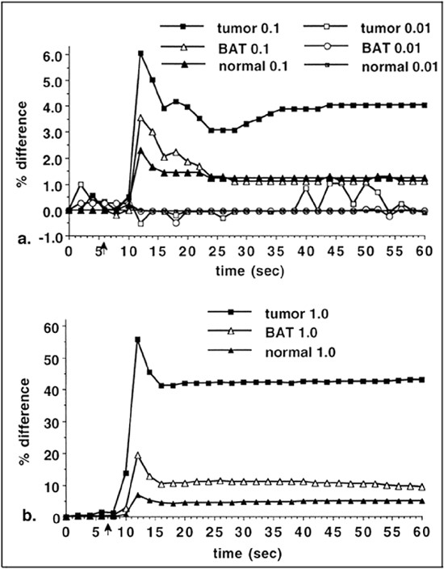
Figure 3. A, optical changes from three boxes in three separate regions, tumor, BAT, and normal brain, at 0.01 and 0.1 ...
Notes:
Figure 3. A, optical changes from three boxes in three separate regions, tumor, BAT, and normal brain, at 0.01 and 0.1 mg/kg doses, as labeled in Figure 2A. The arrow marks the time of dye injection. The peak change at the 0.1 mg/kg dose in the tumor tissue is near 6.0% compared with only 3.5% for the BAT and 2.3% for the normal brain. The 0.01 mg/kg dose did not show any peak and demonstrates the inherent baseline noise in the optical imaging system to be near 1.0% over the 60 seconds of the imaging trial. B, optical changes from the same three regions at the 1.0 mg/kg dose. The peak change is 10 times greater near 60% compared with the 0.1 mg/kg dose. However, the BAT changes are only six times greater than the peak changes in the 0.1 mg/kg dose, and, in the normal brain, the changes are only three to four times greater in the 1.0 mg/kg dose compared with the 0.1 mg/kg dose. These findings suggest that the increase in concentration is even more pronounced in the tumor compared with that in the BAT or the normal brain.
Unless provided in the caption above, the following copyright applies to the content of this slide:

Slide 4
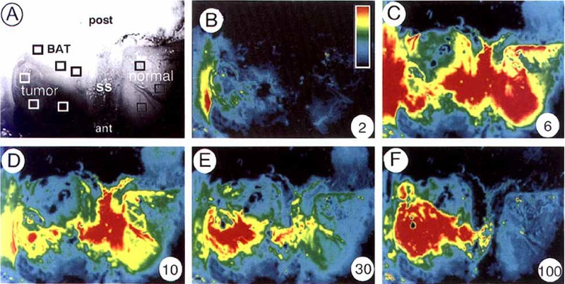
Figure 4. A, area imaged during sequence of Panels B through F. The anterior (ant), sagittal sinus (ss), and posterior ...
Notes:
Figure 4. A, area imaged during sequence of Panels B through F. The anterior (ant), sagittal sinus (ss), and posterior (post) locations are labeled. The tumor is in the lower left (labeled tumor), the BAT is in the upper left (labeled BAT), and the normal brain is on the right (labeled normal). The number in the lower right is the time in seconds after the dye injection, whereas the color bar in Panel B is the magnitude of the optical change, with black being near 0% change and red being more than 15% (B-F). Two seconds after dye injection, the first area with changes is in the region of the tumor (B), but, by 6 seconds, there are optical changes in all areas, including in the normal brain (C). However, over the next 94 seconds, the dye is cleared from the normal brain and can be seen leaving the normal brain via blood vessels in Panels D and E. At the same time, the dye appears to sequester in the tumor tissue (E and F) but not in the BAT.
Unless provided in the caption above, the following copyright applies to the content of this slide:

Slide 5
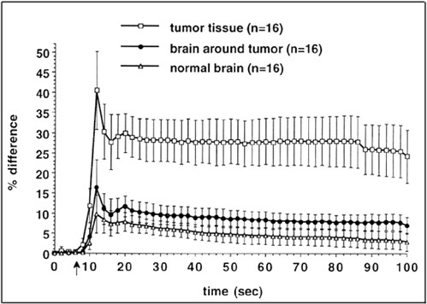
Figure 5. Magnitude and time course of optical change from the cortical surface after the injection of the 1.0 mg/kg ...
Notes:
Figure 5. Magnitude and time course of optical change from the cortical surface after the injection of the 1.0 mg/kg dose in 16 trials from nine animals. A representative sample of boxes drawn for these calculations is shown in Figure 4A. The arrow marks the time when the dye was injected. Error bars represent the standard error for the 16 trials. The peak optical change in the tumor is greater than in the BAT and the normal brain. The plateau of optical changes in the tumor after 100 seconds occurs during a time when the BAT and normal brain are returning toward baseline.
Unless provided in the caption above, the following copyright applies to the content of this slide:

Slide 6
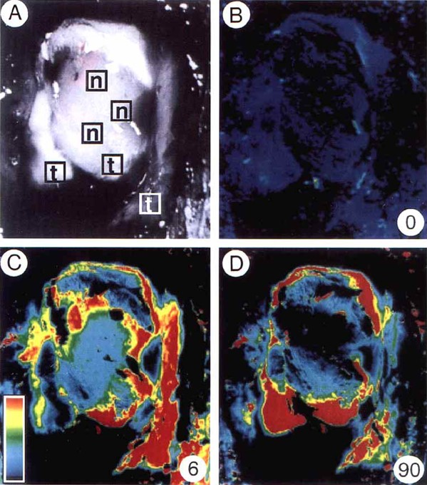
Figure 6. Optical imaging changes from the right hemisphere after gross total tumor resection. The number in the lower ...
Notes:
Figure 6. Optical imaging changes from the right hemisphere after gross total tumor resection. The number in the lower right is the time in seconds after the dye injection, whereas the color bar in Panel C is the magnitude of the optical change, with black being near 0% change and red being more than 30%. A, the boxes show which areas were biopsied for later blinded pathological analysis and confirmation as normal brain (n) or tumor (t) tissue. B, a difference of control images taken before the injection of the dye. C and D, over time, there is sequestration of the dye; those areas with biopsies from boxes marked in Panel A and showing large optical changes (t in Panel A) were positive for tumor, whereas the biopsies that were negative for tumor had small optical changes (n in Panel A). These samples were all less than 1.5 mm3.
Unless provided in the caption above, the following copyright applies to the content of this slide:

Slide 7
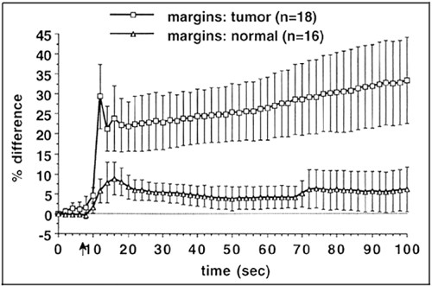
Figure 7. Magnitude and time course of optical changes from the resection cavity after the injection of the 1.0 mg/kg ...
Notes:
Figure 7. Magnitude and time course of optical changes from the resection cavity after the injection of the 1.0 mg/kg dose in 12 animals with 34 biopsies. Of the 34 biopsies, 18 were read as positive for tumor and 16 were read as normal or negative for tumor. The peak optical change is greater, and there is delayed sequestration of dye in the resection cavity positive for tumor on pathological analysis compared with the normal biopsy sites.
Unless provided in the caption above, the following copyright applies to the content of this slide:

Slide 8
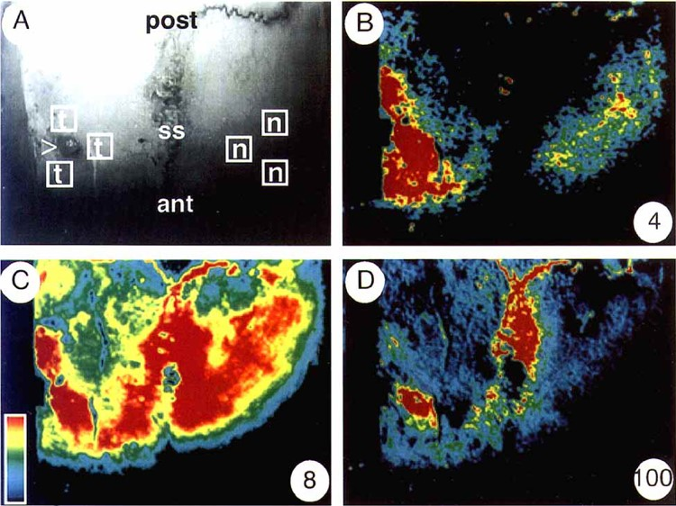
Figure 8. Optical imaging changes obtained through the cranium. The number in the lower right is the time in seconds ...
Notes:
Figure 8. Optical imaging changes obtained through the cranium. The number in the lower right is the time in seconds after the dye injection, whereas the color bar in Panel C is the magnitude of the optical change, with black being near 0% change and red being more than 8%. A, region used for optical imaging in one animal showing the site of the stereotactic implantation of the tumor cells (>), anterior (ant), posterior (post), and the sagittal sinus (ss). B, four seconds after dye injection, the largest changes are in the area of the tumor. C, After 8 seconds, the dye has spread everywhere, but, by 90 seconds (D), the dye is localized only to the tumor and the sagittal sinus.
Unless provided in the caption above, the following copyright applies to the content of this slide:

Slide 9
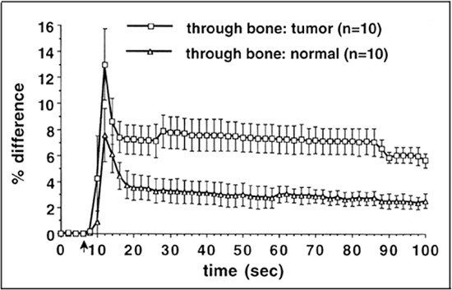
Figure 9. Magnitude and time course of optical changes obtained through the cranium after the injection of the 1.0 ...
Notes:
Figure 9. Magnitude and time course of optical changes obtained through the cranium after the injection of the 1.0 mg/kg dose in four animals during 10 trials. The arrow marks the time of dye injection. The boxes in Figure 8A show the areas typically chosen to compare the tumor and normal brain through the bone. The peak optical changes are less robust than when the cortical surface is exposed but still demonstrate a similar time course, a greater peak optical change, and delayed clearance of the dye in the tumor tissue compared with normal brain tissue.
Unless provided in the caption above, the following copyright applies to the content of this slide:

