Slide 1
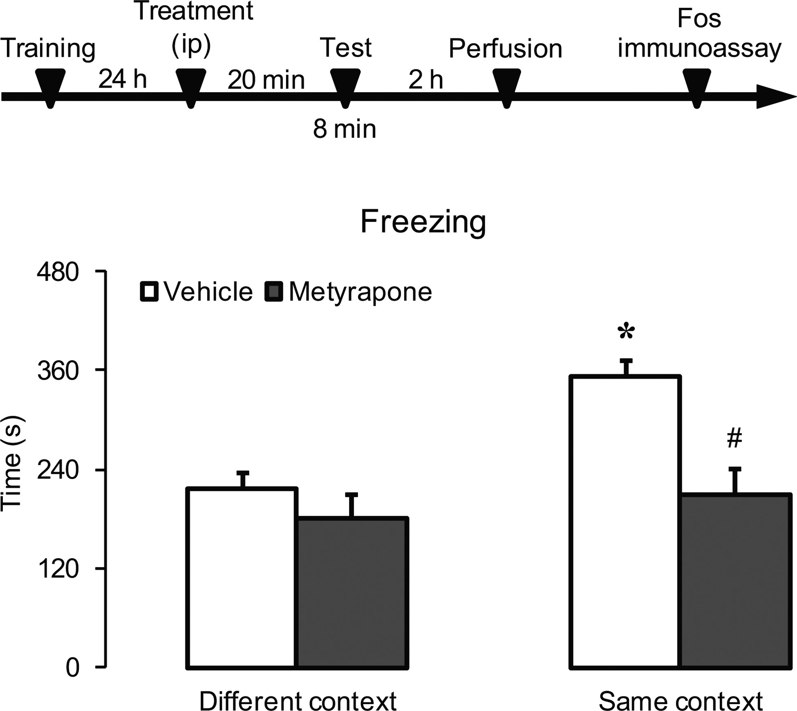
Figure 1. Effects of metyrapone on the expression of conditioned fear response. Average freezing responses in rats ...
Notes:
Figure 1. Effects of metyrapone on the expression of conditioned fear response. Average freezing responses in rats treated with vehicle or metyrapone and exposed to a different or the same context previously paired with footshock (n = 8 for all groups). * Different from vehicle group exposed to different context; # different from the vehicle group exposed to the same context (P < 0.05).
Unless provided in the caption above, the following copyright applies to the content of this slide: © The Author 2015. Published by Oxford University Press. All rights reserved. For Permissions, please e-mail: journals.permissions@oup.com

Slide 2
Figure 2. Effects of aversive context and metyrapone on the expression of Fos protein in the mPFC. Average number of ...
Notes:
Figure 2. Effects of aversive context and metyrapone on the expression of Fos protein in the mPFC. Average number of Fos-positive cells in the PrL, IL, Cg1, and Cg2 subregions of rats treated with vehicle or metyrapone and exposed to a different or to the same context previously paired with footshock (A). Representative photomicrographs illustrating the Fos-protein immunoreactivity in the PrL of rats treated with vehicle or metyrapone and exposed to the same context (B). * Different from the vehicle group exposed to a different context, # different from the vehicle group exposed to the same context (P < 0.05). n = 7–8 “per” group. Scale bar equal to 100 µm. DC, different context; SC, same context; PrL, prelimbic cortex; IL, infralimbic cortex; Cg1, anterior cingulate cortex area 1; and Cg2, anterior cingulate cortex area 2.
Unless provided in the caption above, the following copyright applies to the content of this slide: © The Author 2015. Published by Oxford University Press. All rights reserved. For Permissions, please e-mail: journals.permissions@oup.com

Slide 3
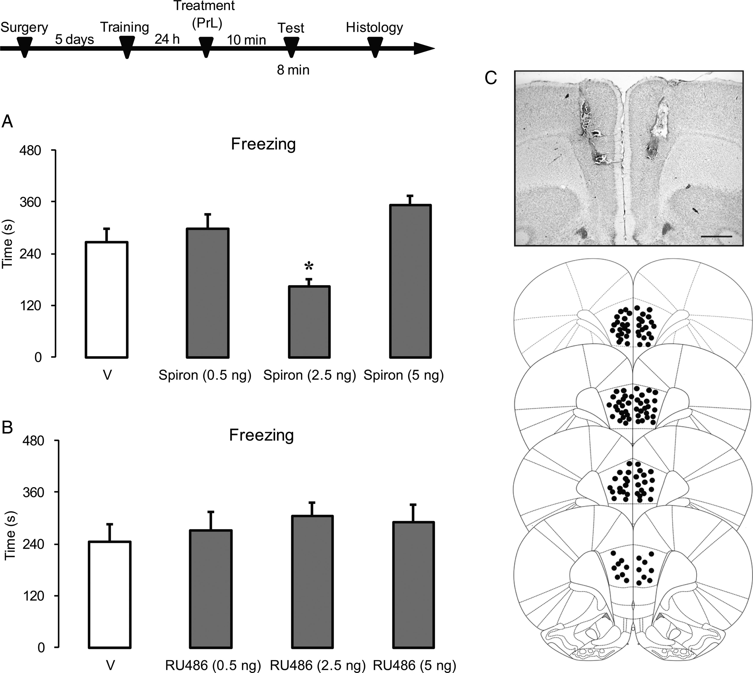
Figure 3. Effects of MR and GR antagonists microinjected in the PrL in the expression of contextual fear conditioning. ...
Notes:
Figure 3. Effects of MR and GR antagonists microinjected in the PrL in the expression of contextual fear conditioning. Average of freezing responses in rats treated with vehicle (n = 10) or spironolactone at doses of 0.5 ng (n = 7), 2.5 ng (n = 10), or 5 ng (n = 10) and exposed the same context previously paired with footshocks (A). Average of freezing responses in rats that received bilateral microinjections of vehicle (n = 12) or RU38486 at doses of 0.5 ng (n = 9), 2.5 ng (n = 10), or 5 ng (n = 10); exposed to the same context (B). Photomicrograph representative of microinjection sites in the PrL and diagrams representing the microinjection sites in cross-sections of the Paxinos and Watson atlas (Paxinos and Watson 2007) (C). Scale bar equal to 1.0 mm. PrL, prelimbic cortex. The number of points in the figure is less than the total number of animals because of overlapping injection sites.* Different from vehicle group (P < 0.05). Spiron, spironolactone.
Unless provided in the caption above, the following copyright applies to the content of this slide: © The Author 2015. Published by Oxford University Press. All rights reserved. For Permissions, please e-mail: journals.permissions@oup.com

Slide 4
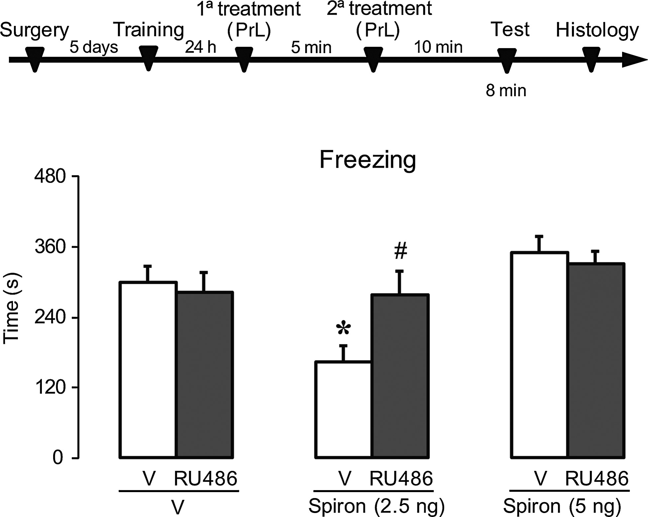
Figure 4. Effect of prior administration of RU38486 on the effects promoted by spironolactone microinjected in the PrL ...
Notes:
Figure 4. Effect of prior administration of RU38486 on the effects promoted by spironolactone microinjected in the PrL in the expression of contextual fear conditioning. Average freezing responses in rats treated with the combination of V + V, (n = 7); RU38486 (5 ng) + V, (n = 7); V + Spiron (2.5 ng), (n = 7); RU38486 (5 ng) + Spiron (2.5 ng), (n = 6); V + Spiron (5 ng), (n = 7); and RU38486 + Spiron (5 ng), (n = 7) and exposed to the same context previously paired with footshocks. * Different from V + V group, # different from the V + Spiron (5 ng) group (P < 0.05). V, vehicle; Spiron, spironolactone.
Unless provided in the caption above, the following copyright applies to the content of this slide: © The Author 2015. Published by Oxford University Press. All rights reserved. For Permissions, please e-mail: journals.permissions@oup.com

Slide 5
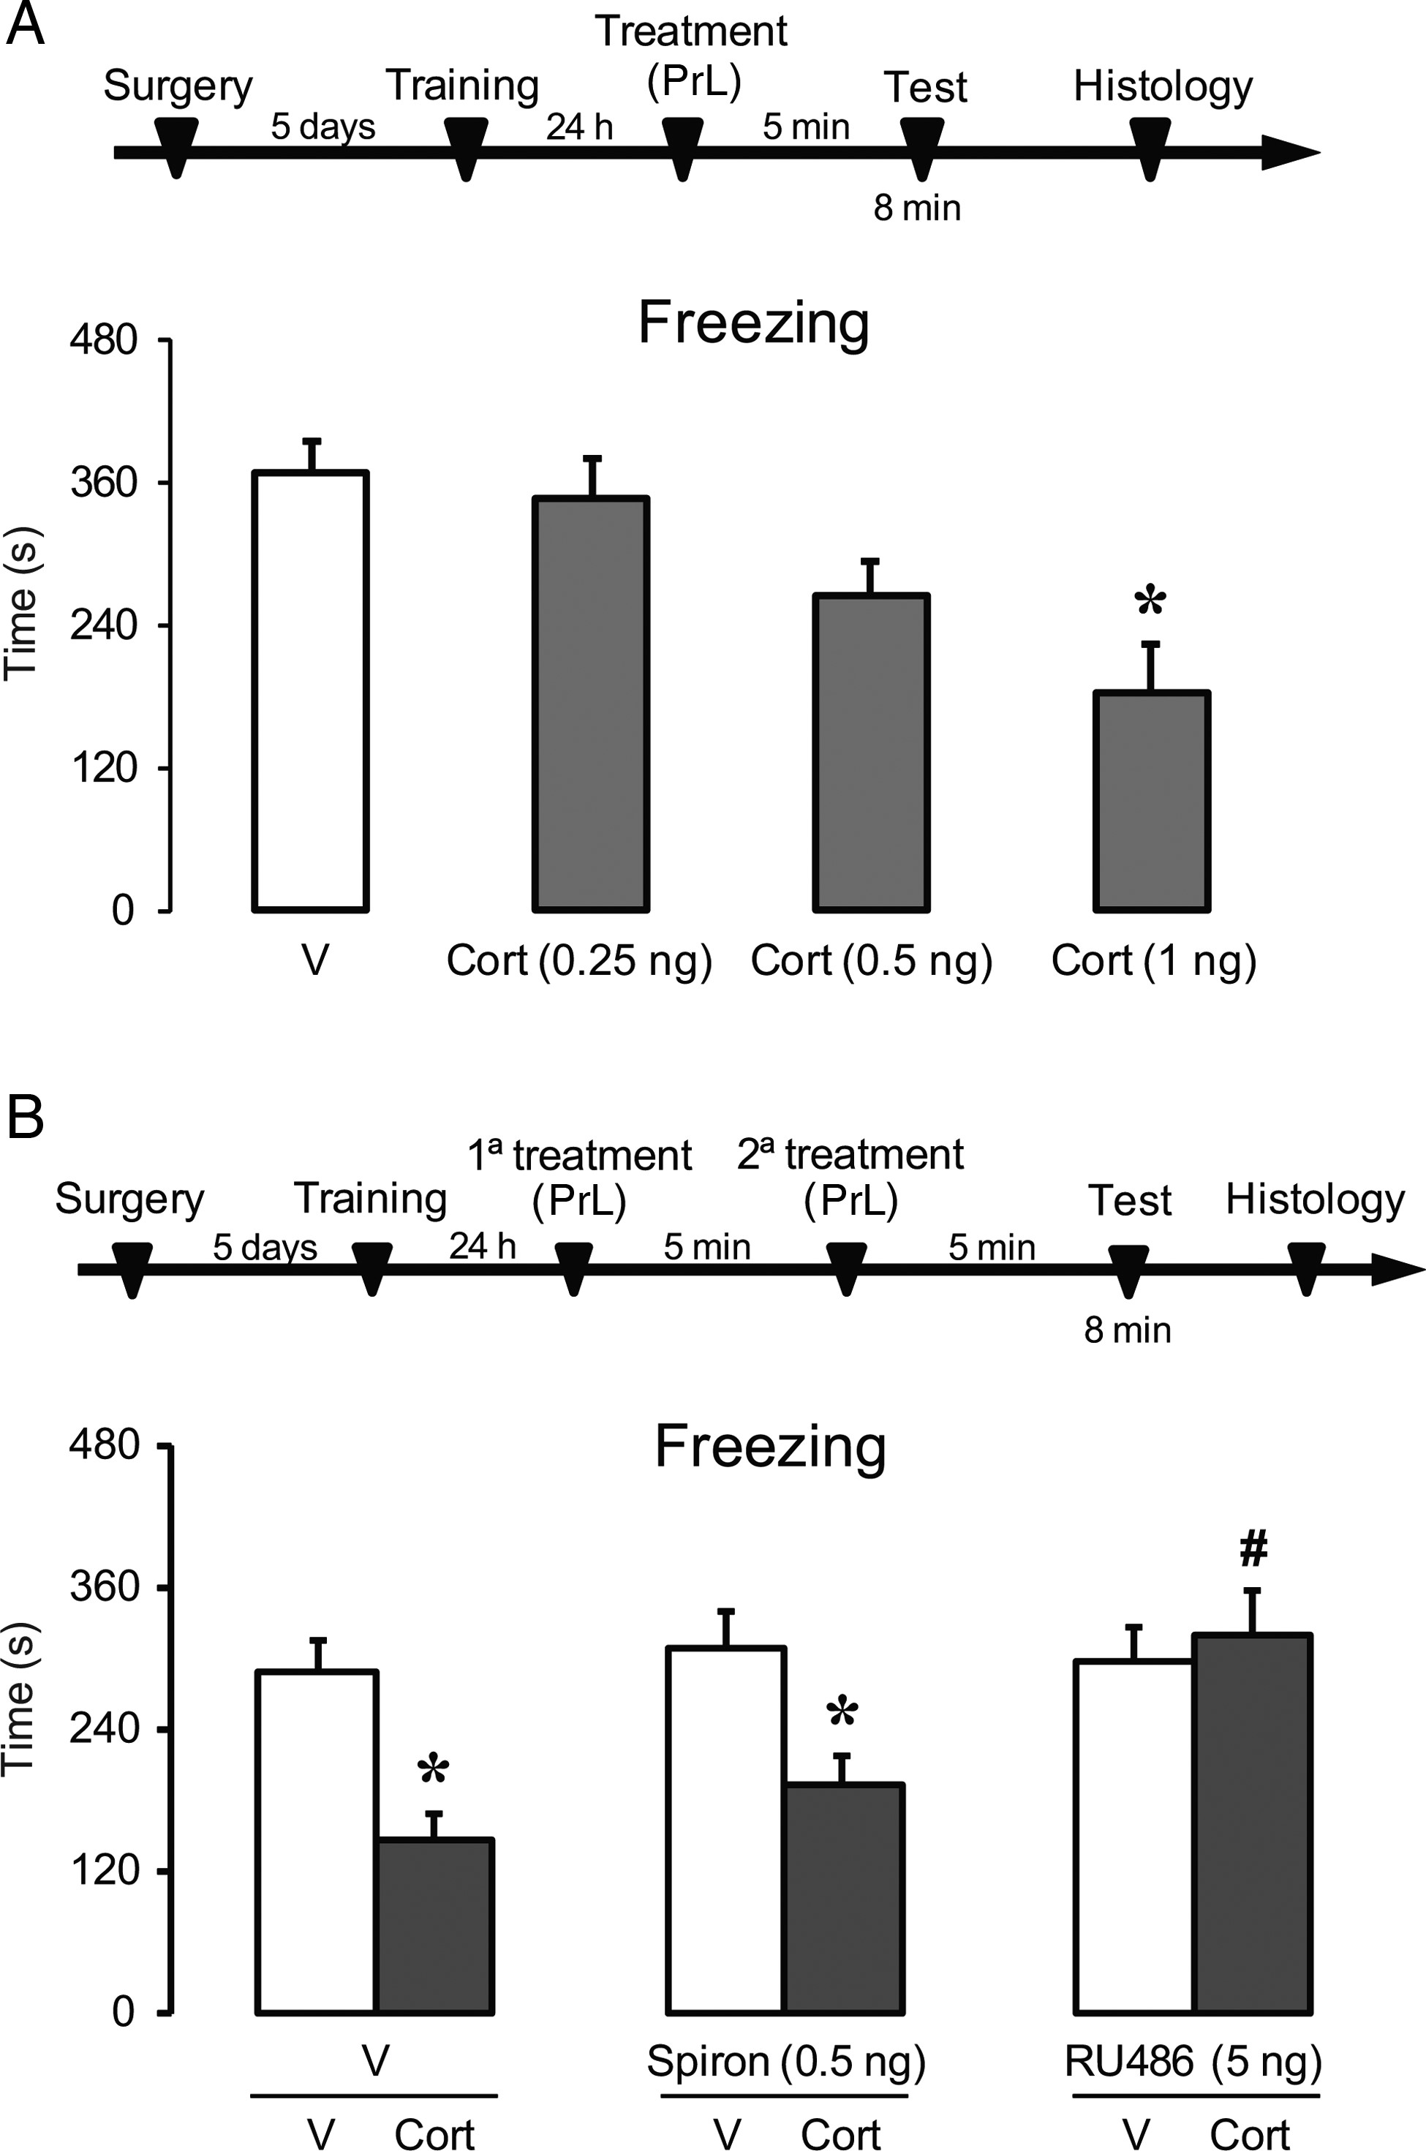
Figure 5. Effect of corticosterone and prior administration of spironolactone or RU38486 microinjected in the PrL in ...
Notes:
Figure 5. Effect of corticosterone and prior administration of spironolactone or RU38486 microinjected in the PrL in the expression of contextual fear conditioning. Average of freezing responses in rats treated with vehicle (n = 5) or corticosterone at doses of 0.25 ng (n = 5), 0.5 ng (n = 7), or 1 ng (n = 6) and exposed to the same context previously paired with footshocks (A). * Different from vehicle group (P < 0.05). Average freezing responses in rats treated with the combination of V + V, (n = 7); V + Cort (1 ng), (n = 7); Spiron (0.5 ng) + V, (n = 7); Spiron (0.5 ng) + Cort (1 ng), (n = 6); RU38486 (5 ng) + V, (n = 7); and RU38486 (5 ng) + Cort (1 ng), (n = 7) and exposed to the same context previously paired with footshocks (B). * Different from V + V, Spiron (0.5 ng) + V, and V + RU38486 (5 ng) groups. # Different from the V + Cort (1 ng) and Spiron (0.5 ng) + Cort (1 ng) groups (P < 0.05). V, vehicle; Spiron, spironolactone; Cort, corticosterone.
Unless provided in the caption above, the following copyright applies to the content of this slide: © The Author 2015. Published by Oxford University Press. All rights reserved. For Permissions, please e-mail: journals.permissions@oup.com

