Slide 1
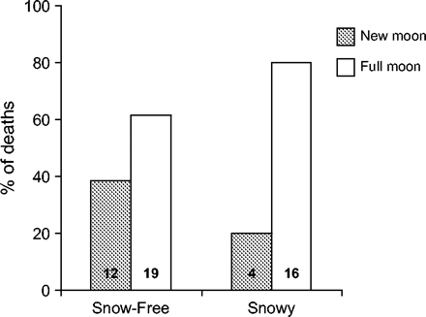
Figure 1 Observed mortality under two moon-phase categories. More snowshoe hares died during the 14 days around full ...
Notes:
Figure 1 Observed mortality under two moon-phase categories. More snowshoe hares died during the 14 days around full moons (white bars) than the 15.5 days around new moons (gray bars). The number of deaths under the full moon was significantly higher when the ground was snowy (right pair; n = 20; χ2 = 7.2; p = .0073) but not when it was snow free (left pair; n = 31; χ2 = 1.58; p = .21). The sample size for each moon and season category based on a 7-day uncertainty interval is shown on each bar.
Unless provided in the caption above, the following copyright applies to the content of this slide: © The Author 2005. Published by Oxford University Press on behalf of the International Society for Behavioral Ecology. All rights reserved. For permissions, please e-mail: journals.permissions@oupjournals.org

Slide 2
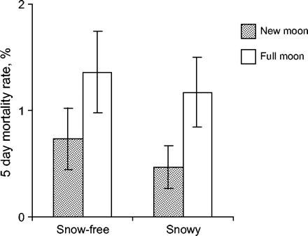
Figure 2 Estimated 5-day predation risk in different moon phases and seasons. Predation risk was higher in the 5 days ...
Notes:
Figure 2 Estimated 5-day predation risk in different moon phases and seasons. Predation risk was higher in the 5 days centered on the full moon (white bars), compared with the new moon (gray bars). Full moons were relatively more risky when the ground was snowy (right pair) than when it was snow free (left pair). Estimates are ± 1 SE.
Unless provided in the caption above, the following copyright applies to the content of this slide: © The Author 2005. Published by Oxford University Press on behalf of the International Society for Behavioral Ecology. All rights reserved. For permissions, please e-mail: journals.permissions@oupjournals.org

Slide 3
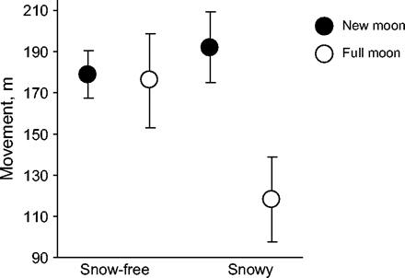
Figure 3 Estimated movement distances for snowshoe hares under new moons (dark circles) and full moons (open circles) ...
Notes:
Figure 3 Estimated movement distances for snowshoe hares under new moons (dark circles) and full moons (open circles) in different seasons. Snowshoe hares reduced movement under full moons when conditions were snowy (right pair) but not when conditions were snow free (left pair). Estimates are ± 1 SE.
Unless provided in the caption above, the following copyright applies to the content of this slide: © The Author 2005. Published by Oxford University Press on behalf of the International Society for Behavioral Ecology. All rights reserved. For permissions, please e-mail: journals.permissions@oupjournals.org

