Slide 1
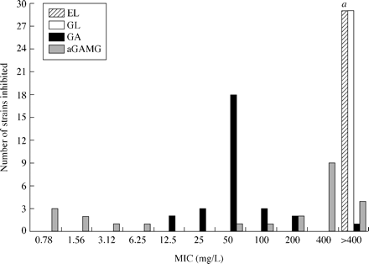
Figure 1. MIC (mg/L) distribution of Extractum liquiritiae (EL), glycyrrhizic acid (GL), glycyrrhetinic acid (GA) and ...
Notes:
Figure 1. MIC (mg/L) distribution of Extractum liquiritiae (EL), glycyrrhizic acid (GL), glycyrrhetinic acid (GA) and acetylated glycyrrhetinic acid monoglucuronide (aGAMG) for 29 H. pylori strains. αThe MIC values of EL were >1600 and 800 mg/L for 21 and one of H. pylori strains, respectively. For EL, the maximum concentration was 1600 mg/L for 22 of the 29 tested strains, for all other compounds it was 400 mg/L for all strains.
Unless provided in the caption above, the following copyright applies to the content of this slide: JAC vol.54 no.1 © The British Society for Antimicrobial Chemotherapy 2004; all rights reserved.

Slide 2
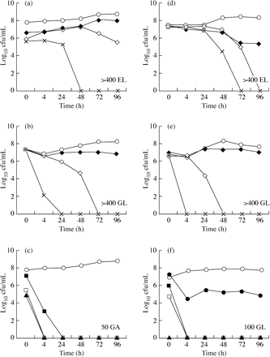
Figure 2. Time–kill analysis of Extractum liquiritiae (EL), glycyrrhizic acid (GL) and glycyrrhetinic acid (GA) against ...
Notes:
Figure 2. Time–kill analysis of Extractum liquiritiae (EL), glycyrrhizic acid (GL) and glycyrrhetinic acid (GA) against two H. pylori (Hp) isolates (selected data). Left three panels (a, b and c) Hp 311; right three panels (d, e and f) Hp 287; (a, d) and (b, e) results for EL and GL, respectively, at concentrations (mg/L) of 400 (filled diamonds), 800 (open diamonds) and 1600 (crosses); (c, f) results for GA at 0.5 × MIC (filled circles) [examined only in Hp 287 isolate (f)], 1 × MIC (filled squares), 2 × MIC (open squares) and 4 × MIC (filled triangles). Control (open circles), bacterial suspension without addition of non-antibiotic compounds, containing either DMSO or NaOH at the concentration used. The MICs (shown in bottom right corner of each plot) of GA for Hp 311 (c) and Hp 287 (f) were 50 and 100 mg/L, respectively; MICs of EL (a, d) and GL (b, e) were >400 mg/L for both isolates.
Unless provided in the caption above, the following copyright applies to the content of this slide: JAC vol.54 no.1 © The British Society for Antimicrobial Chemotherapy 2004; all rights reserved.

