Slide 1
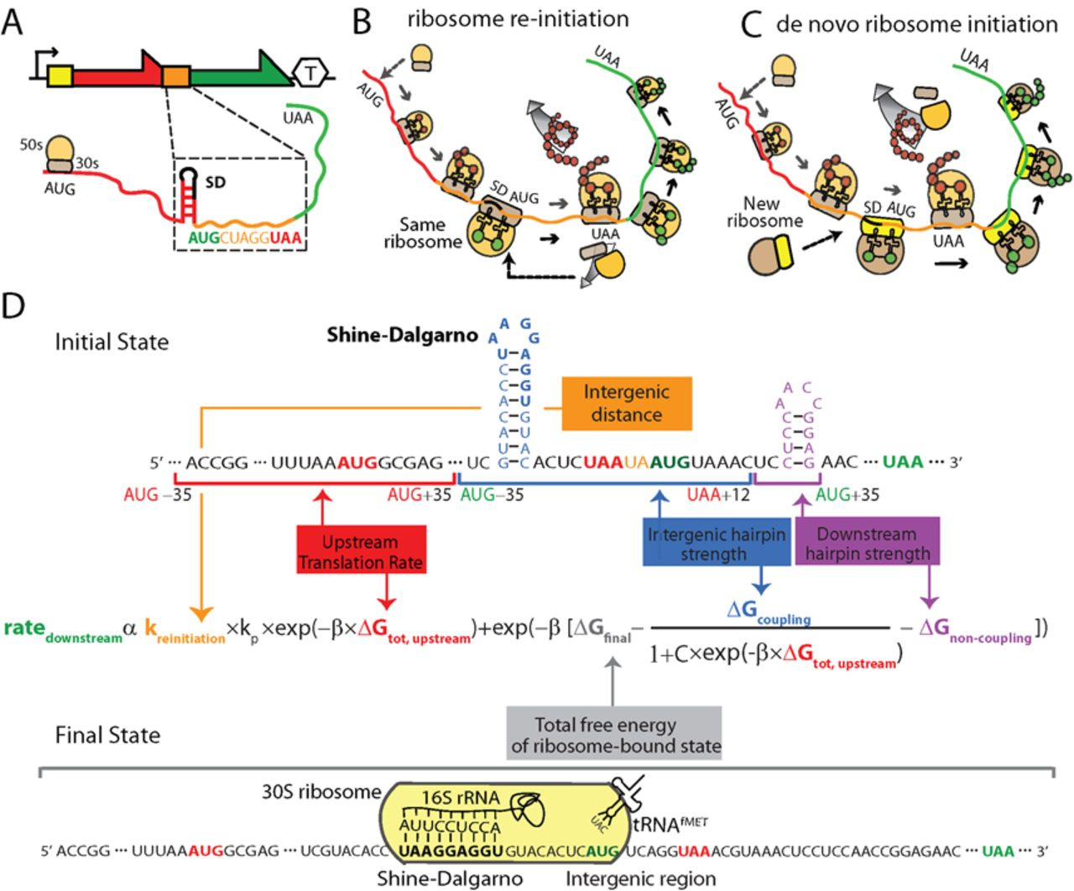
Figure 1. A Mechanistic Model of Translational Coupling. (A) Translation of a bi-cistronic operon. The schematic shows ...
Notes:
Figure 1. A Mechanistic Model of Translational Coupling. (A) Translation of a bi-cistronic operon. The schematic shows the (black arrow) promoter, the (yellow box) 5′ UTR, the (red) upstream coding sequence, the (orange box) intergenic region, the (green) downstream coding sequence, and the (hexagon) transcriptional terminator. The intergenic region contains an inhibitory RNA structure, a Shine-Dalgarno (SD) sequence, and overlapping coding sequences. (B) Ribosome re-initiation occurs when an upstream elongating ribosome dissociates and reassembles at an intergenic region, followed by translation initiation of the downstream coding sequence. (C) Ribosome de novo initiation occurs when cytosolic ribosomes assemble onto the mRNA at intergenic regions and initiate translation of the downstream coding sequence. (D) The proposed biophysical model of translational coupling quantifies the molecular interactions that control both ribosome re-initiation and de novo initiation rates according to an inputted mRNA sequence. Model components and their corresponding sequence region are color coded, including the free energies of inhibitory RNA structures (coupled and non-coupled), the intergenic distance, the free energy of the ribosome-bound state, and the upstream coding sequence's translation rate.
Unless provided in the caption above, the following copyright applies to the content of this slide: © The Author(s) 2015. Published by Oxford University Press on behalf of Nucleic Acids Research.This is an Open Access article distributed under the terms of the Creative Commons Attribution License (http://creativecommons.org/licenses/by-nc/4.0/), which permits non-commercial re-use, distribution, and reproduction in any medium, provided the original work is properly cited. For commercial re-use, please contact journals.permissions@oup.com

Slide 2
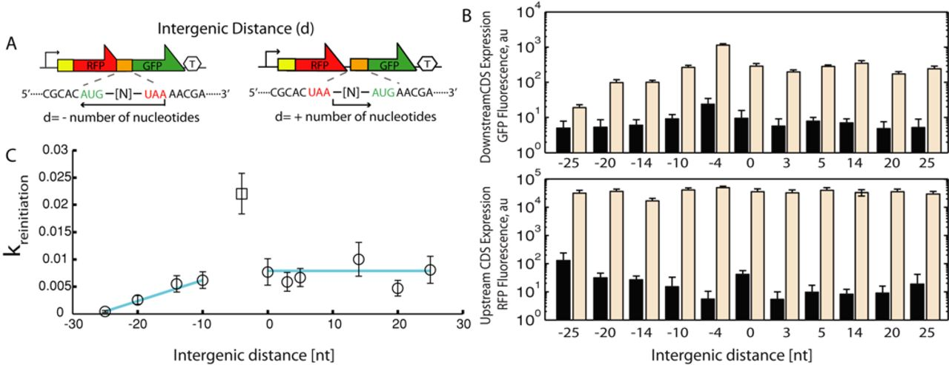
Figure 2. Measuring and modeling ribosome re-initiation rates. (A) The intergenic distance is calculated according to ...
Notes:
Figure 2. Measuring and modeling ribosome re-initiation rates. (A) The intergenic distance is calculated according to the positions of the stop and start codons in the upstream and downstream coding sequences, respectively, within rationally designed bi-cistronic operons. (B) Fluorescence measurements show the expression levels of the (bottom) mRFP1 and (top) GFPmut3b reporters after the mRFP1 translation rates were modified to be either (black bars) very low or (beige) very high. (C) Analysis of these measurements reveals how the re-initiation coefficient (kreinitiation) depends on intergenic distance according to a three parameter model (R2 = 0.91, P = 5.94 × 10−12). Values and error bars are the mean and SD of at least two replicates.
Unless provided in the caption above, the following copyright applies to the content of this slide: © The Author(s) 2015. Published by Oxford University Press on behalf of Nucleic Acids Research.This is an Open Access article distributed under the terms of the Creative Commons Attribution License (http://creativecommons.org/licenses/by-nc/4.0/), which permits non-commercial re-use, distribution, and reproduction in any medium, provided the original work is properly cited. For commercial re-use, please contact journals.permissions@oup.com

Slide 3
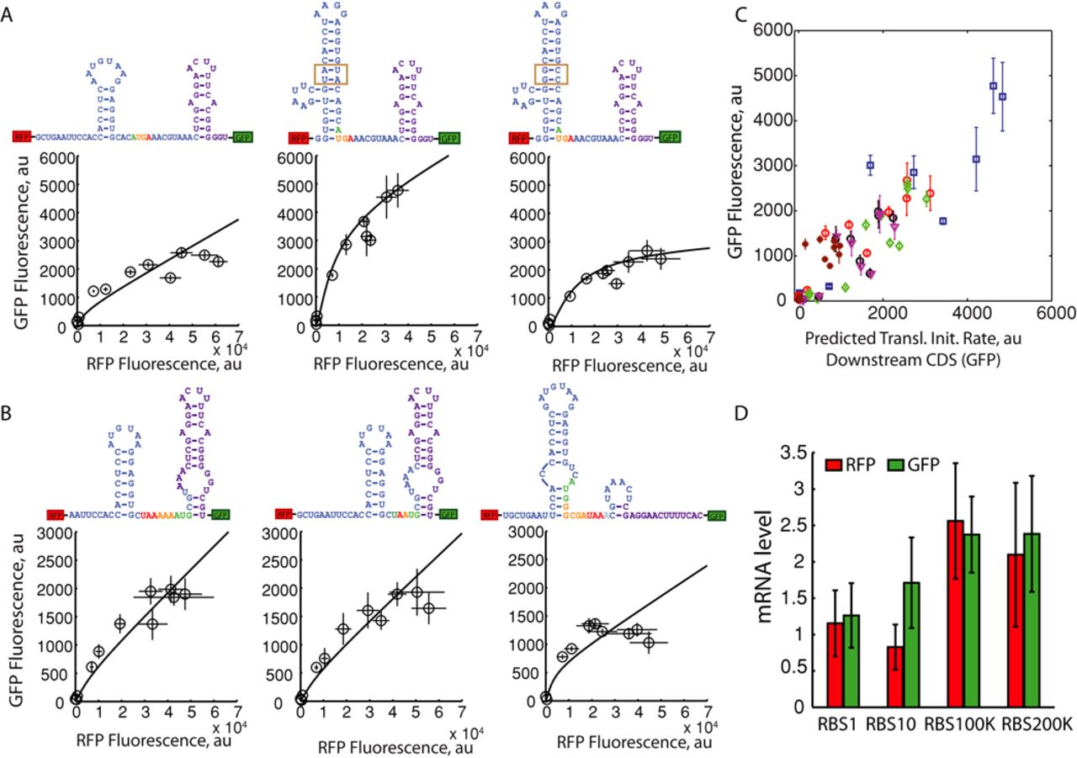
Figure 3. Predicting translational coupling in bi-cistronic operons. The intergenic regions of bi-cistronic reporter ...
Notes:
Figure 3. Predicting translational coupling in bi-cistronic operons. The intergenic regions of bi-cistronic reporter operons were designed and characterized to quantitatively determine how inhibitory RNA structures control translational coupling. (black lines) Biophysical model predictions using C = 0.81 and kP = 10 are shown alongside (black circles) upstream mRFP1 and downstream GFPmut3b expression level measurements as mRFP1 translation rates are systematically increased. Nucleotide colors are the same as in Figure 1. (A) Calculated ΔGcoupling (ΔGnon-coupling) free energies are −5.3 (−20.1), −12.6 (−16.3) and −16.9 (−16.3) kcal/mol, respectively. Boxes highlight a four nucleotide mutation between two operon variants. (B) Three additional bicistronic operons were designed with varying intergenic distances (d = +3, −1 and −11, respectively) and inhibitory RNA structures. Calculated ΔGcoupling (ΔGnon-coupling) free energies are −8.9 (−12.6), −8.9 (−9.8) and −11.1 (−17.7) kcal/mol, respectively. (C) Predicted translation initiation rates are compared to measured downstream CDS (GFPmut3b) expression levels. The apparent proportionality factors are (blue squares, pTTBd-4-13) 9.8, (red circles, pTTBd-4-17) 5.5, (green diamonds, pTTBd-4-5) 17.3, (black circles, pTTBd3-9) 31.0, (pink triangles, pTTBd-1-9) 30.8 and (brown stars, pTTBd-11-11) 4.3 with Pearson coefficients R2 of 0.85 (P = 5 × 10−5), 0.86 (P = 8 × 10−6), 0.84 (P = 3 × 10−5), 0.77 (P = 2 × 10−4), 0.74 (P = 4 × 10−4) and 0.60 (P = 0.0069), respectively. Values and error bars are the mean and SD of three replicates. (D) The mRNA levels of the mRFP1 and gfpmut3b coding sequences within four variants of the bi-cistronic operon pTTBd-4-17 were measured as the mRFP1 translation rates were increased from 1 to 200 000 au on the RBS Calculator proportional scale, showing the effects of upstream translation on mRNA stability in an operon. Values and error bars are the mean and SD of at least two replicates.
Unless provided in the caption above, the following copyright applies to the content of this slide: © The Author(s) 2015. Published by Oxford University Press on behalf of Nucleic Acids Research.This is an Open Access article distributed under the terms of the Creative Commons Attribution License (http://creativecommons.org/licenses/by-nc/4.0/), which permits non-commercial re-use, distribution, and reproduction in any medium, provided the original work is properly cited. For commercial re-use, please contact journals.permissions@oup.com

Slide 4
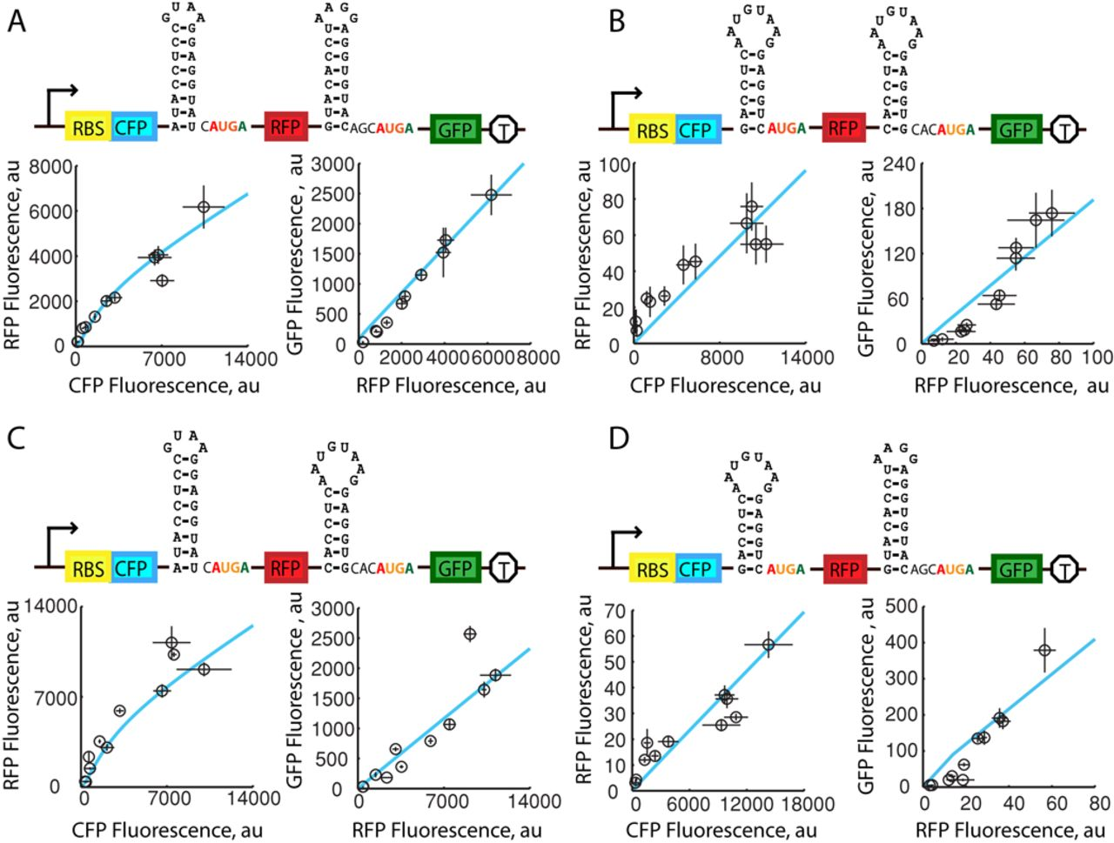
Figure 4. Expression measurements of tri-cistronic operons. The intergenic regions of four tri-cistronic operons were ...
Notes:
Figure 4. Expression measurements of tri-cistronic operons. The intergenic regions of four tri-cistronic operons were rationally designed and characterized to evaluate the biophysical model's predictions. (blue lines) Biophysical model predictions using C = 0.81 and kP = 10 are shown alongside (black circles) expression level measurements of CFP, mRFP1, GFPmut3b reporters as the cfp translation rates are systematically increased. Calculated ΔGcoupling (ΔGnon-coupling) free energies for the two intergenic regions are (A) −14.5 (−15.4) and −12.6 (−16.3); (B) −9.1 (−16.5) and −5.3 (−20.1); (C) −14.5 (−15.4) and −5.3 (−20.1); (D) −9.1 (−16.5) and −12.6 (−16.3) kcal/mol. All have intergenic distances d = −4. Values and error bars are the mean and SD of at least two replicates.
Unless provided in the caption above, the following copyright applies to the content of this slide: © The Author(s) 2015. Published by Oxford University Press on behalf of Nucleic Acids Research.This is an Open Access article distributed under the terms of the Creative Commons Attribution License (http://creativecommons.org/licenses/by-nc/4.0/), which permits non-commercial re-use, distribution, and reproduction in any medium, provided the original work is properly cited. For commercial re-use, please contact journals.permissions@oup.com

Slide 5
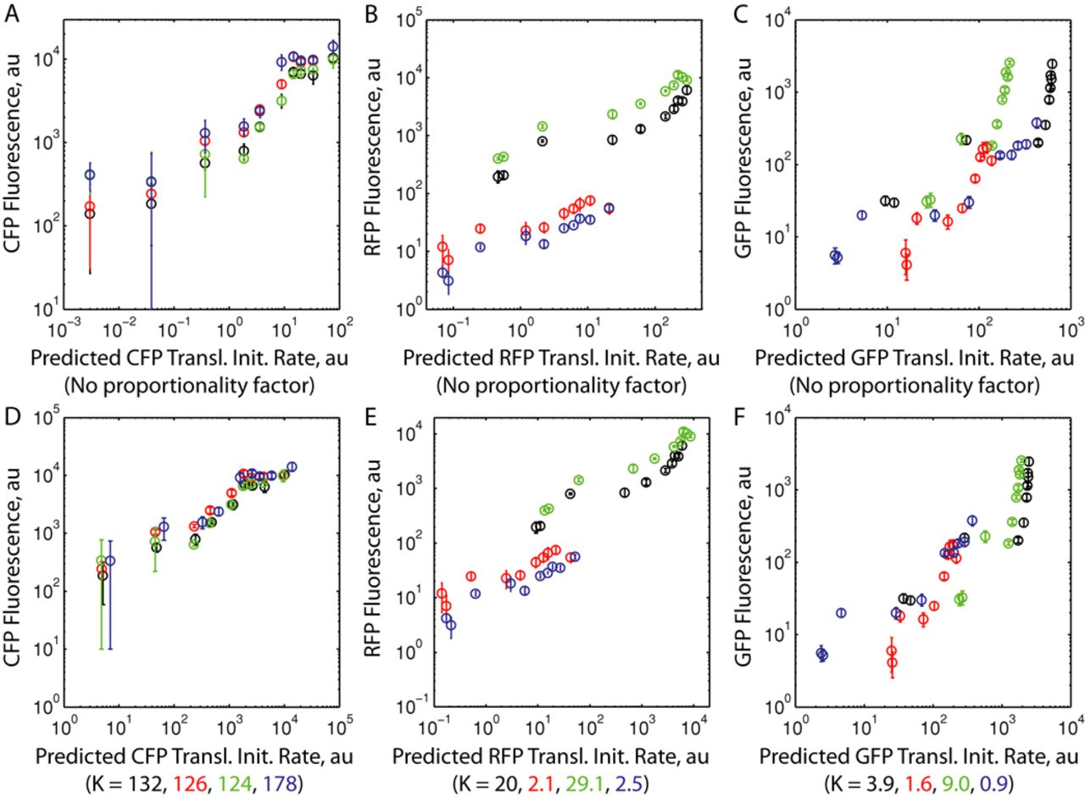
Figure 5. Biophysical model predictions for tri-cistronic operons. (A) A comparison between expression measurements of ...
Notes:
Figure 5. Biophysical model predictions for tri-cistronic operons. (A) A comparison between expression measurements of tricistronic operons and the biophysical model's predictions of translational coupling without using a proportionality factor. (B) The same comparison is performed after multiplying the predicted translation rates by proportionality factors as shown. Average Pearson R2 values for comparison are 0.67, 0.82 and 0.73, left-to-right respectively, and are unchanged by the value of the proportionality factor. Colors represent the operon variants (black) pTTTd-4-15-13, (red) pTTTd-4-9-5, (green) pTTTd-4-15–5 and (blue) pTTTd-4-9-13. Values and error bars are the mean and SD of at least two replicates.
Unless provided in the caption above, the following copyright applies to the content of this slide: © The Author(s) 2015. Published by Oxford University Press on behalf of Nucleic Acids Research.This is an Open Access article distributed under the terms of the Creative Commons Attribution License (http://creativecommons.org/licenses/by-nc/4.0/), which permits non-commercial re-use, distribution, and reproduction in any medium, provided the original work is properly cited. For commercial re-use, please contact journals.permissions@oup.com

Slide 6
Figure 6. Translational coupling parameters that control protein ratios. (A) Predicted rates of upstream and downstream ...
Notes:
Figure 6. Translational coupling parameters that control protein ratios. (A) Predicted rates of upstream and downstream CDS translation rates as an intergenic region's ΔGcoupling energy is varied. (B) The predicted relationship between translation rate ratios and ΔGcoupling when (ΔGfinal − ΔGnon-coupling) is −20 kcal/mol. (C) The predicted relationship between translation rate ratios and ΔGcoupling when (ΔGfinal − ΔGnon-coupling) is −10 kcal/mol. Circles and bars represent the mean and standard deviations of predictions when evaluated across a 10 000-fold range of upstream CDS translation rates.
Unless provided in the caption above, the following copyright applies to the content of this slide: © The Author(s) 2015. Published by Oxford University Press on behalf of Nucleic Acids Research.This is an Open Access article distributed under the terms of the Creative Commons Attribution License (http://creativecommons.org/licenses/by-nc/4.0/), which permits non-commercial re-use, distribution, and reproduction in any medium, provided the original work is properly cited. For commercial re-use, please contact journals.permissions@oup.com

