Slide 1
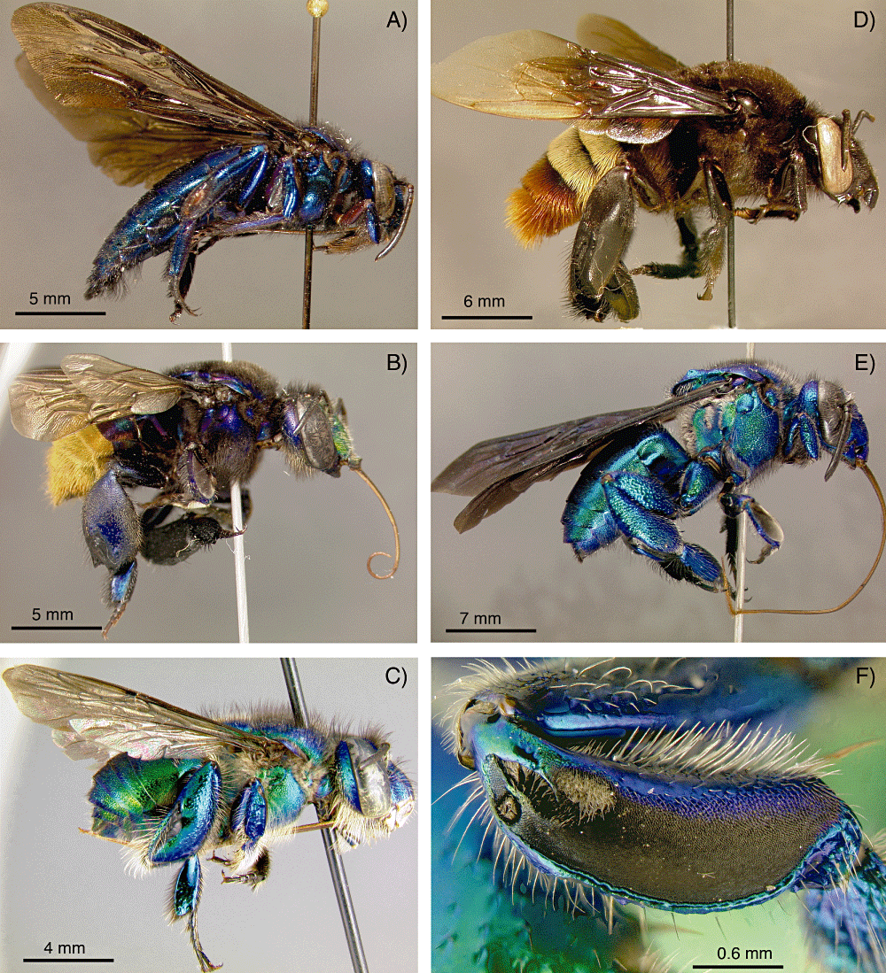
Figure 1. Representative species of each of the five orchid bee genera within the tribe Euglossini: A, Aglae caerulea; ...
Notes:
Figure 1. Representative species of each of the five orchid bee genera within the tribe Euglossini: A, Aglae caerulea; B, Eufriesea lucifera; C, Euglossa paisa; D, Eulaema meriana; E, Exaerete smaragdina. F, An example of a midtibia felty patch (of Euglossa paisa), showing the characters routinely used for species-level diagnosis based on male bees. Note the hindleg opening slit through which male bees deposit and store chemical fragrances.
Unless provided in the caption above, the following copyright applies to the content of this slide: © 2010 The Linnean Society of London

Slide 2
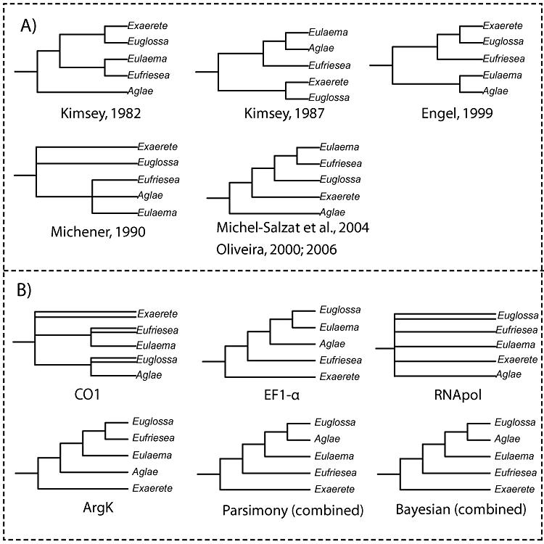
Figure 2. Summary of alternative hypotheses of the generic relationships among orchid bees proposed in previous studies ...
Notes:
Figure 2. Summary of alternative hypotheses of the generic relationships among orchid bees proposed in previous studies (A) and those supported by individual genes in this study (B).
Unless provided in the caption above, the following copyright applies to the content of this slide: © 2010 The Linnean Society of London

Slide 3
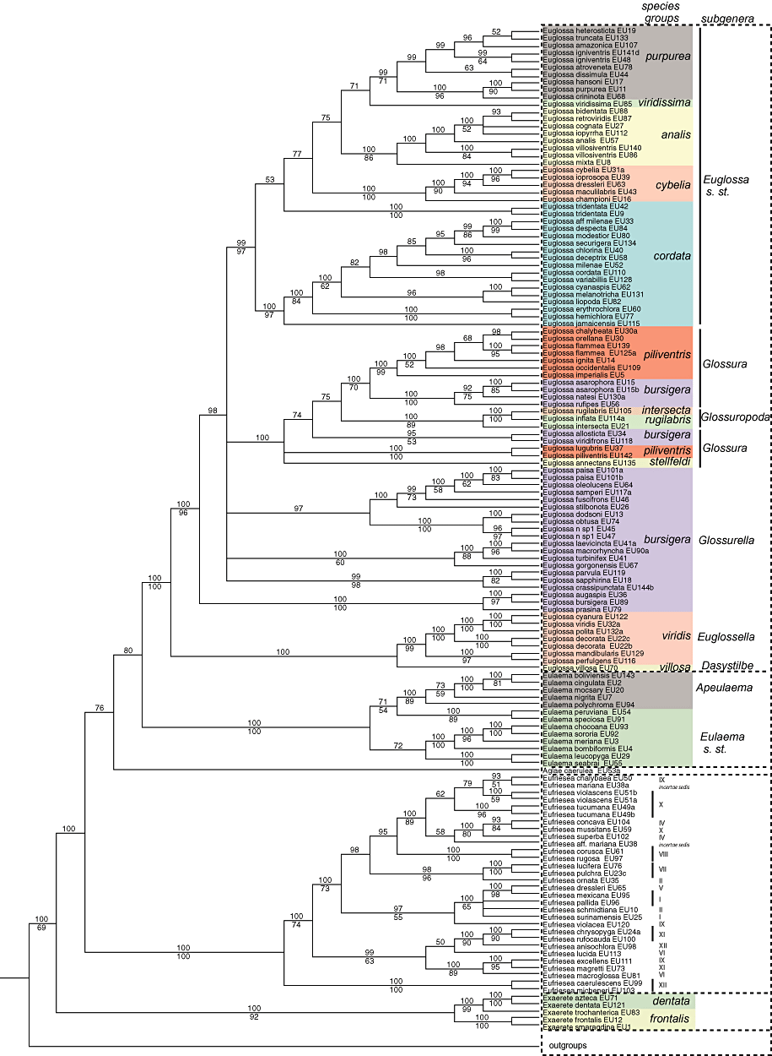
Figure 3. Bayesian cladogram of tribe Euglossini with mapped taxonomic schemes (subgenera and species' groups). Support ...
Notes:
Figure 3. Bayesian cladogram of tribe Euglossini with mapped taxonomic schemes (subgenera and species' groups). Support values below the branches were obtained via parsimony bootstrap; values above the branches correspond to Bayesian posterior probabilities.
Unless provided in the caption above, the following copyright applies to the content of this slide: © 2010 The Linnean Society of London

Slide 4
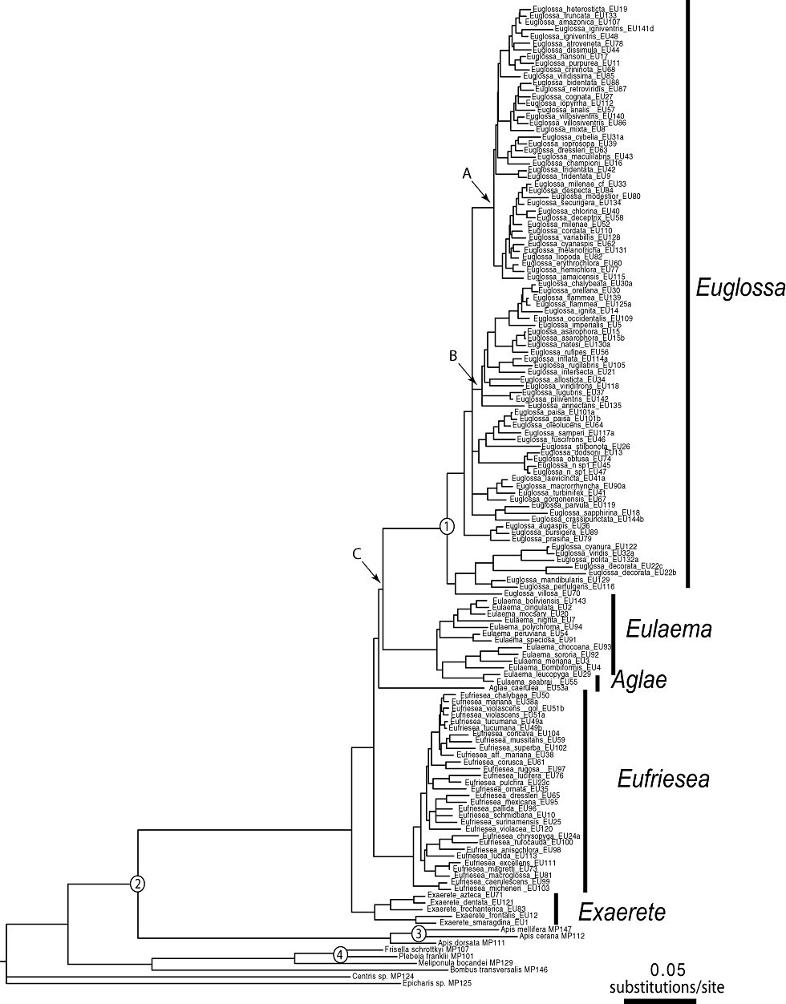
Figure 4. Phylogram of consensus tree obtained from a Bayesian tree search using a partitioned optimization model (see ...
Notes:
Figure 4. Phylogram of consensus tree obtained from a Bayesian tree search using a partitioned optimization model (see text for details). Branch lengths were calculated via maximum likelihood under a GTR + I + Γ model of sequence evolution. Numbers indicate the position of fossil calibrations; letters indicate nodes referred to in Supporting Information Table S2.
Unless provided in the caption above, the following copyright applies to the content of this slide: © 2010 The Linnean Society of London

Slide 5
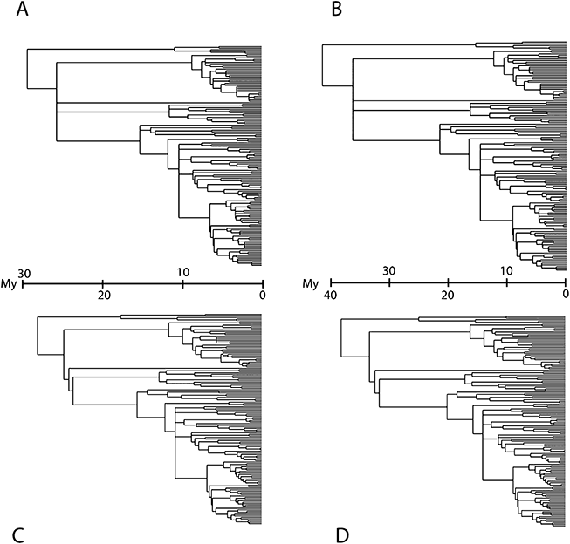
Figure 5. Chronograms of orchid bees obtained via minimum path length (A, B) and penalized likelihood (C, D) employing ...
Notes:
Figure 5. Chronograms of orchid bees obtained via minimum path length (A, B) and penalized likelihood (C, D) employing the younger minimum ages (A, C) and older ages (B, D) of fossils used to calibrate molecular clocks.
Unless provided in the caption above, the following copyright applies to the content of this slide: © 2010 The Linnean Society of London

Slide 6
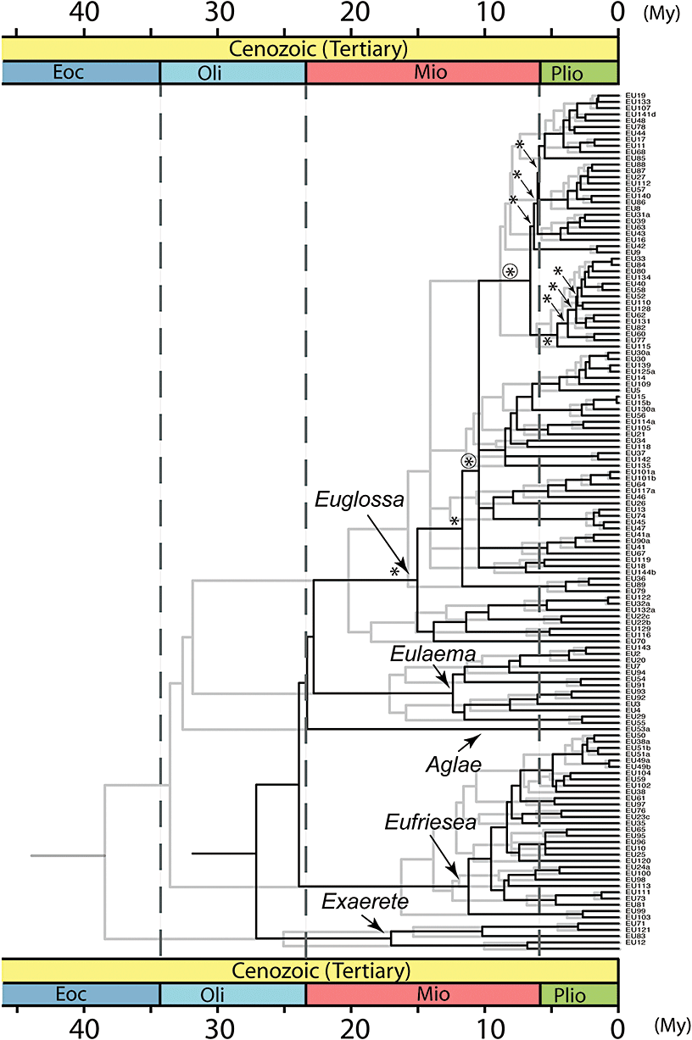
Figure 6. Fossil-calibrated chronogram of the tribe Euglossini, inferred from a single topology obtained via Bayesian ...
Notes:
Figure 6. Fossil-calibrated chronogram of the tribe Euglossini, inferred from a single topology obtained via Bayesian methods (see text), and calibrated via penalized likelihood with two sets of age constraints corresponding to the younger (darker lines) and older (lighter lines) fossil age boundaries. Asterisks subtend the nodes for which a diversification increase was noted using the relative cladogenesis test, even when applying a Bonferroni correction (circled asterisks).
Unless provided in the caption above, the following copyright applies to the content of this slide: © 2010 The Linnean Society of London

Slide 7
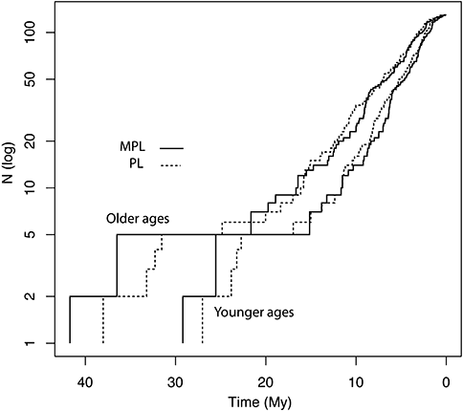
Figure 7. Semi-logarithmic lineage-through-time (LTT) plot depicting diversification patterns of orchid bees. LTT plots ...
Notes:
Figure 7. Semi-logarithmic lineage-through-time (LTT) plot depicting diversification patterns of orchid bees. LTT plots obtained via penalized likelihood (PL) and minimum path length (MPL) are superimposed for comparison. Two sets of ages were used to calibrate the molecular clock analysis: those corresponding to older and younger age boundaries for each fossil record used in the calibration of the molecular clock.
Unless provided in the caption above, the following copyright applies to the content of this slide: © 2010 The Linnean Society of London

Slide 8
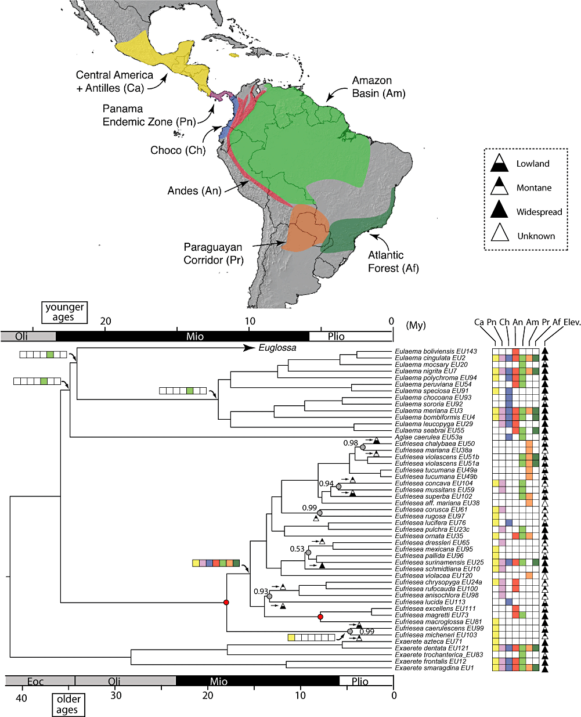
Figure 8. Dated chronogram of orchid bees (split into two panels) showing extant and selected reconstructed ...
Notes:
Figure 8. Dated chronogram of orchid bees (split into two panels) showing extant and selected reconstructed geographical and altitudinal range distributions. Estimated model-based LAGRANGE ancestral splits are shown only for selected nodes, together with their relative probabilities.
Unless provided in the caption above, the following copyright applies to the content of this slide: © 2010 The Linnean Society of London

Slide 9
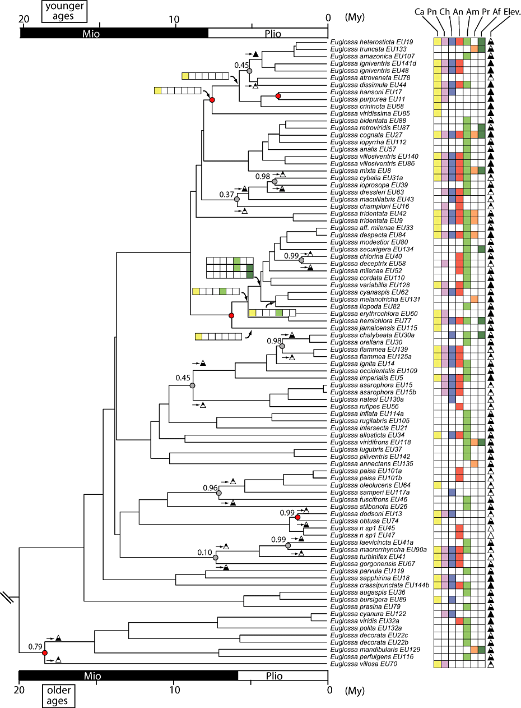
Figure 8. Dated chronogram of orchid bees (split into two panels) showing extant and selected reconstructed ...
Notes:
Figure 8. Dated chronogram of orchid bees (split into two panels) showing extant and selected reconstructed geographical and altitudinal range distributions. Estimated model-based LAGRANGE ancestral splits are shown only for selected nodes, together with their relative probabilities.
Unless provided in the caption above, the following copyright applies to the content of this slide: © 2010 The Linnean Society of London

Slide 10
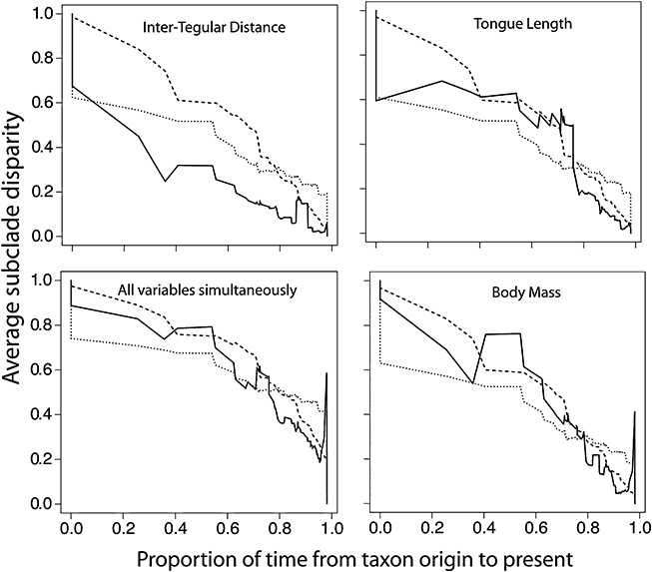
Figure 9. Disparity-through-time plot of morphological traits analysed both separately and simultaneously. Full lines ...
Notes:
Figure 9. Disparity-through-time plot of morphological traits analysed both separately and simultaneously. Full lines correspond to the empirical values, broken lines to the simulated Brownian motion null model and dotted lines to the simulated speciation null model.
Unless provided in the caption above, the following copyright applies to the content of this slide: © 2010 The Linnean Society of London

Slide 11
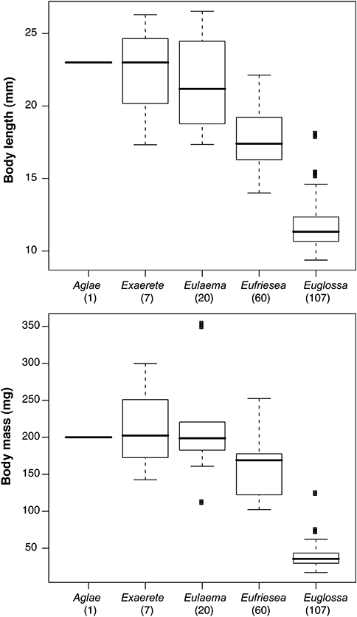
Figure 10. Boxplots of body mass and body size grouped by orchid bee genera. Numbers in parentheses indicate the ...
Notes:
Figure 10. Boxplots of body mass and body size grouped by orchid bee genera. Numbers in parentheses indicate the approximate number of total species within each clade.
Unless provided in the caption above, the following copyright applies to the content of this slide: © 2010 The Linnean Society of London

