Slide 1
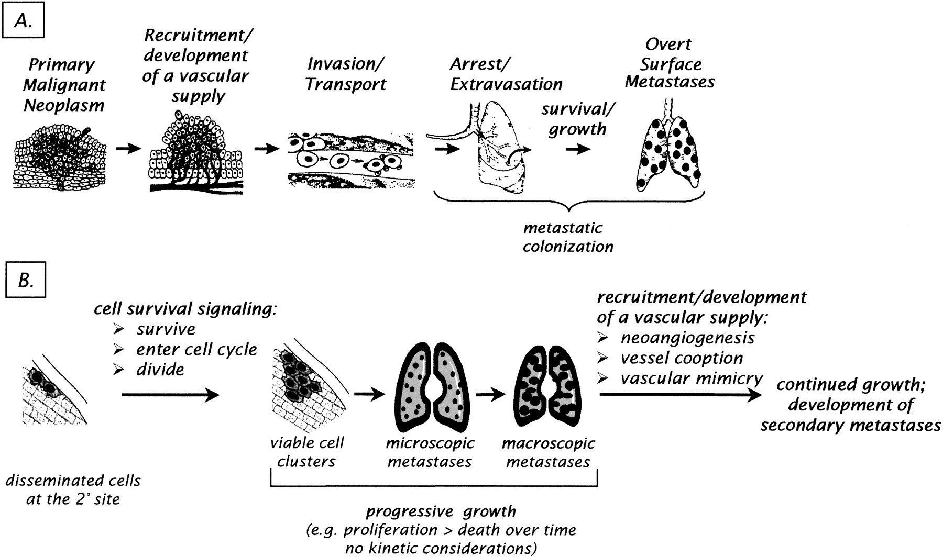
Fig. 1. Development of spontaneous hematogenous metastases. Panel A: The development of spontaneous hematogenous ...
Notes:
Fig. 1. Development of spontaneous hematogenous metastases. Panel A: The development of spontaneous hematogenous metastases requires cancer cells to complete a well-defined series of steps. This figure is adapted from (13).Panel B: To form overt metastases, disseminated cells must complete additional steps at the metastatic site(s).
Unless provided in the caption above, the following copyright applies to the content of this slide: © Oxford University Press

Slide 2
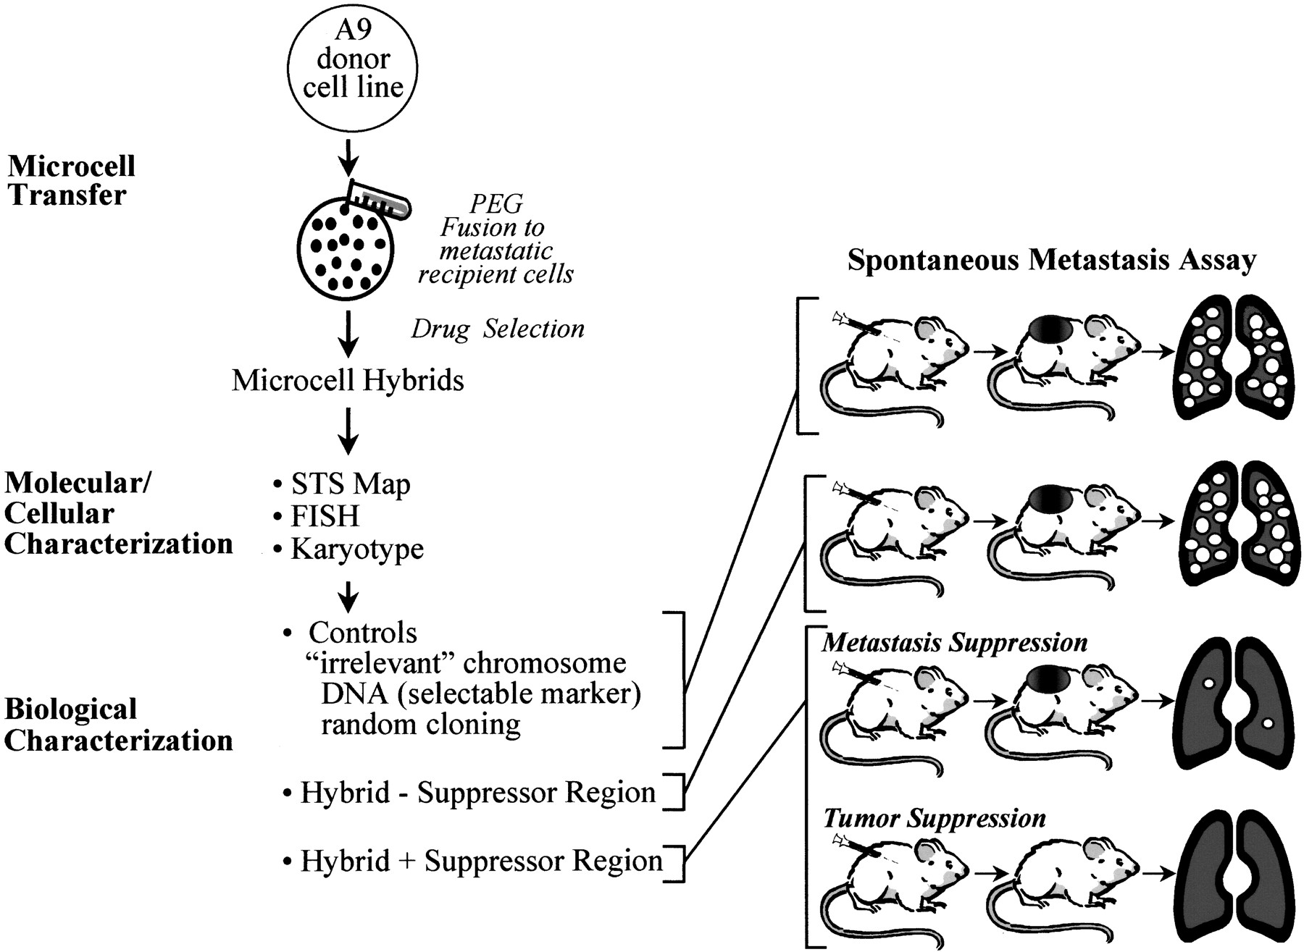
Fig. 2. Identification of metastasis-suppressor activities by use of microcell-mediated chromosomal transfer. A9 ...
Notes:
Fig. 2. Identification of metastasis-suppressor activities by use of microcell-mediated chromosomal transfer. A9 donor cells containing a single human chromosome are used for the preparation of microcells that will be transferred to the recipient cell lines. Stable microcell hybrids are selected and characterized by molecular and cellular methods. To screen the microcell hybrids for the minimal metastasis-suppressor region, one employs the following techniques: FISH, karyotyping, and PCR amplification for human specific sequences using STS markers. Ultimately, the presence or absence of a suppressor region is determined by subcutaneous injection of the hybrids into the flanks of immunodeficient mice (63). Inclusion of a variety of controls is critical for the definition of metastasis-suppressor activity in vivo. The potential outcomes of in vivo studies using control, suppressed, and unsuppressed hybrids are illustrated at left. FISH = fluorescence in situ hybridization, PCR = polymerase chain reaction, STS = sequence-tagged site, and PEG = polyethylene glycol.
Unless provided in the caption above, the following copyright applies to the content of this slide: © Oxford University Press

Slide 3
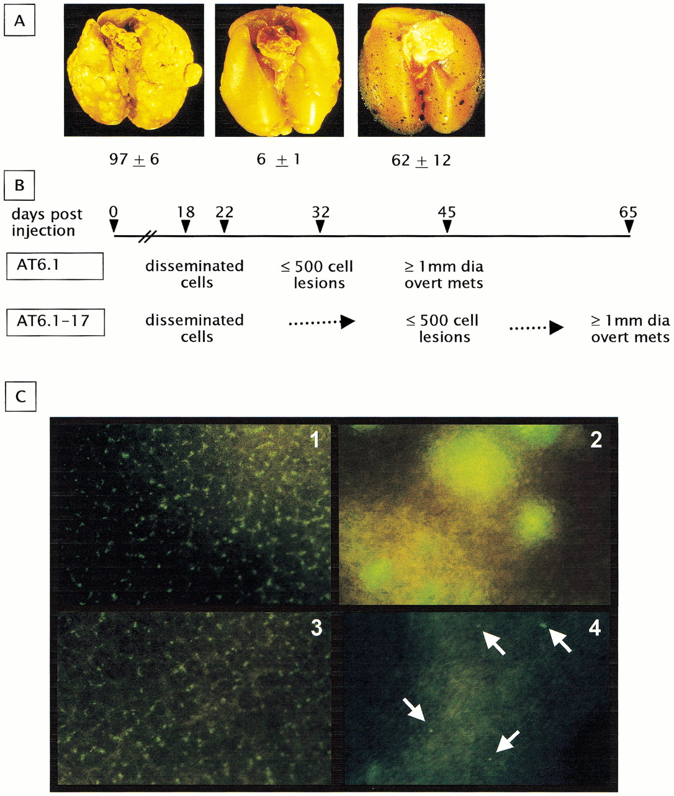
Fig. 3. Examination of the mechanism of metastasis suppression by chromosome 17 and 6. A) Quantification of overt ...
Notes:
Fig. 3. Examination of the mechanism of metastasis suppression by chromosome 17 and 6. A) Quantification of overt surface metastases and micrometastases. AT6.1 cells are highly metastatic rat prostate cancer cells. AT6.1–17-Tβgal cells contain the metastasis-suppressor region of human chromosome 17 and are tagged with a β-galactosidase reporter gene enabling the sensitive detection of microscopic metastases. The numbers of overt and microscopic metastases were determined by use of Bouin's fixation and β-galactosidase activity, respectively. At the experimental end point, lungs were removed from tumor-bearing animals. Left—lung from AT6.1 tumor-bearing animal stained with Bouin's solution; middle—lung from AT6.1–17-Tβgal tumor-bearing animal stained with Bouin's solution; and right—lung from AT6.1–17-Tβgal tumor-bearing animal stained for β-galactosidase activity. The average number of overt or microscopic metastases and standard error are shown below the panels. This figure is adapted from (139).B) A combination of techniques has been used to examine the time course of cancer cell dissemination and growth in suppressed AT6.1–17 cells as compared with metastatic AT6.1 parental cells. These data indicate that genes encoded by chromosome 17 inhibit a step in metastatic colonization. C) Photomicrographs of mouse lung following intravenous injection of green fluorescent protein-tagged C8161 and metastasis-suppressed neo6/C8161 cells (panel C3) are present. At 1 month, however, C8161 cells have proliferated to form macroscopic lung lesions (C2), but most neo6/C8161 cells have been cleared. Occasional single cells (C4, arrows) can be found in the lungs but fail to proliferate. These results imply that chromosome 6 suppresses metastasis by inhibiting the ability of C8161 cells to grow in the lung at an early stage of colonization (original magnification ×300). Data adapted from (144).
Unless provided in the caption above, the following copyright applies to the content of this slide: © Oxford University Press

