Slide 1
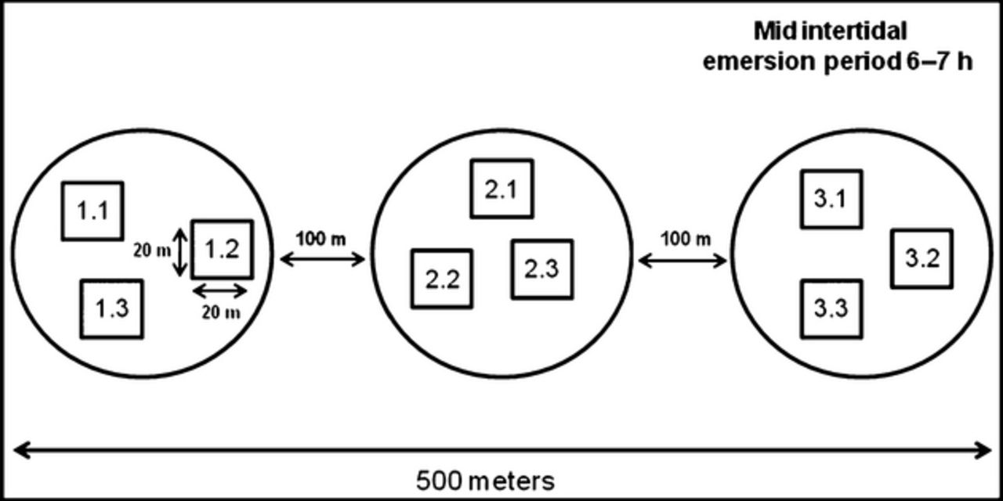
Experimental setup for sampling at the intertidal sandflat at Sylt (German Wadden Sea, simplified after ...
Notes:
Experimental setup for sampling at the intertidal sandflat at Sylt (German Wadden Sea, simplified after Volkenborn and Reise, 2007). Each sampling plot (circles) was sampled at three different locations (squares).
Unless provided in the caption above, the following copyright applies to the content of this slide: © 2011 Federation of European Microbiological Societies

Slide 2
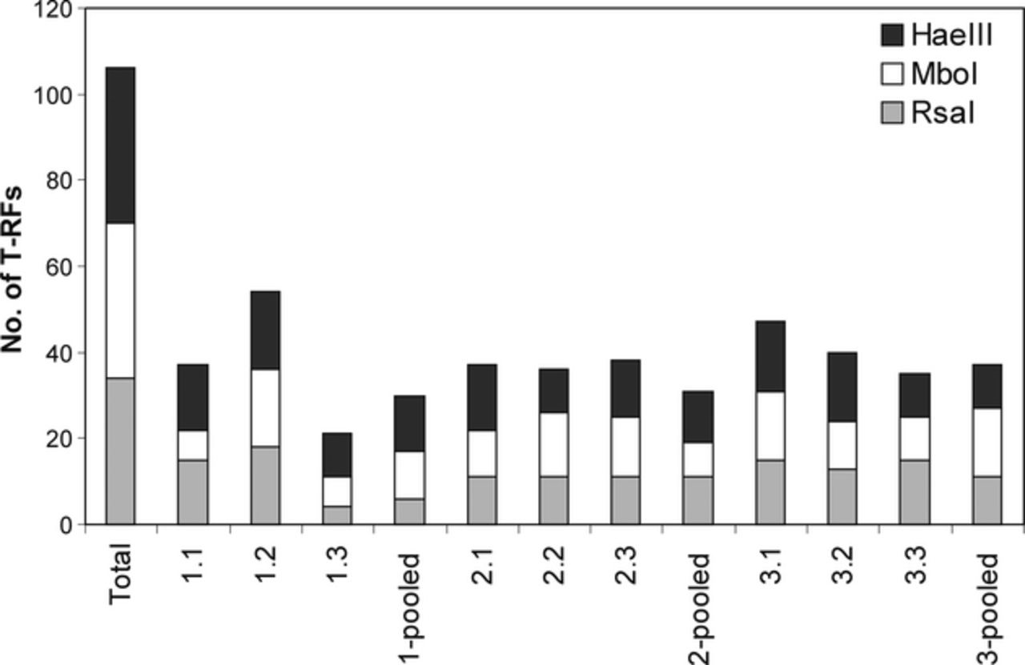
Phylotype diversity as detected by T-RFLP analyses. Numbers of obtained T-RFs are given in total as well as ...
Notes:
Phylotype diversity as detected by T-RFLP analyses. Numbers of obtained T-RFs are given in total as well as for each of the nine biological replicates and for the samples pooled per plot. Colors refer to the three different restriction enzymes applied (HaeIII, black; MboI, white; RsaI, gray).
Unless provided in the caption above, the following copyright applies to the content of this slide: © 2011 Federation of European Microbiological Societies

Slide 3
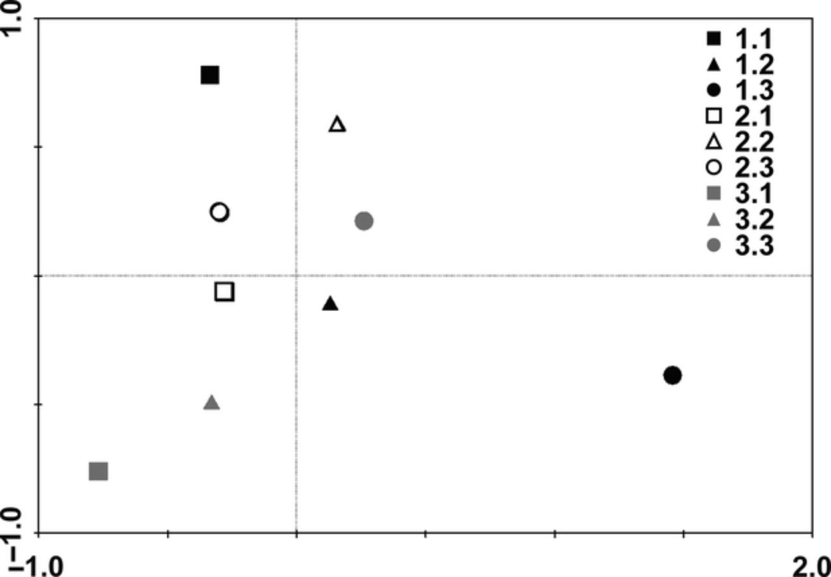
Analysis of ciliate community composition by means of the principal component analysis of the nine biological ...
Notes:
Analysis of ciliate community composition by means of the principal component analysis of the nine biological replicates. Filled symbols refer to biological replicates from the first plot (1.1, 1.2, 1.3), empty symbols to biological replicates from the second plot (2.1, 2.2, 2.3), and gray symbols to biological replicates from the third plot (3.1, 3.2, 3.3). Different symbols represent different biological replicates: square, first biological replicate (X.1); triangle, second biological replicate (X.2), and circle, third biological replicate (X.3).
Unless provided in the caption above, the following copyright applies to the content of this slide: © 2011 Federation of European Microbiological Societies

Slide 4
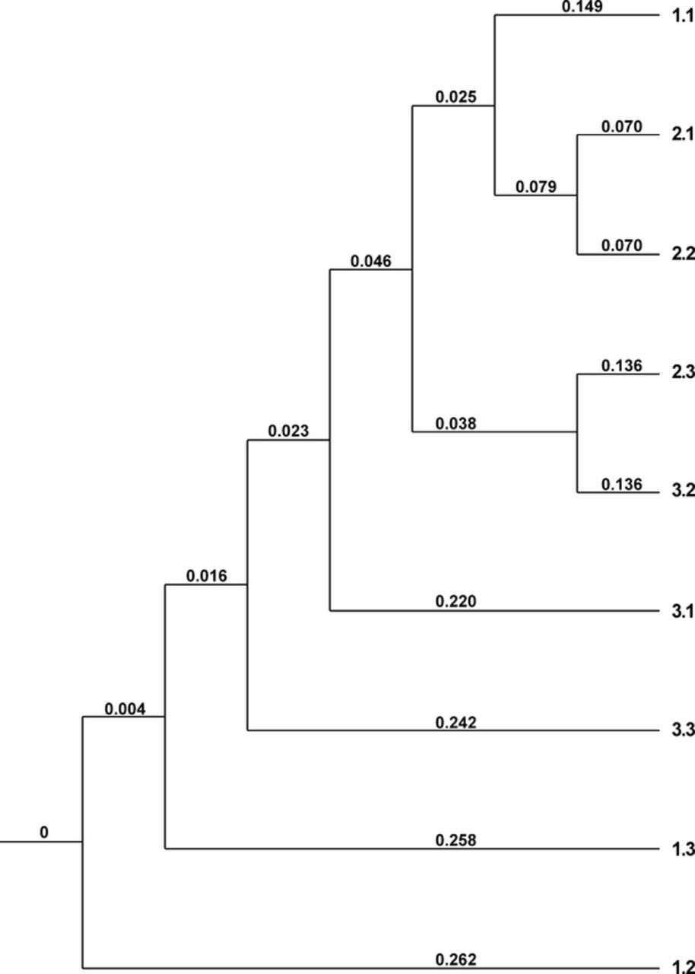
Analysis of ciliate community structures of the nine biological replicates displayed by a upgma tree. Numbers ...
Notes:
Analysis of ciliate community structures of the nine biological replicates displayed by a upgma tree. Numbers at tree branches refer to calculated distances between biological replicates (Marczewski–Steinhaus-distances), and numbers at tree leaves refer to the nine biological replicates.
Unless provided in the caption above, the following copyright applies to the content of this slide: © 2011 Federation of European Microbiological Societies

Slide 5
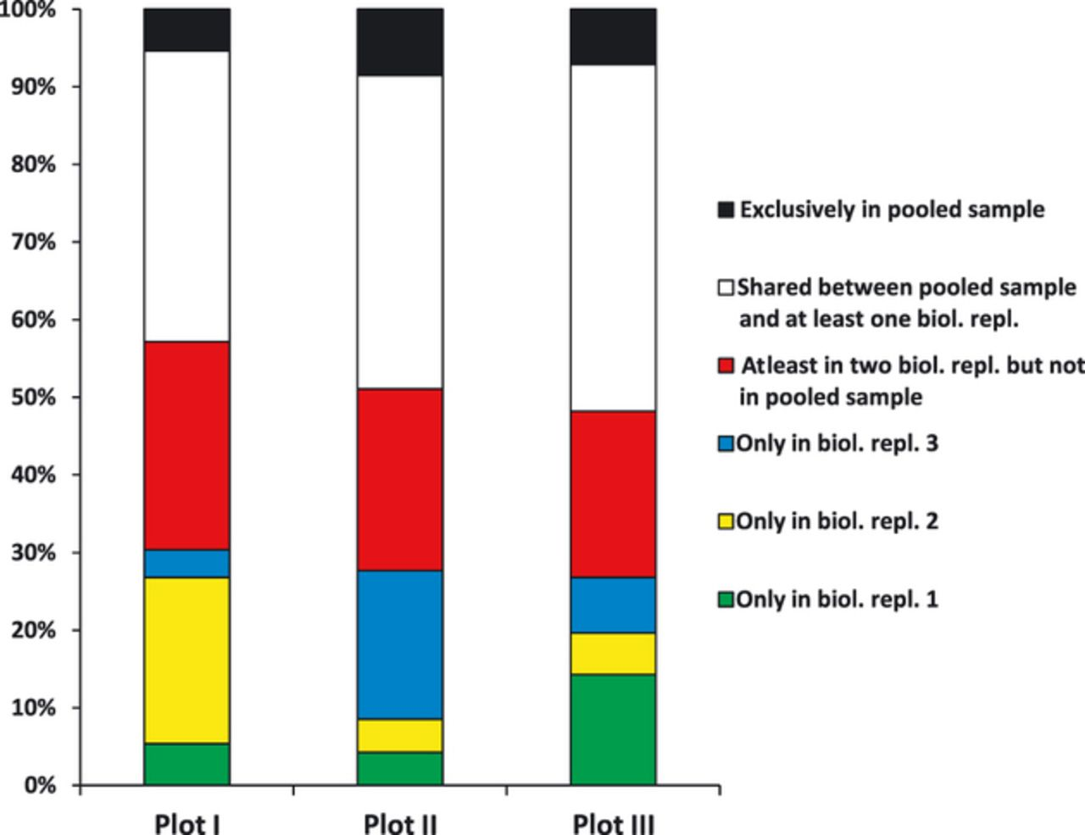
Distribution of T-RFs detected within the three plots. Community membership was analyzed based on the ...
Notes:
Distribution of T-RFs detected within the three plots. Community membership was analyzed based on the incidence of phylotypes (i) in only one of three biological replicates (green, yellow, and blue), (ii) in at least two biological replicates but not in the pooled sample (red), (iii) in at least one biological replicate and the pooled sample (white), and (iv) in the pooled sample only (black).
Unless provided in the caption above, the following copyright applies to the content of this slide: © 2011 Federation of European Microbiological Societies

Slide 6
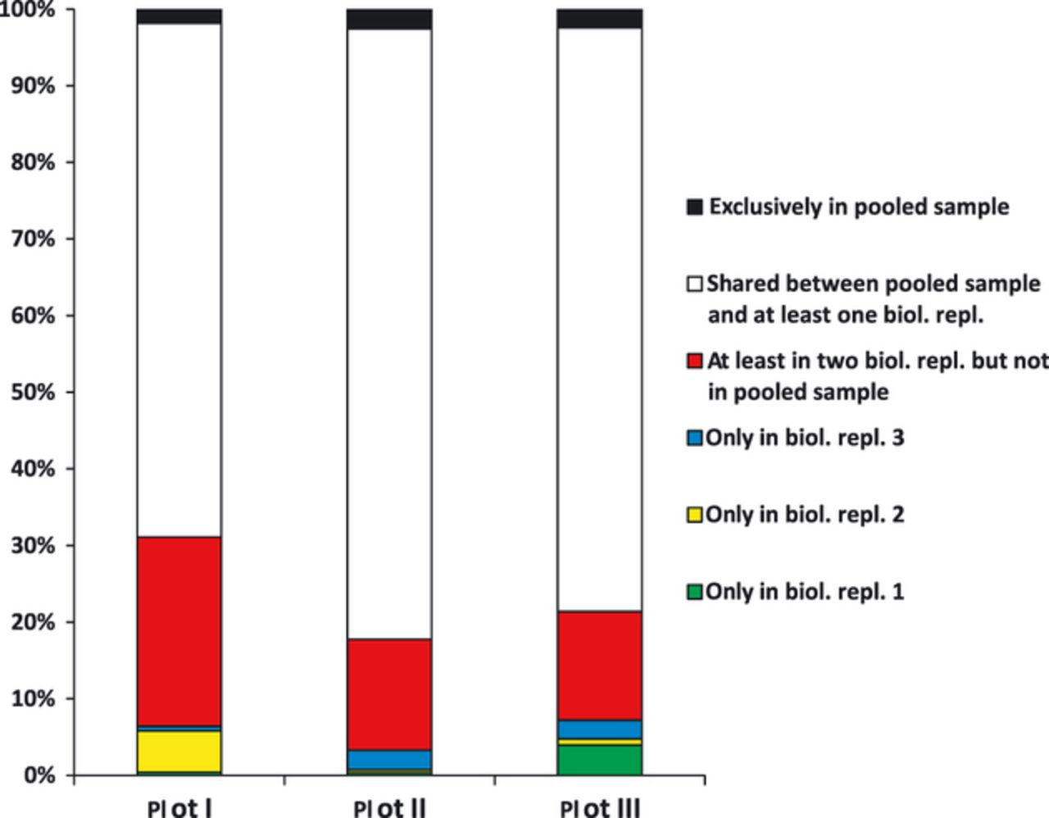
Abundance distribution of T-RFs detected within the three investigated plots. Community structure was ...
Notes:
Abundance distribution of T-RFs detected within the three investigated plots. Community structure was analyzed based on relative abundance of phylotypes present (i) in only one of three biological replicates (green, yellow, and blue), (ii) in at least two biological replicates but not in the pooled sample (red), (iii) in at least one biological replicate and the pooled sample (white), and (iv) in the pooled sample only (black).
Unless provided in the caption above, the following copyright applies to the content of this slide: © 2011 Federation of European Microbiological Societies

