Slide 1
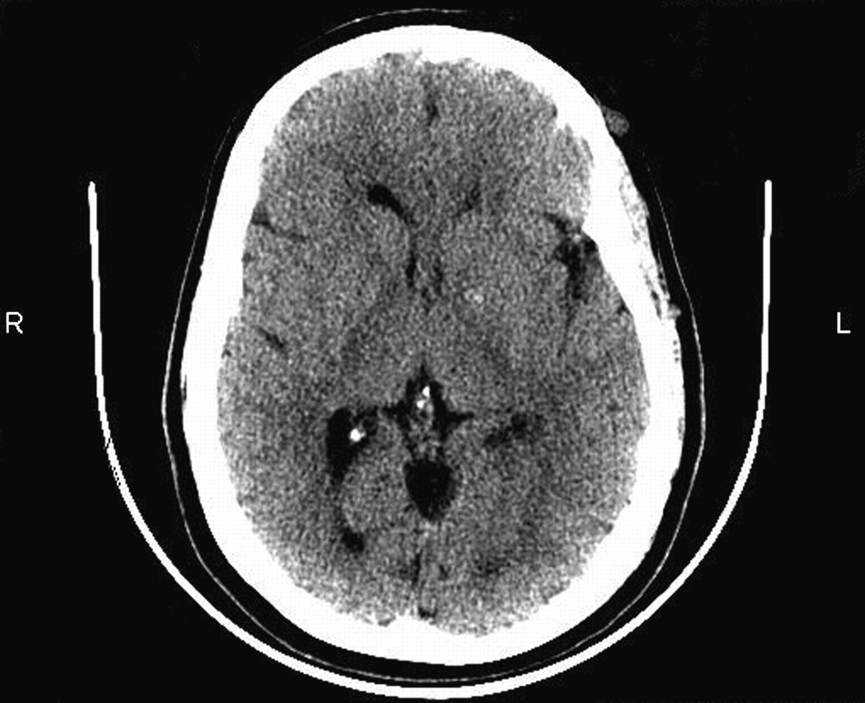
Figure 1. Computed tomography scan for Case 1 performed 2 years before death. It demonstrates focal calcifications in ...
Notes:
Figure 1. Computed tomography scan for Case 1 performed 2 years before death. It demonstrates focal calcifications in the left internal globus pallidus but otherwise normal findings. The resolution was not sufficient to detect the heterotopic nodules.
Unless provided in the caption above, the following copyright applies to the content of this slide: © The Author 2008. Published by Oxford University Press. All rights reserved. For permissions, please e-mail: journals.permissions@oxfordjournals.org

Slide 2
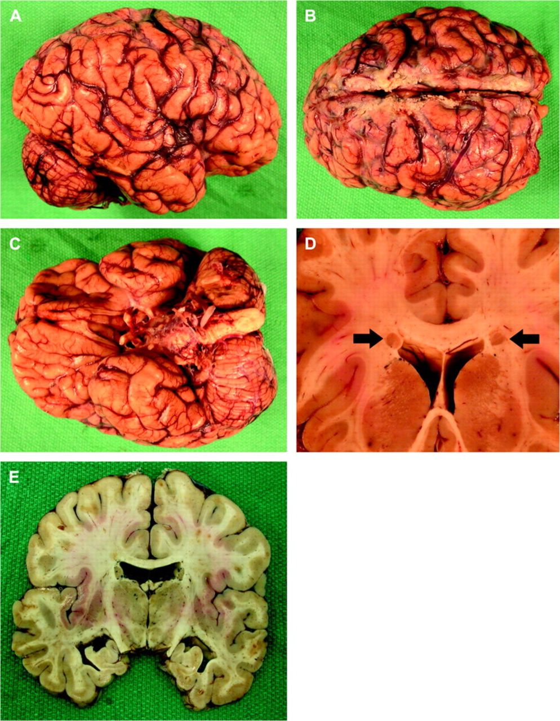
Figure 2. Macroscopic neuropathology for Case 1. (A) The gyration pattern was normal, with no evidence of ...
Notes:
Figure 2. Macroscopic neuropathology for Case 1. (A) The gyration pattern was normal, with no evidence of polymicrogyria or pachygyria. (B) Some relatively large gyri were present in the posterior frontal and anterior parietal lobes. (C) The base of the brain was unremarkable. (D) Coronal sections revealed BPNH along the lateral edge of both lateral ventricles (arrows), only seen in the frontal lobes. (E) White matter structures were unremarkable.
Unless provided in the caption above, the following copyright applies to the content of this slide: © The Author 2008. Published by Oxford University Press. All rights reserved. For permissions, please e-mail: journals.permissions@oxfordjournals.org

Slide 3
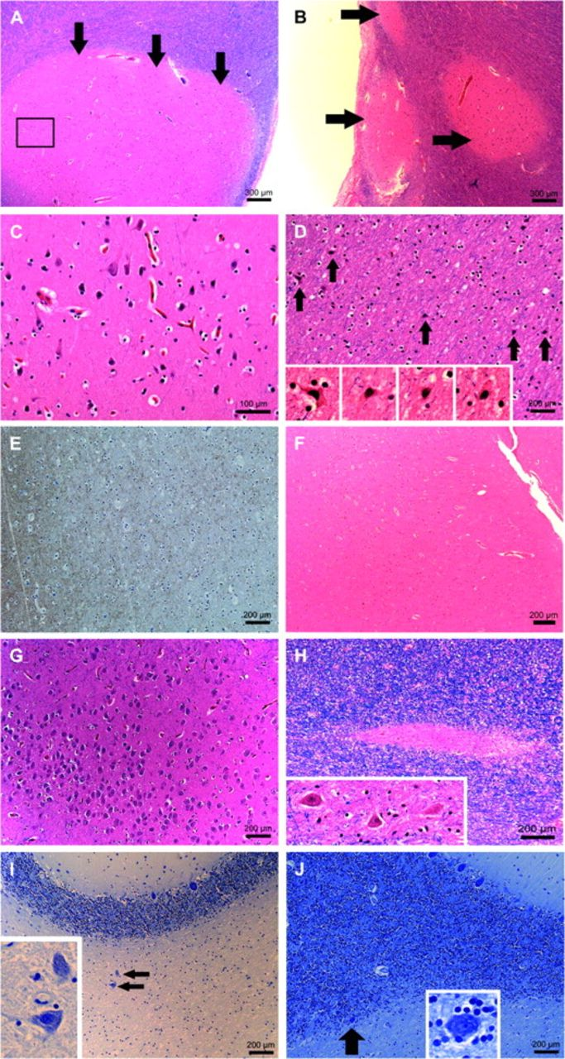
Figure 3. Histopathologic findings for Case 1. (A, B) Sections from the heterotopic nodules revealed disorganized gray ...
Notes:
Figure 3. Histopathologic findings for Case 1. (A, B) Sections from the heterotopic nodules revealed disorganized gray matter (arrows). The frame corresponds to Figure 3C. (B) Smaller nodules were only visible microscopically (arrows). The ventricular surface was frequently denuded, and there was subependymal fibrosis. (C) Higher power view of the heterotopic nodule from Figure 3A reveals haphazard arrangement of neurons with a cortical-type morphology. (D) Large numbers of neurons (arrows) were found in the white matter between the heterotopic nodules and closest cortical surface. Magnification (insets) reveals cytologic details, such as triangular shape. (E) Immunohistochemistry for synaptophysin showed abundant reactivity in this white matter region. (F) The cortex over this area (right side) was poorly demarcated from the white matter, seen on the left side, which is only minimally stained with Luxol fast blue. (G) In the hippocampus, most of the neurons in the pyramidal layer showed a highly abnormal morphology. (H) Patches of ectopic gray matter resembling dentate nucleus were seen deep in the cerebellar white matter, magnified in the inset. (I) Scattered large ectopic neurons (arrows) were present individually in the white matter, magnified in the inset, or (J) at the interface (arrow) between the white matter and granular cell layer of the cerebellum (inset).
Unless provided in the caption above, the following copyright applies to the content of this slide: © The Author 2008. Published by Oxford University Press. All rights reserved. For permissions, please e-mail: journals.permissions@oxfordjournals.org

Slide 4
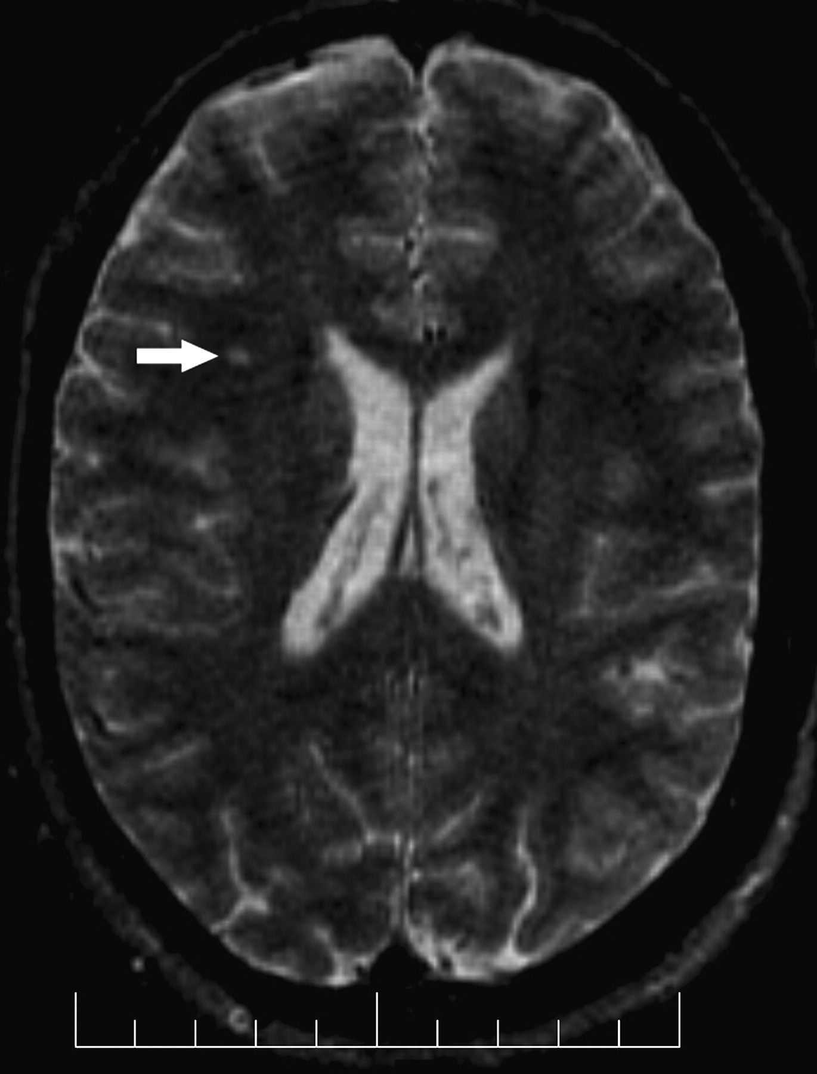
Figure 4. MRI scan for Case 2, performed 5 years before death. The axial T₂ image reveals a single 3- to ...
Notes:
Figure 4. MRI scan for Case 2, performed 5 years before death. The axial T2 image reveals a single 3- to 4-mm focus of increased signal in the right frontal white matter (arrow). There is a slight cavum vergae posteriorly.
Unless provided in the caption above, the following copyright applies to the content of this slide: © The Author 2008. Published by Oxford University Press. All rights reserved. For permissions, please e-mail: journals.permissions@oxfordjournals.org

Slide 5
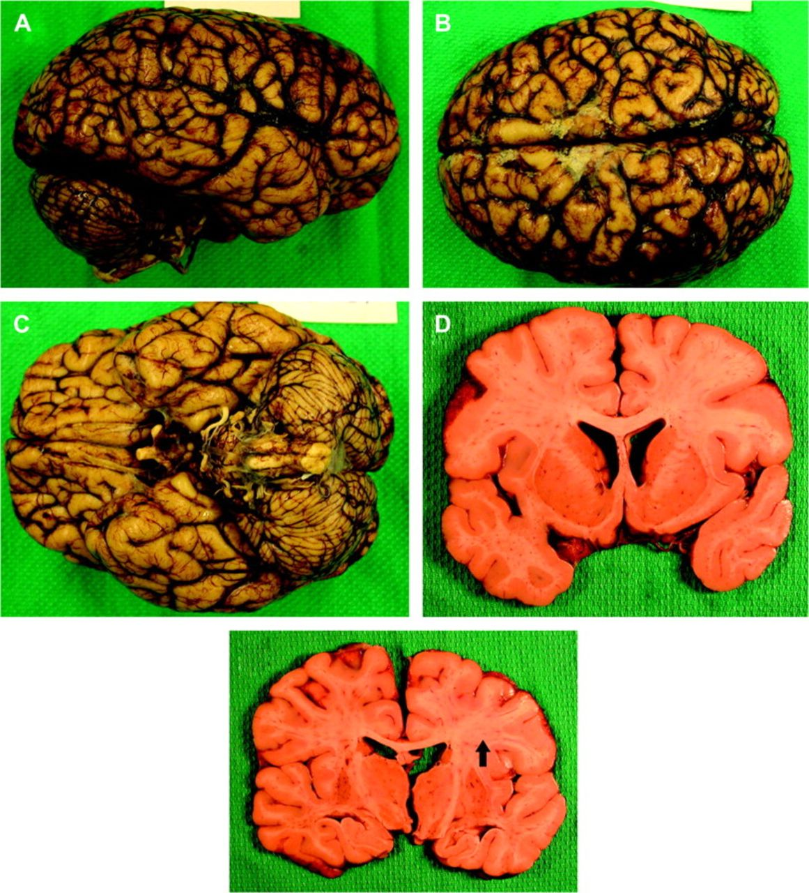
Figure 5. Macroscopic neuropathology for Case 2. (A–C) The gyration pattern was normal. (D) Coronal sections revealed ...
Notes:
Figure 5. Macroscopic neuropathology for Case 2. (A–C) The gyration pattern was normal. (D) Coronal sections revealed an anatomically largely unremarkable brain, except for (E) focal mild thinning of the corpus callosum.
Unless provided in the caption above, the following copyright applies to the content of this slide: © The Author 2008. Published by Oxford University Press. All rights reserved. For permissions, please e-mail: journals.permissions@oxfordjournals.org

Slide 6
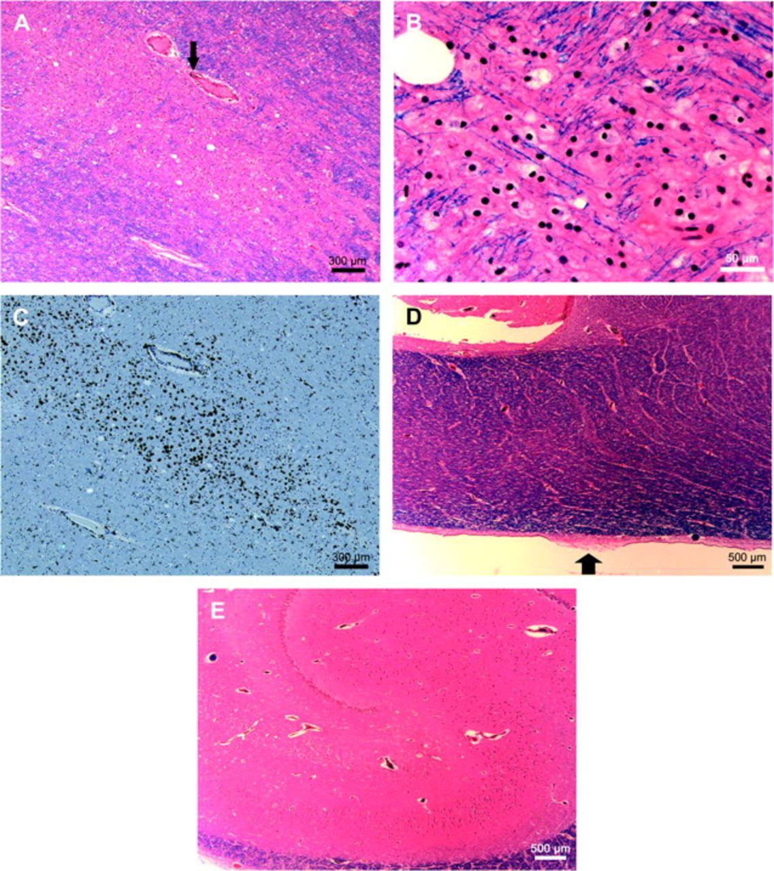
Figure 6. Histopathologic findings for Case 2. (A) Focal pallor and attenuation of myelinated fibers in the right ...
Notes:
Figure 6. Histopathologic findings for Case 2. (A) Focal pallor and attenuation of myelinated fibers in the right frontal lobe. (B) Higher magnification showed abundant lipid-laden macrophages, many of which contain a blue tinge of myelin. (C) An immunostain for CD68 confirms the presence of macrophages. (D) The area of thin corpus callosum was microscopically unremarkable, except for focal ependymal stripping (arrow). (E) The hippocampus showed no cytoarchitectural abnormalities.
Unless provided in the caption above, the following copyright applies to the content of this slide: © The Author 2008. Published by Oxford University Press. All rights reserved. For permissions, please e-mail: journals.permissions@oxfordjournals.org

Slide 7
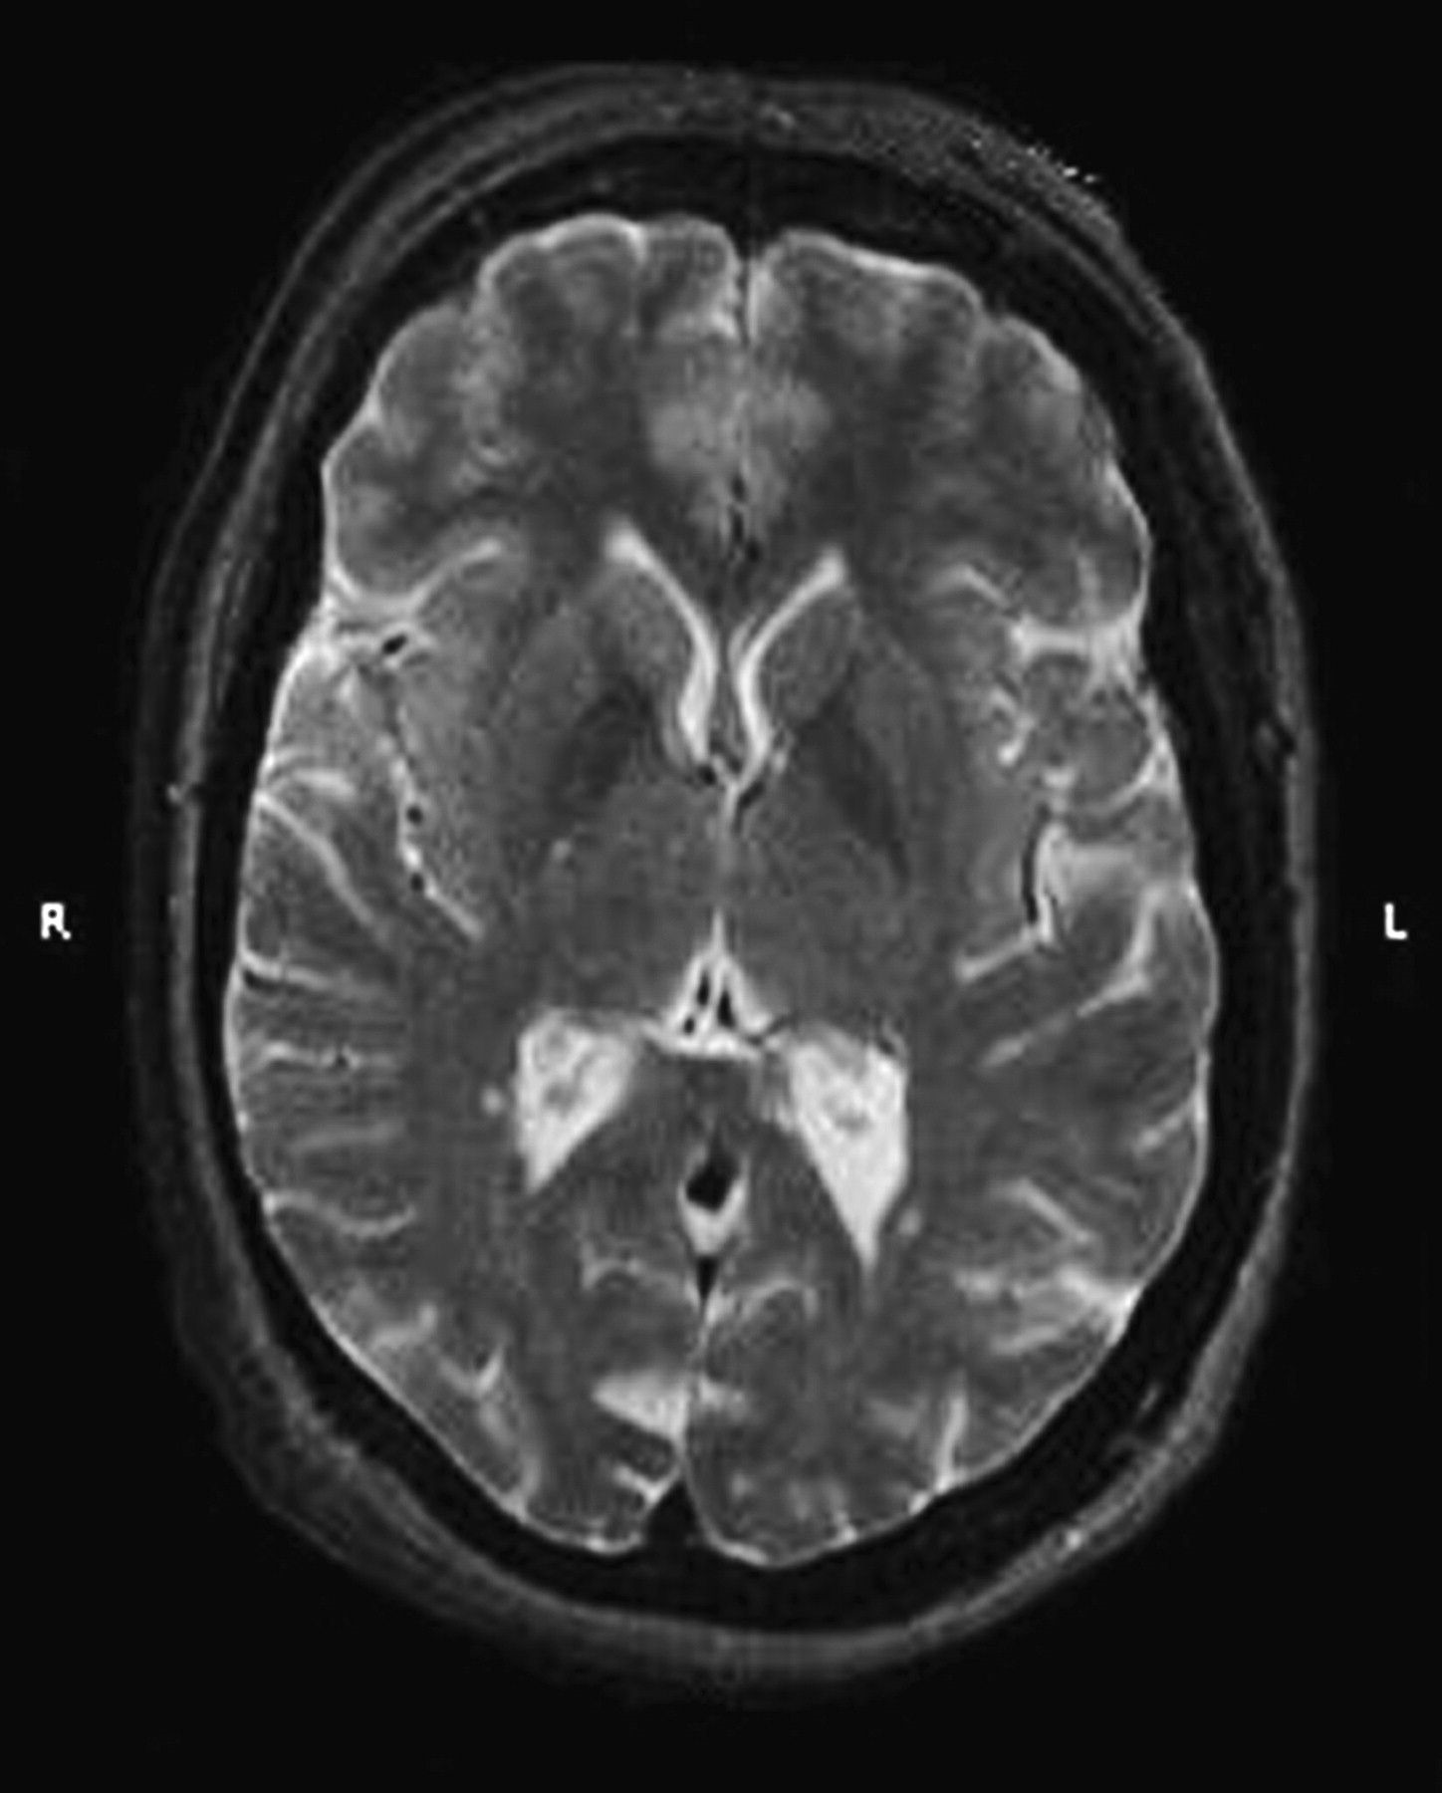
Figure 7. MRI scan for Case 3 showed multiple scattered foci of increased T₂ signal, involving the ...
Notes:
Figure 7. MRI scan for Case 3 showed multiple scattered foci of increased T2 signal, involving the subcortical and periventricular white matter of both hemispheres. Ventricles are normal in size.
Unless provided in the caption above, the following copyright applies to the content of this slide: © The Author 2008. Published by Oxford University Press. All rights reserved. For permissions, please e-mail: journals.permissions@oxfordjournals.org

Slide 8
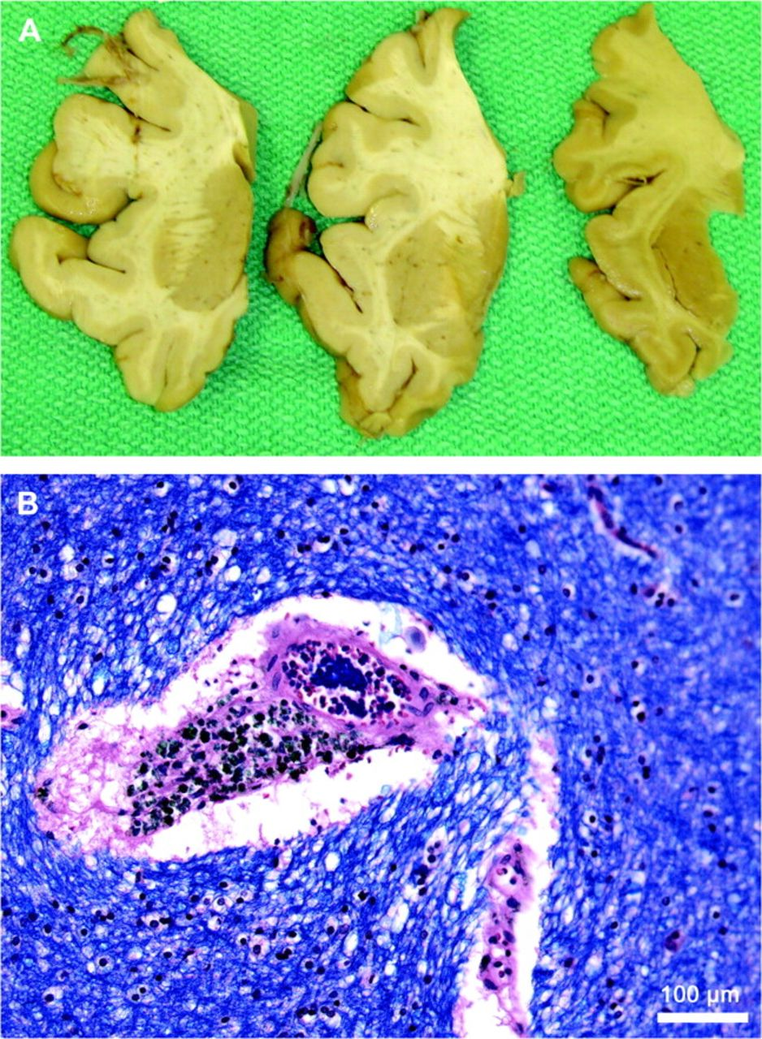
Figure 8. Neuropathology for Case 3. (A) After a forensic autopsy, multiple pieces of brain tissue were available for ...
Notes:
Figure 8. Neuropathology for Case 3. (A) After a forensic autopsy, multiple pieces of brain tissue were available for neuropathologic examination. The largest fragment was from the left frontal lobe and included the anterior basal ganglia, all grossly unremarkable. (B) Histopathologic exam revealed severe cerebrovascular hypertensive-type changes, for example, vascular thickening, perivascular pallor, and abundant perivascular hemosiderin-laden macrophages.
Unless provided in the caption above, the following copyright applies to the content of this slide: © The Author 2008. Published by Oxford University Press. All rights reserved. For permissions, please e-mail: journals.permissions@oxfordjournals.org

Slide 9
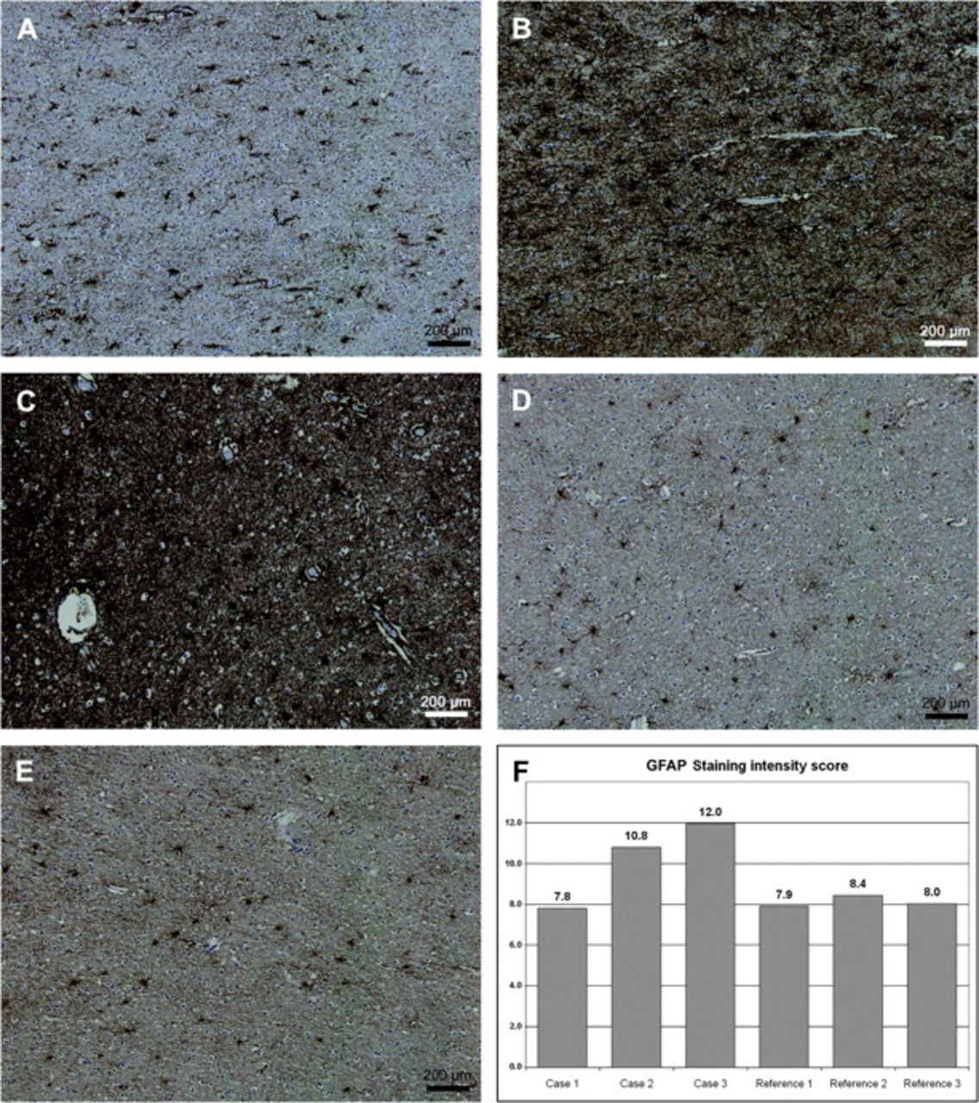
Figure 9. Immunohistochemistry for GFAP in deep frontal white matter. (A) Unremarkable staining in Case 1 and (B, C) ...
Notes:
Figure 9. Immunohistochemistry for GFAP in deep frontal white matter. (A) Unremarkable staining in Case 1 and (B, C) severe gliosis in Cases 2 and 3, respectively, when compared with (D, E) normal control reference cases (2 shown of 3 analyzed). (F) Histogram of average GFAP staining intensity score, expressed as [1000]/[luminosity value].
Unless provided in the caption above, the following copyright applies to the content of this slide: © The Author 2008. Published by Oxford University Press. All rights reserved. For permissions, please e-mail: journals.permissions@oxfordjournals.org

