Slide 1
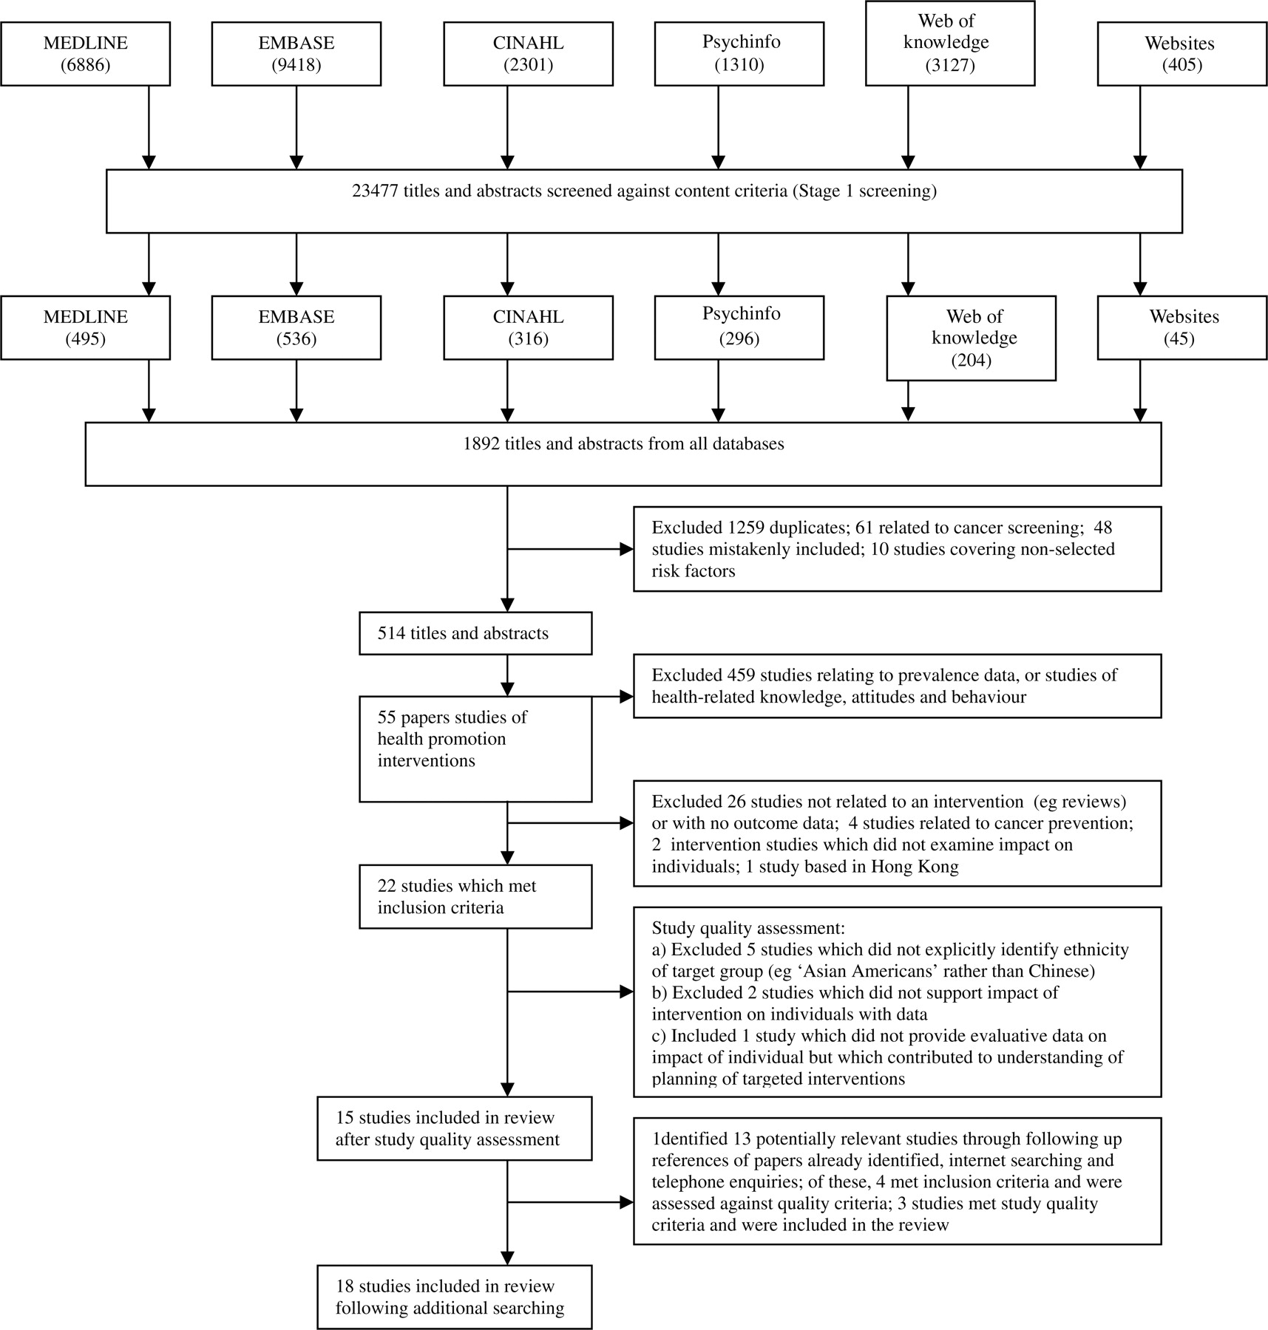
Fig. 1: Identification of studies.
Notes:
Fig. 1: Identification of studies.
Unless provided in the caption above, the following copyright applies to the content of this slide: © The Author (2010). Published by Oxford University Press. All rights reserved. For Permissions, please email: journals.permissions@oxfordjournals.org

