Slide 1
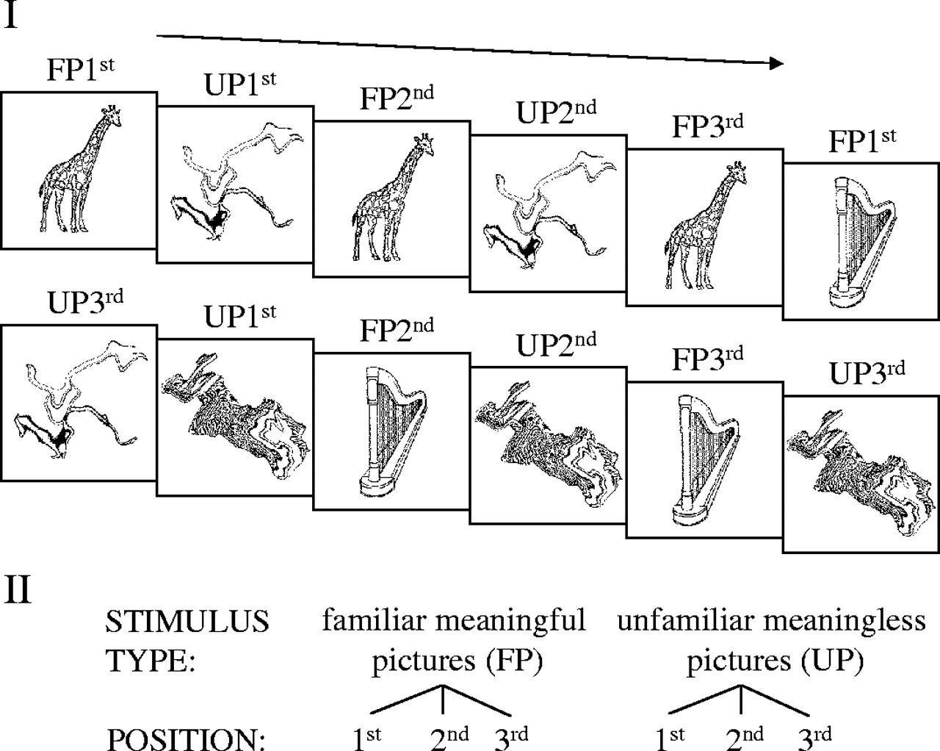
Figure 1. (I) Excerpt of stimulus sequence. Meaningful (familiar) and meaningless (unfamiliar) objects are presented ...
Notes:
Figure 1. (I) Excerpt of stimulus sequence. Meaningful (familiar) and meaningless (unfamiliar) objects are presented for a first (FP1st and UP1st), a second (FP2nd and UP2nd) and a third time (FP3rd and UP3rd). (II) Repeated measurement ANOVA model used for statistical analysis.
Unless provided in the caption above, the following copyright applies to the content of this slide: Cerebral Cortex V 15 N 1 © Oxford University Press 2005; all rights reserved

Slide 2
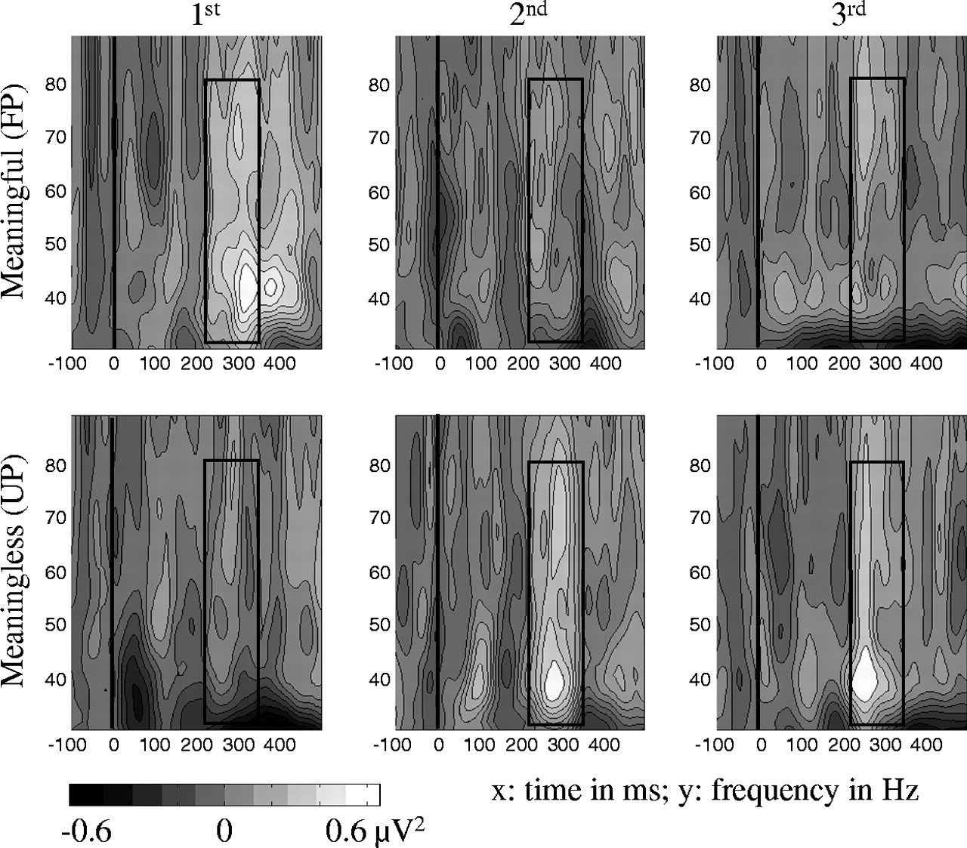
Figure 2. Grand mean baseline-corrected TF-plots averaged across posterior electrode sites (see text) for all ...
Notes:
Figure 2. Grand mean baseline-corrected TF-plots averaged across posterior electrode sites (see text) for all experimental conditions.
Unless provided in the caption above, the following copyright applies to the content of this slide: Cerebral Cortex V 15 N 1 © Oxford University Press 2005; all rights reserved

Slide 3
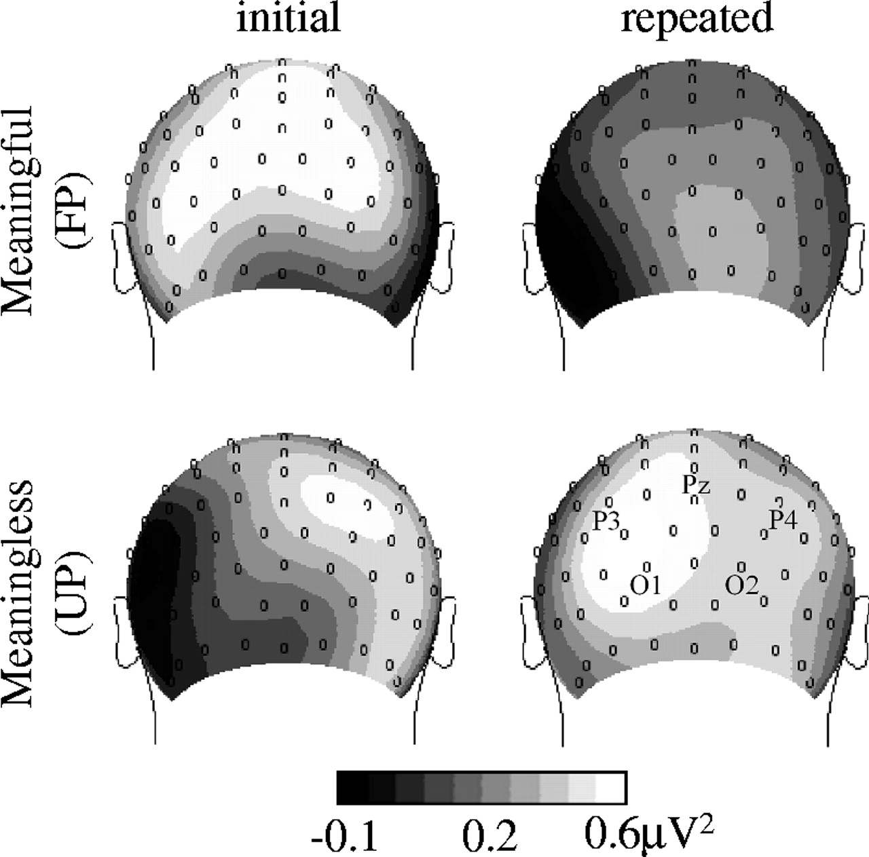
Figure 3. Grand mean spherical-spline isocontour power-maps based on the individual maximal power in the gamma range in ...
Notes:
Figure 3. Grand mean spherical-spline isocontour power-maps based on the individual maximal power in the gamma range in the time window between 220 and 350 ms after stimulus onset. Topographies for repeated stimuli were obtained by averaging across second and third presentations.
Unless provided in the caption above, the following copyright applies to the content of this slide: Cerebral Cortex V 15 N 1 © Oxford University Press 2005; all rights reserved

Slide 4
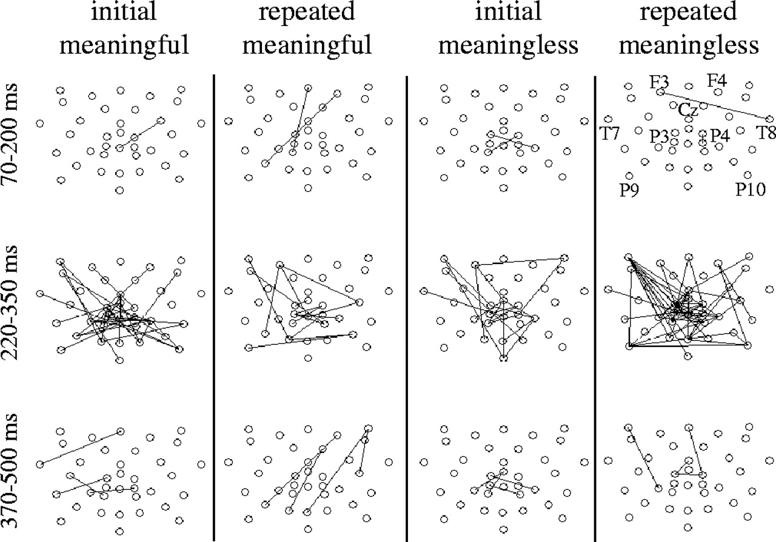
Figure 4. Phase-locking in the gamma band between 10 and 20 electrode pairs for initial and repeated picture ...
Notes:
Figure 4. Phase-locking in the gamma band between 10 and 20 electrode pairs for initial and repeated picture presentations. Lines are drawn only if the phase-locking value is beyond the distribution of randomized data (P < 0.01).
Unless provided in the caption above, the following copyright applies to the content of this slide: Cerebral Cortex V 15 N 1 © Oxford University Press 2005; all rights reserved

Slide 5
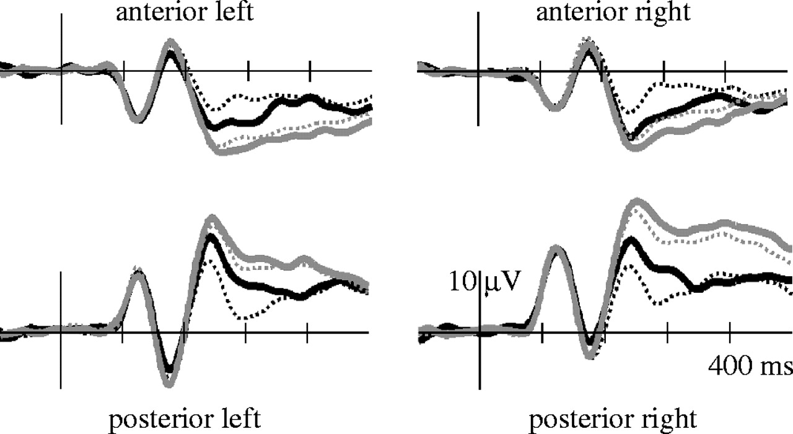
Figure 5. Grand mean baseline corrected ERPs for initial meaningful object presentation (bold black line), repeated ...
Notes:
Figure 5. Grand mean baseline corrected ERPs for initial meaningful object presentation (bold black line), repeated meaningful object presentations (dotted black line), initial meaningless object presentation (bold gray line) and repeated meaningless object presentations (dotted gray line) at four regional means (corresponding 10–20 sites: anterior left = F7, F3, FC5, FC1, C3; anterior right = F8, F4, FC6, FC2, C4; posterior left = P7, P3, PO3, PO7, O1; posterior right = P8, P4, PO4, PO8, O2).
Unless provided in the caption above, the following copyright applies to the content of this slide: Cerebral Cortex V 15 N 1 © Oxford University Press 2005; all rights reserved

