Slide 1
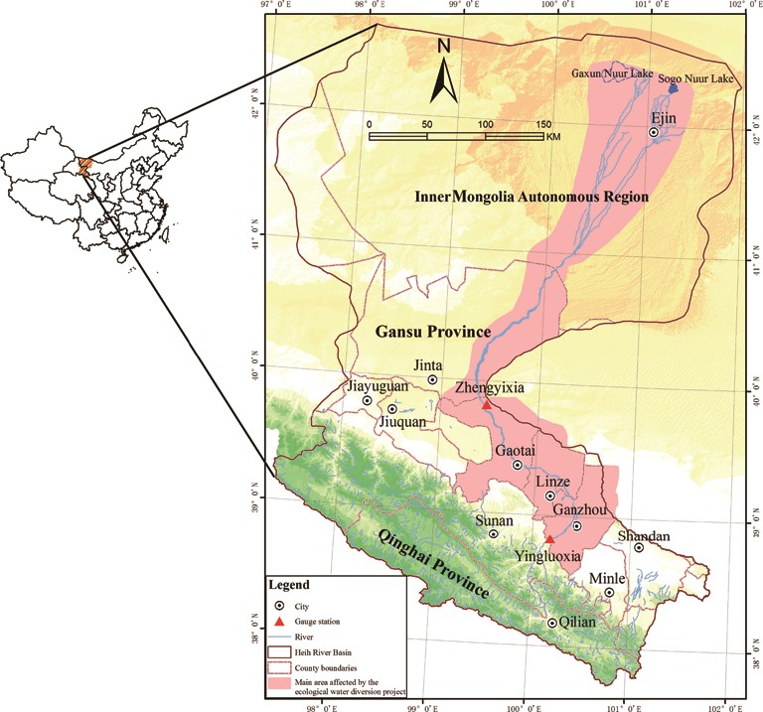
Figure 1. HRB and its location in China.
Notes:
Figure 1. HRB and its location in China.
Unless provided in the caption above, the following copyright applies to the content of this slide: © The Author(s) 2014. Published by Oxford University Press on behalf of China Science Publishing &s Media Ltd. All rights reserved. For Permissions, please email: journals.permissions@oup.comThis is an Open Access article distributed under the terms of the Creative Commons Attribution License (http://creativecommons.org/licenses/by/4.0/), which permits non-commercial reuse, distribution, and reproduction in any medium, provided the original work is properly cited. for commercial re-use, please contact journals.permissions@oup.com

Slide 2
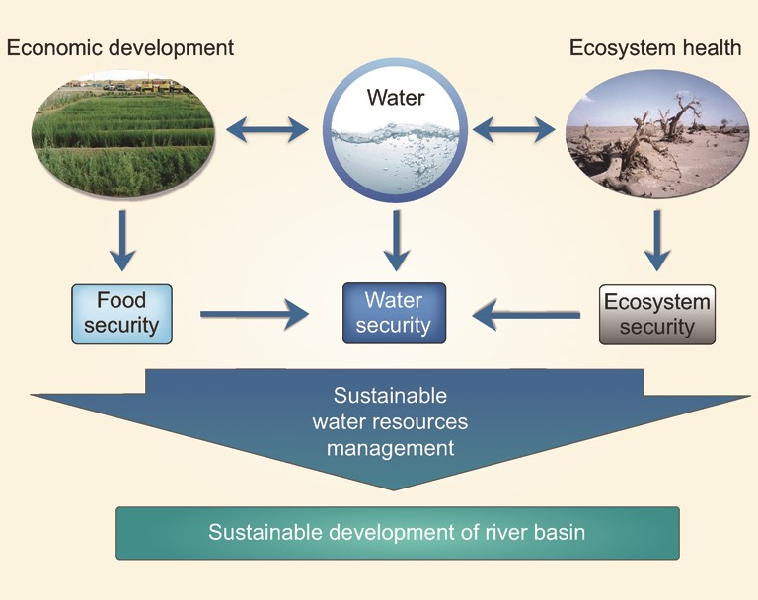
Figure 2. Framework of the integrated study of the water–ecosystem–economy in the HRB.
Notes:
Figure 2. Framework of the integrated study of the water–ecosystem–economy in the HRB.
Unless provided in the caption above, the following copyright applies to the content of this slide: © The Author(s) 2014. Published by Oxford University Press on behalf of China Science Publishing &s Media Ltd. All rights reserved. For Permissions, please email: journals.permissions@oup.comThis is an Open Access article distributed under the terms of the Creative Commons Attribution License (http://creativecommons.org/licenses/by/4.0/), which permits non-commercial reuse, distribution, and reproduction in any medium, provided the original work is properly cited. for commercial re-use, please contact journals.permissions@oup.com

Slide 3
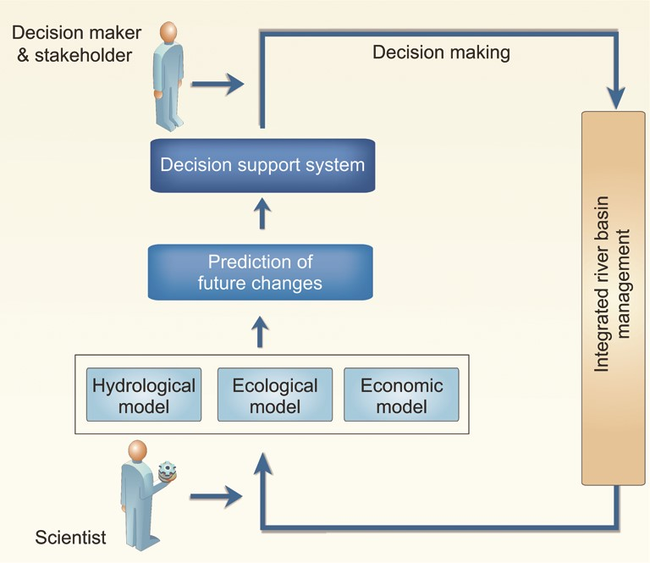
Figure 3. The relationship between the DSS and the integrated watershed models.
Notes:
Figure 3. The relationship between the DSS and the integrated watershed models.
Unless provided in the caption above, the following copyright applies to the content of this slide: © The Author(s) 2014. Published by Oxford University Press on behalf of China Science Publishing &s Media Ltd. All rights reserved. For Permissions, please email: journals.permissions@oup.comThis is an Open Access article distributed under the terms of the Creative Commons Attribution License (http://creativecommons.org/licenses/by/4.0/), which permits non-commercial reuse, distribution, and reproduction in any medium, provided the original work is properly cited. for commercial re-use, please contact journals.permissions@oup.com

