Slide 1
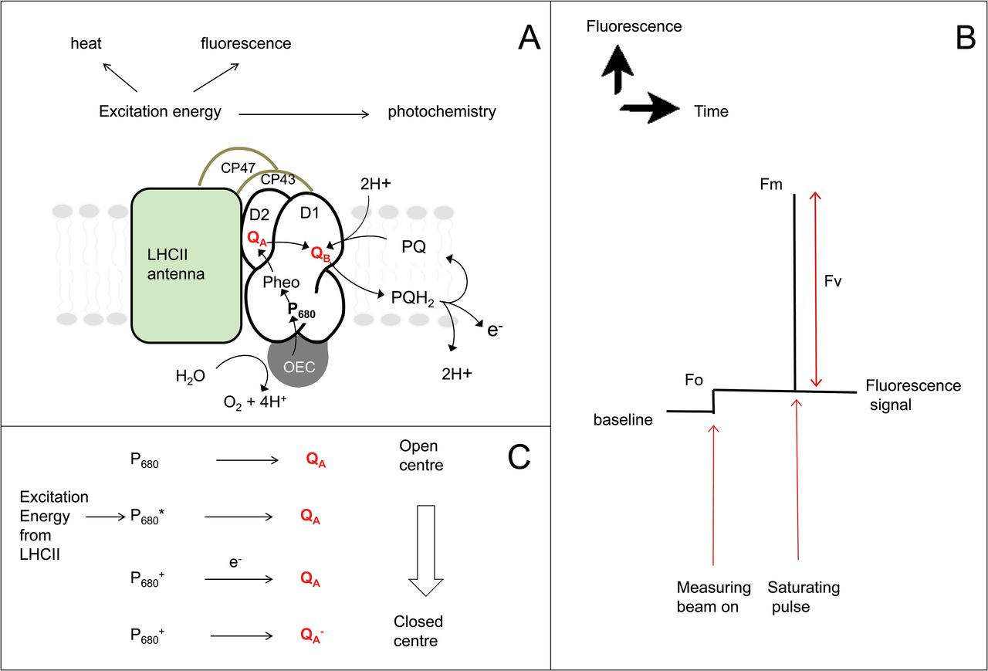
Fig. 1. A simplified depiction of events in PSII that lead to identification of key parameters in fluorescence ...
Notes:
Fig. 1. A simplified depiction of events in PSII that lead to identification of key parameters in fluorescence analysis. (A) A schematic figure showing electron transport within the PSII reaction centre complex. Energy absorbed by chlorophyll within the light-harvesting complex can be dissipated via photochemistry, by heat (non-photochemical quenching), or as fluorescence. The competition between these processes allows us to resolve the efficiency of PSII. (B) A typical fluorescence trace made on dark-adapted leaf material showing how Fo and Fm are formed. The measuring beam excites chlorophyll but is not of a sufficient intensity to induce electron transport through PSII (i.e. ‘charge separation’ when Pheo is reduced). This gives Fo, the minimal level of fluorescence, and reaction centres are said to be open. A brief saturating pulse of light results in the formation of the maximum possible yield of fluorescence, Fm. During this pulse reaction centres are effectively closed. (C) A schematic figure explaining the transfer of energy and electrons within PSII that result in open and closed centres and the formation of Fo and Fm states, respectively. The excited state P680* and subsequent transfer of an electron to the primary acceptor QA gives rise to a closed centre. QA– cannot accept another electron until it has passed its electron onto the next electron acceptor, QB.
Unless provided in the caption above, the following copyright applies to the content of this slide: © The Author [2013]. Published by Oxford University Press on behalf of the Society for Experimental Biology. All rights reserved. For permissions, please email: journals.permissions@oup.com

Slide 2
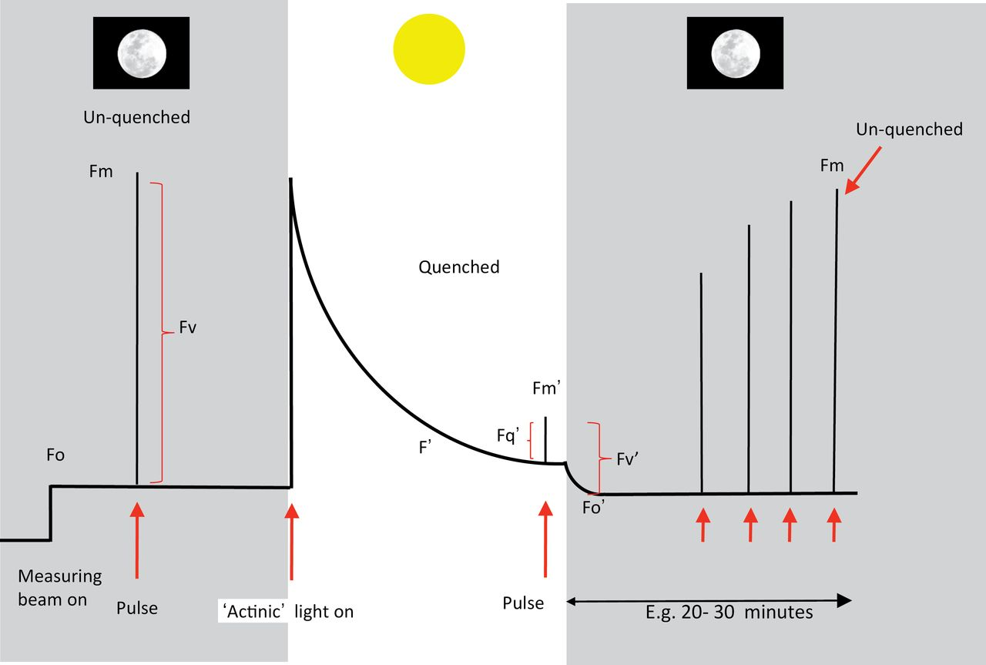
Fig. 2. A stylized fluorescence trace of a typical experiment using dark-adapted leaf material to measure ...
Notes:
Fig. 2. A stylized fluorescence trace of a typical experiment using dark-adapted leaf material to measure photochemical and non-photochemical parameters. This would be typical of an induction at high irradiance of ≥500 μmol m–2 s–1. A true ‘Kautsky’ effect would be measured at moderate illumination, for example <200 μmol m–2 s–1, where transients corresponding to induction of photosynthesis are revealed. Note that the ‘decay’ of Fo′ in the dark after switching off the actinic light would be accelerated by adding FR light to stimulate PSI activity. More explanation is given in the text.
Unless provided in the caption above, the following copyright applies to the content of this slide: © The Author [2013]. Published by Oxford University Press on behalf of the Society for Experimental Biology. All rights reserved. For permissions, please email: journals.permissions@oup.com

Slide 3
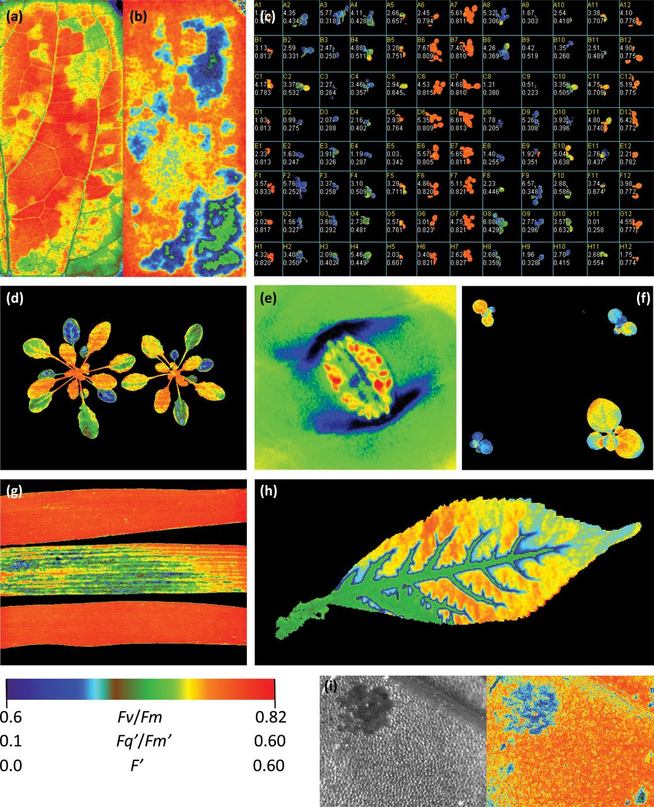
Fig. 3. (a) Images of steady-state fluorescence (F′) and (b) photosynthetic efficiency of PSII photochemistry ...
Notes:
Fig. 3. (a) Images of steady-state fluorescence (F′) and (b) photosynthetic efficiency of PSII photochemistry (Fq′/Fm′) from 10cm2 leaf area enclosed in a chamber during simultaneous gas exchange measurements demonstrating the effect of patchy stomatal closure. Images were captured 5min after dropping the humidity rapidly from 80% to 20%. All other chamber conditions were maintained at 200 μmol m–2 s–1 PPFD, 400 mmol mol–1 [CO2], 2% [O2], and a temperature of 24 °C. (c) An example of chlorophyll fluorescence as a screening technique showing the detection of the effects of herbicide treatment on Fv/Fm of 1-week-old Arabidopsis plants growing on a 96-well plate (unpublished image of Technologica Ltd, with permission). (d) An Fq′/Fm′ image showing the heterogeneity of two Arabidopsis plants after 10min acclimation to 300 μmol m–2 s–1 PPFD following induction of heterogeneity with 1h at a high light intensity of 1000 μmol m–2 s–1. (e) An image of Fv/Fm of the epidermis of an intact Tradescantia leaf showing the guard cell chloroplasts following the methods of Oxborough and Baker (1997b) taken with a high resolution microscope chlorophyll fluorescence imaging system (unpublished image of McAusland and Lawson). (f) Use of the chlorophyll fluorescence parameter Fq′/Fm′ to screen transgenic plants that have reduced levels of SBPase. The plant in the upper right and lower left have much greater reductions in SBPase than the other two plants. (g) Images of Fv/Fm taken after 20min dark adaption from three different varieties of wheat plants grown in the field, with different susceptibilities to rust. The middle images show a variety that is more susceptible to rust (unpublished image of Lawson and Driever). (h) A cut elder leaf illustrates the decrease in photosynthetic efficiency (Fq′/Fm′) with DCMU uptake via the petiole during transpiration. (i) High-resolution image of the effect of Cd on photosynthetic efficiency in the aquatic plant Lemna. The image was captured after stabilizing to 200 μmol m–2 s–1 light after having been exposed to Cd for 1 d. The image on the left represent steady-state fluorescence (F′) while that on the right is a false-colour image of Fq′/Fm′. (Unless stated all images are unpublished data of TL.)
Unless provided in the caption above, the following copyright applies to the content of this slide: © The Author [2013]. Published by Oxford University Press on behalf of the Society for Experimental Biology. All rights reserved. For permissions, please email: journals.permissions@oup.com

