Slide 1
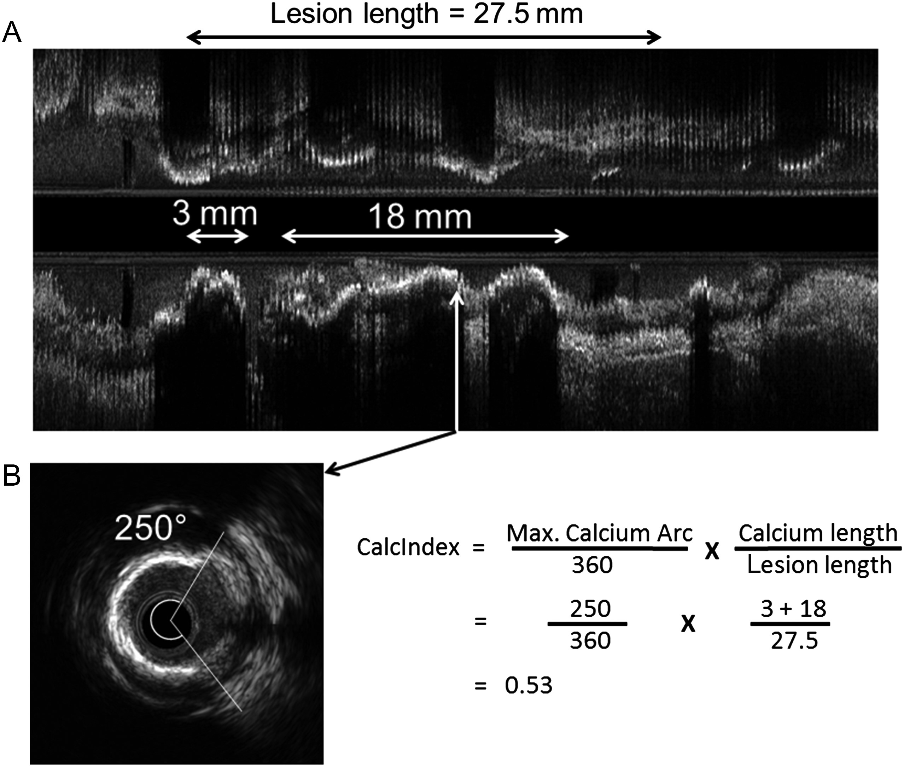
Figure 1 Derivation of Calcium Index (CalcIndex) by IVUS. (A) In this longitudinal IVUS reconstruction, the lesion ...
Notes:
Figure 1 Derivation of Calcium Index (CalcIndex) by IVUS. (A) In this longitudinal IVUS reconstruction, the lesion measures 27.5 mm in length from the proximal to the distal reference site and contains two lengths of diffuse calcification (note acoustic shadows) that are 3 and 18 mm in length (white horizontal arrows). The vertical white arrow indicates the point of maximum calcium arc. (B) Cross-sectional image taken from the same IVUS scan showing the point of maximum calcium arc, measuring 250°. The calculation of CalcIndex is shown and was 0.53 in this case.18
Unless provided in the caption above, the following copyright applies to the content of this slide: Published on behalf of the European Society of Cardiology. All rights reserved. © The Author 2013. For permissions please email: journals.permissions@oup.com

Slide 2
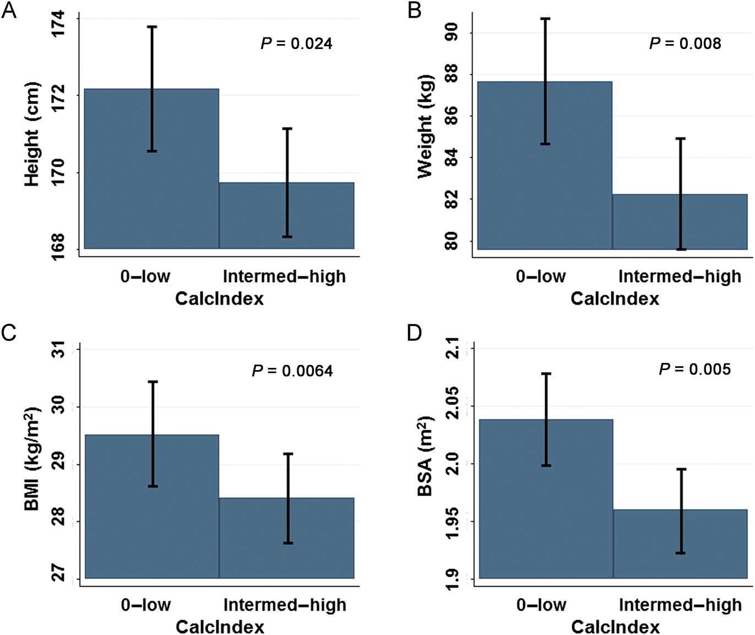
Figure 2 Unadjusted comparisons of mean CalcIndex (zero or low vs. intermediate or high) according to patient (A) ...
Notes:
Figure 2 Unadjusted comparisons of mean CalcIndex (zero or low vs. intermediate or high) according to patient (A) height, (B) weight, (C) BMI, and (D) BSA. Values shown are mean for each group and 95% confidence interval.
Unless provided in the caption above, the following copyright applies to the content of this slide: Published on behalf of the European Society of Cardiology. All rights reserved. © The Author 2013. For permissions please email: journals.permissions@oup.com

Slide 3
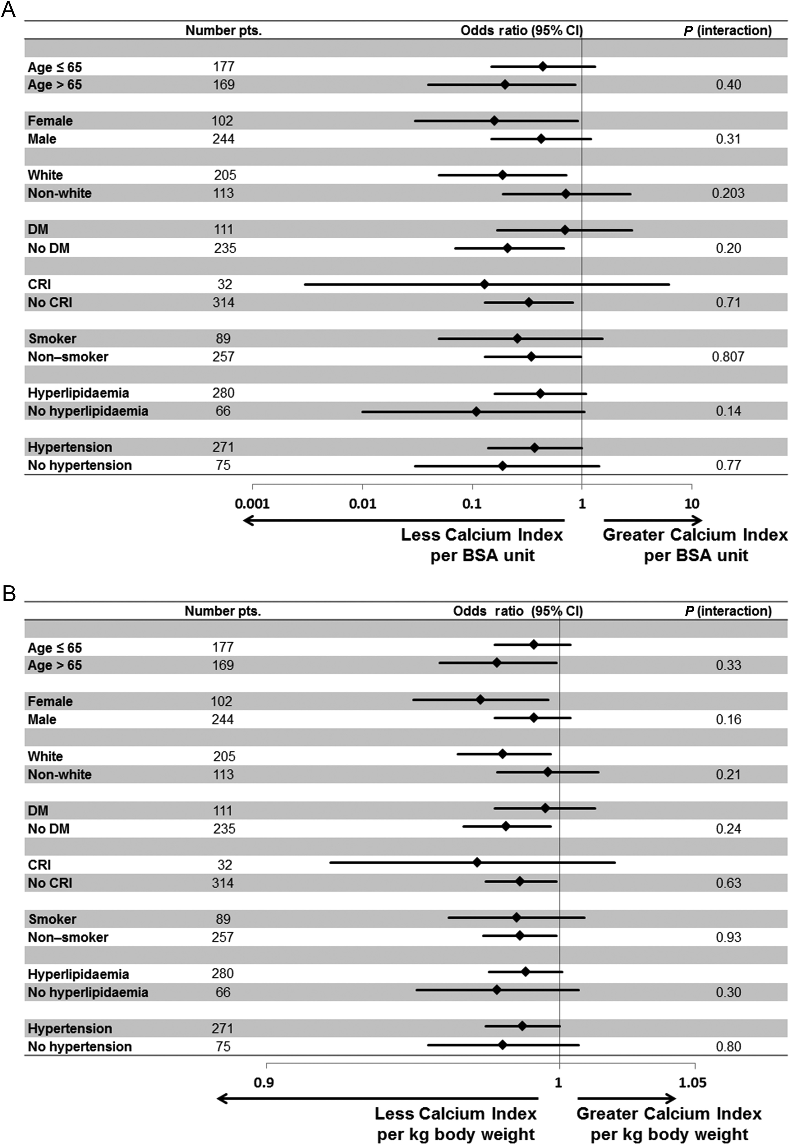
Figure 3 Forest plots demonstrating associations between (A) BSA and CalcIndex, and (B) weight and CalcIndex, in ...
Notes:
Figure 3 Forest plots demonstrating associations between (A) BSA and CalcIndex, and (B) weight and CalcIndex, in clinically relevant subgroups. BSA and weight were treated as continuous variables. Current and former smokers were combined in this analysis as the ‘smoking’ category. Boxes represent age-, gender-, and race/ethnicity-adjusted ORs for CalcIndex; lines represent 95% confidence intervals. Abbreviations not previously defined: DM, diabetes mellitus.
Unless provided in the caption above, the following copyright applies to the content of this slide: Published on behalf of the European Society of Cardiology. All rights reserved. © The Author 2013. For permissions please email: journals.permissions@oup.com

