Slide 1
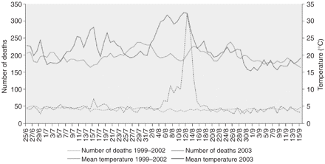
Figure 1 Daily mortality and mean temperature in Paris, France, June to September 2003
Notes:
Figure 1 Daily mortality and mean temperature in Paris, France, June to September 2003
Unless provided in the caption above, the following copyright applies to the content of this slide: © The Author 2006. Published by Oxford University Press on behalf of the European Public Health Association. All rights reserved.

Slide 2
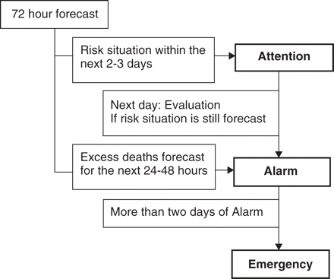
Figure 2 An example of a heat health warning system with three levels of alert (attention, alarm, emergency)
Notes:
Figure 2 An example of a heat health warning system with three levels of alert (attention, alarm, emergency)
Unless provided in the caption above, the following copyright applies to the content of this slide: © The Author 2006. Published by Oxford University Press on behalf of the European Public Health Association. All rights reserved.

