Slide 1
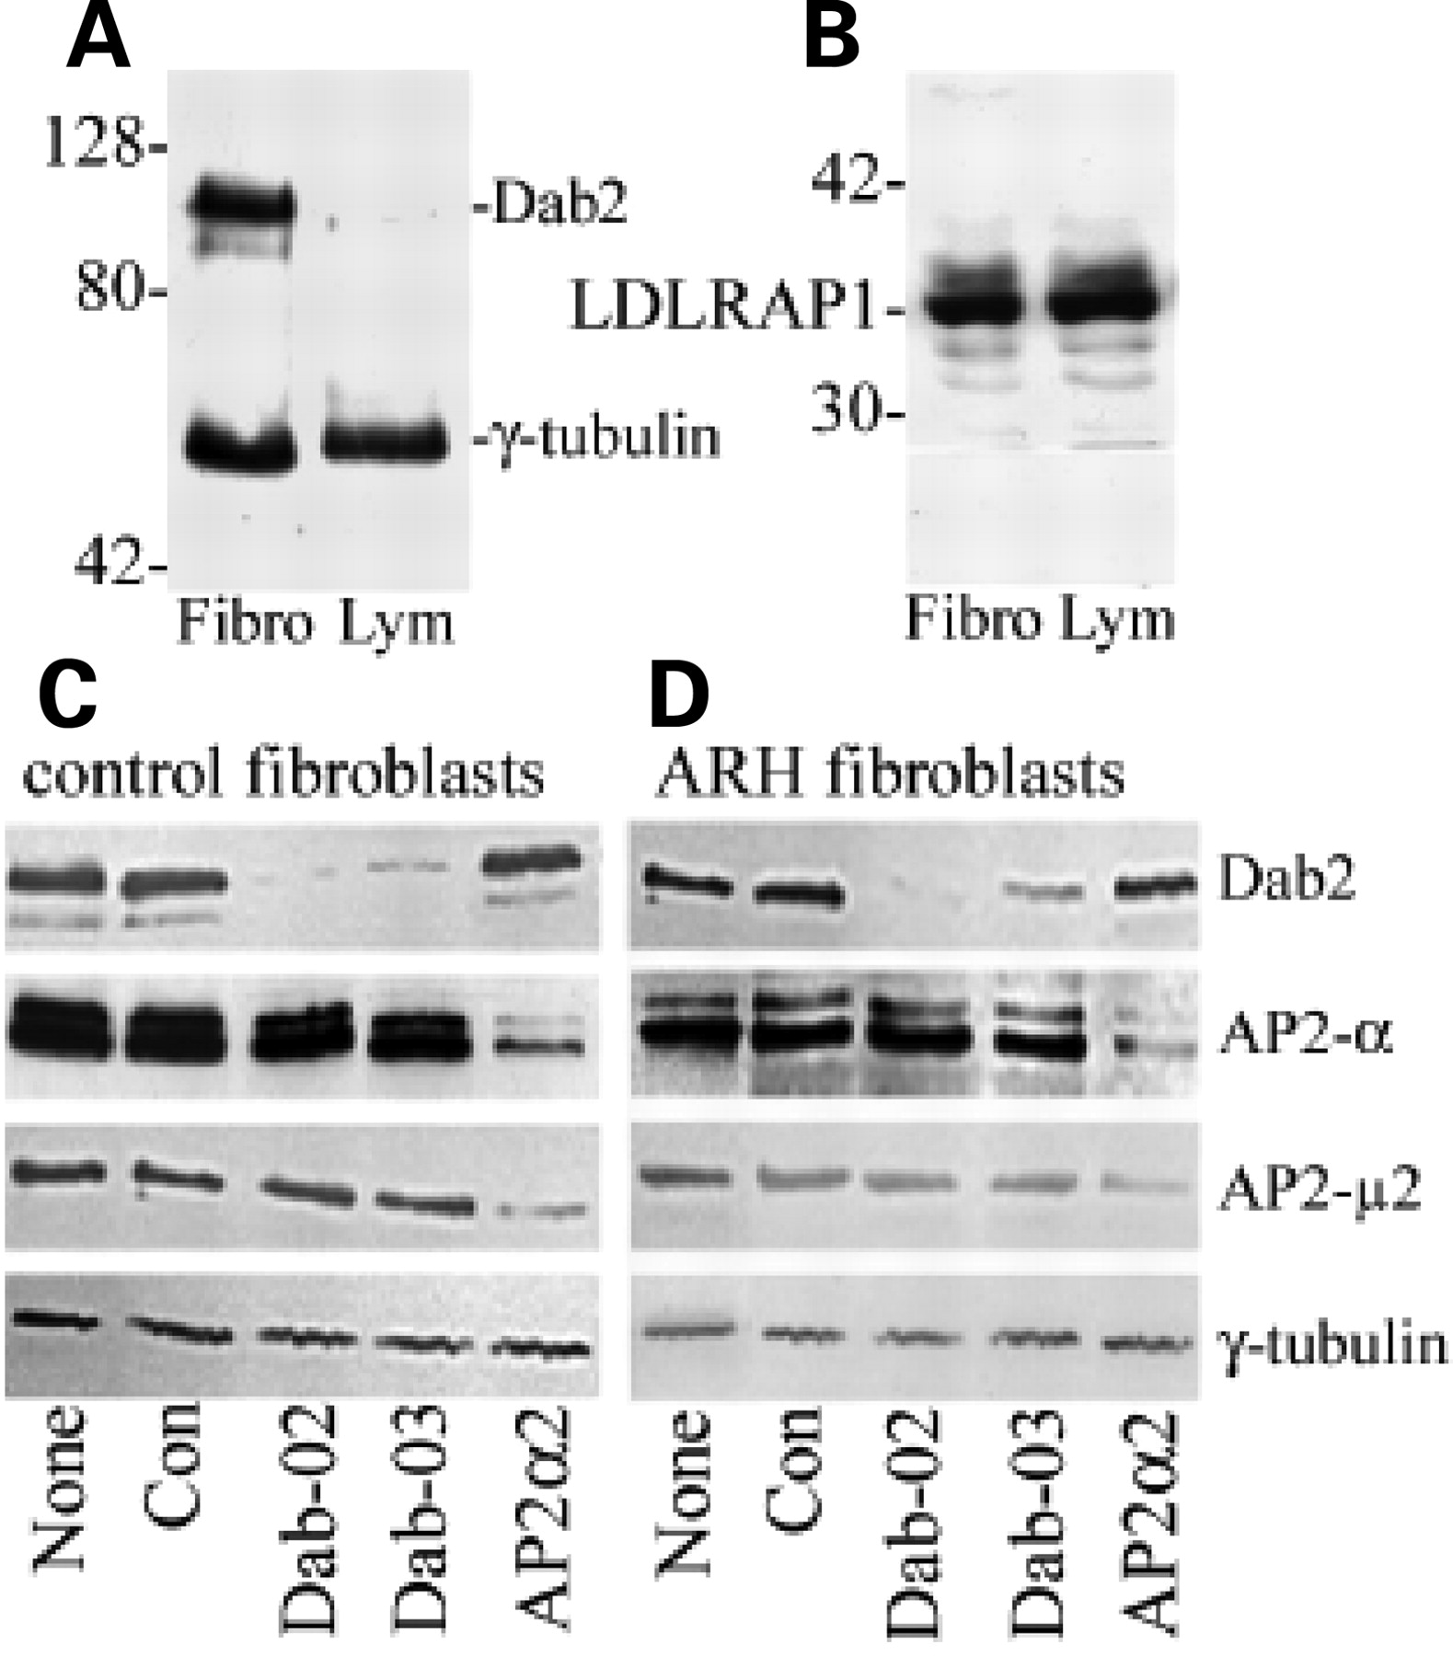
Figure 1. Expression of Dab2 and LDLRAP1. Cell extracts were fractionated on non-reduced SDS–polyacrylamide gels (10%), ...
Notes:
Figure 1. Expression of Dab2 and LDLRAP1. Cell extracts were fractionated on non-reduced SDS–polyacrylamide gels (10%), transferred to nylon membranes and immunoblotted with antibodies to Dab2, LDLRAP1, AP2-α or AP2-µ2 as indicated on the side of the gel images, and with anti-γ-tubulin as a protein loading control. (A and B) Total cell extracts (25 µg of protein/lane) of skin fibroblasts (fibro) or EBV-transformed-lymphocytes (lym). The approximate MW (kDa) of protein markers run on the same gel is indicated. (C and D) Depletion of Dab2. Whole cell lysates of cultured skin fibroblasts from a control subject (C) or an ARH patient (D) were prepared 92 h after transfection with different siRNA, as indicated below: none, untransfected cells; con, non-targeting; Dab2-02 and Dab2-03, two different siRNA targeted to Dab2; AP2-α, siRNA to α-adaptin subunit of AP2.
Unless provided in the caption above, the following copyright applies to the content of this slide: © 2007 The Author(s)This is an Open Access article distributed under the terms of the Creative Commons Attribution Non-Commercial License (http://creativecommons.org/licenses/by-nc/2.0/uk/) which permits unrestricted non-commercial use, distribution, and reproduction in any medium, provided the original work is properly cited.

Slide 2
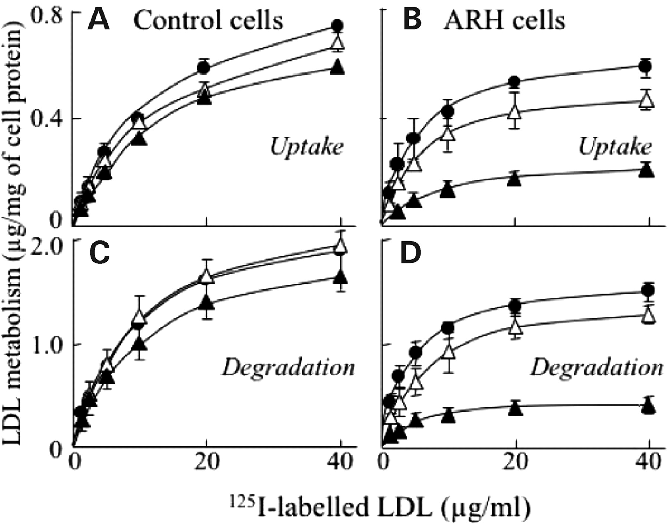
Figure 2. Uptake and degradation of ¹²⁵I-LDL by human skin fibroblasts transfected with siRNA. Skin ...
Notes:
Figure 2. Uptake and degradation of 125I-LDL by human skin fibroblasts transfected with siRNA. Skin fibroblasts from control subjects (A and C) or an ARH patient [homozygous Q136X (B and D)] were transfected with non-targeting siRNA (siCon), or siRNA targeted to either α-adaptin (siAP2) or Dab2 (siDab2). After 48 h, cells were transferred to medium containing LPDS for a further 40 h and then incubated for 4 h at 37°C with 125I-labelled LDL at the indicated concentrations. Saturable uptake (A and B) and degradation (C and D) of LDL was determined in duplicate dishes as the difference in the amount of cell-associated or trichloroacetic acid-soluble, non-iodide radioactivity in the medium of cells incubated in the presence and absence of an excess of unlabelled LDL (1 mg/ml); the data shown are the mean of three separate experiments ± SEM. Non-saturable uptake of LDL by control cells was always <5% of total.
Unless provided in the caption above, the following copyright applies to the content of this slide: © 2007 The Author(s)This is an Open Access article distributed under the terms of the Creative Commons Attribution Non-Commercial License (http://creativecommons.org/licenses/by-nc/2.0/uk/) which permits unrestricted non-commercial use, distribution, and reproduction in any medium, provided the original work is properly cited.

Slide 3
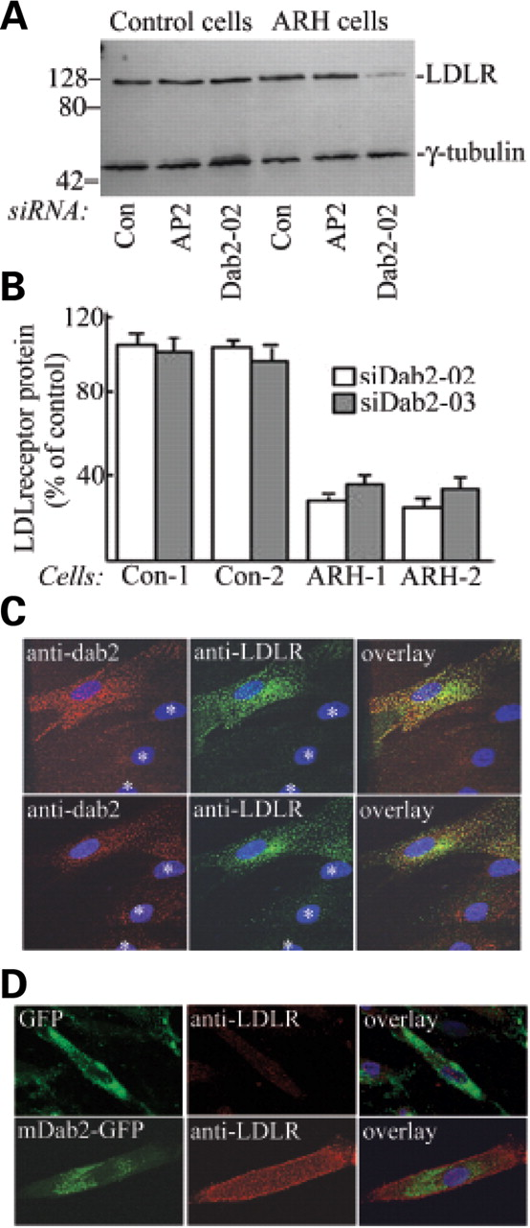
Figure 3. LDL-receptor protein in AP2- and Dab2-depleted fibroblasts. (A) Whole cell extracts of cells treated with ...
Notes:
Figure 3. LDL-receptor protein in AP2- and Dab2-depleted fibroblasts. (A) Whole cell extracts of cells treated with siRNA (as indicated below the gel image) and pre-incubated with LPDS were fractioned on non-reduced SDS–polyacrylamide gels (10%) and immunoblotted with antibodies to the LDL receptor and γ-tubulin, as indicated on the right. (B) The ratios of LDL receptor to γ-tubulin in cells transfected with two different Dab2 siRNA (SiDab2-02 and SiDab2-03) were quantified by densitometry and expressed relative to cells transfected with non-targeting siRNA (control); Con-1 and -2 cells, skin fibroblasts from two control subjects; ARH-1 and -2, skin fibroblasts from ARH patients homozygous for the Q136X (ARH-1) and the W22X (ARH-2) mutations. The data shown are the mean of three separate experiments ± SEM. (C) ARH cells on cover slips were treated with Dab-02 siRNA, incubated with LPDS and then fixed and stained with antisera to Dab2 (red) and LDL receptor (green), with the overlay shown on the right; upper panels, cell surface; lower panels, section through centre of cell. Asterisks indicate cells in which Dab2 was depleted (D) Fibroblasts from an ARH patient (heterozygous for two defective alleles, a large deletion of approximately exons 6–9 and insC620) were transfected on day 1 with Dab2 siRNA, then re-transfected on day 3 with a plasmid expressing either GFP (upper panels) or murine Dab2-GFP (mDab2-GFP, lower panels). On day 5, the cells were fixed and stained with anti-serum to the LDLR (red).
Unless provided in the caption above, the following copyright applies to the content of this slide: © 2007 The Author(s)This is an Open Access article distributed under the terms of the Creative Commons Attribution Non-Commercial License (http://creativecommons.org/licenses/by-nc/2.0/uk/) which permits unrestricted non-commercial use, distribution, and reproduction in any medium, provided the original work is properly cited.

Slide 4
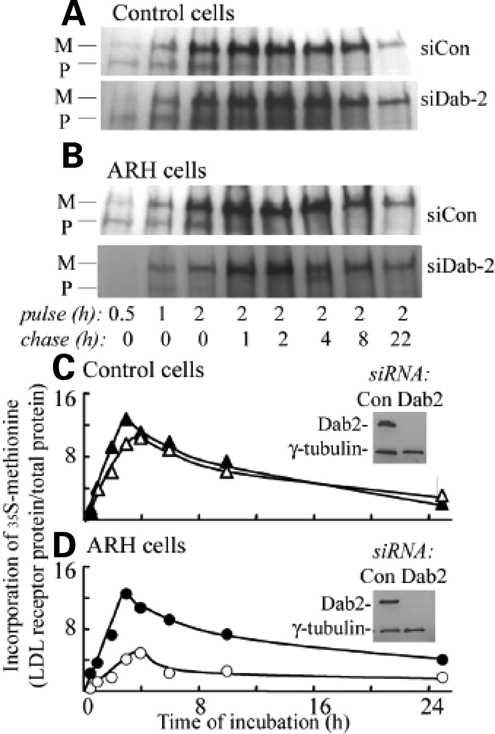
Figure 4. Incorporation of ³⁵S -labelled amino acids into LDL receptor protein. Control (A and C) or ARH ...
Notes:
Figure 4. Incorporation of 35S -labelled amino acids into LDL receptor protein. Control (A and C) or ARH cells (B and D) (heterozygous for two defective alleles, a large deletion of approximately exons 6–9 and insC620) (4) treated with Dab2-02 si-RNA (Dab2) or control siRNA (Con) were pre-incubated with LPDS for 14 h and then incubated in methionine-free medium containing [35S]methionine and cysteine for the indicated times (pulse); cells incubated for 2 h were then incubated with medium containing unlabelled amino acids (chase). (A and B), immunoprecipitated LDL receptor protein in cell lysates was fractionated by SDS–PAGE; horizontal lines indicate the precursor (P) and mature (M) forms. (C and D) Incorporated radioactivity in mature LDL receptor protein was measured by phosphorimaging and expressed relative to incorporation into total cell protein (closed symbols, cells treated with control siRNA; open symbols, cells treated with Dab2 siRNA). The insets show immunoblots of Dab2 and a loading control (γ-tubulin) in the same extracts (siRNA treatment indicated above the gel images).
Unless provided in the caption above, the following copyright applies to the content of this slide: © 2007 The Author(s)This is an Open Access article distributed under the terms of the Creative Commons Attribution Non-Commercial License (http://creativecommons.org/licenses/by-nc/2.0/uk/) which permits unrestricted non-commercial use, distribution, and reproduction in any medium, provided the original work is properly cited.

Slide 5
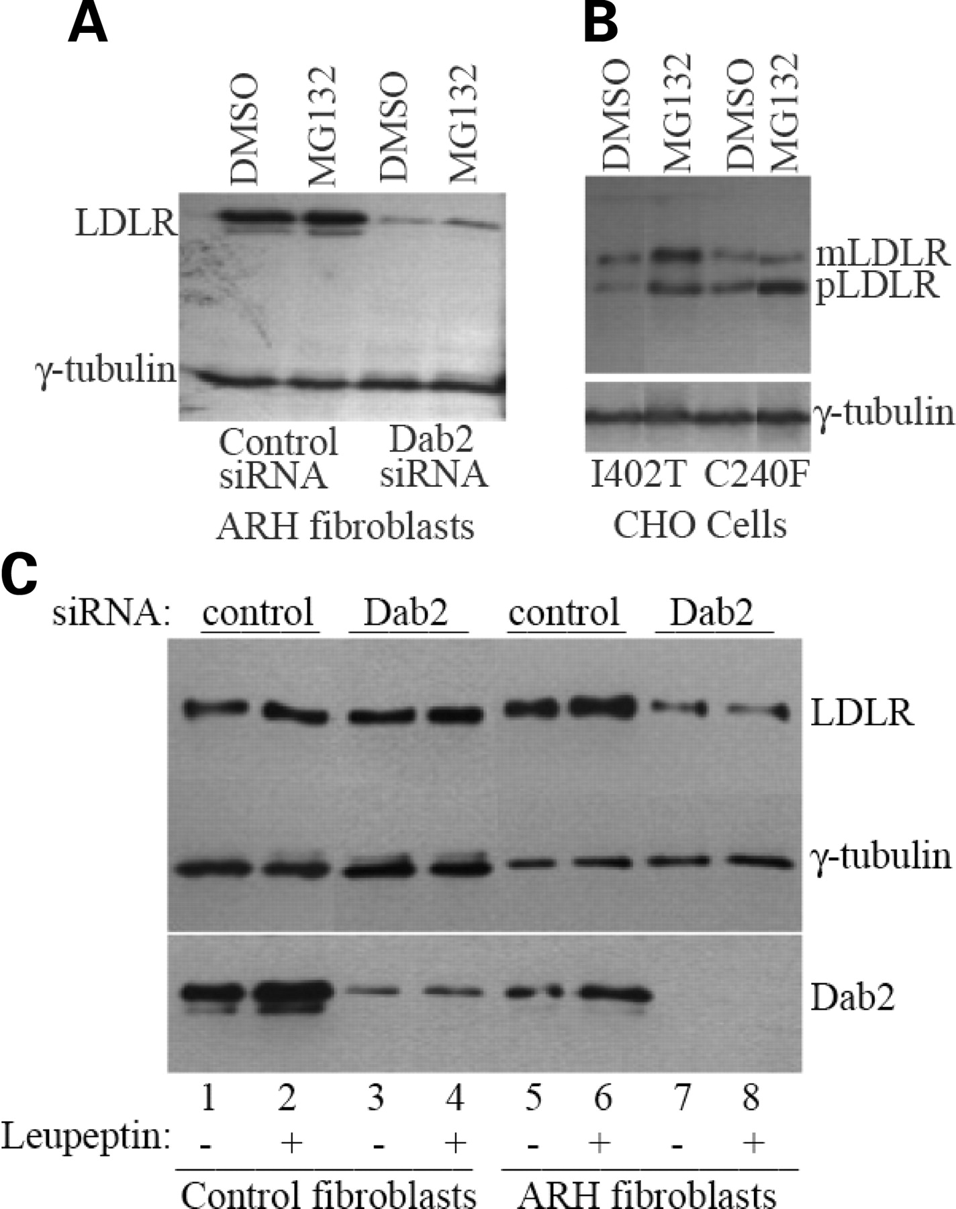
Figure 5. Effects of proteolysis inhibitors on LDL-receptor protein content of cells. ARH fibroblasts treated with ...
Notes:
Figure 5. Effects of proteolysis inhibitors on LDL-receptor protein content of cells. ARH fibroblasts treated with control siRNA or Dab2 siRNA (A) or CHO cells transfected with cDNA for LDL receptor mutants I420T or C240F, as indicated (B), were incubated with MG132 (20 µm) or vehicle (DMSO) for 8 h. (C) Control (lanes 1–4) or ARH (lanes 5–8) fibroblasts treated with control siRNA (lanes 1, 2, 5 and 6) or Dab2 siRNA (lanes 3, 4, 7 and 8) were incubated with (+) or without (−) leupeptin (100 µm) for 20 h. Protein extracts from these cells were analysed by immunoblotting with antibodies to γ-tubulin (as a loading control) or to the LDL receptor as indicated. mLDLR, mature LDL-receptor protein; pLDLR, immature precursor form of LDL receptor.
Unless provided in the caption above, the following copyright applies to the content of this slide: © 2007 The Author(s)This is an Open Access article distributed under the terms of the Creative Commons Attribution Non-Commercial License (http://creativecommons.org/licenses/by-nc/2.0/uk/) which permits unrestricted non-commercial use, distribution, and reproduction in any medium, provided the original work is properly cited.

Slide 6
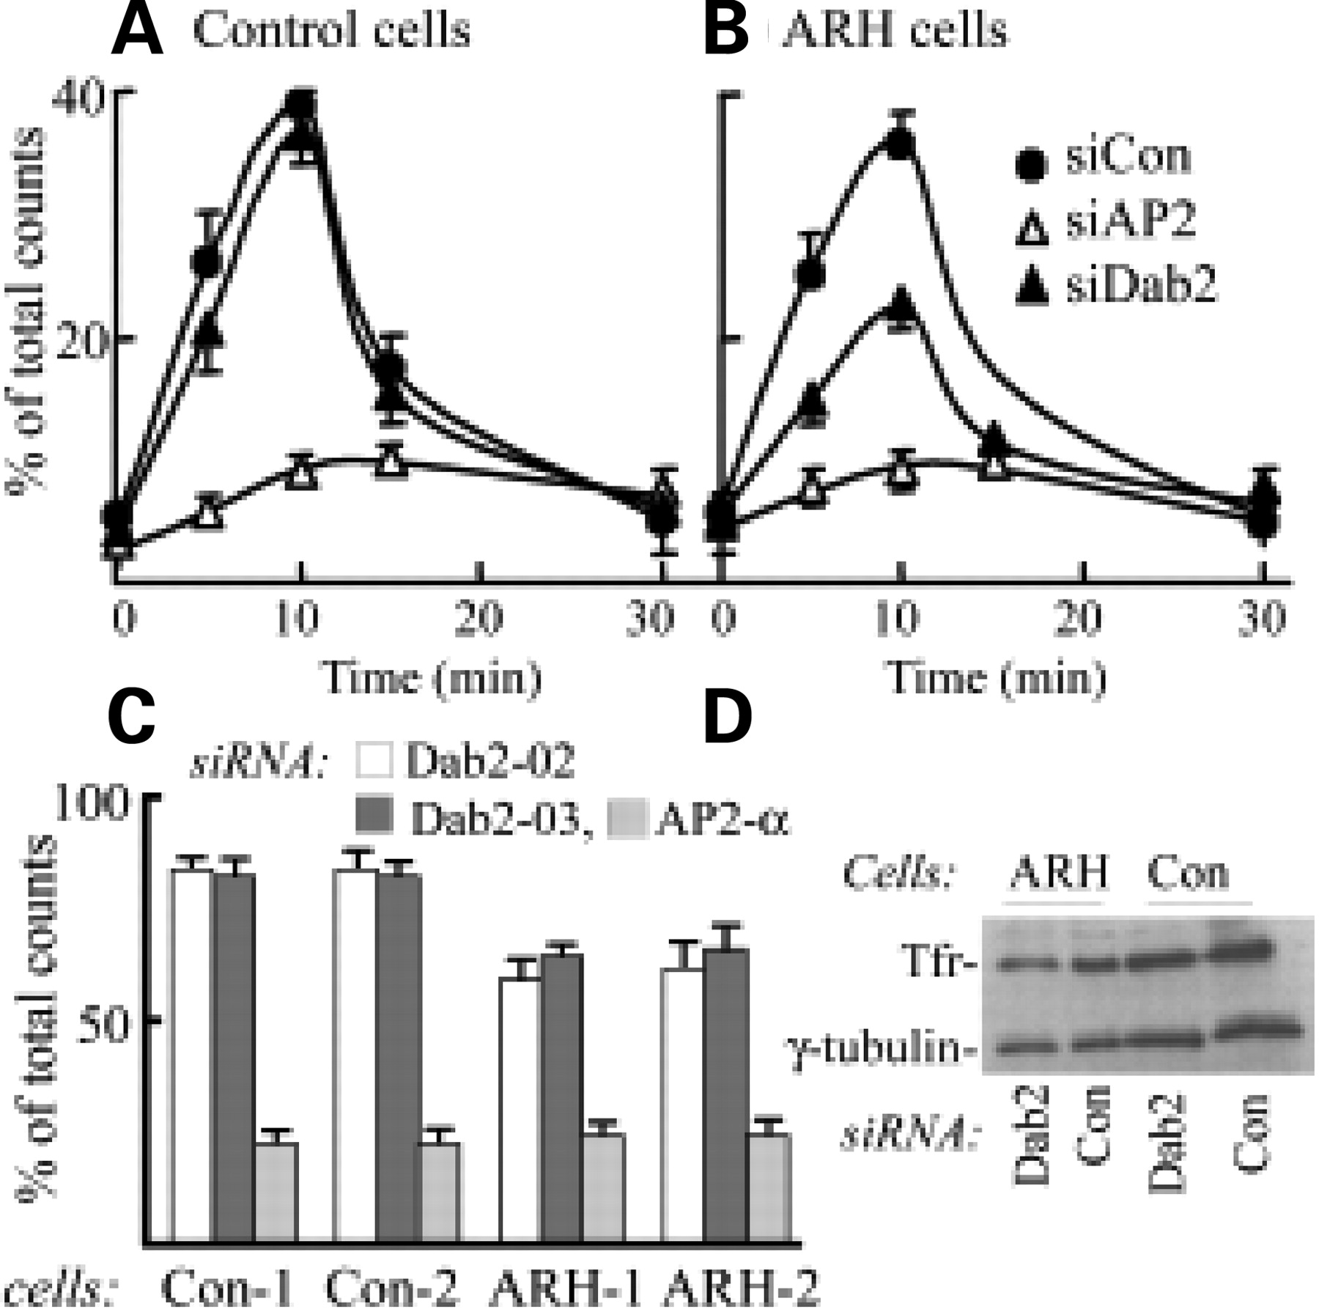
Figure 6. Uptake of ¹²⁵I-Tf by human skin fibroblasts transfected with siRNA. Control (A) or ARH (B) skin ...
Notes:
Figure 6. Uptake of 125I-Tf by human skin fibroblasts transfected with siRNA. Control (A) or ARH (B) skin fibroblasts were treated with siRNA as described in Figure 3, and 4 days later, the internalization and recycling of 125I-labelled Tf was determined and expressed as a percentage of the total counts in the lysate. Data shown are the mean of duplicate values in three separate experiments. (C) Tf uptake after 10 min at 37°C was measured in fibroblasts from two control subjects (Con-1 and -2) and two ARH patients (ARH-1, homozygous for Q136X and ARH-2, homozygous for W22X) transfected with a control siRNA, siDab2-02, siDab2-03 or α-adaptin siRNA (siAP2-α); values were expressed as the percentage of uptake in the cells transfected with a non-targeting siRNA. (D) Extracts of control (Con) or ARH cells treated with control siRNA (Con) or siRNA targeted to Dab2 were immunoblotted with antisera to Tf receptor (TfR) or γ-tubulin, all as indicated.
Unless provided in the caption above, the following copyright applies to the content of this slide: © 2007 The Author(s)This is an Open Access article distributed under the terms of the Creative Commons Attribution Non-Commercial License (http://creativecommons.org/licenses/by-nc/2.0/uk/) which permits unrestricted non-commercial use, distribution, and reproduction in any medium, provided the original work is properly cited.

