Slide 1
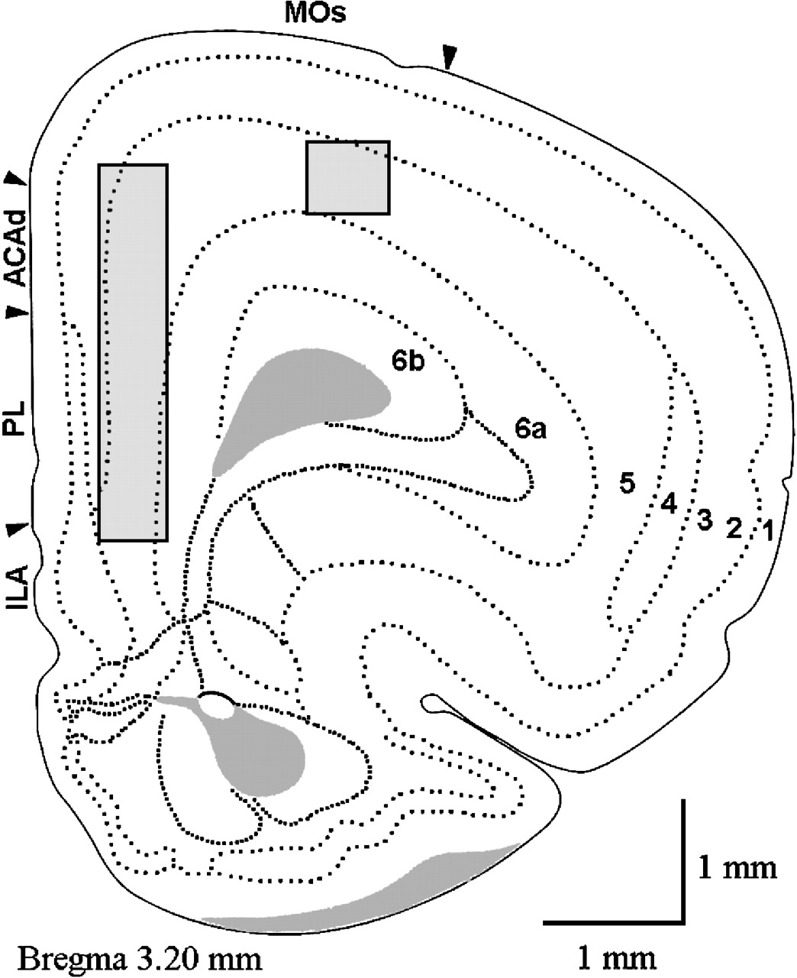
Figure 1. Schematic localization of the recording area in the dorsal anterior cingulate area (ACAd) and prelimbic area ...
Notes:
Figure 1. Schematic localization of the recording area in the dorsal anterior cingulate area (ACAd) and prelimbic area (PL) of the medial prefrontal cortex. Shown is also the localization of recordings in the secondary motor area (MOs). In both areas recordings were made mainly in layer V neurons. Section taken from Brain Maps, Swanson (1998).
Unless provided in the caption above, the following copyright applies to the content of this slide: Cerebral Cortex V 15 N 1 © Oxford University Press 2005; all rights reserved

Slide 2
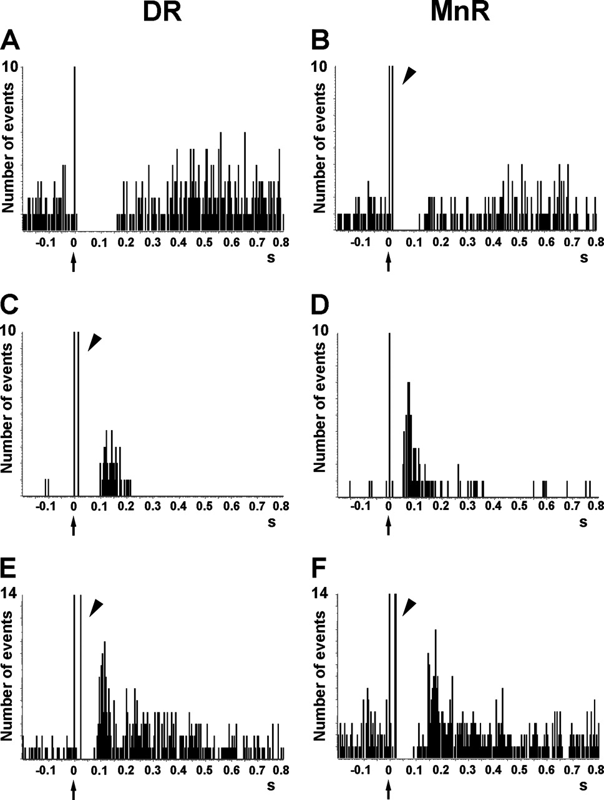
Figure 2. Representative examples of the responses evoked in pyramidal neurons of the anterior cingulate and prelimbic ...
Notes:
Figure 2. Representative examples of the responses evoked in pyramidal neurons of the anterior cingulate and prelimbic areas of the mPFC by the electrical stimulation of the DR and MnR (see Materials and Methods). (A, B) Short latency long duration inhibitory responses. (C, D) Pure excitatory responses, which are often seen in pyramidal neurons with a low firing rate. These orthodromic excitations have a similar duration after DR or MnR stimulation but the latency is significantly lower after MnR stimulation, as in the example seen in the figure (see also Table 1). (E, F) Orthodromic excitations preceded by short latency inhibitions (biphasic responses). Note the presence of antidromic spikes in the units recorded (B, C, E, F). The units in (A) and (D) were antidromically activated at currents higher than those used to evoke a pyramidal response. Each PSTH consists of 110 triggers (2 min). Bin size = 4 ms. The arrow in the abcissa denotes the stimulus artifact (time = 0). The arrowheads indicate antidromic spikes.
Unless provided in the caption above, the following copyright applies to the content of this slide: Cerebral Cortex V 15 N 1 © Oxford University Press 2005; all rights reserved

Slide 3
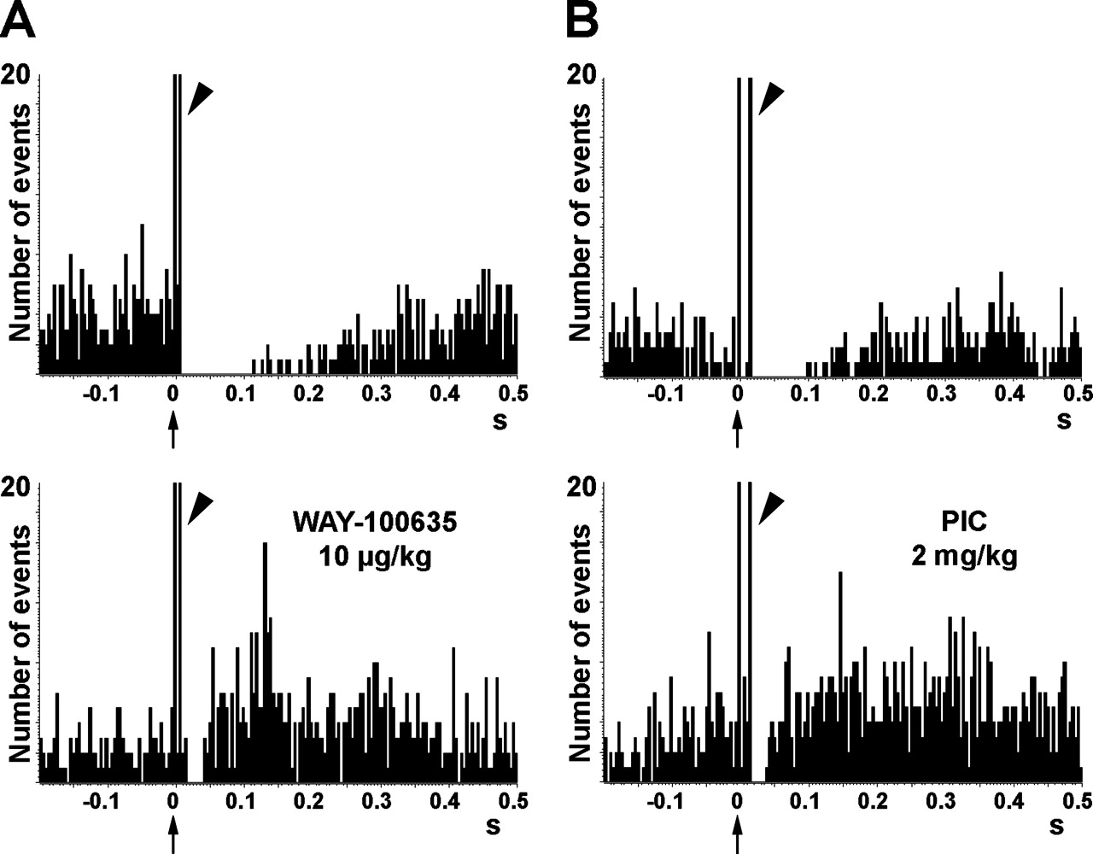
Figure 3. Antagonism of the DR/MnR-evoked inhibitory responses in mPFC by the 5-HT_{1A} receptor antagonist ...
Notes:
Figure 3. Antagonism of the DR/MnR-evoked inhibitory responses in mPFC by the 5-HT1A receptor antagonist WAY-100635 and the GABAA receptor antagonist picrotoxinin (PIC). Upper panels correspond to PSTHs obtained in basal conditions and lower panels, to those after drug treatment. The response in A was obtained by DR stimulation at 1 mA and shows an antidromic spike at 10 ms. This inhibitory response had a latency of 9 ms. The firing rate, expressed as percentage of pre-stimulus value, was 19% in basal conditions and 215% after WAY-100635 administration. The inhibitory response of this unit was particularly sensitive to WAY-100635 administration. On average, WAY-100635 administration did not reverse the inhibitory response between 0 and 69 ms (n = 8; Amargós-Bosch et al., 2004). The response in B was obtained by DR stimulation at 2 mA and shows an antidromic spike at 14 ms. This inhibitory response had a latency of 13 ms. The firing rates, expressed as percentage of pre-stimulus value were 27 and 153% in basal conditions and after picrotoxinin, respectively. Note the overall increase in firing rate after picrotoxinin administration. Each PSTH consists of 110 triggers. Bin size = 4 ms.
Unless provided in the caption above, the following copyright applies to the content of this slide: Cerebral Cortex V 15 N 1 © Oxford University Press 2005; all rights reserved

Slide 4
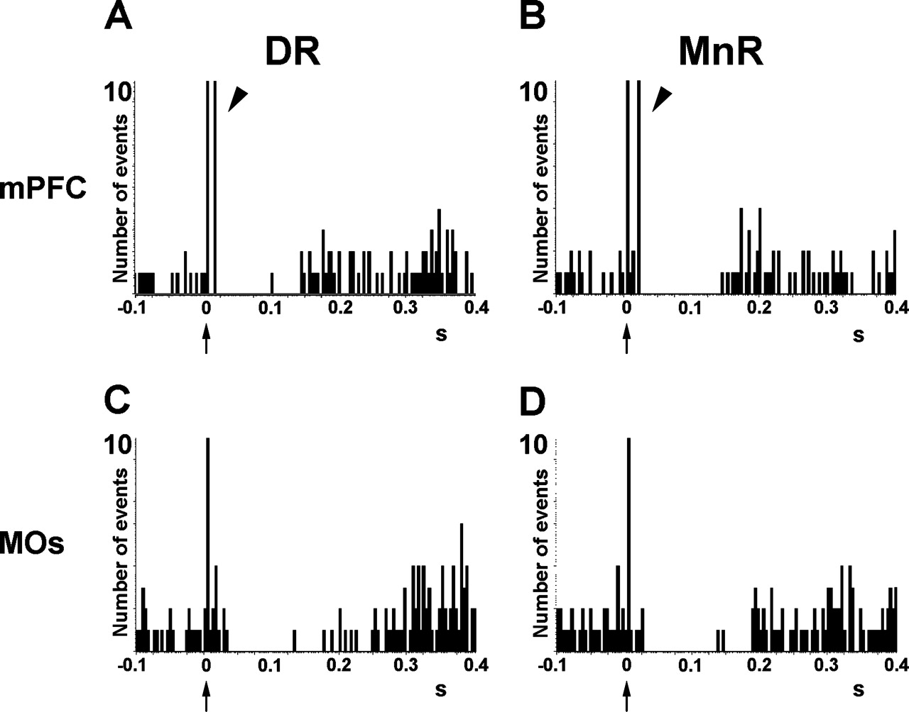
Figure 4. Comparison of the inhibitory responses evoked in mPFC (A, B) and MOs (C, D) by the electrical stimulation of ...
Notes:
Figure 4. Comparison of the inhibitory responses evoked in mPFC (A, B) and MOs (C, D) by the electrical stimulation of the DR and MnR. Characteristics are as follows: (A) stimulation at 2 mA; latency = 4 ms; duration = 140 ms; 5% of pre-stimulus firing; (B) stimulation at 1 mA; latency = 11 ms; duration = 148 ms; 0% of pre-stimulus firing; (C) stimulation at 1 mA; latency = 31 ms; duration = 232 ms; 19% of pre-stimulus firing; (D) stimulation at 1 mA; latency = 20 ms; duration = 156 ms; 3% of pre-stimulus firing. Note the antidromic spikes (arrowheads; latency = 13 and 18 ms in A and B, respectively) in the units recorded in mPFC (but not MOs), a consequence of the reciprocal connectivity of the mPFC and the raphe nuclei (only two cells out of a total of 65 in MOs were found to be antidromically activated from the raphe nuclei; see Fig. 5C). For a better visualization of the inhibitions, PSTHs have been drawn between −100 and +400 ms. Each PSTH consists of 110 triggers. Bin size is 4 ms.
Unless provided in the caption above, the following copyright applies to the content of this slide: Cerebral Cortex V 15 N 1 © Oxford University Press 2005; all rights reserved

Slide 5
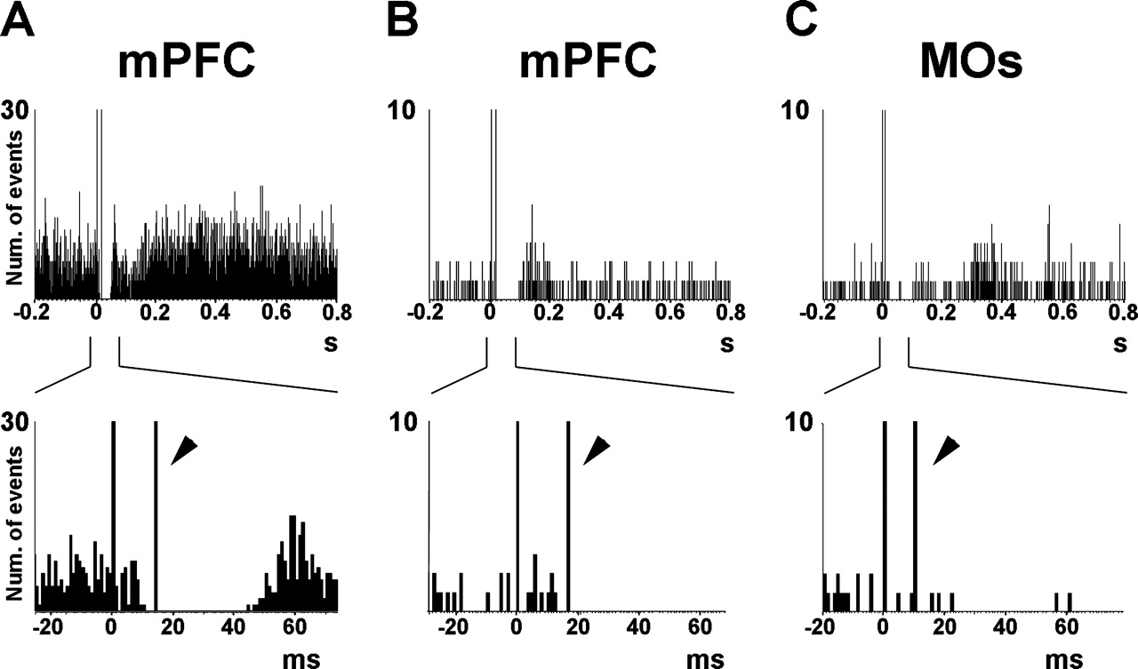
Figure 5. PSTHs of a midbrain raphe-evoked inhibitions in mPFC (A, B) and MOs (C) (lower panels show an enlargement of ...
Notes:
Figure 5. PSTHs of a midbrain raphe-evoked inhibitions in mPFC (A, B) and MOs (C) (lower panels show an enlargement of the time period around the stimulus). (A) The stimulation of the DR at 1 mA evoked a short latency, short duration inhibition in mPFC (32 ms; 8% of pre-stimulus firing rate). The latency of the inhibition was 11 ms, whereas the antidromic spike (arrowhead) had a latency of 15 ms. PSTH made of 718 triggers (∼13 min recording). (B) Short latency inhibition evoked in mPFC by DR stimulation at 1 mA (duration 78 ms, 3% of pre-stimulus firing rate). The latency of the inhibition was 12 ms and that of the antidromic spike was 15 ms. PSTH made of 617 triggers (∼11 min). (C) Inhibition evoked in an identified projection neuron in MOs by MnR stimulation at 1 mA (duration 257 ms, 38% of pre-stimulus firing rate). Despite this neuron projected to midbrain, as denoted by the antidromic spike (latency 9 ms), the latency of the inhibition was 19 ms. PSTH made of 102 triggers (∼2 min). Note the absence of spikes before the antidromic spike in the inhibitions recorded in pyramidal neurons of the mPFC, which precludes that the onset of these inhibitory responses is triggered by antidromic invasion of pyramidal collaterals and further activation of local GABA interneurons. In contrast, the two projection neurons found in MOs (out of 65) had a latency greater than the antidromic spike, as in the example shown in (C). Bin size = 1 ms.
Unless provided in the caption above, the following copyright applies to the content of this slide: Cerebral Cortex V 15 N 1 © Oxford University Press 2005; all rights reserved

Slide 6
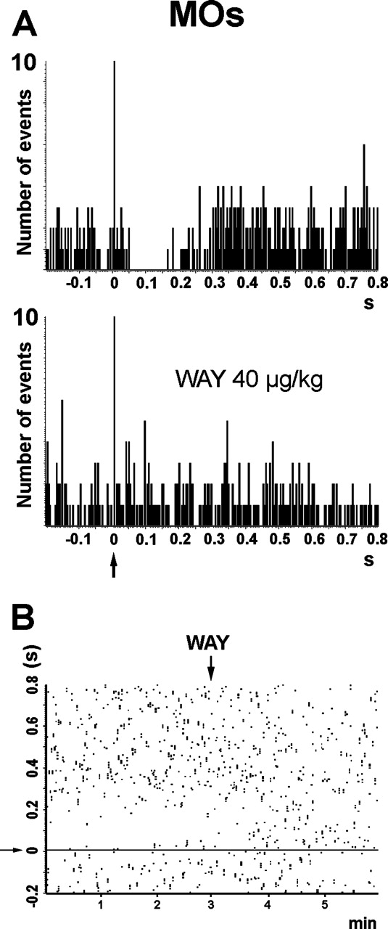
Figure 6. Effect of 5-HT_{1A} receptor blockade on a MnR-evoked inhibition in MOs (1 mA). (A) PSTHs in basal ...
Notes:
Figure 6. Effect of 5-HT1A receptor blockade on a MnR-evoked inhibition in MOs (1 mA). (A) PSTHs in basal conditions (upper panel) and after WAY-100635 administration (40 μg/kg i.v.) (lower panel). Inhibition latency: 46 ms, duration: 160 ms, 13% of pre-stimulus firing during inhibition. (B) A raster display shows the inhibition and the rapid effect of WAY-100635 administration. The horizontal line in (B) corresponds to the vertical line in (A) and denotes the stimulus artifact. Note the full blockade of the MnR-evoked inhibition by WAY-100635. Each PSTH corresponds to 110 triggers. Bin size = 4 ms. The time of administration of WAY-100635 (WAY) is shown by a vertical arrow.
Unless provided in the caption above, the following copyright applies to the content of this slide: Cerebral Cortex V 15 N 1 © Oxford University Press 2005; all rights reserved

Slide 7
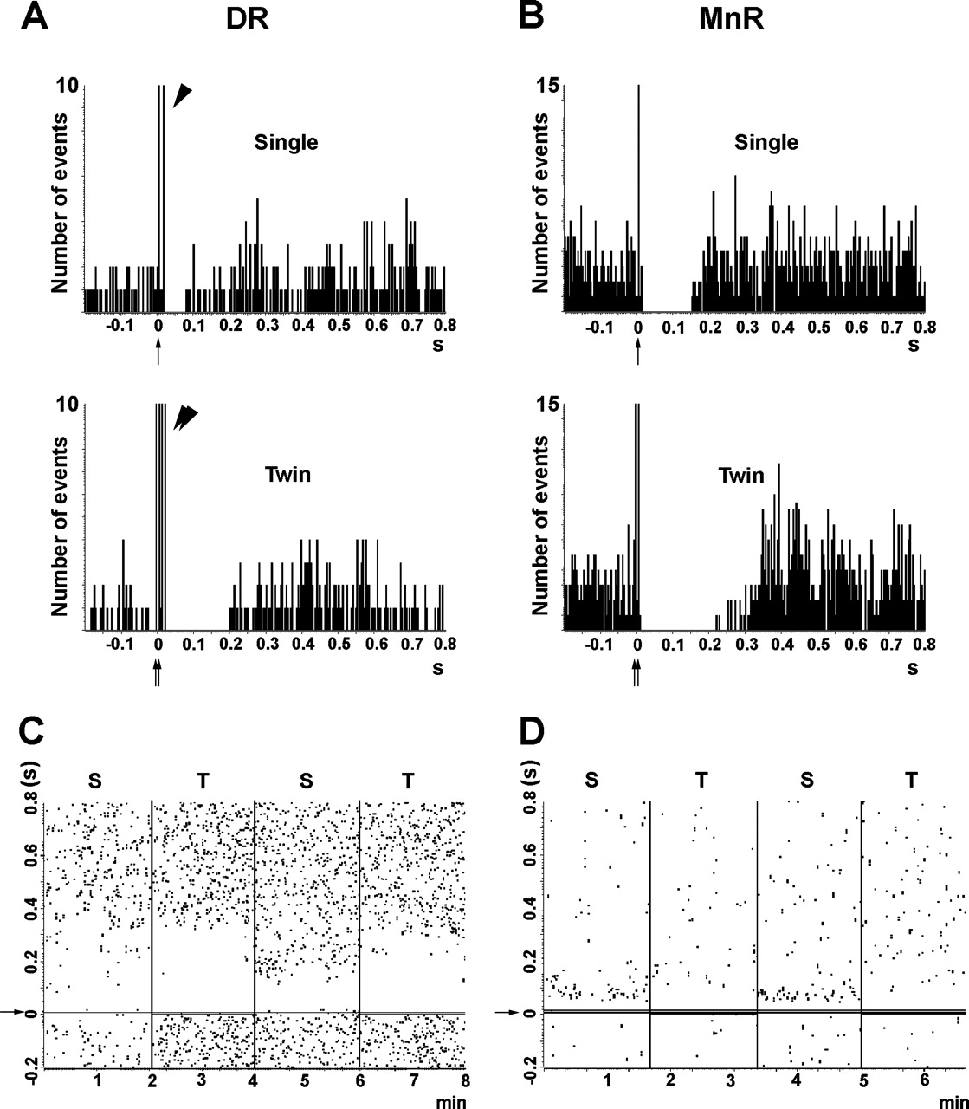
Figure 7. Enhancement of the DR- and MnR-evoked inhibitions in mPFC by twin pulse stimulation. Twin pulses were given 7 ...
Notes:
Figure 7. Enhancement of the DR- and MnR-evoked inhibitions in mPFC by twin pulse stimulation. Twin pulses were given 7 ms apart. The pyramidal neuron in (A) was inhibited by stimulation of the DR at 1.7 mA (latency = 19 ms, duration = 70 ms, 13% of pre-stimulus firing during inhibition). Twin pulse stimulation at the same intensity evoked a longer duration response (181 ms, 0% pre-stimulus firing; see lower panel in A). Similarly, the unit in (B) was inhibited by MnR stimulation at 1 mA (latency = 14 ms, duration = 170 ms, 8% of pre-stimulus firing during inhibition). This unit was antidromically activated at a higher current. Twin pulse stimulation evoked a longer duration response (318 ms, 11% pre-stimulus firing; see lower panel in B). Each PSTH consists of 120 triggers. Bin size = 4 ms. Arrows denote the stimulus artifact and arrowheads show the presence of antidromic spikes. (C, D) Raster displays showing the reversibility of the responses after single (S) and twin (T) pulse stimulation. (C) The enhancement of an inhibitory response after DR stimulation (1 mA) by twin pulse stimulation. This unit was antidromically activated from MnR at 1 mA. (D) The abolishment of an excitation in a biphasic response by twin pulse stimulation in the MnR (1 mA, latency of antidromic spike = 9 ms).
Unless provided in the caption above, the following copyright applies to the content of this slide: Cerebral Cortex V 15 N 1 © Oxford University Press 2005; all rights reserved

Slide 8
Figure 8. Enhancement of an inhibitory response in a pyramidal neuron of the mPFC by twin pulse stimulation of the DR ...
Notes:
Figure 8. Enhancement of an inhibitory response in a pyramidal neuron of the mPFC by twin pulse stimulation of the DR (1 mA; the neuron was antidromically activated from DR at 2 mA with a latency of 17 ms). Basal inhibition is shown in (A) (latency = 12 ms, duration = 282 ms, 18% of pre-stimulus firing during inhibition). Twin pulse stimulation enhanced the duration of the inhibition up to 412 ms (3% of pre-stimulus firing). Note the two stimulus artifacts (7 ms apart; indicated by arrows in the abcissa). The panel in (C) shows the partial reversal of the effect of twin pulse stimulation by the 5-HT1A receptor antagonist WAY-100635 (80 μg/kg i.v.), which reduced the duration of the inhibition to 268 ms. Each PSTH is composed of 110 triggers. Bin size = 4 ms. (D) Raster display of the PSTHs shown in (A–C). The time of administration of WAY-100635 (WAY) is shown by vertical arrows (40 and 80 μg/kg i.v. cumulative doses).
Unless provided in the caption above, the following copyright applies to the content of this slide: Cerebral Cortex V 15 N 1 © Oxford University Press 2005; all rights reserved

