Slide 1
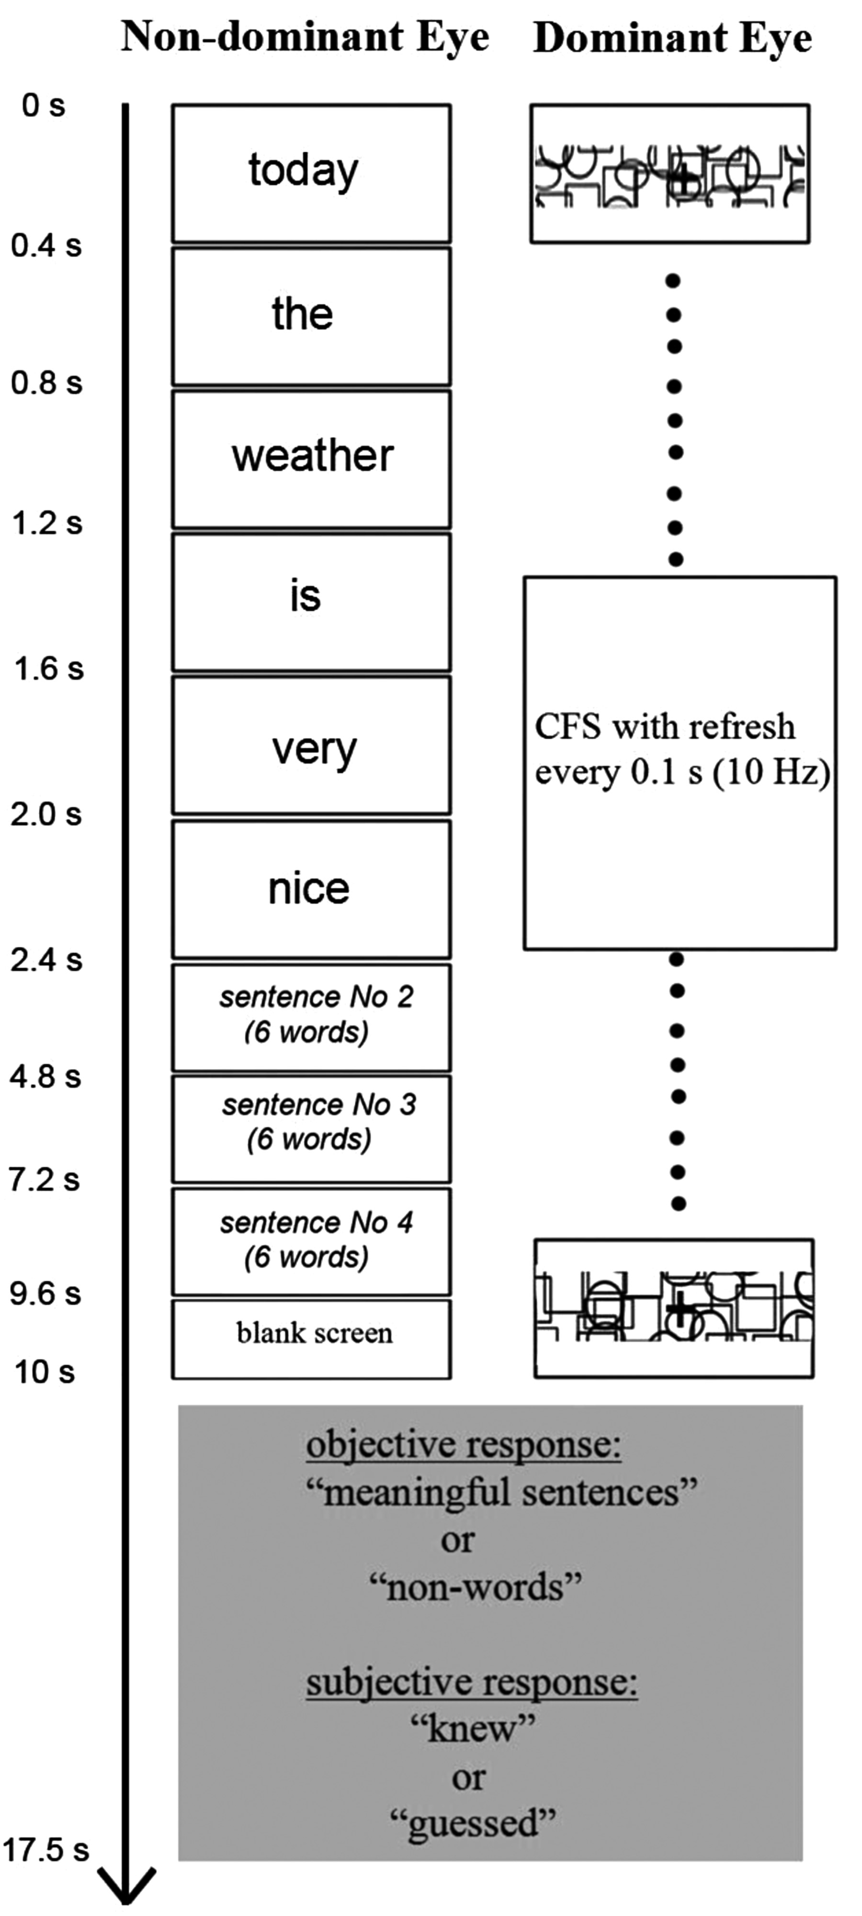
Figure 1. Schematic flow of one block with meaningful sentence in CFS invisible experiment. The words are translated to ...
Notes:
Figure 1. Schematic flow of one block with meaningful sentence in CFS invisible experiment. The words are translated to English for illustrative purpose only while in the experiment all the materials were in Russian. The structure of the blocks with unpronounceable nonwords was the same as the blocks with meaningful sentences, but substituting nonwords (random letter permutations) for words. In the functional localizer (visible experiment) the block flow was similar to that depicted in this figure while the words were visible via both eyes (no CFS mask) and the task was 1-back word repetition (instead of awareness report at the end of the block).
Unless provided in the caption above, the following copyright applies to the content of this slide: © The Author 2014. Published by Oxford University Press.This is an Open Access article distributed under the terms of the Creative Commons Attribution License (http://creativecommons.org/licenses/by/3.0/), which permits unrestricted reuse, distribution, and reproduction in any medium, provided the original work is properly cited.

Slide 2
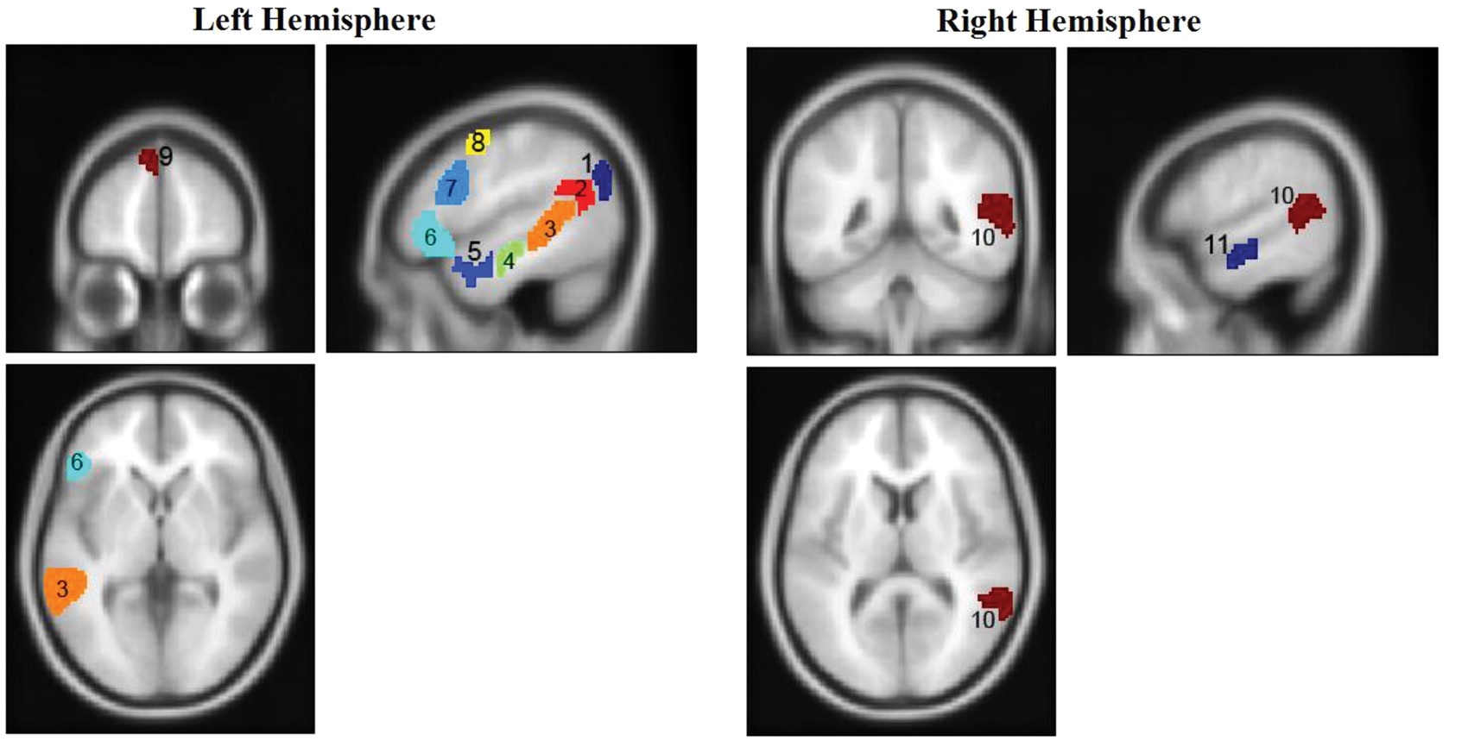
Figure 2. Probabilistic group-level masks of language network (Fedorenko et al. 2010; ...
Notes:
Figure 2. Probabilistic group-level masks of language network (Fedorenko et al. 2010; http://web.mit.edu/evelina9/www/funcloc/funcloc_parcels.html) projected on a SPM template T1 image. The names of the regions are: 1—left angular gyrus, 2—left supramarginal gyrus, 3—left posterior STS, 4—left middle anterior temporal, 5—left anterior temporal, 6—left orbital inferior frontal gyrus, 7—left inferior frontal gyrus, 8—left middle frontal gyrus, 9—left superior frontal gyrus, 10—right posterior STS, 11—right middle anterior temporal. Regions’ IDs correspond to the IDs in Table 3.
Unless provided in the caption above, the following copyright applies to the content of this slide: © The Author 2014. Published by Oxford University Press.This is an Open Access article distributed under the terms of the Creative Commons Attribution License (http://creativecommons.org/licenses/by/3.0/), which permits unrestricted reuse, distribution, and reproduction in any medium, provided the original work is properly cited.

Slide 3
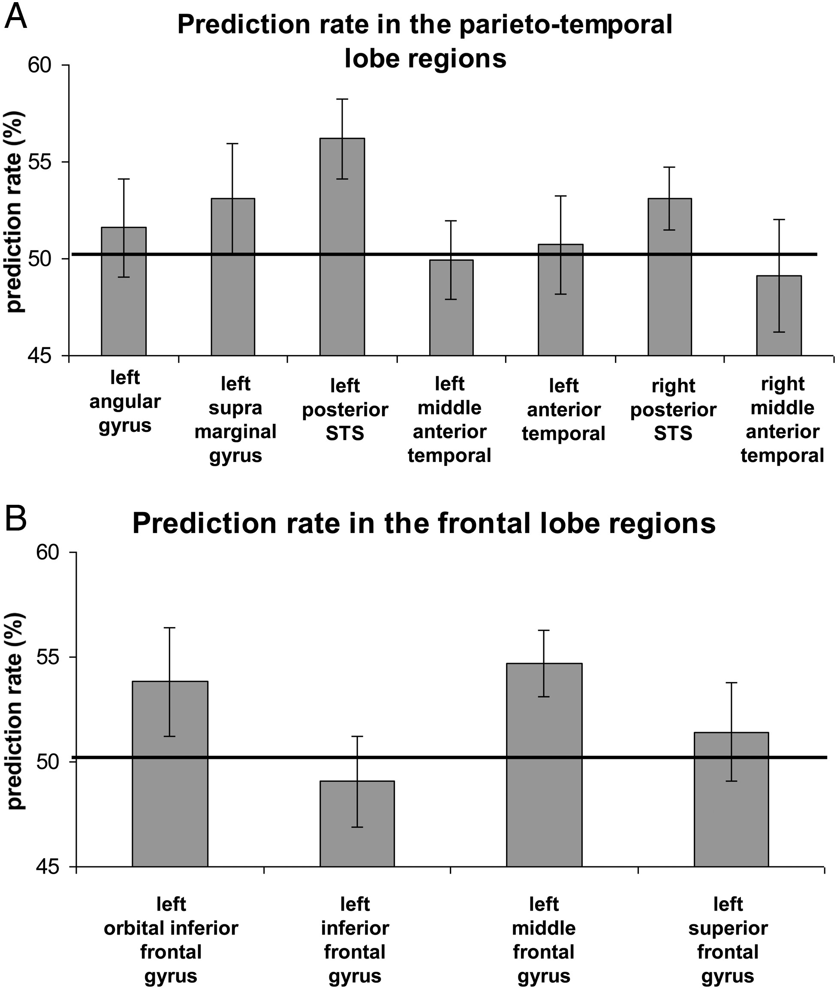
Figure 3. Prediction rate of discrimination between subliminal meaningful sentences and nonwords in language network ...
Notes:
Figure 3. Prediction rate of discrimination between subliminal meaningful sentences and nonwords in language network regions in the temporal lobe (A) and the frontal lobe (B). Black line is a chance level = 50%; error bars denote standard error of the mean.
Unless provided in the caption above, the following copyright applies to the content of this slide: © The Author 2014. Published by Oxford University Press.This is an Open Access article distributed under the terms of the Creative Commons Attribution License (http://creativecommons.org/licenses/by/3.0/), which permits unrestricted reuse, distribution, and reproduction in any medium, provided the original work is properly cited.

Slide 4
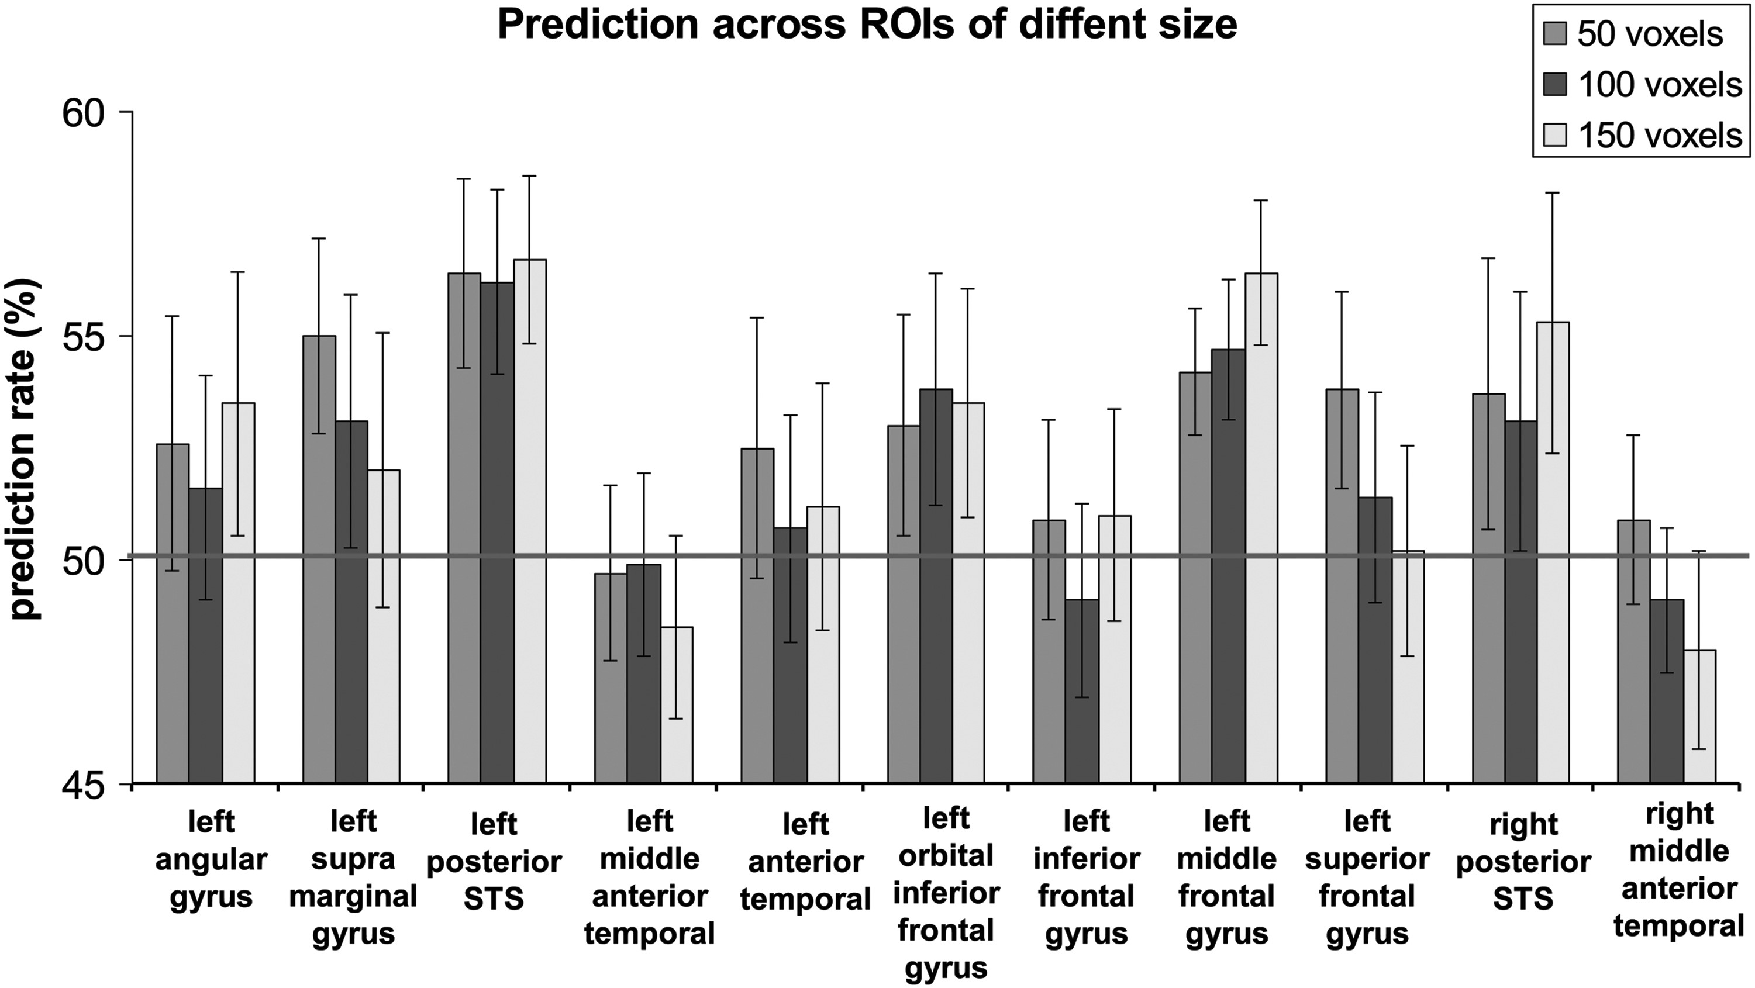
Figure 4. Discrimination between subliminal meaningful sentences and nonwords in language network regions for ROI size ...
Notes:
Figure 4. Discrimination between subliminal meaningful sentences and nonwords in language network regions for ROI size of 50, 100, and 150 voxels. Grey line represents a chance level of performance (50%); error bars denote standard error of the mean.
Unless provided in the caption above, the following copyright applies to the content of this slide: © The Author 2014. Published by Oxford University Press.This is an Open Access article distributed under the terms of the Creative Commons Attribution License (http://creativecommons.org/licenses/by/3.0/), which permits unrestricted reuse, distribution, and reproduction in any medium, provided the original work is properly cited.

