Slide 1
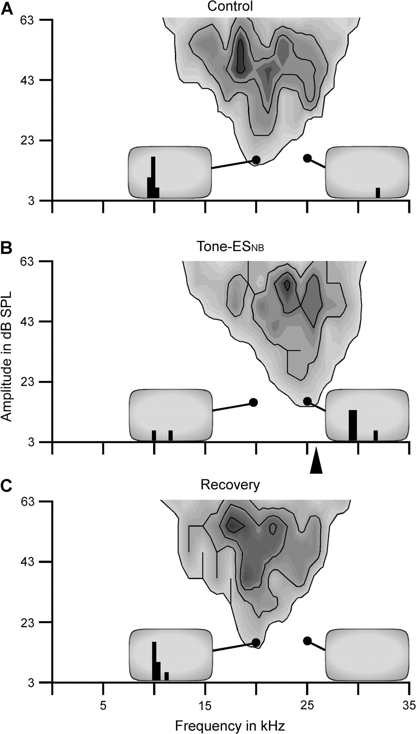
Figure 1. Effect of tone-ES_{NB} on the receptive field of a thalamic neuron in the saline group. ...
Notes:
Figure 1. Effect of tone-ESNB on the receptive field of a thalamic neuron in the saline group. Tone-ESNB shifted the BF of this thalamic neuron toward the frequency of the paired tone (arrowhead in B) paired with electrical stimulation of the basal forebrain (A and B). The BF shifted back to the original frequency at 300 min after tone-ESNB (C). The contour lines, respectively, represent 20%, 40%, 60%, and 80% of the maximum spike number. The insets display the PST histograms of the responses of the neuron to 20.0 kHz with 16.3-dB SPL tone (left) and at 25.0 kHz with 15.4-dB SPL tone (right). The time window of the histogram in the insets is 100 ms and the scale of ordinate is 5 spikes.
Unless provided in the caption above, the following copyright applies to the content of this slide: © The Author 2008. Published by Oxford University Press. All rights reserved. For permissions, please e-mail: journals.permissions@oxfordjournals.org

Slide 2
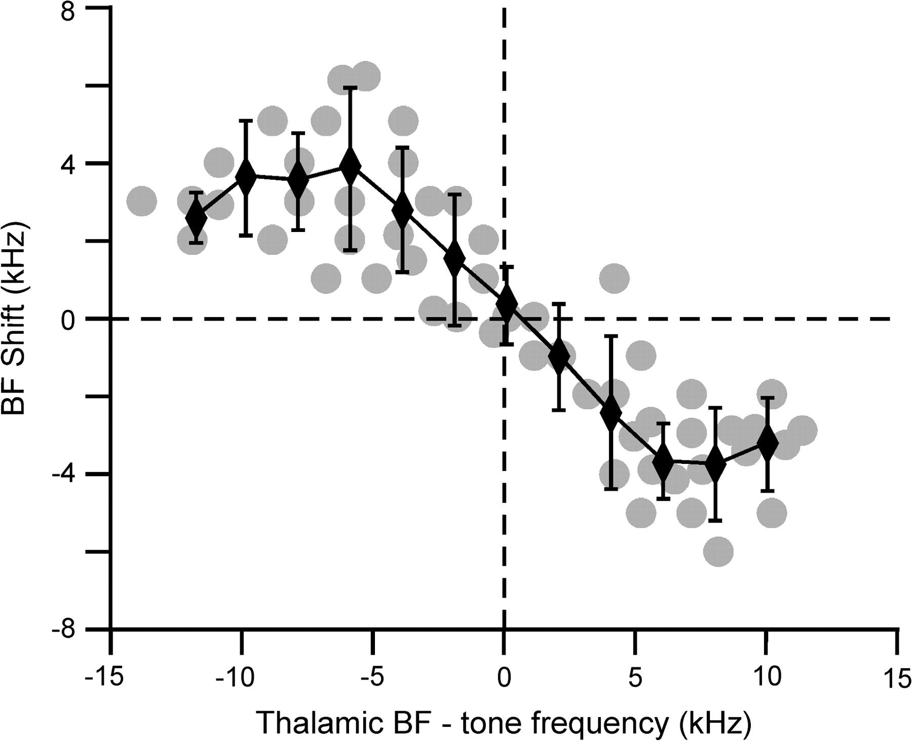
Figure 2. BF shifts of thalamic neurons as the function of the differences between tone frequencies and thalamic BFs. ...
Notes:
Figure 2. BF shifts of thalamic neurons as the function of the differences between tone frequencies and thalamic BFs. Tone-ESNB induced centripetal shift in thalamic BFs. When the difference between control BFs and the frequency of the paired tone was less than 7 kHz, the BF shift was linearly increased following the increase in frequency difference. When the difference was larger than 7.0 kHz, the BF shift became less.
Unless provided in the caption above, the following copyright applies to the content of this slide: © The Author 2008. Published by Oxford University Press. All rights reserved. For permissions, please e-mail: journals.permissions@oxfordjournals.org

Slide 3
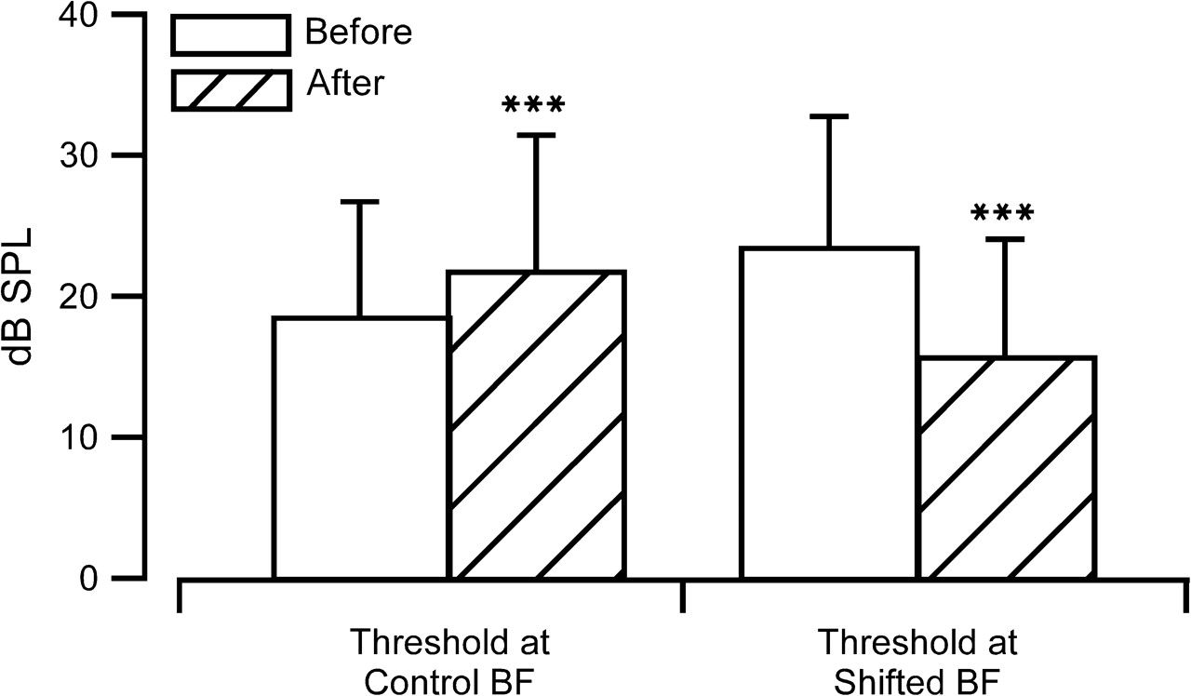
Figure 3. Changes in thresholds caused by tone-ES_{NB}. The response threshold to the control BF was ...
Notes:
Figure 3. Changes in thresholds caused by tone-ESNB. The response threshold to the control BF was significantly increased, and that to the shifted BF was significantly decreased after the tone-ESNB (P < 0.001).
Unless provided in the caption above, the following copyright applies to the content of this slide: © The Author 2008. Published by Oxford University Press. All rights reserved. For permissions, please e-mail: journals.permissions@oxfordjournals.org

Slide 4
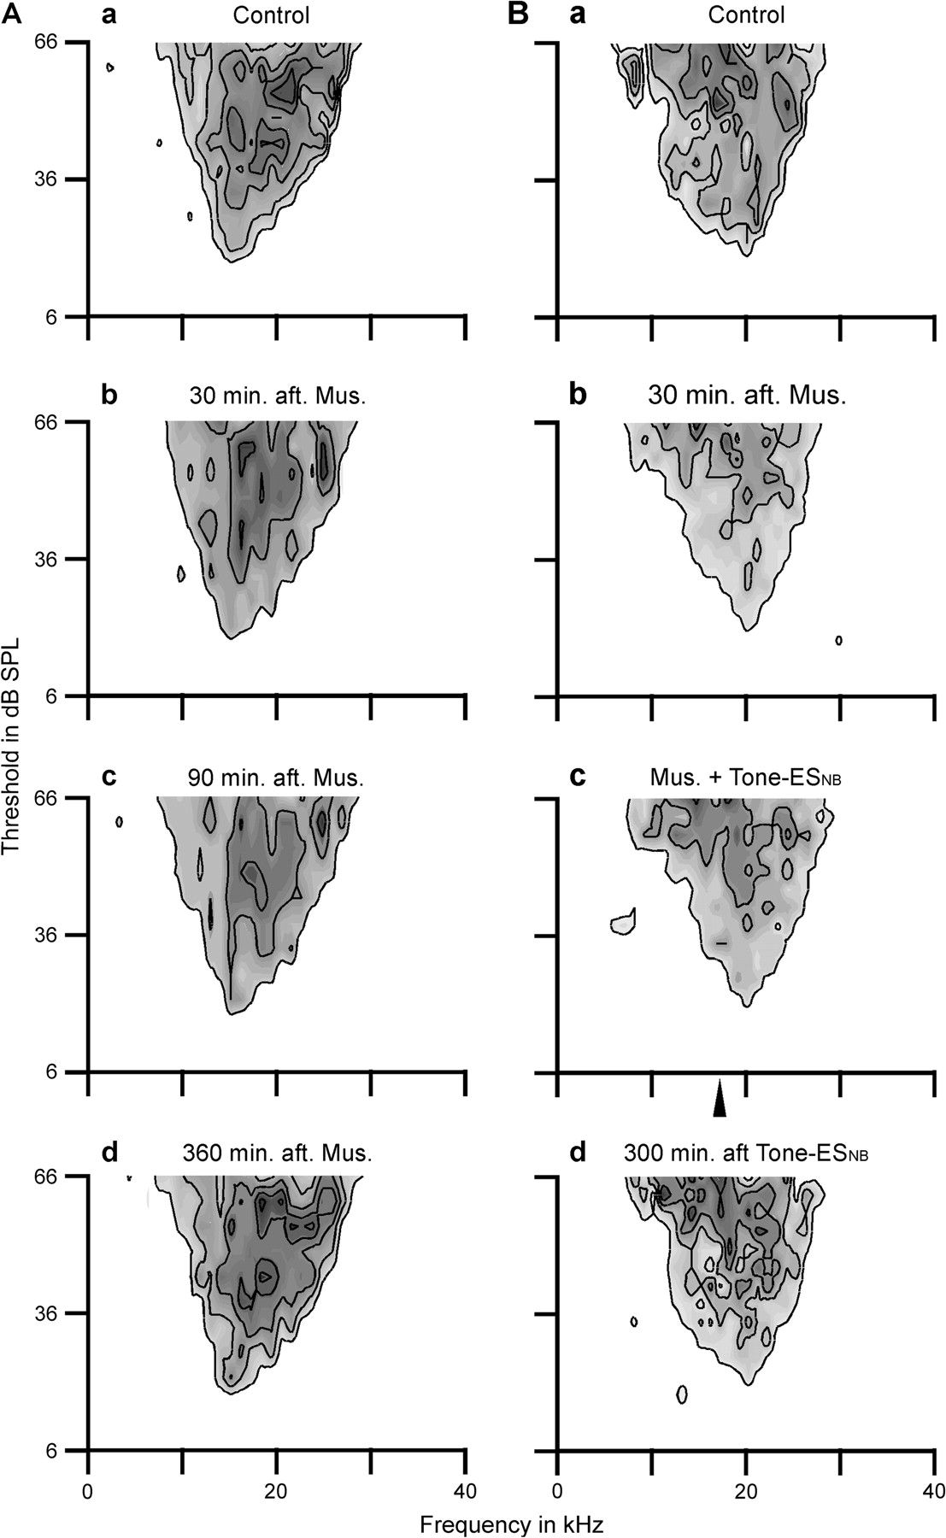
Figure 4. Effects of cortical inhibition (A) and cortical inhibition plus tone-ES_{NB} (B) on the thalamic ...
Notes:
Figure 4. Effects of cortical inhibition (A) and cortical inhibition plus tone-ESNB (B) on the thalamic receptive fields. The cortical application of muscimol decreased the response magnitude but did not change the BFs of these 2 neurons (Aa–d and Ba–b). When the AC was inhibited by muscimol (B), tone-ESNB did not alter the BF of this thalamic neuron (Bb and Bc). The arrowhead indicates the frequency of the paired tone. The thalamic receptive fields recovered to those of the controls 360 min after cortical application of muscimol (Aa and Ad) and 300 min after tone-ESNB (Ba and Bd).
Unless provided in the caption above, the following copyright applies to the content of this slide: © The Author 2008. Published by Oxford University Press. All rights reserved. For permissions, please e-mail: journals.permissions@oxfordjournals.org

Slide 5
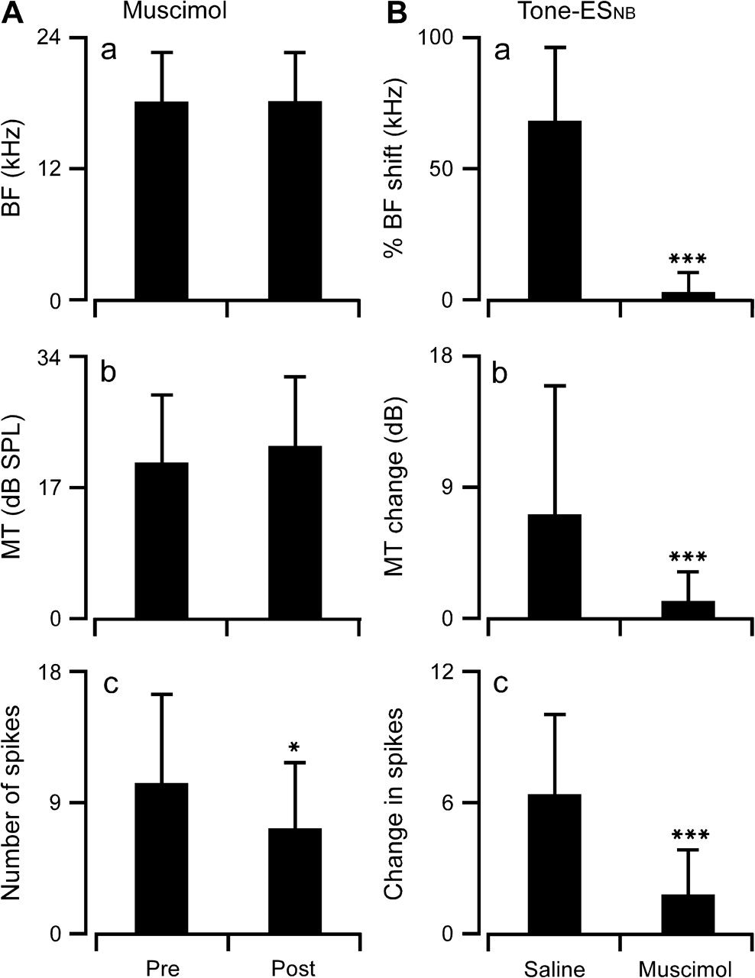
Figure 5. Changes in the BFs, MTs, and spike numbers of thalamic neurons after a cortical application of muscimol (A) ...
Notes:
Figure 5. Changes in the BFs, MTs, and spike numbers of thalamic neurons after a cortical application of muscimol (A) or after tone-ESNB with cortical application of either saline or muscimol (B). The cortical application of muscimol significantly decreased the response magnitude (Ac). The changes in thalamic BF, MT, and spike number were significantly larger for tone-ESNB with saline (i.e., without muscimol) than for tone-ESNB with muscimol (B). The equation of the % of BF shift (Ba) was 100 × (BF shift/difference between tone frequency and thalamic BF). The MT change (Bb) was absolute change. *P < 0.05, compared with data before cortical application of muscimol; ***P < 0.001, comparing between saline and muscimol groups.
Unless provided in the caption above, the following copyright applies to the content of this slide: © The Author 2008. Published by Oxford University Press. All rights reserved. For permissions, please e-mail: journals.permissions@oxfordjournals.org

Slide 6
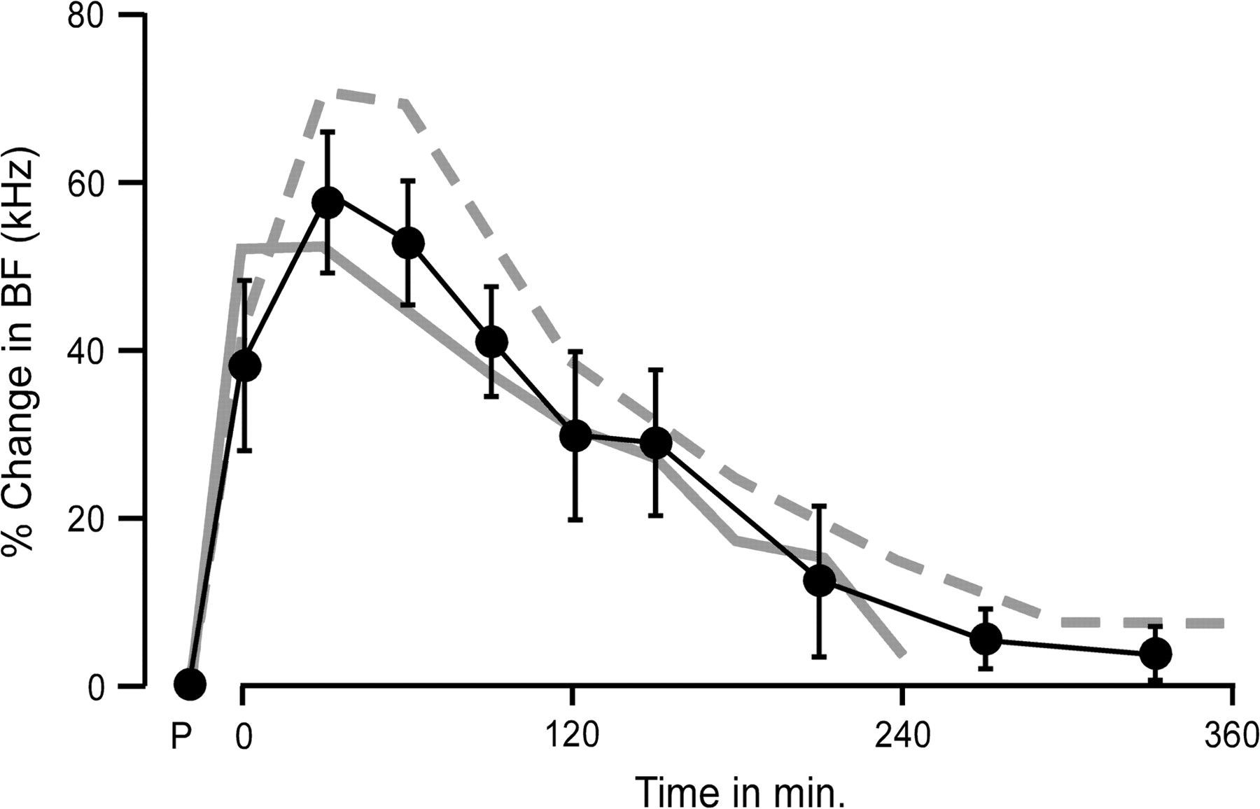
Figure 6. Time course of the percentage change in thalamic BF following tone-ES_{NB} (black line with closed ...
Notes:
Figure 6. Time course of the percentage change in thalamic BF following tone-ESNB (black line with closed circles). The maximum thalamic BF changes occurred at 30 min after tone-ESNB. The thalamic BFs shifted back to the control BFs by 50% at 120–150 min and had almost recovered at 270–300 min after tone-ESNB. The dashed gray and solid gray lines represent the time courses of tone-ESNB–evoked BF changes of cortical neurons (Yan and Zhang 2005) and midbrain neurons (Zhang, Hakes, et al. 2005), respectively. P: prior to tone-ESNB, that is, control.
Unless provided in the caption above, the following copyright applies to the content of this slide: © The Author 2008. Published by Oxford University Press. All rights reserved. For permissions, please e-mail: journals.permissions@oxfordjournals.org

