Slide 1
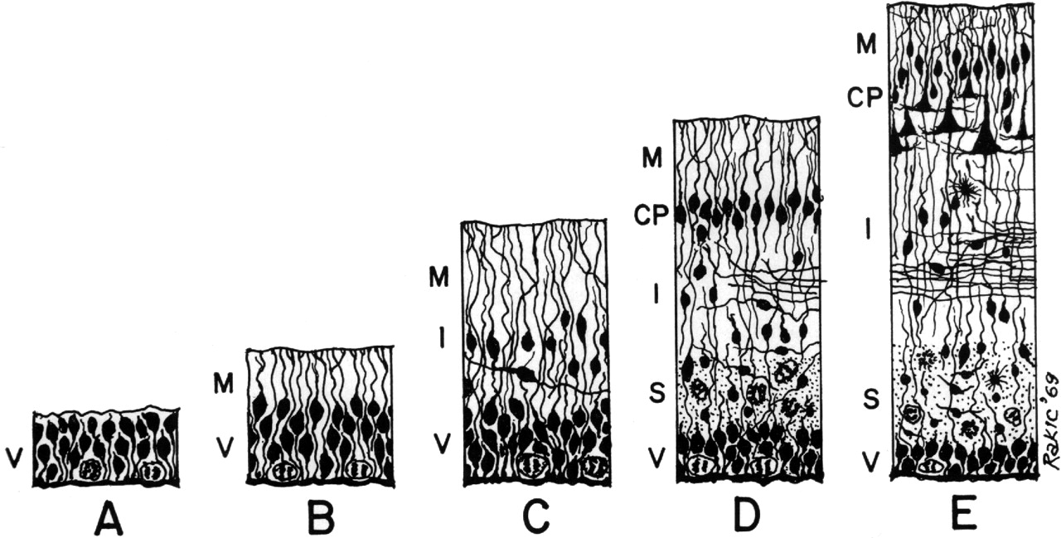
Figure 1. Schematic drawing of five stages (A–E) in the development of the vertebrate central nervous system. ...
Notes:
Figure 1. Schematic drawing of five stages (A–E) in the development of the vertebrate central nervous system. Abbreviations: CP, cortical plate; I, intermediate zone; M, marginal zone; S, subventricular zone; V, ventricular zone.
Unless provided in the caption above, the following copyright applies to the content of this slide: © Oxford University Press

