Slide 1
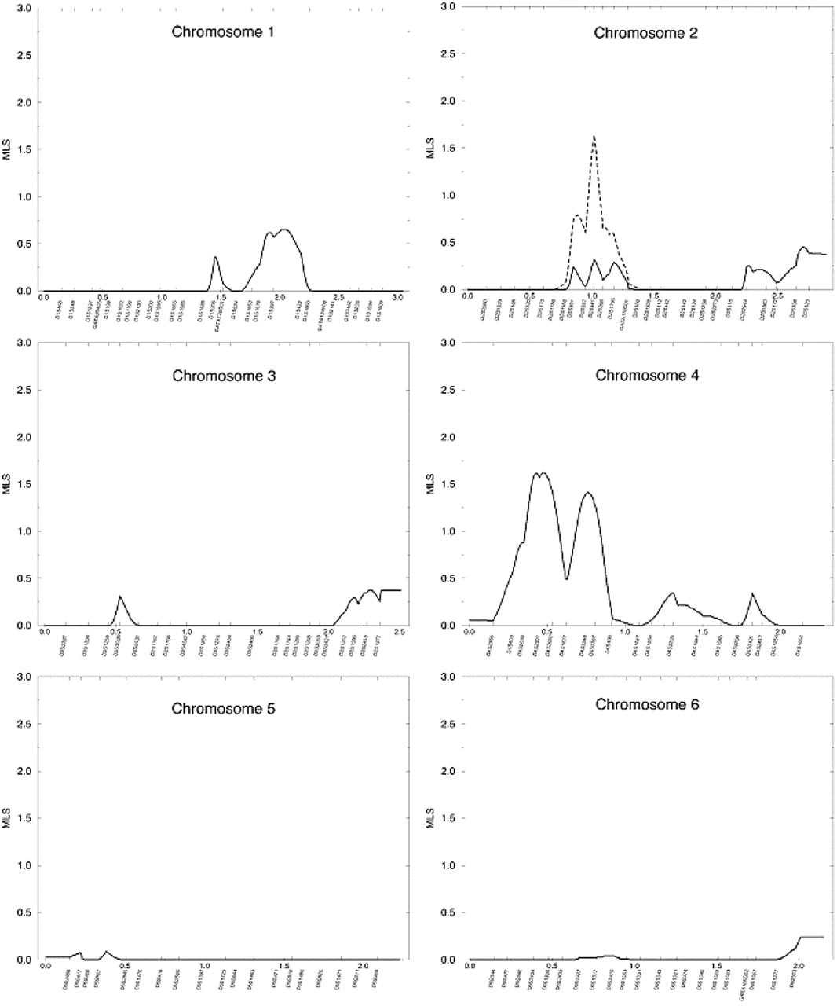
Figure 1. Multipoint lod scores. The graphs for the initial pedigree set (113 sibpairs) are shown as ...
Notes:
Figure 1. Multipoint lod scores. The graphs for the initial pedigree set (113 sibpairs) are shown as continuous lines. The graphs for the combined pedigree set (182 sibpairs) are shown as dashed lines.
Unless provided in the caption above, the following copyright applies to the content of this slide:

Slide 2
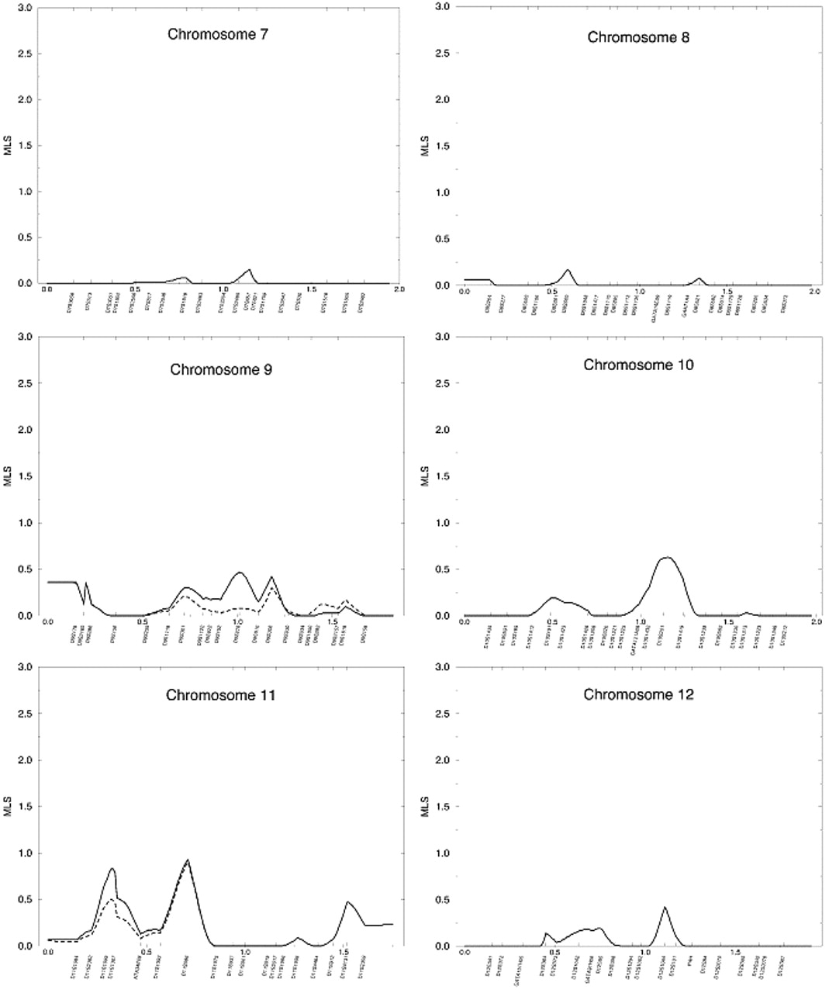
Figure 1. Multipoint lod scores. The graphs for the initial pedigree set (113 sibpairs) are shown as ...
Notes:
Figure 1. Multipoint lod scores. The graphs for the initial pedigree set (113 sibpairs) are shown as continuous lines. The graphs for the combined pedigree set (182 sibpairs) are shown as dashed lines.
Unless provided in the caption above, the following copyright applies to the content of this slide:

Slide 3
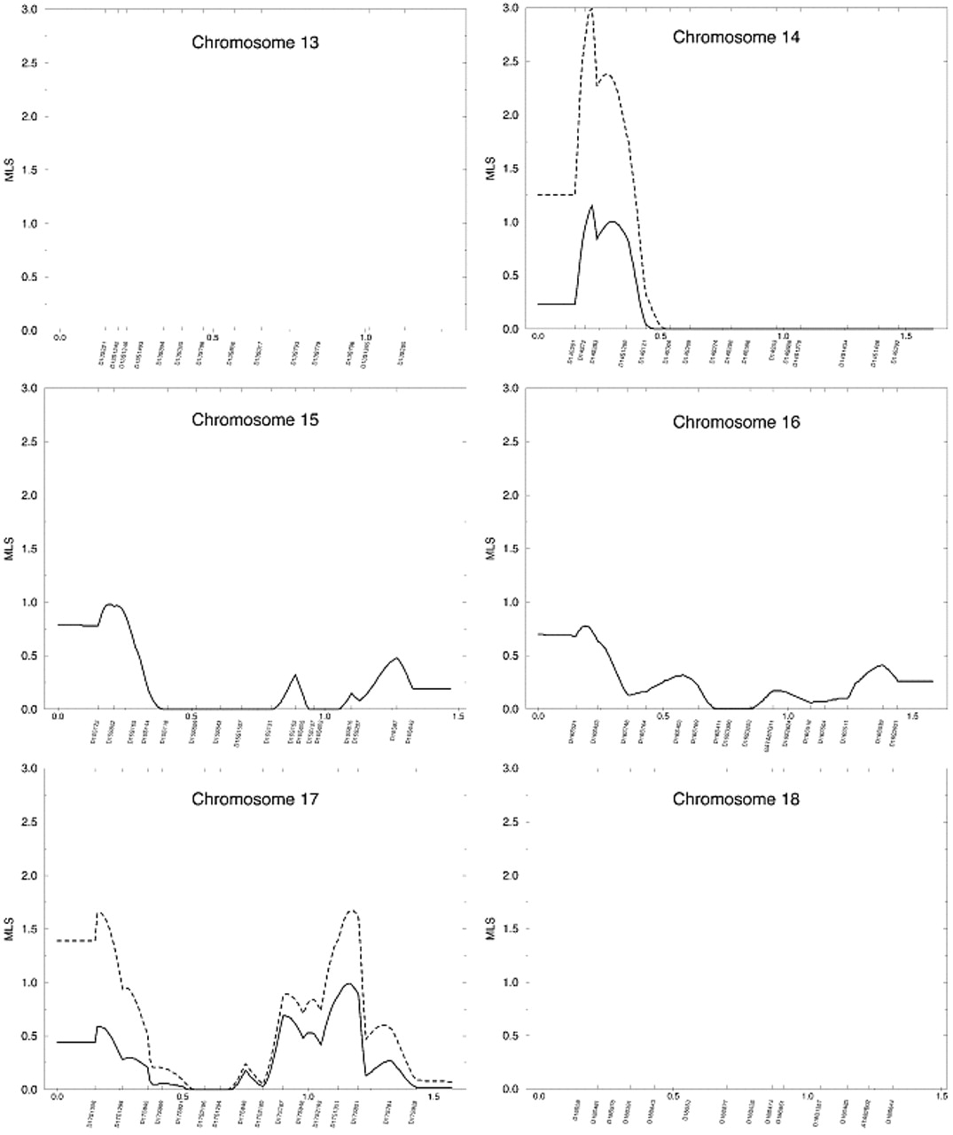
Figure 1. Multipoint lod scores. The graphs for the initial pedigree set (113 sibpairs) are shown as ...
Notes:
Figure 1. Multipoint lod scores. The graphs for the initial pedigree set (113 sibpairs) are shown as continuous lines. The graphs for the combined pedigree set (182 sibpairs) are shown as dashed lines.
Unless provided in the caption above, the following copyright applies to the content of this slide:

Slide 4
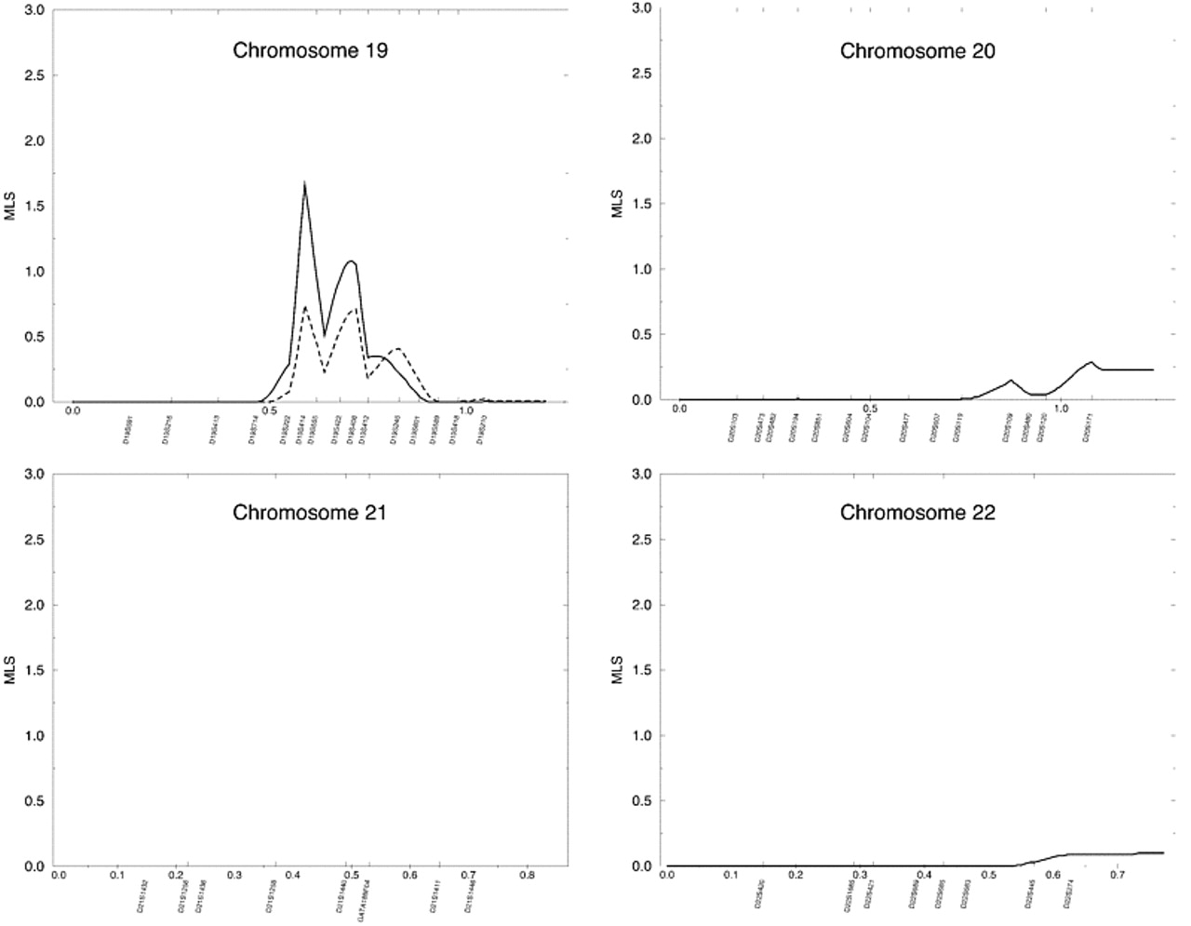
Figure 1. Multipoint lod scores. The graphs for the initial pedigree set (113 sibpairs) are shown as ...
Notes:
Figure 1. Multipoint lod scores. The graphs for the initial pedigree set (113 sibpairs) are shown as continuous lines. The graphs for the combined pedigree set (182 sibpairs) are shown as dashed lines.
Unless provided in the caption above, the following copyright applies to the content of this slide:

