Slide 1
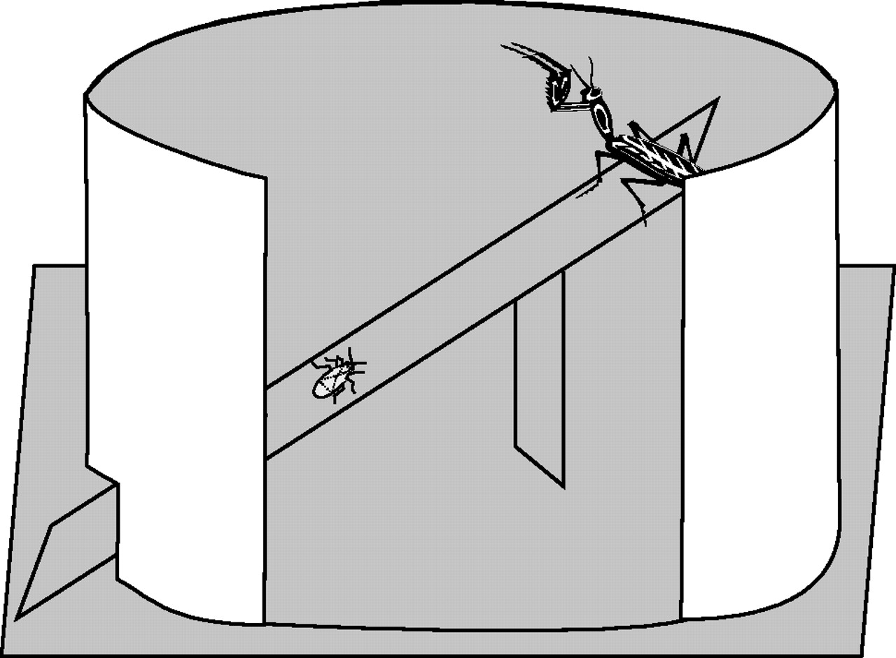
Figure 1 A cutaway diagram of test arena, shown approximately to scale.
Notes:
Figure 1 A cutaway diagram of test arena, shown approximately to scale.
Unless provided in the caption above, the following copyright applies to the content of this slide: © The Author 2006. Published by Oxford University Press on behalf of the International Society for Behavioral Ecology. All rights reserved. For permissions, please e-mail: journals.permissions@oxfordjournals.org

Slide 2
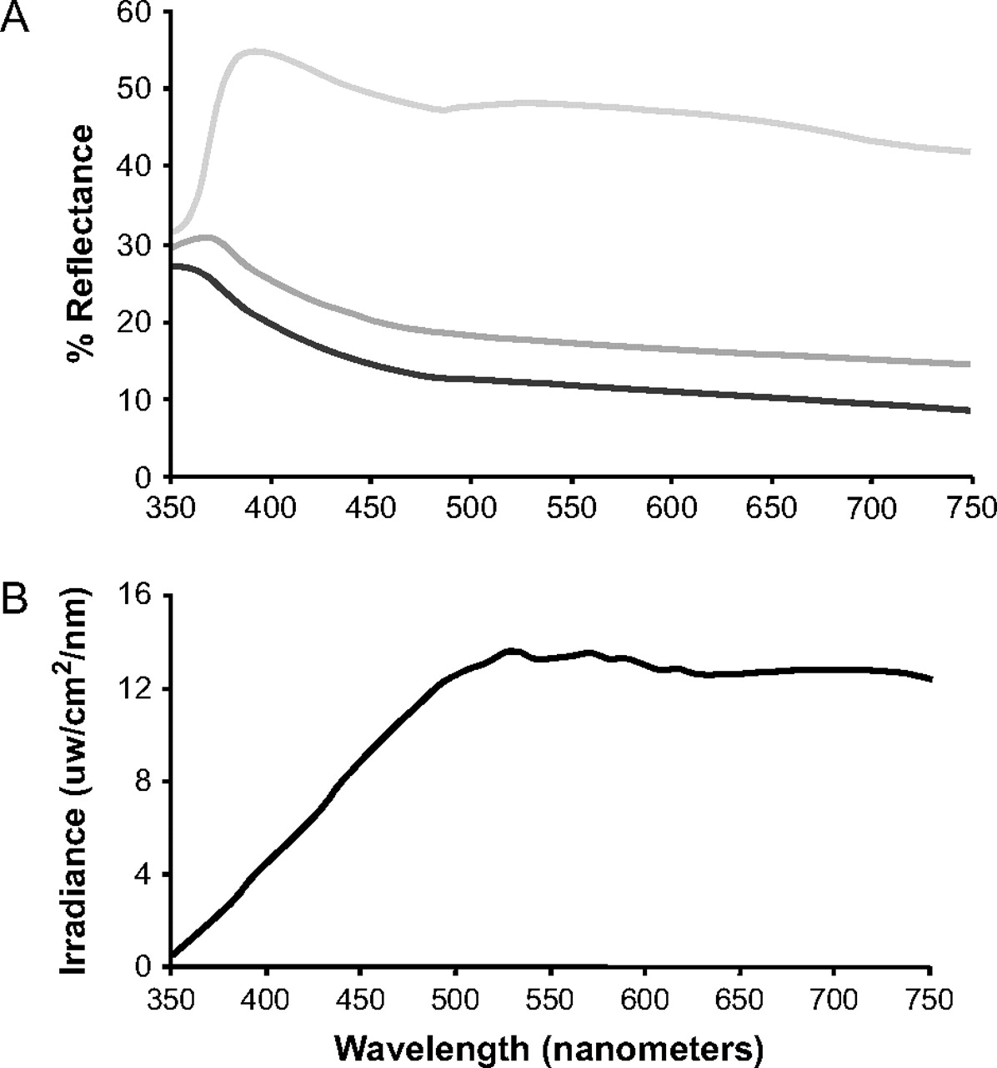
Figure 2 Percent reflectance spectra (A) of experimental gray paints. Background spectrum is indicated by dark-gray ...
Notes:
Figure 2 Percent reflectance spectra (A) of experimental gray paints. Background spectrum is indicated by dark-gray line (lowest reflectance), low–luminance contrast prey spectrum by medium-gray line (medium reflectance), and high–luminance contrast prey spectrum by light-gray line (highest reflectance). Irradiance spectrum (B) of the 50-W SoLux-Eiko lamps used in experiments (spectrum supplied by Eiko Ltd.).
Unless provided in the caption above, the following copyright applies to the content of this slide: © The Author 2006. Published by Oxford University Press on behalf of the International Society for Behavioral Ecology. All rights reserved. For permissions, please e-mail: journals.permissions@oxfordjournals.org

Slide 3
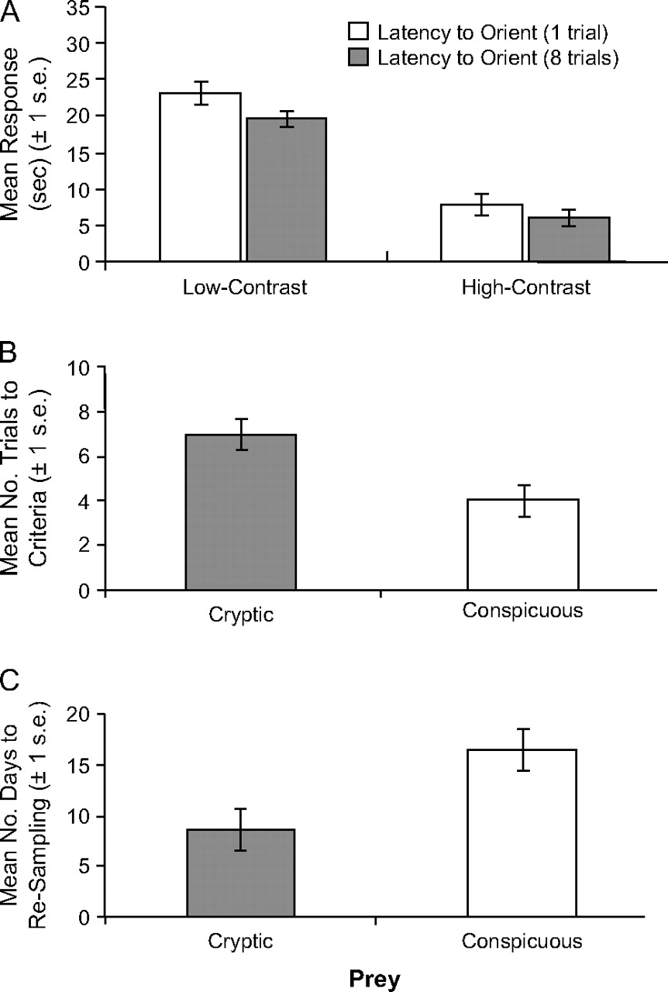
Figure 3 Detectability of low–luminance contrast and high–luminance contrast milkweed bugs (A), as measured by ...
Notes:
Figure 3 Detectability of low–luminance contrast and high–luminance contrast milkweed bugs (A), as measured by mantids' mean latency to orient in the first trial and over multiple trials. Learning performance by mantids exposed to low-contrast or high-contrast bugs (B), estimated as mean number of trials to reach aversion criteria. Retention of aversive response to low-contrast or high-contrast bugs (C), estimated as mean number of days until a bug is attacked again by the mantid.
Unless provided in the caption above, the following copyright applies to the content of this slide: © The Author 2006. Published by Oxford University Press on behalf of the International Society for Behavioral Ecology. All rights reserved. For permissions, please e-mail: journals.permissions@oxfordjournals.org

