Slide 1
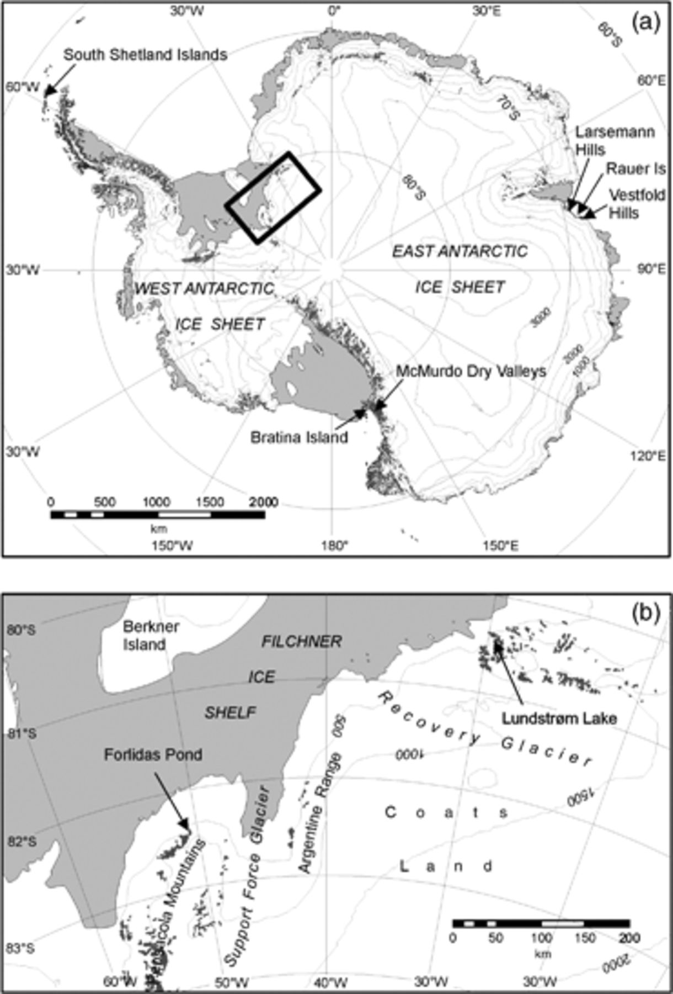
1 Location map of the sampled water bodies. (a) The sampled area is marked with a black rectangle. (b) Lakes ...
Notes:
1 Location map of the sampled water bodies. (a) The sampled area is marked with a black rectangle. (b) Lakes are indicated by arrows.
Unless provided in the caption above, the following copyright applies to the content of this slide: © 2011 Federation of European Microbiological Societies. Published by Blackwell Publishing Ltd. All rights reserved

Slide 2
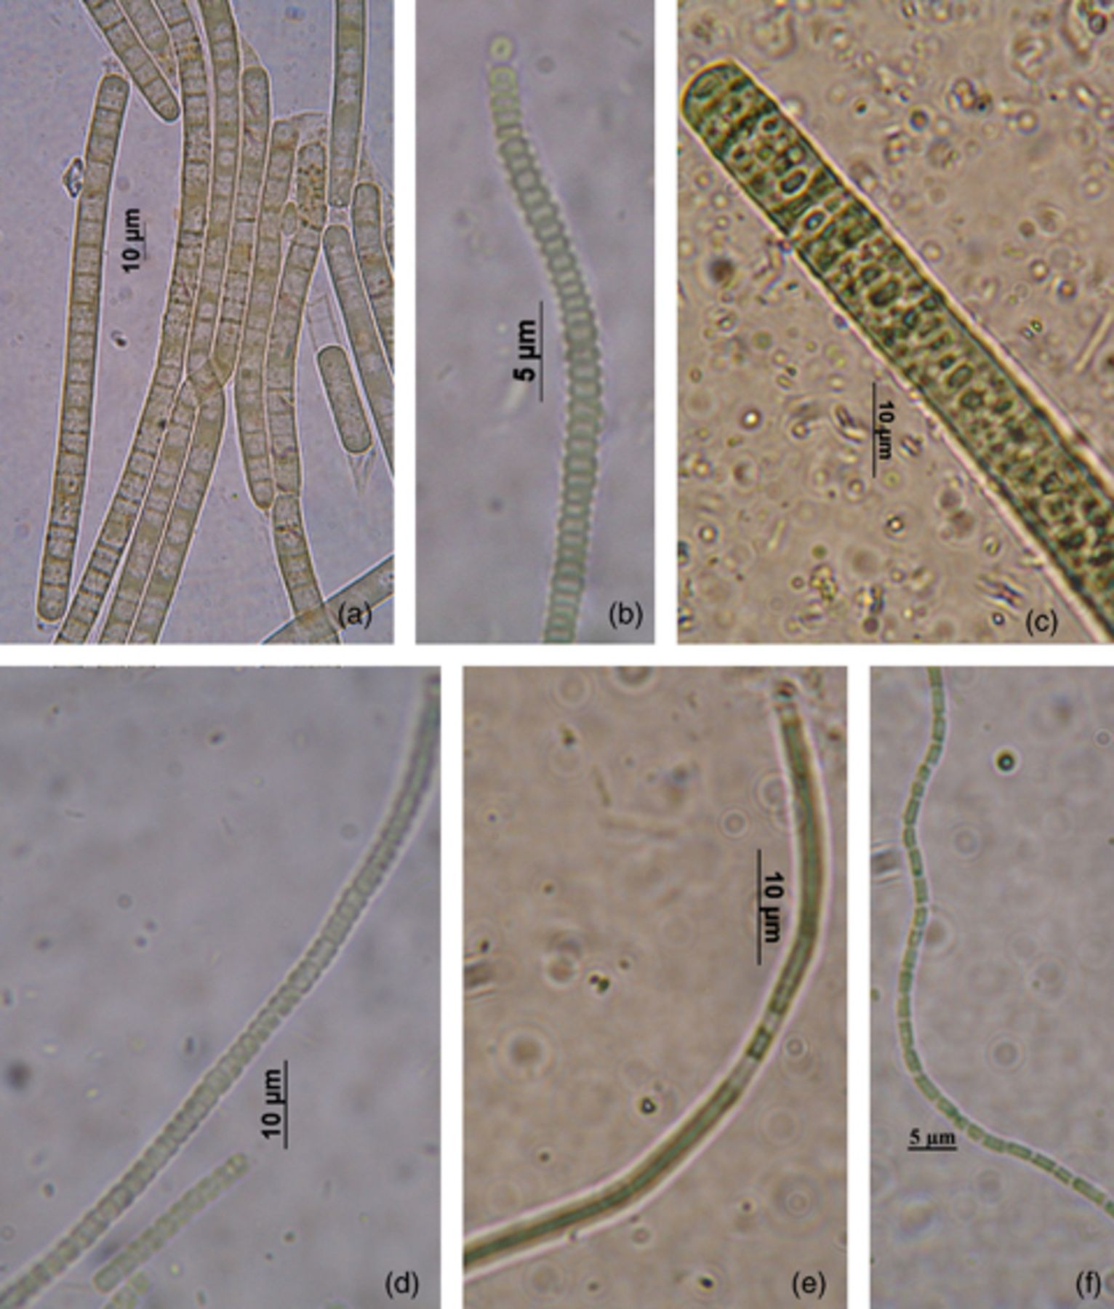
2 Diversity of cyanobacterial morphotypes identified in environmental samples and cultures from Forlidas Pond ...
Notes:
2 Diversity of cyanobacterial morphotypes identified in environmental samples and cultures from Forlidas Pond and Lundström Lake. (a) Phormidium murrayi (TM2ULC130); (b) Leptolyngbya cf. foveolarum (TM2ULC129); (c) Phormidium crassior, TM4 environmental sample; (d) Phormidium priestleyi (TM4LUS131); and (e) Leptolyngbya sp., TM4 environmental sample; (f) Leptolyngbya glacialis (TM1ULC73).
Unless provided in the caption above, the following copyright applies to the content of this slide: © 2011 Federation of European Microbiological Societies. Published by Blackwell Publishing Ltd. All rights reserved

Slide 3
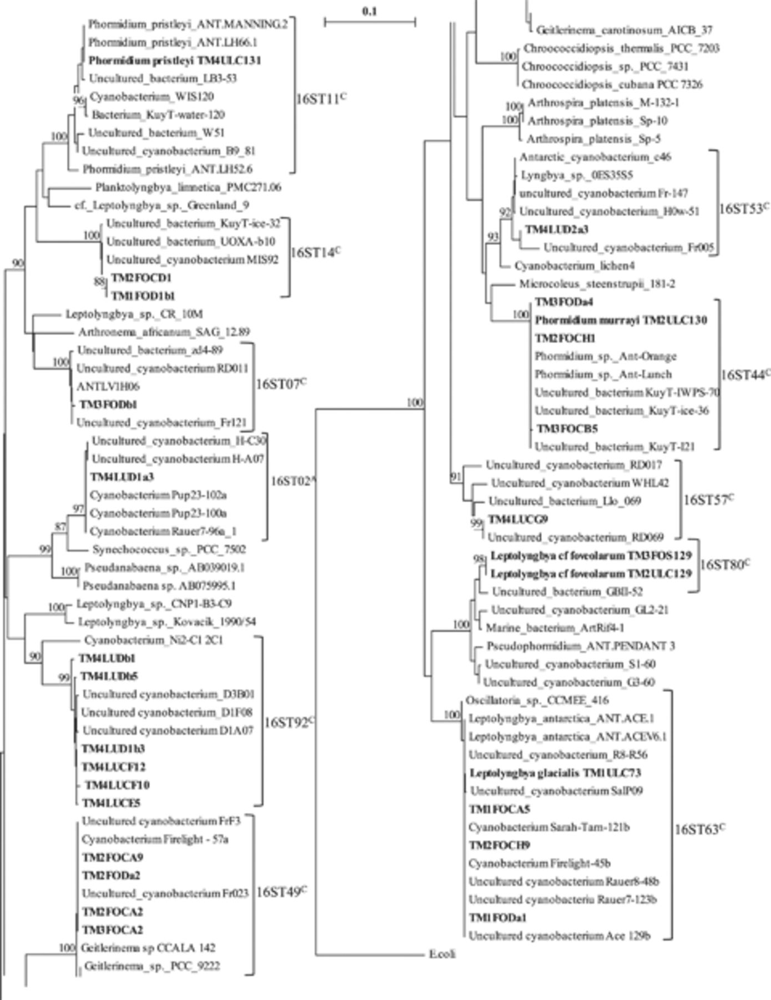
3 Distance tree based on cyanobacterial partial 16S rRNA gene sequences (Escherichia coli positions 379–806) ...
Notes:
3 Distance tree based on cyanobacterial partial 16S rRNA gene sequences (Escherichia coli positions 379–806) constructed using the neighbor-joining method (Saitou & Nei, 1987). A bootstrap analysis was performed that involved the construction of 1000 resampled trees (values indicated at the node). The tree comprised the sequences of 10 DGGE bands, 12 clones and five strains from the Forlidas Pond samples (from Hodgson et al., 2010) and Lundström Lake (both in bold) and their three most similar strain sequences and three uncultured sequences from RDPII (http://rdp.cme.msu.edu). Escherichia coli sequence is used as an outgroup. The OTU numbers are indicated on the right. OTU 16ST16 composed by TM4LUCC30 is not shown in the tree because the fragment of this sequence did not include the positions used for the construction of the tree. The evolutionary distance between two sequences is obtained by adding the lengths of the horizontal branches connecting them and using the scale bar (0.1 mutation per position). The superscripts in the OTUs numbering mean: ‘C’ for cosmopolitan distribution and ‘A’ for potentially endemic to Antarctica.
Unless provided in the caption above, the following copyright applies to the content of this slide: © 2011 Federation of European Microbiological Societies. Published by Blackwell Publishing Ltd. All rights reserved

