Slide 1
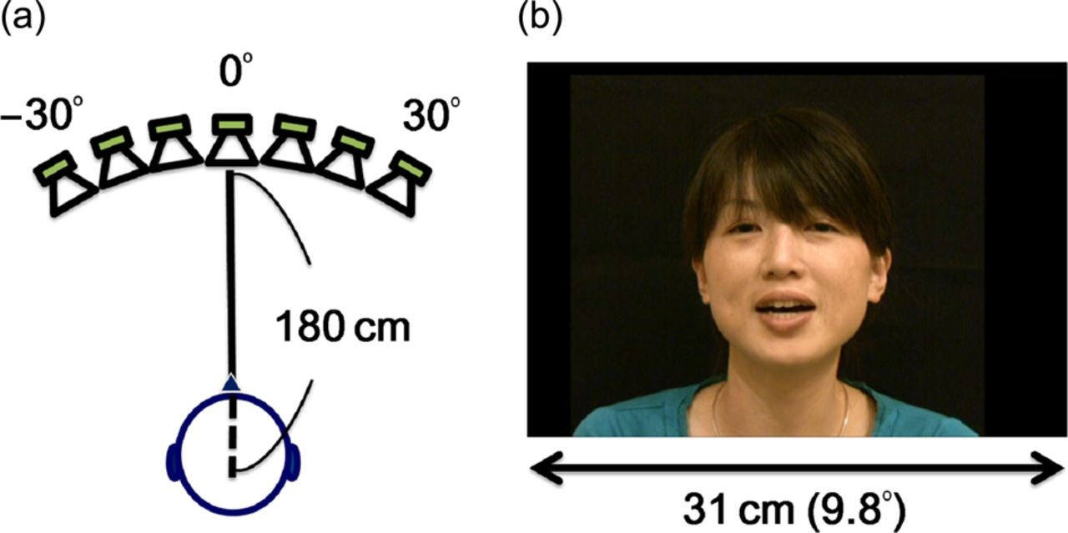
Figure 1. Experimental set-up. (a) Recording set-up of auditory stimuli. The speech sounds were presented through a ...
Notes:
Figure 1. Experimental set-up. (a) Recording set-up of auditory stimuli. The speech sounds were presented through a loudspeaker from 1 of the 7 horizontal directions (−30°, −20°, −10°, 0°, 10°, 20°, and 30°, left to right, angle 0° was in front of the participant) with a distance of 180 cm from the participants. (b) An example frame of the visual stimuli.
Unless provided in the caption above, the following copyright applies to the content of this slide: © The Author 2015. Published by Oxford University PressThis is an Open Access article distributed under the terms of the Creative Commons Attribution Non-Commercial License (http://creativecommons.org/licenses/by-nc/4.0/), which permits non-commercial re-use, distribution, and reproduction in any medium, provided the original work is properly cited. For commercial re-use, please contact journals.permissions@oup.com

Slide 2
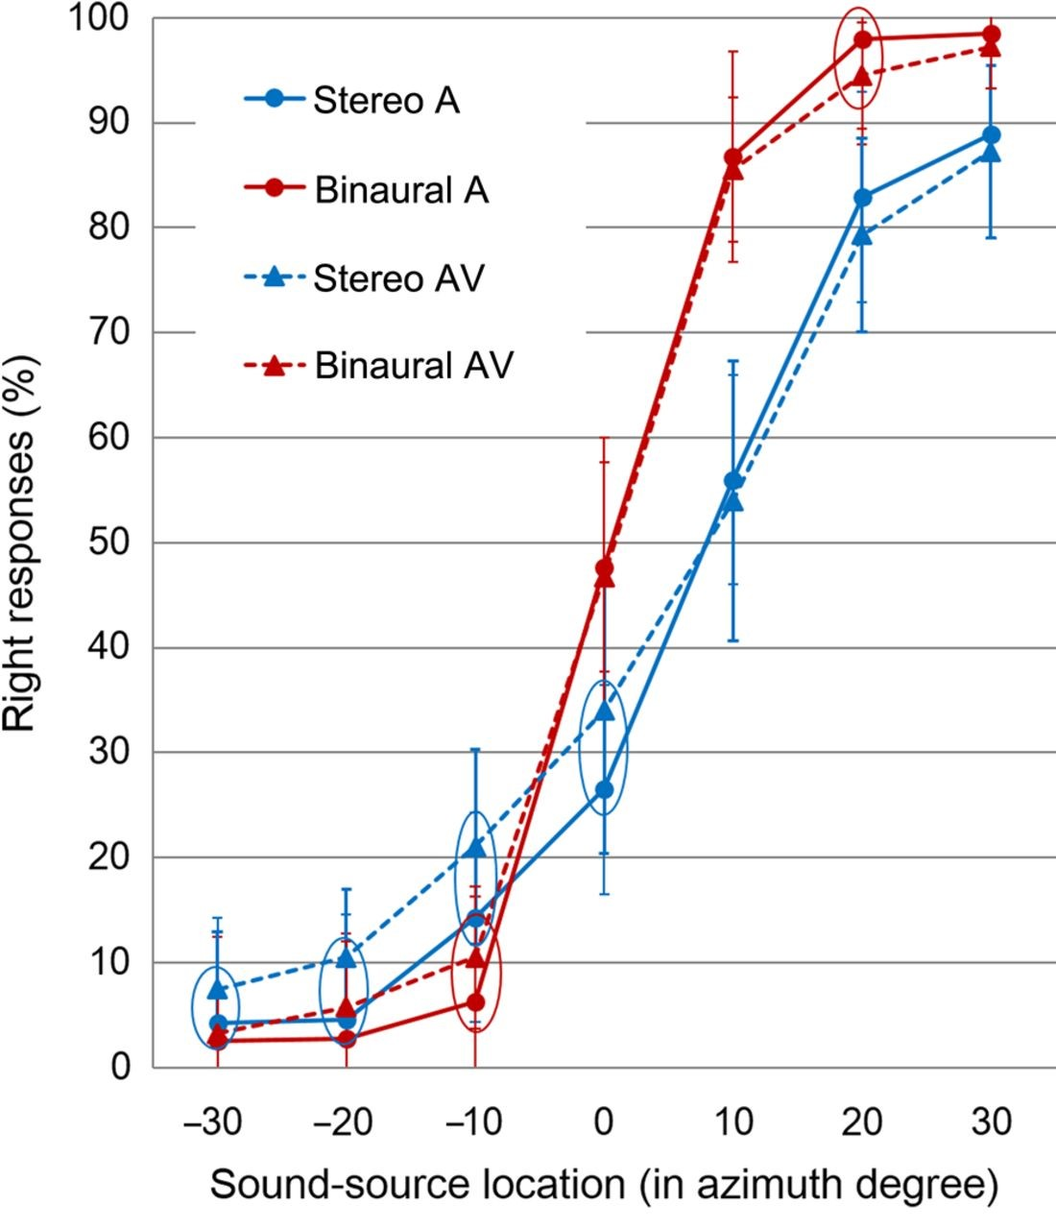
Figure 2. Percentage of “right” responses. Means and standard errors of the means (SEM) are plotted. On both SR and BR ...
Notes:
Figure 2. Percentage of “right” responses. Means and standard errors of the means (SEM) are plotted. On both SR and BR conditions, slopes were steeper for auditory-only conditions than for audiovisual conditions. At each sound location, a significant difference (P < 0.05) between the auditory-only and audiovisual conditions was indicated by a circle. Stereo A, SR auditory-only; binaural A, BR auditory-only; stereo AV, SR audiovisual; binaural AV, BR audiovisual.
Unless provided in the caption above, the following copyright applies to the content of this slide: © The Author 2015. Published by Oxford University PressThis is an Open Access article distributed under the terms of the Creative Commons Attribution Non-Commercial License (http://creativecommons.org/licenses/by-nc/4.0/), which permits non-commercial re-use, distribution, and reproduction in any medium, provided the original work is properly cited. For commercial re-use, please contact journals.permissions@oup.com

Slide 3
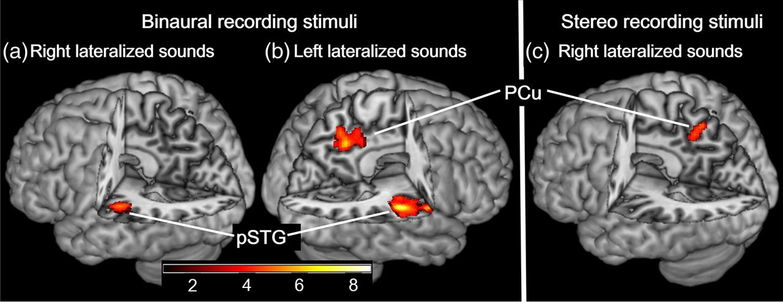
Figure 3. Brain regions activated to a greater extent for more lateral sound locations. Significant activation was ...
Notes:
Figure 3. Brain regions activated to a greater extent for more lateral sound locations. Significant activation was rendered on a high-resolution anatomical MRI brain template and a color bar indicates t-value. (a) The left pSTG was activated to a greater extent for more right lateral (30° > 20° > 10° > 0°) BR stimuli. (b) The right pSTG and the right precuneus (PCu) were activated to a greater extent for more left lateral (−30° > −20° > −10° > 0°) BR stimuli. (c) The left PCu was activated to a greater extent for more right lateral (30° > 20° > 10° > 0°) stereo-recording stimuli.
Unless provided in the caption above, the following copyright applies to the content of this slide: © The Author 2015. Published by Oxford University PressThis is an Open Access article distributed under the terms of the Creative Commons Attribution Non-Commercial License (http://creativecommons.org/licenses/by-nc/4.0/), which permits non-commercial re-use, distribution, and reproduction in any medium, provided the original work is properly cited. For commercial re-use, please contact journals.permissions@oup.com

Slide 4
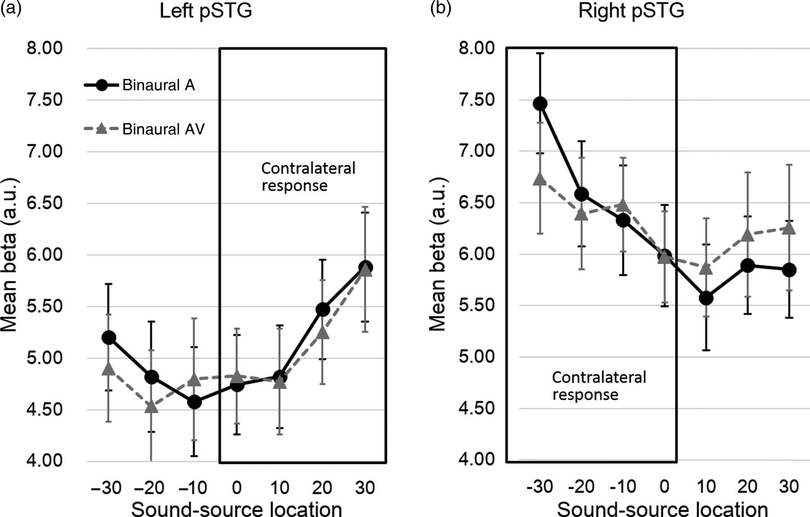
Figure 4. Activation of pSTG correlated with sound azimuth. Means and SEMs of beta (parameter estimates) are plotted. ...
Notes:
Figure 4. Activation of pSTG correlated with sound azimuth. Means and SEMs of beta (parameter estimates) are plotted. Both left and right pSTG responded significantly greater for contralateral BR stimuli. (a) The left pSTG responded more for right lateral sounds. (b) The right pSTG responded more for left lateral sounds and the slope was significantly steeper for the auditory-only condition than for the audiovisual condition. Binaural A, BR auditory-only; binaural AV, BR audiovisual.
Unless provided in the caption above, the following copyright applies to the content of this slide: © The Author 2015. Published by Oxford University PressThis is an Open Access article distributed under the terms of the Creative Commons Attribution Non-Commercial License (http://creativecommons.org/licenses/by-nc/4.0/), which permits non-commercial re-use, distribution, and reproduction in any medium, provided the original work is properly cited. For commercial re-use, please contact journals.permissions@oup.com

Slide 5
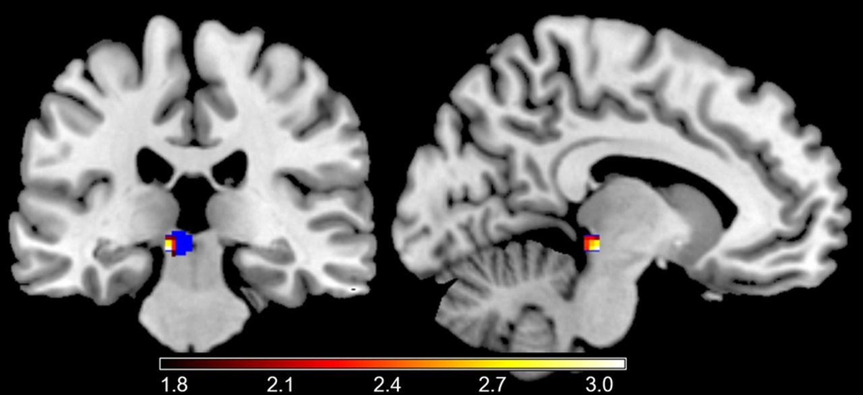
Figure 5. The left superior colliculus activated to a greater extent for more right lateral sound locations. Activation ...
Notes:
Figure 5. The left superior colliculus activated to a greater extent for more right lateral sound locations. Activation (P < 0.05 for display purpose) is plotted on a high-resolution anatomical MRI brain template and a color bar indicates t-value. The blue region corresponds to the left region sphere for the SVC analysis.
Unless provided in the caption above, the following copyright applies to the content of this slide: © The Author 2015. Published by Oxford University PressThis is an Open Access article distributed under the terms of the Creative Commons Attribution Non-Commercial License (http://creativecommons.org/licenses/by-nc/4.0/), which permits non-commercial re-use, distribution, and reproduction in any medium, provided the original work is properly cited. For commercial re-use, please contact journals.permissions@oup.com

Slide 6
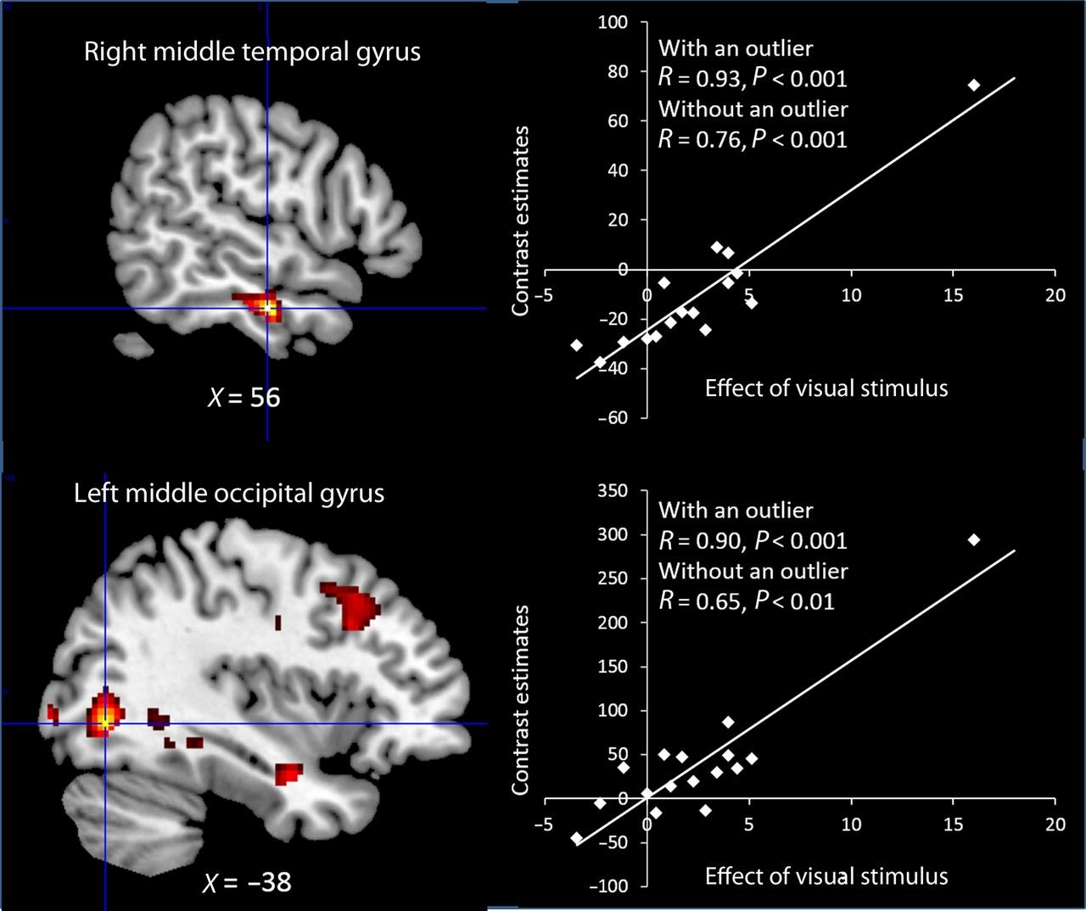
Figure 6. The result of the linear regression analysis between the neural responses and the behavioral data. Left: the ...
Notes:
Figure 6. The result of the linear regression analysis between the neural responses and the behavioral data. Left: the activation maps are superimposed on a high-resolution anatomical MRI brain template. Crosshairs corresponds to peak voxels from which we extracted contrast estimates in the scatter plots. Right: scatter plots illustrating the relationship between the neural responses during the audiovisual trials and the behavioral index of the ventriloquism effect. The large behavioral index indicates strong influence of visual stimuli on auditory localization. Each dot represents a separate participant.
Unless provided in the caption above, the following copyright applies to the content of this slide: © The Author 2015. Published by Oxford University PressThis is an Open Access article distributed under the terms of the Creative Commons Attribution Non-Commercial License (http://creativecommons.org/licenses/by-nc/4.0/), which permits non-commercial re-use, distribution, and reproduction in any medium, provided the original work is properly cited. For commercial re-use, please contact journals.permissions@oup.com

