Slide 1
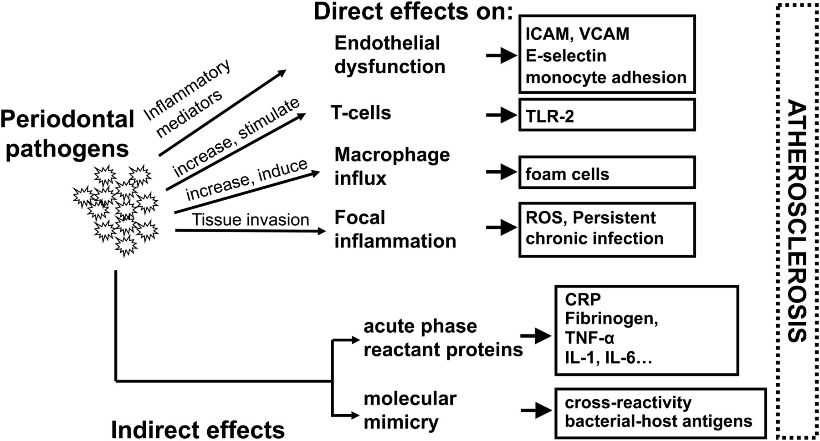
Figure 1 Suggested biological mechanisms linking periodontal infection with AS. Data from epidemiological studies are ...
Notes:
Figure 1 Suggested biological mechanisms linking periodontal infection with AS. Data from epidemiological studies are typically adjusted for conventional risk factors, including smoking and demographics. Statins could modify the clinical course of bacteria-induced inflammation via decreased adhesion of leucocytes to vascular endothelium and decreased inflammatory cytokine release, thus mitigating endothelial dysfunction, first step of the pathology, reducing ROS synthesis, leucocyte influx, and the development of focal persistent inflammation. ICAM, intercellular adhesion molecule; VCAM, vascular cell adhesion molecule; TLR, Toll-like receptor; ROS, reactive oxygen species; CRP, C-reactive protein; TNF, tumour necrosis factor; IL, interleukin.
Unless provided in the caption above, the following copyright applies to the content of this slide: Published on behalf of the European Society of Cardiology. All rights reserved. © The Author 2014. For permissions please email: journals.permissions@oup.com.

Slide 2
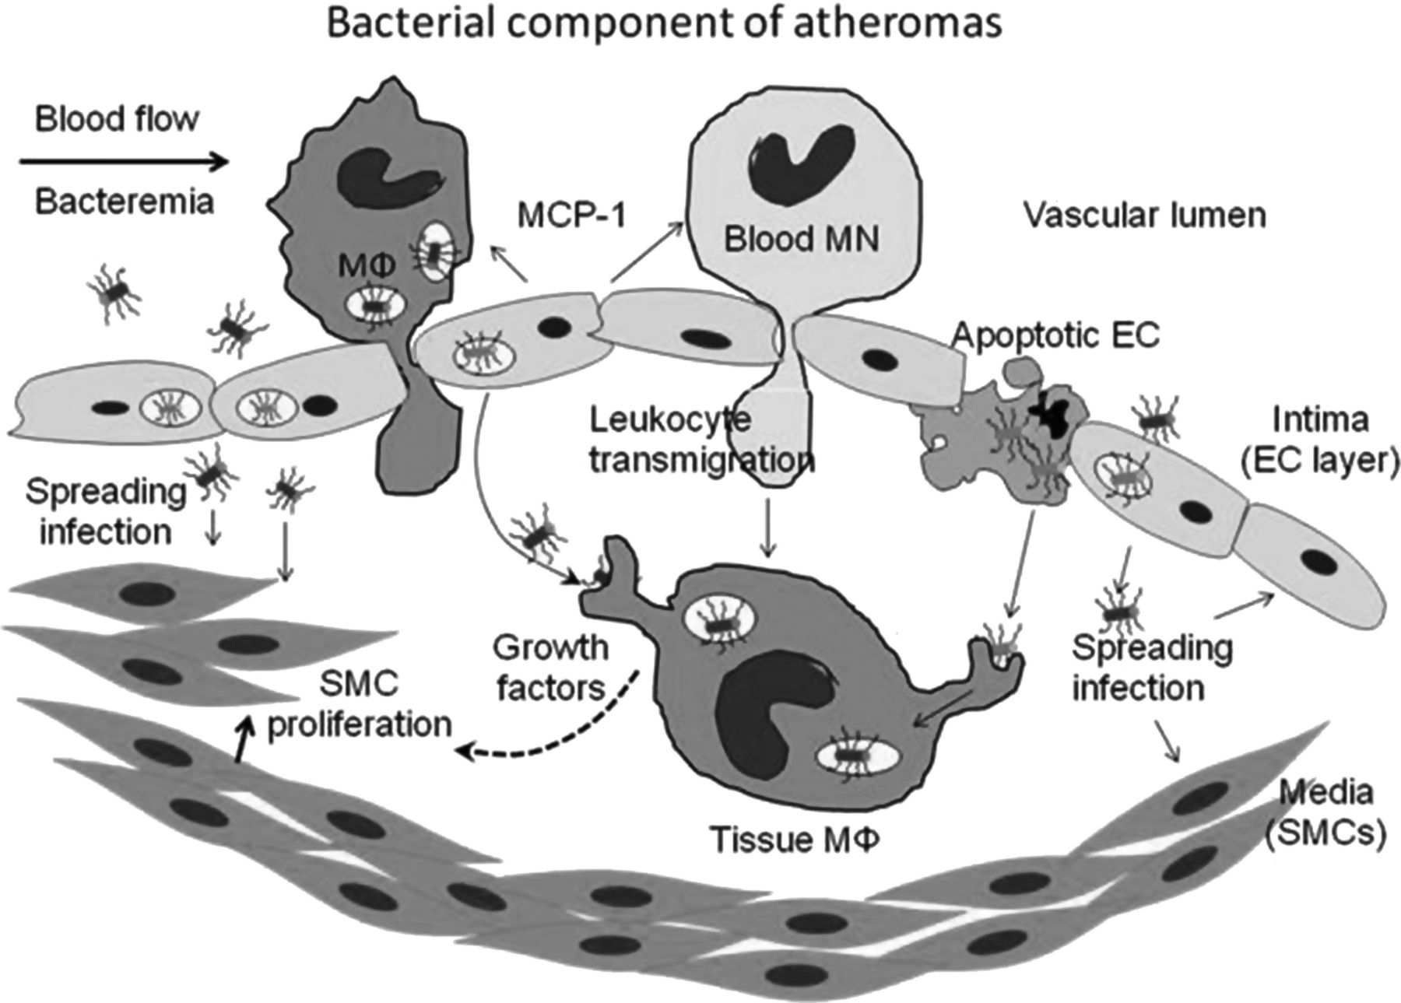
Figure 2 Biological evidence supporting infection-based model of atherogenesis. Both bacteraemia and ...
Notes:
Figure 2 Biological evidence supporting infection-based model of atherogenesis. Both bacteraemia and phagocyte-mediated delivery of bacteria to the site of inflammation are indicated. Bacteraemic organisms are invading the endothelial layer and spreading into vessel wall (left), releasing pro-inflammatory chemokines (such as MCP-1). Blood monocytes (MN) and macrophages (MΦ) are thus activated, prompting their adhesion and diapedesis. Transmigrating leucocytes (centre) can carry internalized bacteria, thus promoting systemic dissemination of bacteria. In addition, the internalization of bacteria can switch them into uncultivable state (black into grey), while their internalization by phagocytes can reactivate them back to metabolic activity (from grey to black). The growth of atheromas is due in large extent to macrophage-secreted growth factors that induce SMC proliferation. Host cell death (depicted at right) can also lead to pathogen release in the tissue. MN, monocyte; MΦ, macrophage with internalized bacteria; EC, endothelial cell; SMC, smooth muscle cell; MCP-1, monocyte chemotactic protein-1; Apoptotic EC, apoptotic endothelial cell releasing intracellular bacteria.
Unless provided in the caption above, the following copyright applies to the content of this slide: Published on behalf of the European Society of Cardiology. All rights reserved. © The Author 2014. For permissions please email: journals.permissions@oup.com.

Slide 3
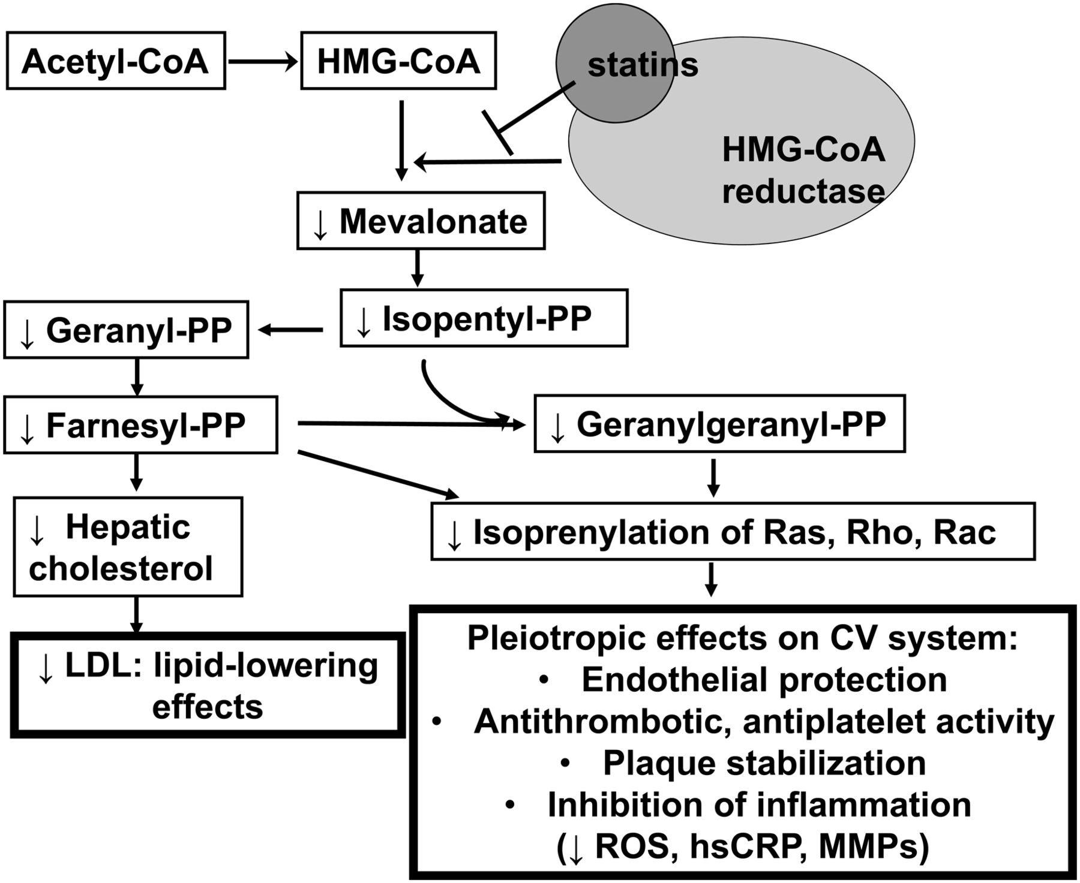
Figure 3 Different actions of statins based on cholesterol synthesis pathway, with pleiotropic effects on ...
Notes:
Figure 3 Different actions of statins based on cholesterol synthesis pathway, with pleiotropic effects on cardiovascular inflammations. PP, pyrophosphate; LDL, low-density lipoprotein; MMPs, matrix metalloproteinases.
Unless provided in the caption above, the following copyright applies to the content of this slide: Published on behalf of the European Society of Cardiology. All rights reserved. © The Author 2014. For permissions please email: journals.permissions@oup.com.

