Slide 1
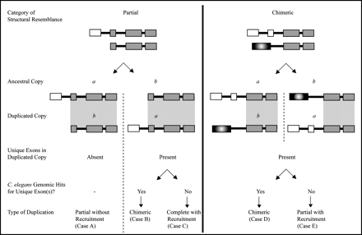
FIG. 1.— Schematic outlining the rationale and methods employed for the identification of the type of duplication ...
Notes:
FIG. 1.— Schematic outlining the rationale and methods employed for the identification of the type of duplication event contributing to the formation of a novel duplicate gene. Large rectangles denote exons; narrow rectangles indicate introns. Correspondence of exons with identical color and pattern between the two copies denotes sequence homology. Duplicate pairs are first classified into two categories, namely, those with partial and chimeric structure. The two duplicate copies are labeled a and b. For each structural category, two scenarios are considered, namely, (1) copy a is ancestral or (2) copy b is ancestral. Identification of the ancestral copy in a duplicate pair after comparison with a Caenorhabditis briggsae ortholog and subsequent characterization of the duplication breakpoints helps determine the portion of the ancestral gene that was duplicated (area shaded gray and encompassing the two copies [ancestral and duplicated]). The next two steps determine if the duplicated copy contains any unique exons to the exclusion of the ancestral copy and when present, if these yield a hit in the Caenorhabditis elegans genome. Finally, based on these results, the type of duplication event is characterized as (1) partial without recruitment (Case A), (2) chimeric (Cases B and D), (3) complete with recruitment (Case C), or (4) partial with recruitment (Case E).
Unless provided in the caption above, the following copyright applies to the content of this slide: © The Author 2006. Published by Oxford University Press on behalf of the Society for Molecular Biology and Evolution. All rights reserved. For permissions, please e-mail: journals.permissions@oxfordjournals.org

Slide 2
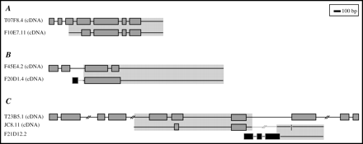
FIG. 2.— Representative examples of the three types of duplication events leading to the formation of novel genes. ...
Notes:
FIG. 2.— Representative examples of the three types of duplication events leading to the formation of novel genes. Shaded narrow rectangles denote exons, horizontal lines linking exons represent introns and duplicated UTR regions where applicable. The regions that were duplicated are highlighted in gray. Duplicated segments as determined by shared sequence homology between the ancestral and derived locus are also depicted by correspondence of regions with identical color and pattern. All figures are drawn to scale. Gene names followed by cDNA in parentheses denote paralogs that are either partially or fully confirmed by cDNA data. (A) Partial duplication (without recruitment) of ancestral locus T07F8.4 comprising seven exons resulted in the partial duplicate copy F10E7.11 (KS = 0.00 over region of homology). The duplication was initiated at nucleotide position 54 of T07F8.4's exon 3, spanning the remainder downstream exons and introns of T07F8.4 as well as the first 326 nt of its 3′ UTR. Both the ancestral and derived copies are wholly confirmed by cDNA data. (B) Partial duplication with recruitment. The ancestral copy F45E4.2 comprises four exons. The duplication was initiated at nucleotide position 230 of F45E4.2's intron 2 and spans exons 3 through 4 and the first 1530 nt of the 3′ UTR. The derived copy F20D1.4's unique first exon and partial first intron contain a nonhomologous region of 156 nt that failed to yield any hits in the Caenorhabditis elegans genome, suggesting the recruitment of the additional sequence from its new genomic neighborhood. The ancestral and derived copies exhibit 2% divergence at synonymous sites over the region of homology. Ancestral copy F45E4.2 and derived copy F20D1.4 are wholly and partially confirmed by cDNA data, respectively. (C) Chimeric duplication. JC8.11 is a chimeric gene derived from two ancestral genes, T23B5.1 and F21D12.2. JC8.11's 5′ UTR (581 nt) and first two exons are derived from a region encompassing T23B5.1's intron 4 through partial intron 7 (79 nt). The next 687 nt of JC8.11's intron 2 have no corresponding hits in the C. elegans genome. JC8.11's remainder intron 2 (last 172 nt), terminal exon (8 nt), and 466 nt of 3′ UTR are homologous to a region encompassing F21D12.2's partial terminal exon and 3′ UTR. Ancestral copy T23B5.1 and derived copy JC8.11 are wholly and partially confirmed by cDNA data, respectively.
Unless provided in the caption above, the following copyright applies to the content of this slide: © The Author 2006. Published by Oxford University Press on behalf of the Society for Molecular Biology and Evolution. All rights reserved. For permissions, please e-mail: journals.permissions@oxfordjournals.org

Slide 3
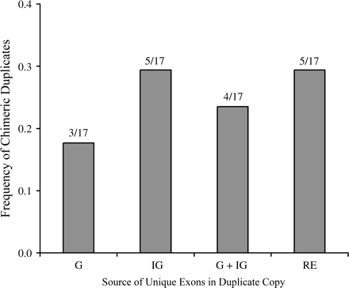
FIG. 3.— Relative contributions of four sequence types to the formation of unique exons in the duplicated copy (n = ...
Notes:
FIG. 3.— Relative contributions of four sequence types to the formation of unique exons in the duplicated copy (n = 17). The four sequence types are denoted as genic (G), intergenic (IG), both genic and intergenic (G + IG), and repetitive element (RE).
Unless provided in the caption above, the following copyright applies to the content of this slide: © The Author 2006. Published by Oxford University Press on behalf of the Society for Molecular Biology and Evolution. All rights reserved. For permissions, please e-mail: journals.permissions@oxfordjournals.org

Slide 4
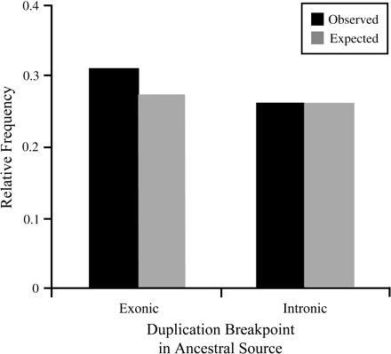
FIG. 4.— Distribution comparing observed and expected frequencies of duplication breakpoints in two types of sequences ...
Notes:
FIG. 4.— Distribution comparing observed and expected frequencies of duplication breakpoints in two types of sequences (exonic and intronic). Black shading denotes observed location of duplication breakpoints in ancestral copies. Light gray shading denotes expected frequencies if duplication breakpoints occurred uniformly in the genome.
Unless provided in the caption above, the following copyright applies to the content of this slide: © The Author 2006. Published by Oxford University Press on behalf of the Society for Molecular Biology and Evolution. All rights reserved. For permissions, please e-mail: journals.permissions@oxfordjournals.org

