Slide 1
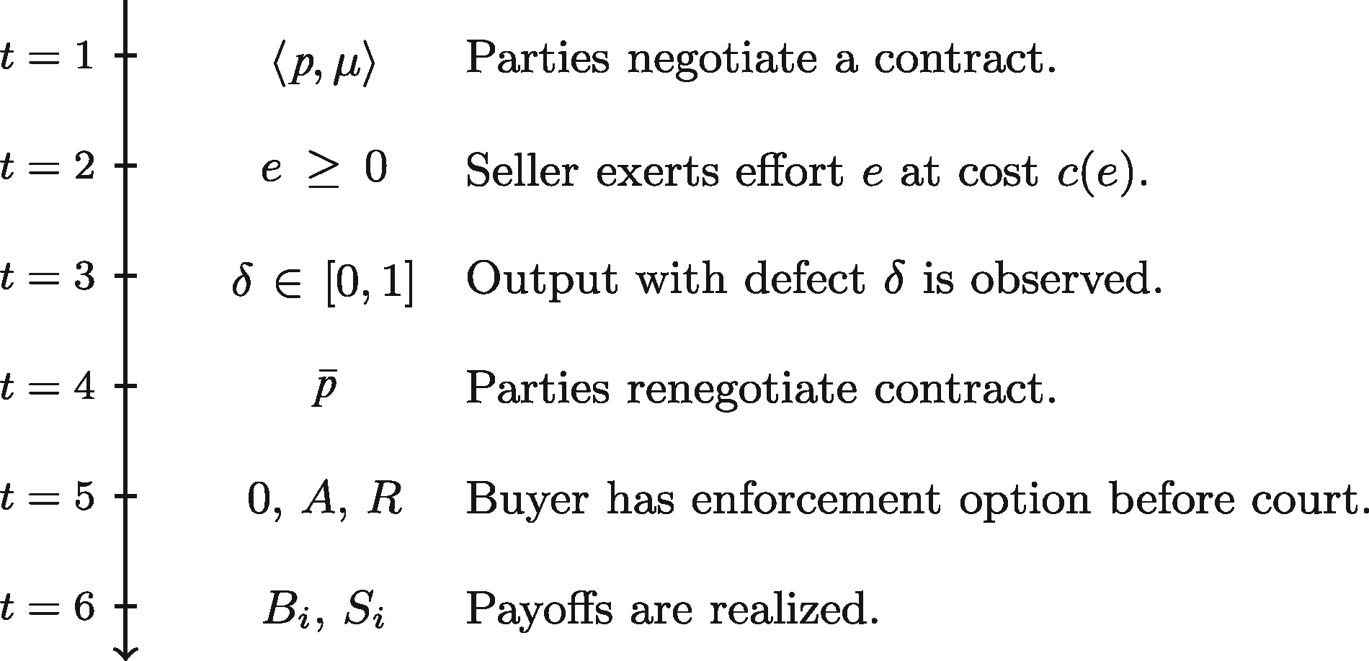
Figure 1. Timeline.
Notes:
Figure 1. Timeline.
Unless provided in the caption above, the following copyright applies to the content of this slide: © The Author 2017. Published by Oxford University Press on behalf of Yale University. All rights reserved. For Permissions, please email: journals.permissions@oup.com

Slide 2
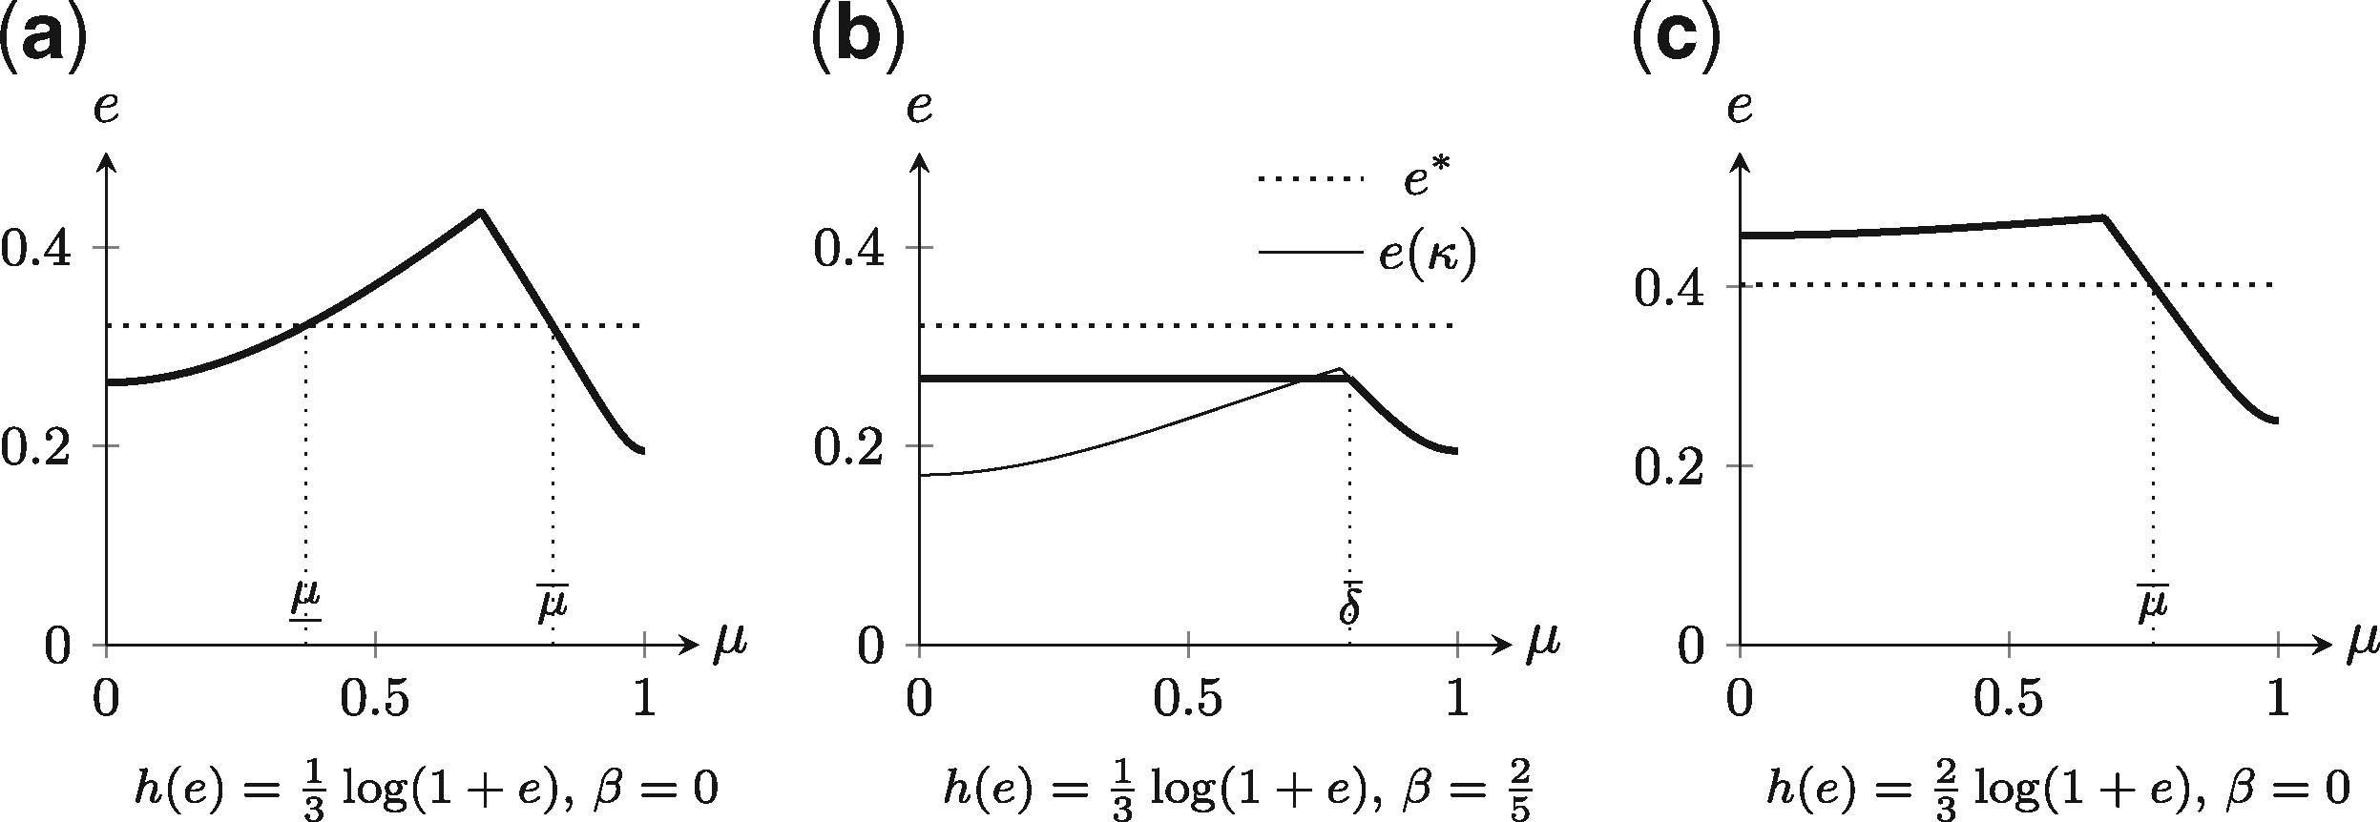
Figue 2. Threshold of Efficient Material Breach of Contract: These figures summarize the results from Proposition 2 ...
Notes:
Figue 2. Threshold of Efficient Material Breach of Contract: These figures summarize the results from Proposition 2 for the parameterization in the text. Effort e is depicted on the vertical axis, the threshold of material breach μ on the horizontal axis. The dotted horizontal line depicts the level of efficient effort. In panels (a) and (b), the baseline probability of no defect is h(e)=13log (1+e). In panel (a), under-compensation upon rejection is β = 0 and the threshold of efficient material breach is μ*∈{μ̲,μ¯}; in panel (b), β=2/5 is too high for the efficient outcome to be implemented by a satisfaction clause and μ* does not exist. The best satisfaction clause is μ+, which is not effective because δ¯=2β=4/5>μ+. The optimal threshold is any μo≤δ¯ so that κ(μo)=δ¯. In panel (c), the baseline probability h(e)=23log (1+e) is sufficiently high so that e(0)>e*, implying a unique threshold of efficient material breach, μ*=μ¯.
Unless provided in the caption above, the following copyright applies to the content of this slide: © The Author 2017. Published by Oxford University Press on behalf of Yale University. All rights reserved. For Permissions, please email: journals.permissions@oup.com

Slide 3
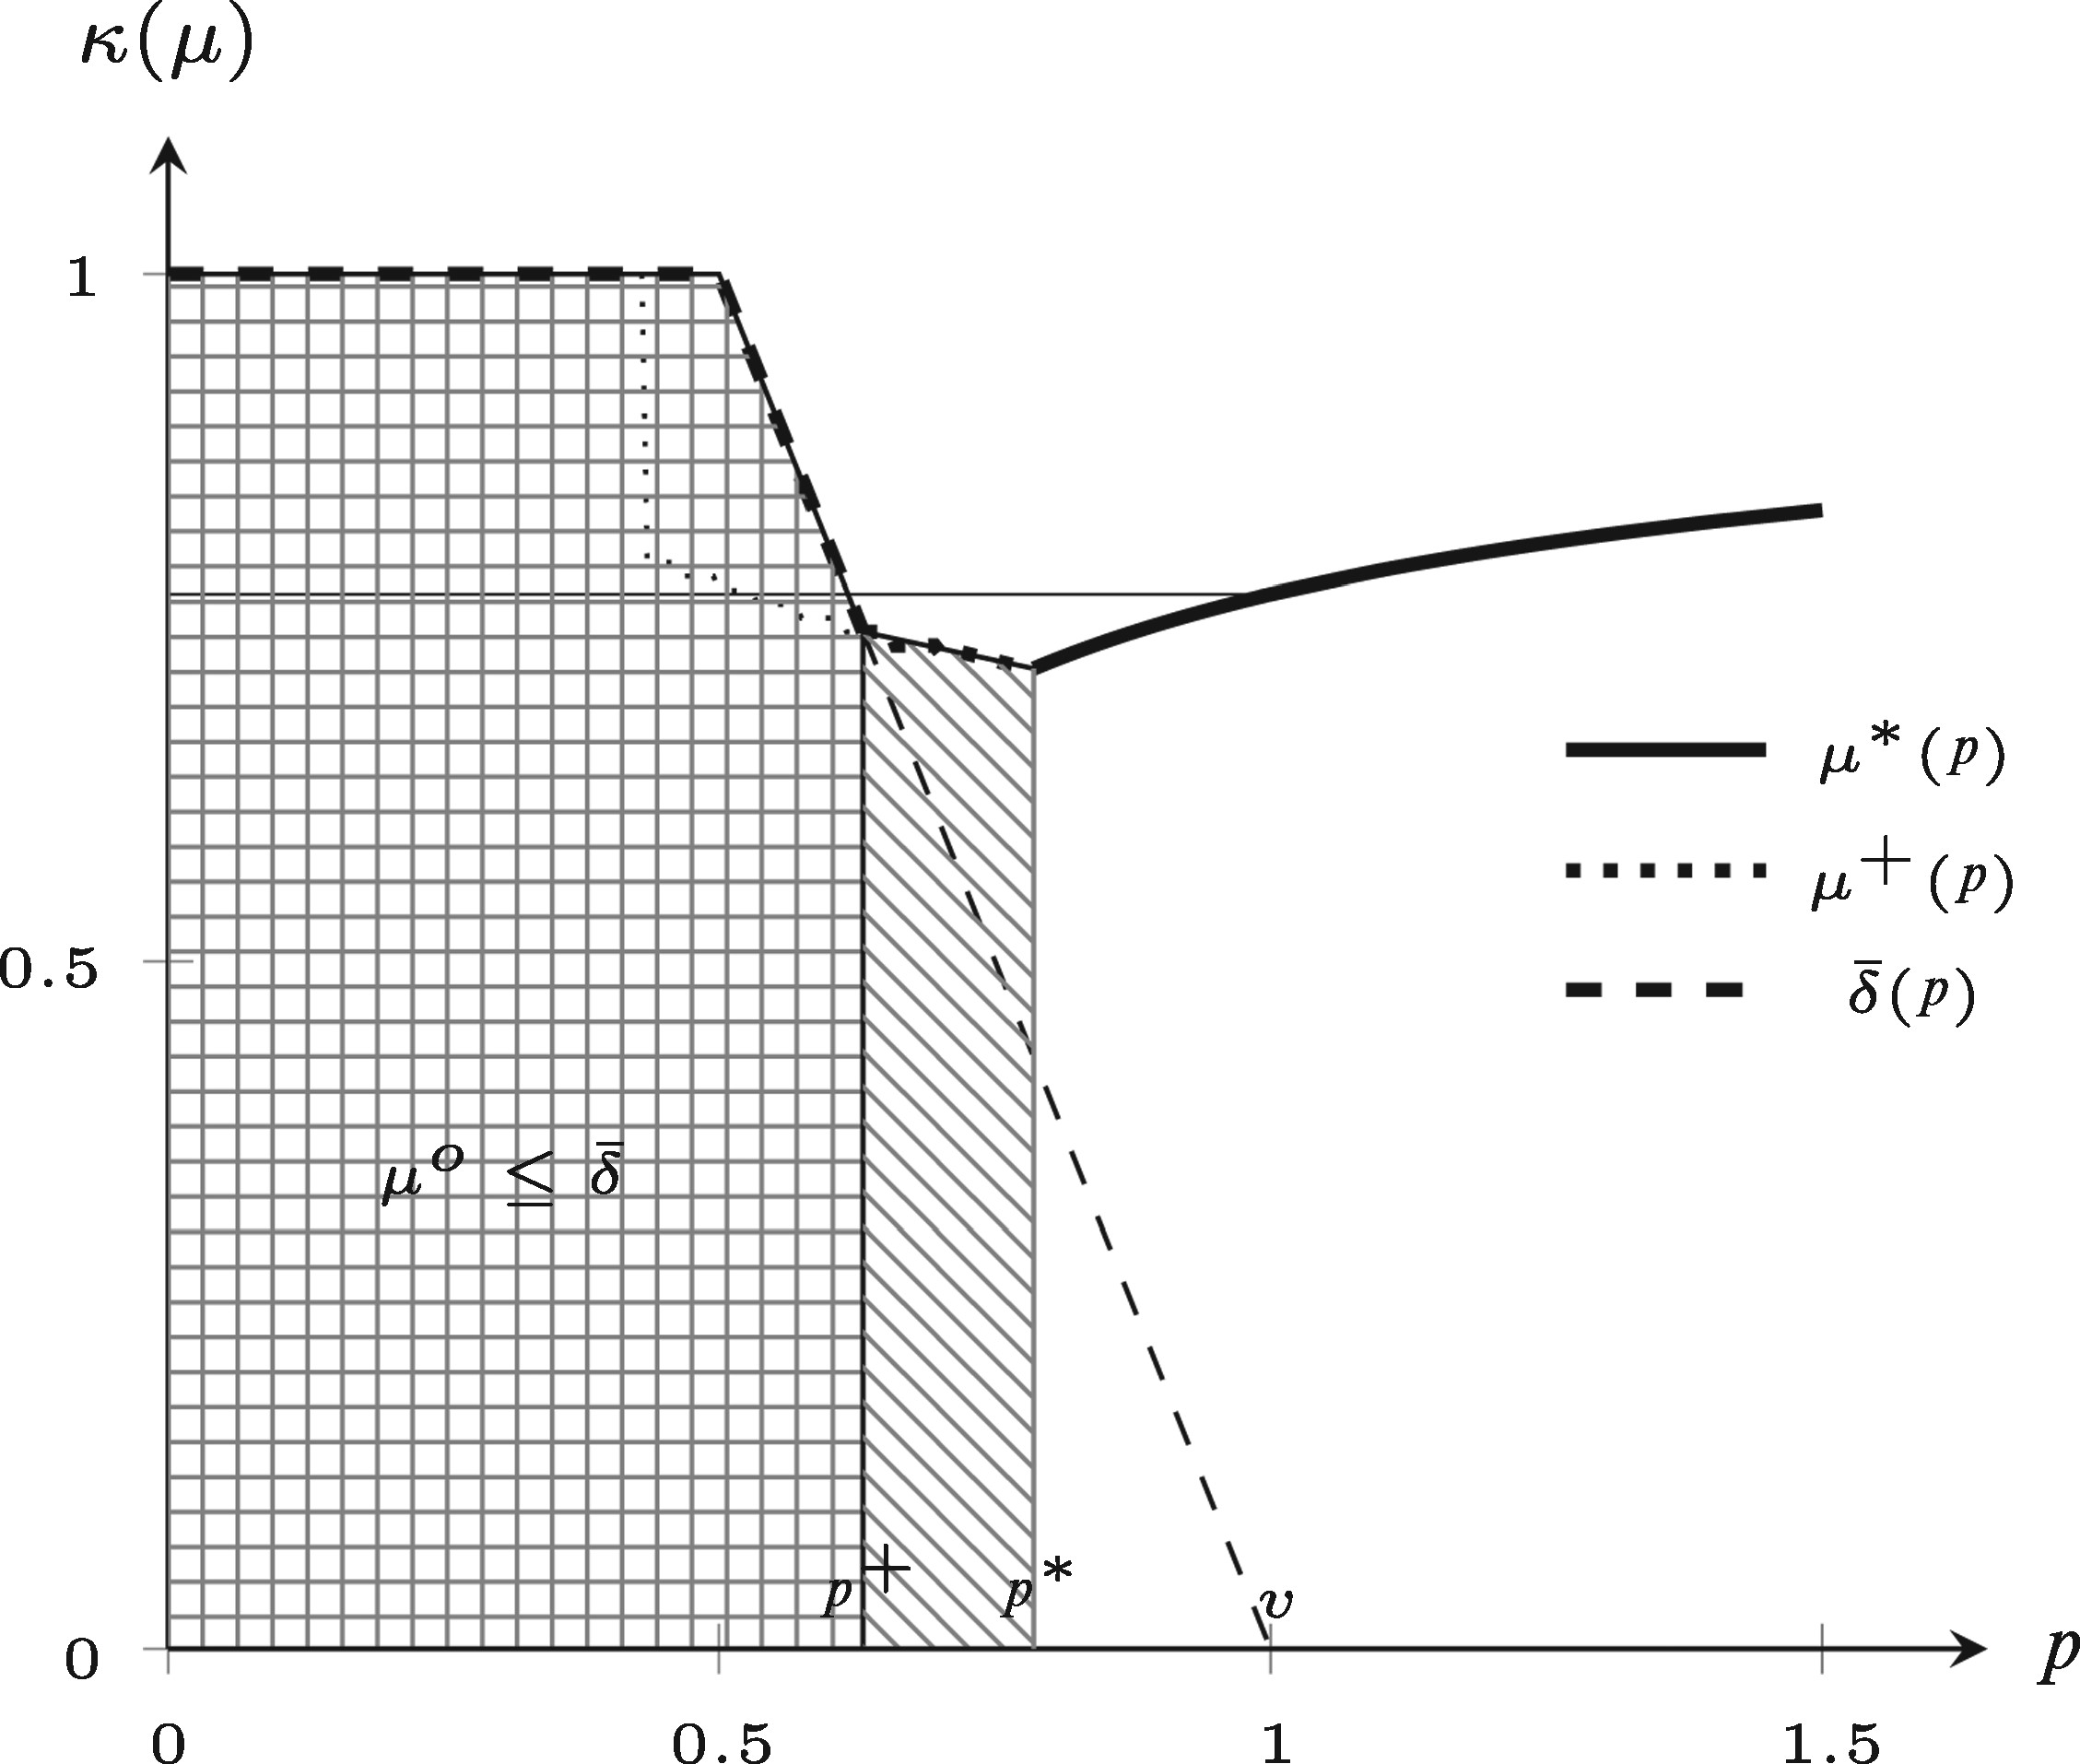
Figure 3. Material Breach of Contract for Rejection Without Compensation: The figure illustrates the results from ...
Notes:
Figure 3. Material Breach of Contract for Rejection Without Compensation: The figure illustrates the results from Proposition 4 when rejection and damages are mutually exclusive so that β=max{v−p,0}. The buyer’s payoffs when she rejects are BR = 0. The baseline probability is h(e)=23 log (1+e). The effective threshold of rejection κ(μ) (Lemma 1) is depicted on the vertical axis; the ex ante contract price p is on the horizontal axis. For low prices p≤p+, κ(μ)=δ¯=1>μ+(p). For intermediate prices p∈(p+,p*), a threshold of efficient material breach does not exist; the optimal threshold of material breach is μ+ with e(μ+)<e*. For higher prices p≥p*, κ(μ*)=μ* and the first-best outcome is implemented. The thin horizontal line depicts the threshold of efficient material breach in Proposition 2 for β = 0 (or, p=v).
Unless provided in the caption above, the following copyright applies to the content of this slide: © The Author 2017. Published by Oxford University Press on behalf of Yale University. All rights reserved. For Permissions, please email: journals.permissions@oup.com

Slide 4
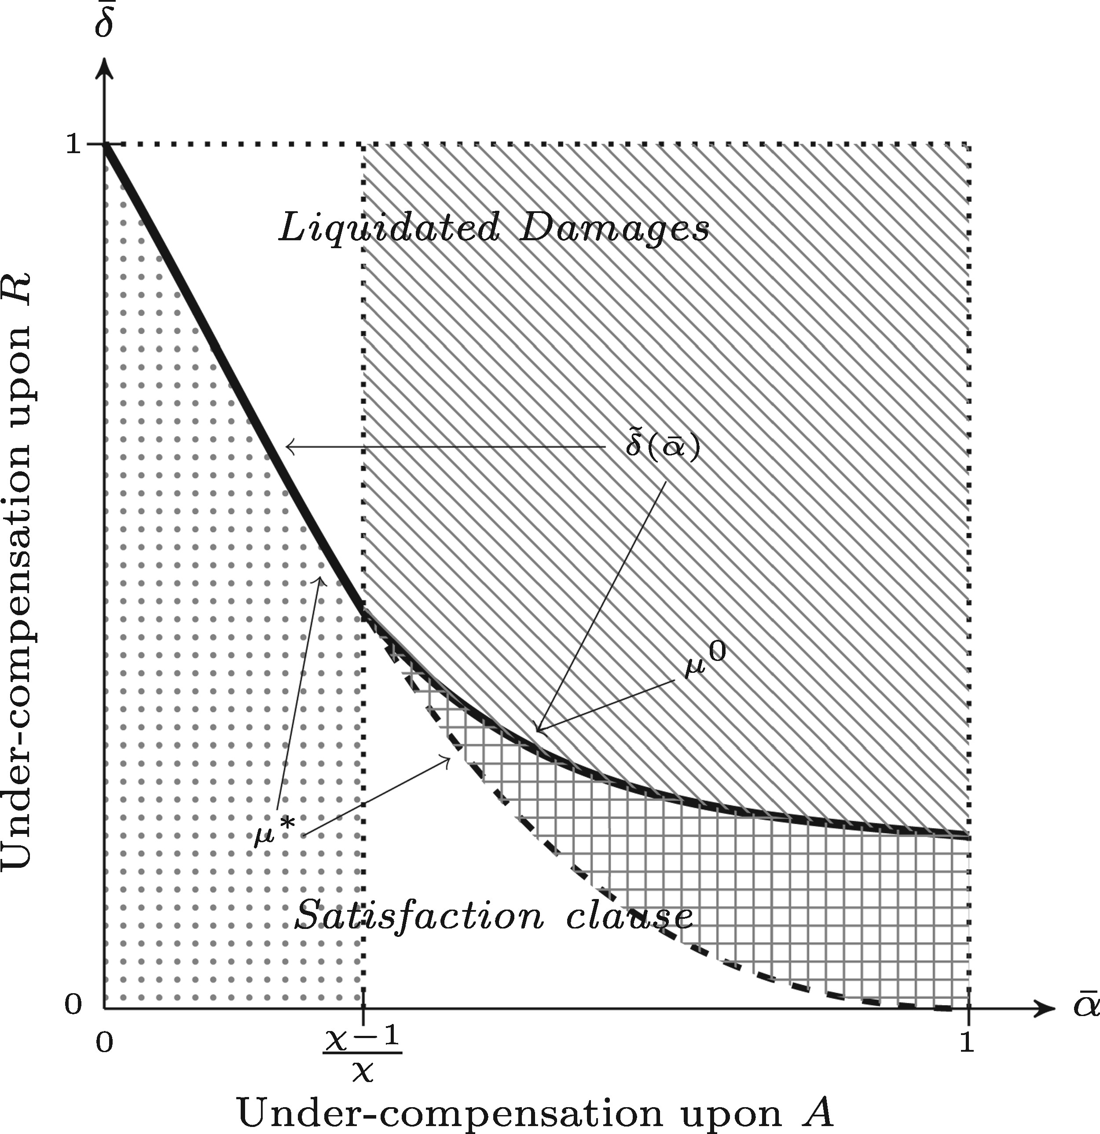
Figure 4. Liquidated Damages and Efficient Material Breach: The figure illustrates the results from Proposition 5. The ...
Notes:
Figure 4. Liquidated Damages and Efficient Material Breach: The figure illustrates the results from Proposition 5. The level of under-compensation upon acceptance (captured by the probability α¯ that a defect cannot be proven with reasonable certainty) is depicted on the horizontal axis, the level of under-compensation upon rejection (captured by δ¯) is depicted on the vertical axis. A contract with satisfaction clause, 〈p,μ〉, (weakly) dominates a contract with liquidated damages, 〈p0,q*(δ,α¯)〉 for all (α¯,δ¯) to the lower left of the solid curve δ~(α¯). The dot-shaded area depicts all (α¯,δ¯) pairs for which a satisfaction clause weakly dominates liquidated damages by a transactions costs argument. The line-shaded area (liquidated damages dominate) and the square-shaded area (satisfaction clause dominates) depict (α¯,δ¯) pairs for which seller’s effort is insufficient, e<e*, and the equilibrium outcome under the optimal contract is inefficient.
Unless provided in the caption above, the following copyright applies to the content of this slide: © The Author 2017. Published by Oxford University Press on behalf of Yale University. All rights reserved. For Permissions, please email: journals.permissions@oup.com

