Slide 1
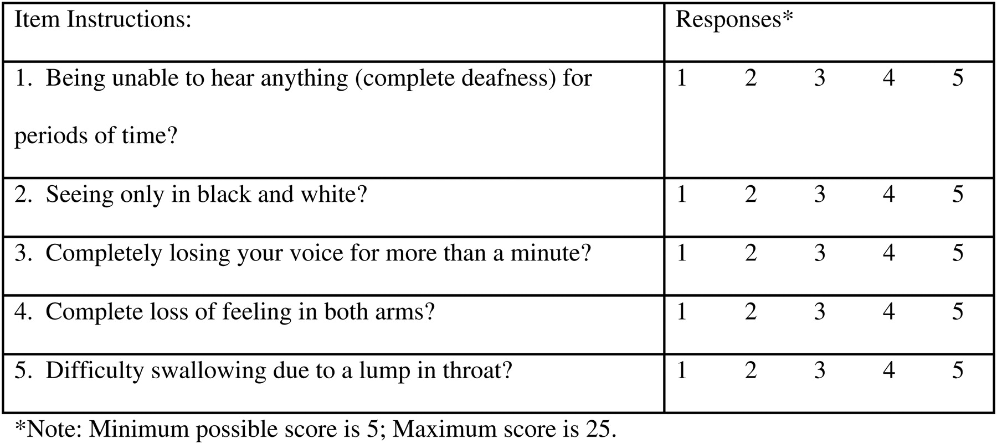
Fig. 1. Individual mBIAS items.
Notes:
Fig. 1. Individual mBIAS items.
Unless provided in the caption above, the following copyright applies to the content of this slide: Published by Oxford University Press on behalf of US Government. All rights reserved. For permissions, please e-mail: journals.permissions@oup.com.

