Slide 1
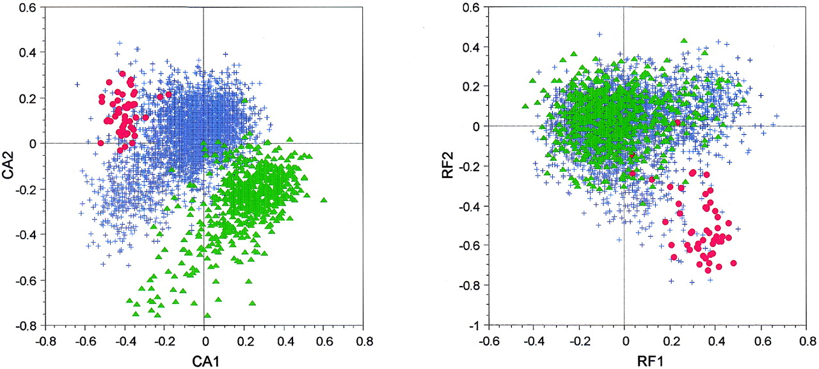
Figure 1. Factor maps obtained by crossing the first and second axes of two correspondence analyses computed ...
Notes:
Figure 1. Factor maps obtained by crossing the first and second axes of two correspondence analyses computed on 4052 B.subtilis genes. CA1 × CA2 is the plot of the analysis computed on codon counts, while RF1 × RF2 is the plot of the analysis computed on relative frequencies. Red dots, highly expressed genes; green triangles, genes encoding proteins having a gravy score >0.3 (i.e. highly hydrophobic proteins); blue crosses, all other genes.
Unless provided in the caption above, the following copyright applies to the content of this slide:

Slide 2
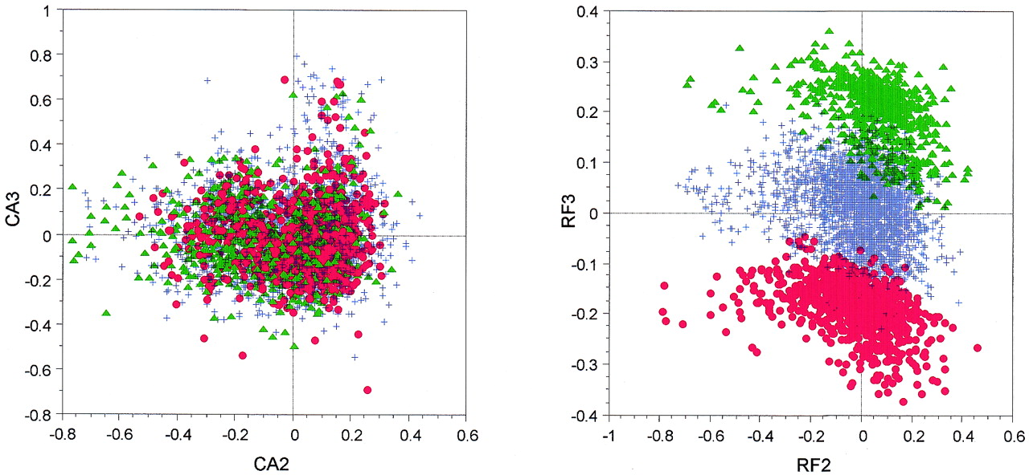
Figure 2. Factor maps obtained by crossing the second and third axes of two correspondence analyses computed ...
Notes:
Figure 2. Factor maps obtained by crossing the second and third axes of two correspondence analyses computed on 4052 B.subtilis genes. CA2 × CA3 is the plot of the analysis computed on codon counts, while RF2 × RF3 is the plot of the analysis computed on relative frequencies. Red dots, genes where the relative frequencies of UGC/UGU codons are equal to 1/0; green triangles, genes where the relative frequencies of UGC/UGU codons are equal to 0/1; blue crosses, all other genes.
Unless provided in the caption above, the following copyright applies to the content of this slide:

Slide 3
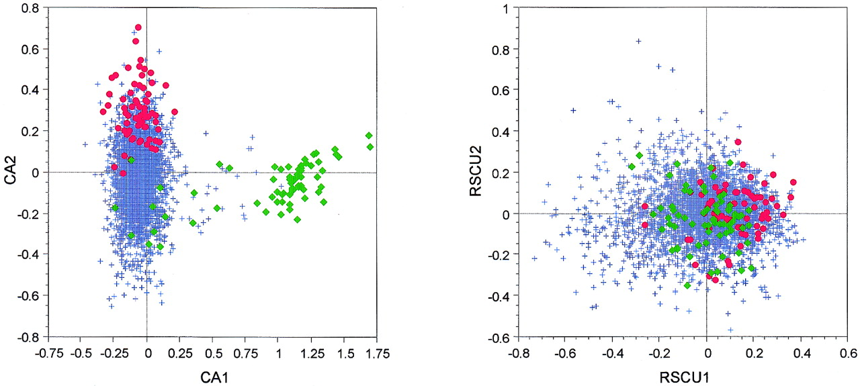
Figure 3. Factor maps obtained by crossing the first and second axes of two correspondence analyses computed ...
Notes:
Figure 3. Factor maps obtained by crossing the first and second axes of two correspondence analyses computed on 3912 M.tuberculosis (strain H37Rv) genes. CA1 × CA2 is the plot of the analysis computed on codon counts, while RSCU1 × RSCU2 is the plot of the analysis computed on RSCU values. Red dots, highly expressed genes; green diamonds, genes encoding proteins belonging to the PE‐PGRS family; blue crosses, all other genes.
Unless provided in the caption above, the following copyright applies to the content of this slide:

Slide 4
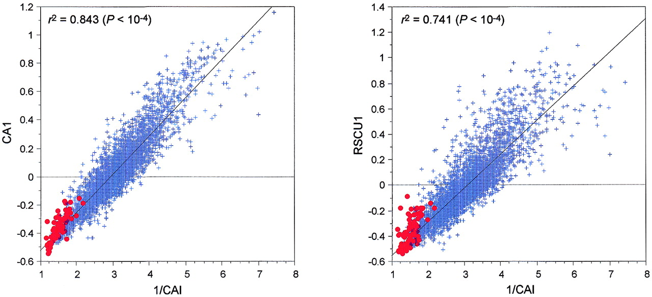
Figure 4. Regression plots between the factor scores on the first axes of two correspondence analyses ...
Notes:
Figure 4. Regression plots between the factor scores on the first axes of two correspondence analyses computed on 4254 E.coli (strain K12) genes and the inverse of their respective CAI values. 1/CAI × CA1 is the plot of the analysis computed on codon counts, while 1/CAI × RSCU1 is the plot of the analysis computed on RSCU values. Red dots, highly expressed genes; blue crosses, all other genes.
Unless provided in the caption above, the following copyright applies to the content of this slide:

Slide 5
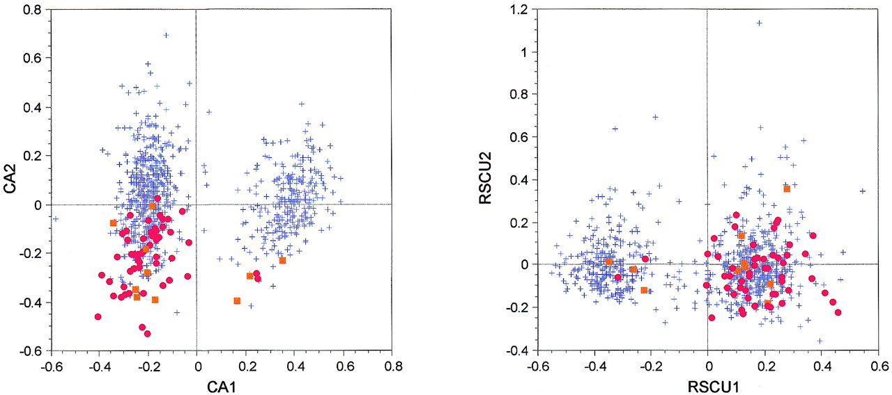
Figure 5. Factor maps obtained by crossing the first and second axes of two correspondence analyses computed ...
Notes:
Figure 5. Factor maps obtained by crossing the first and second axes of two correspondence analyses computed on 821 B.burgdorferi genes. CA1 × CA2 is the plot of the analysis computed on codon counts, while RSCU1 × RSCU2 is the plot of the analysis computed on RSCU values. Red dots, ribosomal protein genes; orange squares, other highly expressed genes (see Table 1); blue crosses, all other genes.
Unless provided in the caption above, the following copyright applies to the content of this slide:

Slide 6
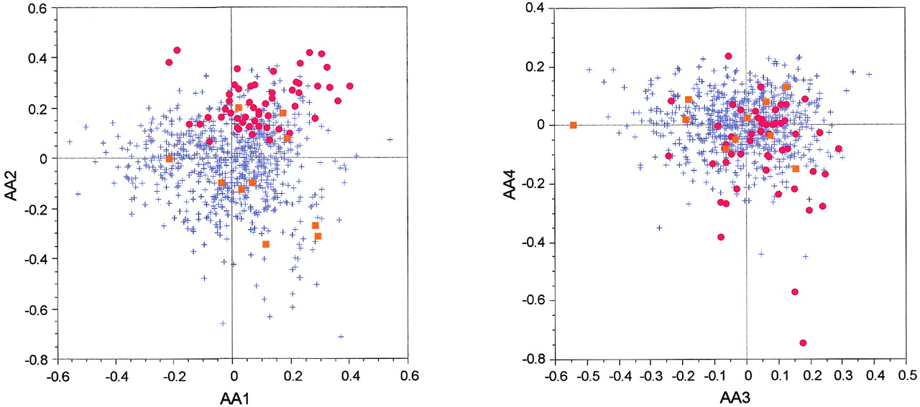
Figure 6. Factor maps obtained by crossing the first four axes of a correspondence analysis computed on 821 ...
Notes:
Figure 6. Factor maps obtained by crossing the first four axes of a correspondence analysis computed on 821 B.burgdorferi proteins. AA1 × AA2 is the plot crossing the first and second axes, while AA3 × AA4 is the plot crossing the third and fourth axes. Red dots, ribosomal protein genes; orange squares, other highly expressed genes (see Table 1); blue crosses, all other genes.
Unless provided in the caption above, the following copyright applies to the content of this slide:

Slide 7
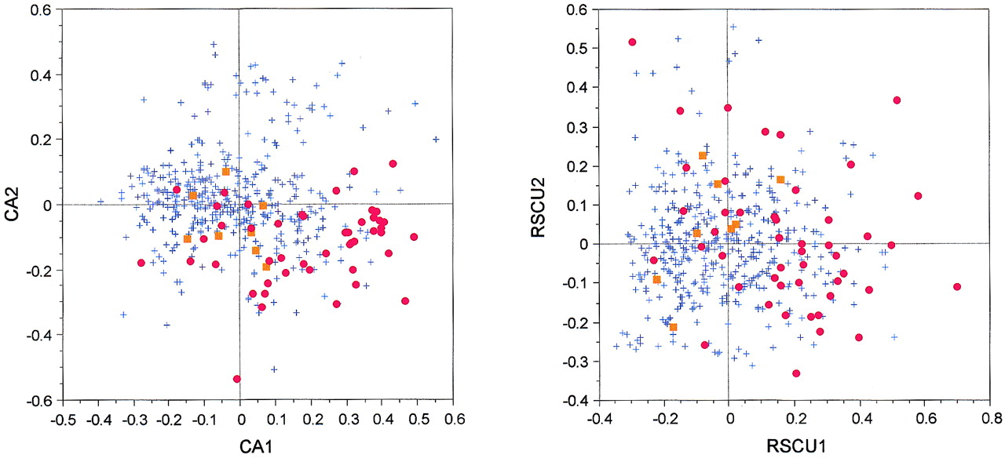
Figure 7. Factor maps obtained by crossing the first and second axes of two correspondence analyses computed ...
Notes:
Figure 7. Factor maps obtained by crossing the first and second axes of two correspondence analyses computed on 466 M.genitalium genes. CA1 × CA2 is the plot of the analysis computed on codon counts, while RSCU1 × RSCU2 is the plot of the analysis computed on RSCU values. Red dots, ribosomal protein genes; orange squares, other highly expressed genes (see Table 1); blue crosses, all other genes.
Unless provided in the caption above, the following copyright applies to the content of this slide:

