Slide 1
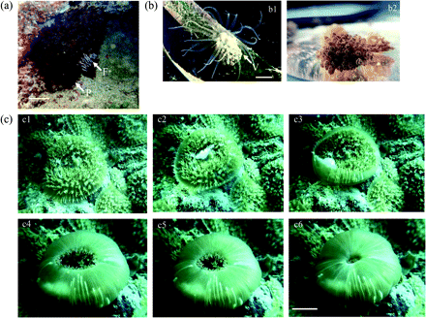
Fig. 1 Morphological adaptations for light capture in sea anemones with photosynthetic symbionts. Scale bars=2.5 cm. ...
Notes:
Fig. 1 Morphological adaptations for light capture in sea anemones with photosynthetic symbionts. Scale bars=2.5 cm. (a) Dimorphic tentacles of Lebrunia danae (i) photosynthetic tentacles and (ii) colourless feeding tentacles emerging in response to a prey item. (b) Vesicles on the body wall of Bunodeopsis antilliensis bearing symbiotic algal cells: at night, when feeding tentacles are extended; and by day when the feeding tentacles are retracted and the vesicles expanded. (Photographs of R Day.) (c) Tentacles on the oral disc of Discosoma sanctithome (i), and capture of small fish prey by extension of the oral veil (2–4, see text for details). (Photographs of B Watson.)
Unless provided in the caption above, the following copyright applies to the content of this slide: © The Author [2008]. Published by Oxford University Press [on behalf of the Society for Experimental Biology]. All rights reserved. For Permissions, please e-mail: journals.permissions@oxfordjournals.org

Slide 2
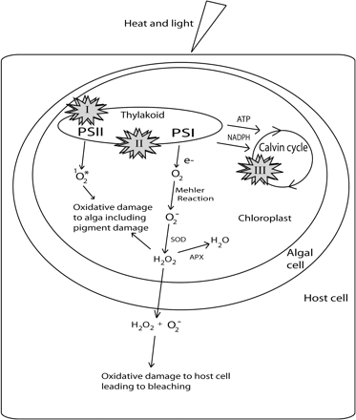
Fig. 2 Three proposed primary impacts of elevated temperature on the photosystems of symbiotic algae in animal ...
Notes:
Fig. 2 Three proposed primary impacts of elevated temperature on the photosystems of symbiotic algae in animal hosts, shown as I, II, and III in the figure. (I) Dysfunction of PSII and degradation of the D1 protein. (II) Energetic uncoupling in the thylakoid membranes. (III) Impairment of the Calvin cycle. During bleaching ROS are generated from O2 via the Mehler reaction and are detoxified by superoxide dismutase (SOD) and ascorbate peroxidase (APX). If the rate of ROS generation exceeds detoxification, then oxidative damage can occur, triggering signalling pathways and cellular responses that underpin bleaching. Singlet oxygen can be generated at damaged PSII reaction centres and in the photosynthetic antennae causing photobleaching of chlorophyll and accessory pigments.
Unless provided in the caption above, the following copyright applies to the content of this slide: © The Author [2008]. Published by Oxford University Press [on behalf of the Society for Experimental Biology]. All rights reserved. For Permissions, please e-mail: journals.permissions@oxfordjournals.org

