Slide 1
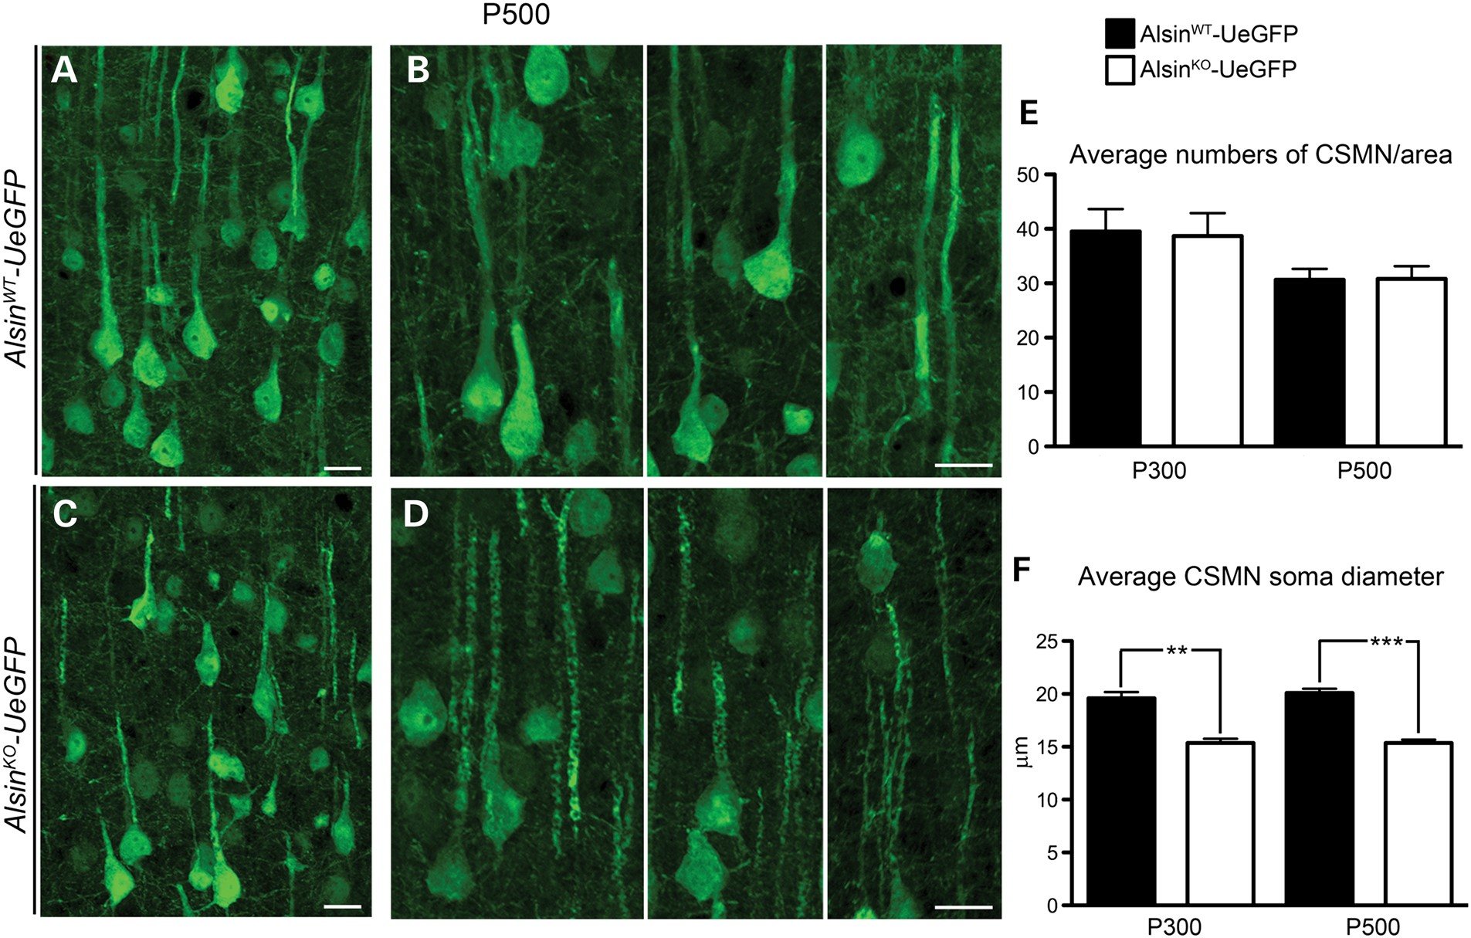
Figure 3. Reduced soma diameter suggests potential neuronal defects, without major cell loss. (A and B) Representative ...
Notes:
Figure 3. Reduced soma diameter suggests potential neuronal defects, without major cell loss. (A and B) Representative images of CSMN in AlsinWT-UeGFP and (C and D) AlsinKO-UeGFP mice at P500. (E) Average numbers of CSMN were comparable between AlsinWT-UeGFP and AlsinKO-UeGFP mice. (F) The average CSMN soma diameter significantly decreased in AlsinKO-UeGFP mice at P300 and at P500. Bar graph values are mean ± SEM. Student's t-test, ** P < 0.003; *** P < 0.0007. Scale bar: 20 µm (A–D).
Unless provided in the caption above, the following copyright applies to the content of this slide: © The Author 2016. Published by Oxford University Press.This is an Open Access article distributed under the terms of the Creative Commons Attribution Non-Commercial License (http://creativecommons.org/licenses/by-nc/4.0/), which permits non-commercial re-use, distribution, and reproduction in any medium, provided the original work is properly cited. For commercial re-use, please contact journals.permissions@oup.com

Slide 2
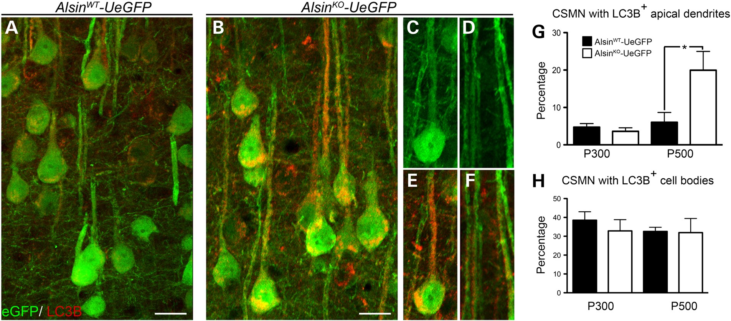
Figure 4. CSMN display increased autophagy in the absence of alsin function. (A–F) Representative images of CSMN ...
Notes:
Figure 4. CSMN display increased autophagy in the absence of alsin function. (A–F) Representative images of CSMN expressing LC3B, a prominent autophagy marker, in AlsinWT-UeGFP (A) and AlsinKO-UeGFP (B–F) mice. (G and H) Quantitative analysis of percent CSMN with autophagy within their apical dendrites (G) and soma (H). Bar graph values are mean ± SEM. Student's t-test, *P < 0.02. Scale bar: 20 µm (A and B).
Unless provided in the caption above, the following copyright applies to the content of this slide: © The Author 2016. Published by Oxford University Press.This is an Open Access article distributed under the terms of the Creative Commons Attribution Non-Commercial License (http://creativecommons.org/licenses/by-nc/4.0/), which permits non-commercial re-use, distribution, and reproduction in any medium, provided the original work is properly cited. For commercial re-use, please contact journals.permissions@oup.com

Slide 3
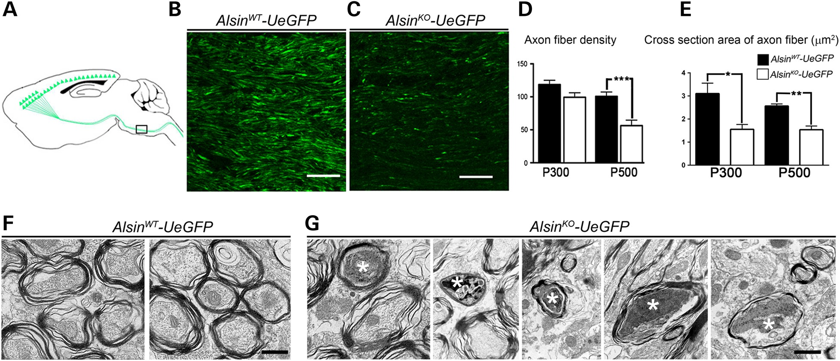
Figure 2. Corticospinal tract axons degenerate in Alsin^{KO}-UeGFP mice. (A) Schematic drawing of sagittal ...
Notes:
Figure 2. Corticospinal tract axons degenerate in AlsinKO-UeGFP mice. (A) Schematic drawing of sagittal section showing CST axons. Pons, (the boxed area), is used for quantification of axon fiber density and thickness. (B and C) Representative images of eGFP+ CST axons in pons of AlsinWT-UeGFP (B) and AlsinKO-UeGFP (C) mice. (D) The average fiber density is reduced in AlsinKO-UeGFP mice at P500, but not at P300. (E) The average cross-section area of axon fiber is gradually reduced in AlsinKO-UeGFP mice at P300 and P500. (F) Electron micrographs of CST axons in ventral pons of AlsinWT-UeGFP mice show healthy axon fiber bundles. (G) There are numerous degenerating axon fibers within CST of AlsinKO-UeGFP mice at P500 displaying a wide variety of morphological defects such as: membranous debris, mitochondria aggregation, collapsed synaptic vesicles and membrane debris, electrodense material, crenated mitochondria and final stages of degeneration (denoted by stars). Bar graph values are mean ± SEM. Student's t-test, ***P < 0.0001. Scale bar: 50 µm (B and C); 500 nm (F–G).
Unless provided in the caption above, the following copyright applies to the content of this slide: © The Author 2016. Published by Oxford University Press.This is an Open Access article distributed under the terms of the Creative Commons Attribution Non-Commercial License (http://creativecommons.org/licenses/by-nc/4.0/), which permits non-commercial re-use, distribution, and reproduction in any medium, provided the original work is properly cited. For commercial re-use, please contact journals.permissions@oup.com

Slide 4
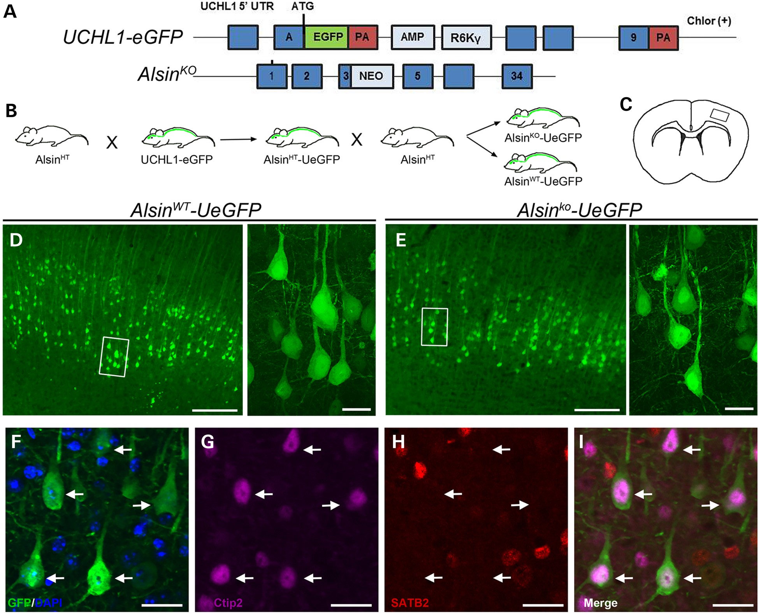
Figure 1. Neurons expressing eGFP in Alsin^{WT}-UeGFP and Alsin^{KO}-UeGFP mice retain CSMN identity. ...
Notes:
Figure 1. Neurons expressing eGFP in AlsinWT-UeGFP and AlsinKO-UeGFP mice retain CSMN identity. (A) Schematic representation of the transgenic constructs of UCHL1-eGFP and AlsinKO gene used to generate AlsinWT-UeGFP and AlsinKO-UeGFP mice, respectively. (B) Breeding strategy to generate AlsinWT-UeGFP and AlsinKO-UeGFP mice, reporter line of CSMN in the AlsinKO background. (C) A cross-section area of the brain. Boxed area represents layer V of motor cortex. (D and E) eGFP+ neurons reside in layer V of the motor cortex and display pyramidal neuron morphology with prominent apical dendrites in both AlsinWT-UeGFP (D) and AlsinKO-UeGFP (E), inset are enlarged to the right. (F–I) eGFP+ neurons express Ctip2 (G) but not Satb2 (H). Scale bar: 500 µm (D and E), 20 µm (insets, F–I).
Unless provided in the caption above, the following copyright applies to the content of this slide: © The Author 2016. Published by Oxford University Press.This is an Open Access article distributed under the terms of the Creative Commons Attribution Non-Commercial License (http://creativecommons.org/licenses/by-nc/4.0/), which permits non-commercial re-use, distribution, and reproduction in any medium, provided the original work is properly cited. For commercial re-use, please contact journals.permissions@oup.com

Slide 5
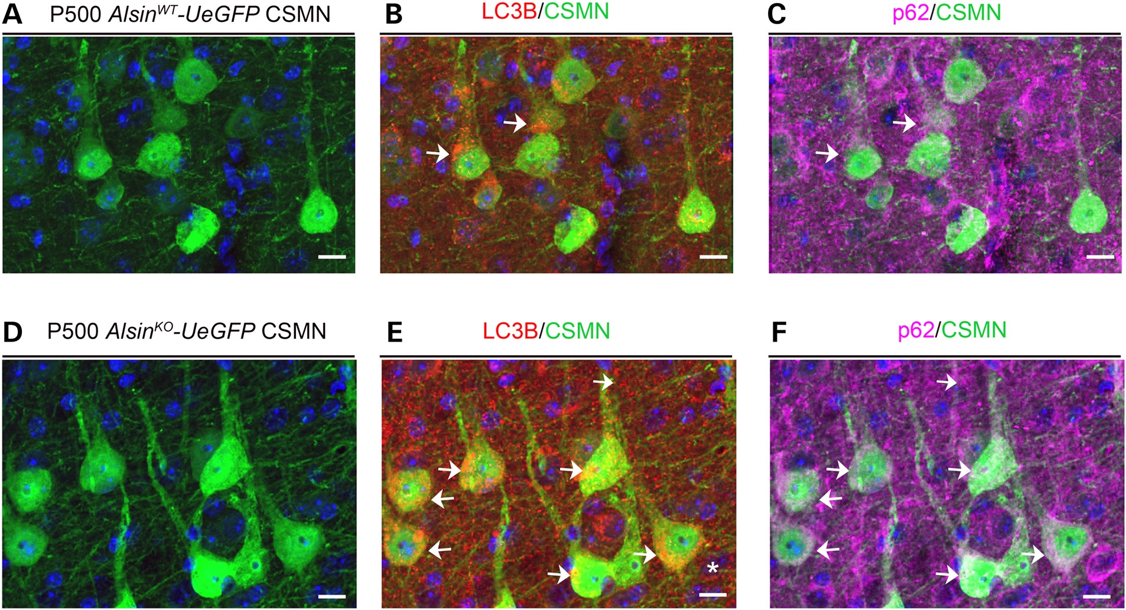
Figure 5. p62 is present in CSMN that expresses LC3B in Alsin^{KO}-UeGFP mice (A–C) Representative images of ...
Notes:
Figure 5. p62 is present in CSMN that expresses LC3B in AlsinKO-UeGFP mice (A–C) Representative images of CSMN (A) that express LC3B (B) and p62 (C) in the AlsinWT-UeGFP mice. (D–F) Representative images of CSMN (D) that express LC3B (E) and p62 (F) in the AlsinKO-UeGFP mice. Arrows indicate CSMN that express both LC3B and p62. Scale Bar: 10 µm.
Unless provided in the caption above, the following copyright applies to the content of this slide: © The Author 2016. Published by Oxford University Press.This is an Open Access article distributed under the terms of the Creative Commons Attribution Non-Commercial License (http://creativecommons.org/licenses/by-nc/4.0/), which permits non-commercial re-use, distribution, and reproduction in any medium, provided the original work is properly cited. For commercial re-use, please contact journals.permissions@oup.com

Slide 6
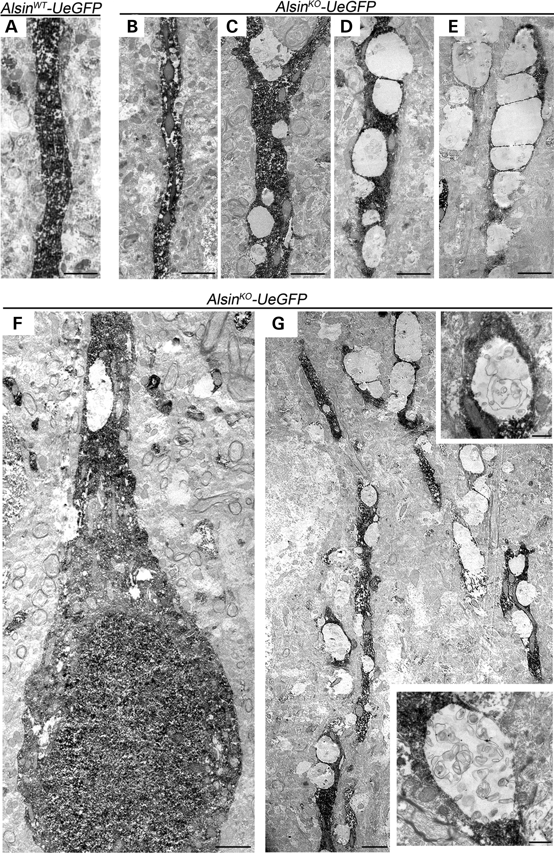
Figure 6. eGFP immunocytochemistry coupled with EM reveal major defects within apical dendrites of diseased CSMN. (A) ...
Notes:
Figure 6. eGFP immunocytochemistry coupled with EM reveal major defects within apical dendrites of diseased CSMN. (A) Apical dendrite of CSMN in AlsinWT-UeGFP mice are devoid of any vacuoles and display healthy morphology. (B–E) Apical dendrites of CSMN in AlsinKO-UeGFP mice have vacuoles of different sizes and various stages. (F) A GFP labeled CSMN soma with vacuolated proximal apical dendrite and (G) distal apical dendrite with many vacuoles only in diseased CSMN. Insets display magnified view of representative vacuoles with numerous disintegrating cellular debris. Scale bar: 2 µm (A–G); 500 nm (insets).
Unless provided in the caption above, the following copyright applies to the content of this slide: © The Author 2016. Published by Oxford University Press.This is an Open Access article distributed under the terms of the Creative Commons Attribution Non-Commercial License (http://creativecommons.org/licenses/by-nc/4.0/), which permits non-commercial re-use, distribution, and reproduction in any medium, provided the original work is properly cited. For commercial re-use, please contact journals.permissions@oup.com

Slide 7
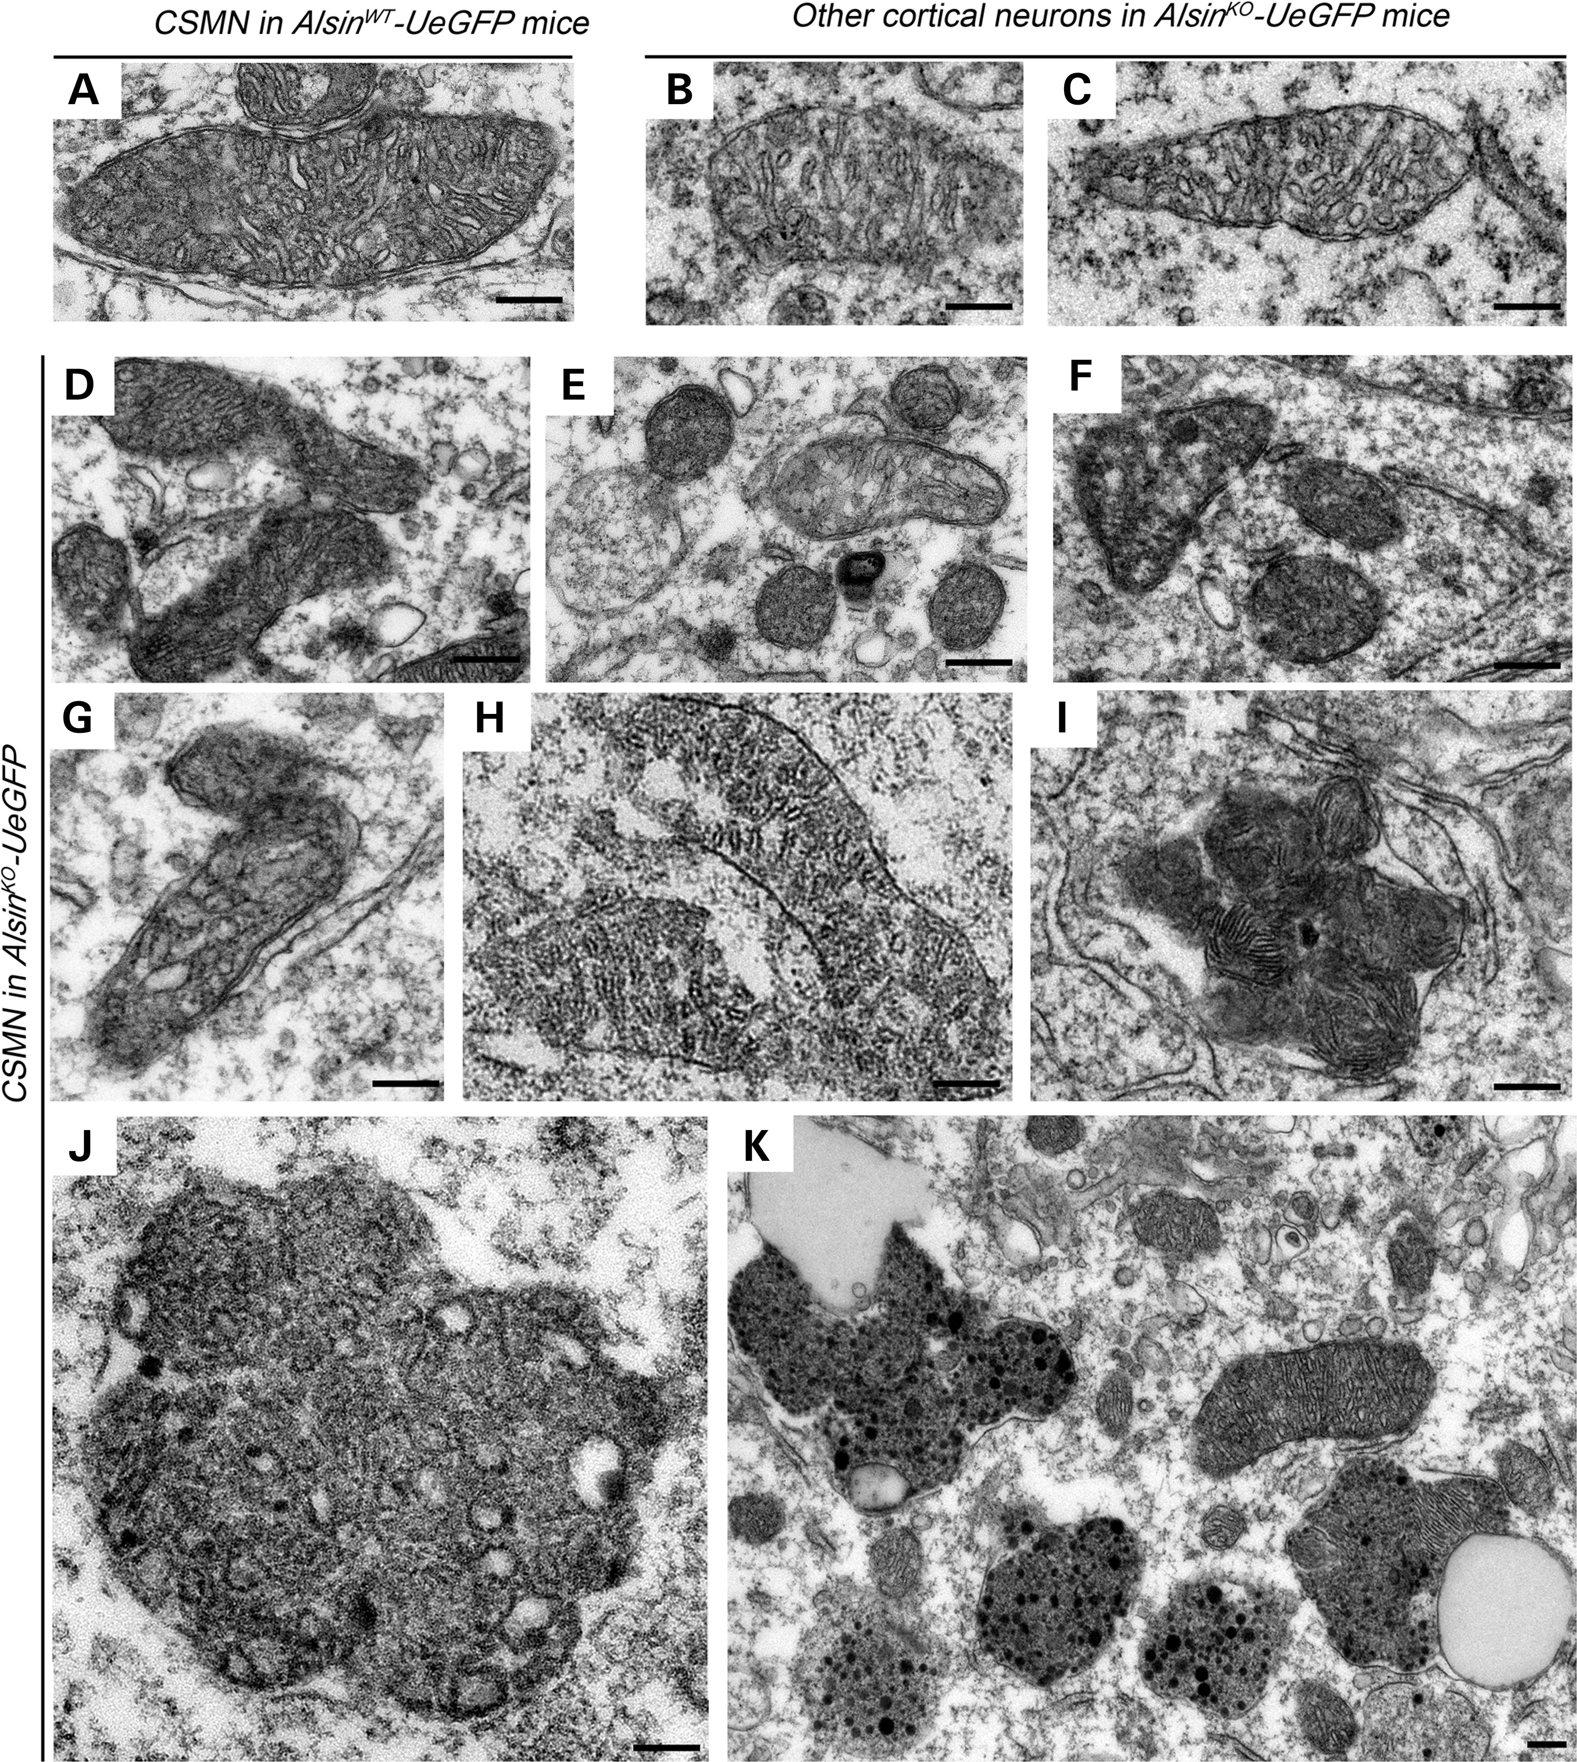
Figure 7. Absence of alsin function leads to mitochondrial defects in CSMN. (A–C) Representative images of mitochondria ...
Notes:
Figure 7. Absence of alsin function leads to mitochondrial defects in CSMN. (A–C) Representative images of mitochondria present in the CSMN of AlsinWT-UeGFP mice (A) and other cortical neurons of AlsinKO-UeGFP mice (B and C). (D–K) Representative images of mitochondria present in the CSMN of AlsinKO-UeGFP mice. They display numerous structural defects, such as disintegration of inner membranes (D–G), broken cristae (H), fusion with other mitochondria (I), aggregation (J) and fusion of these aggregates with endolysosome-like structures (K). Scale bar: 200 nm (A–J); 1 µm (K).
Unless provided in the caption above, the following copyright applies to the content of this slide: © The Author 2016. Published by Oxford University Press.This is an Open Access article distributed under the terms of the Creative Commons Attribution Non-Commercial License (http://creativecommons.org/licenses/by-nc/4.0/), which permits non-commercial re-use, distribution, and reproduction in any medium, provided the original work is properly cited. For commercial re-use, please contact journals.permissions@oup.com

Slide 8
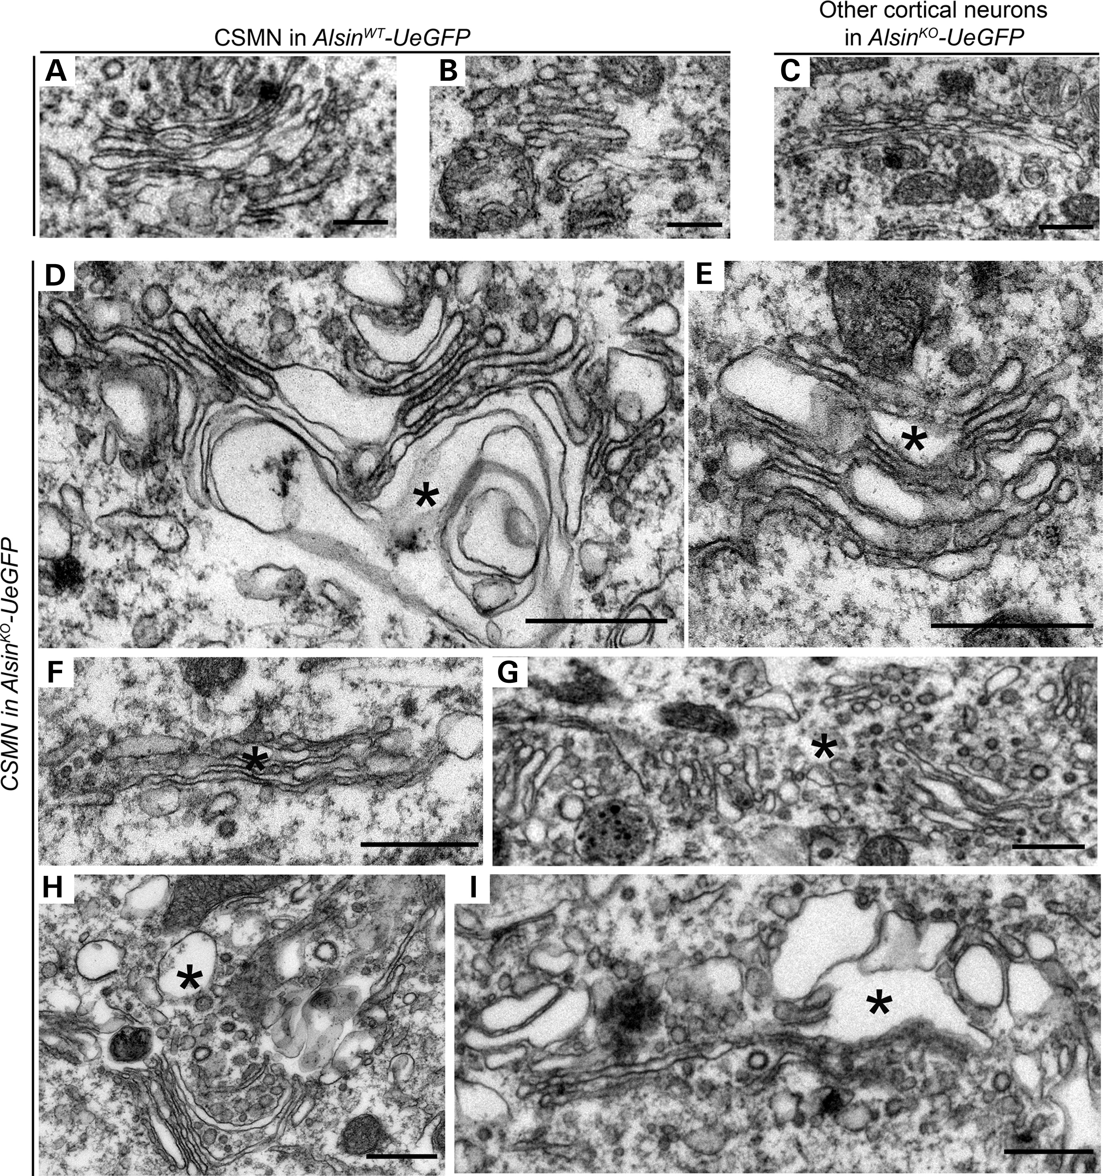
Figure 8. Alsin function is required for the stability of Golgi apparatus in CSMN. (A–C) Representative images of Golgi ...
Notes:
Figure 8. Alsin function is required for the stability of Golgi apparatus in CSMN. (A–C) Representative images of Golgi apparatus present in the CSMN of AlsinWT-UeGFP mice (A) and other cortical neurons of AlsinKO-UeGFP mice (B and C). (D–I) Representative images of Golgi apparatus present in the CSMN of AlsinKO-UeGFP mice. They display numerous structural defects, such as vacuolated cisternae (denoted by asterisk) (D and E), cisternae filled with dark material (F and G) and dark vesicles and vacuoles disrupting their ultrastructure (H and I). Scale bar: 500 nm (A–I).
Unless provided in the caption above, the following copyright applies to the content of this slide: © The Author 2016. Published by Oxford University Press.This is an Open Access article distributed under the terms of the Creative Commons Attribution Non-Commercial License (http://creativecommons.org/licenses/by-nc/4.0/), which permits non-commercial re-use, distribution, and reproduction in any medium, provided the original work is properly cited. For commercial re-use, please contact journals.permissions@oup.com

Slide 9
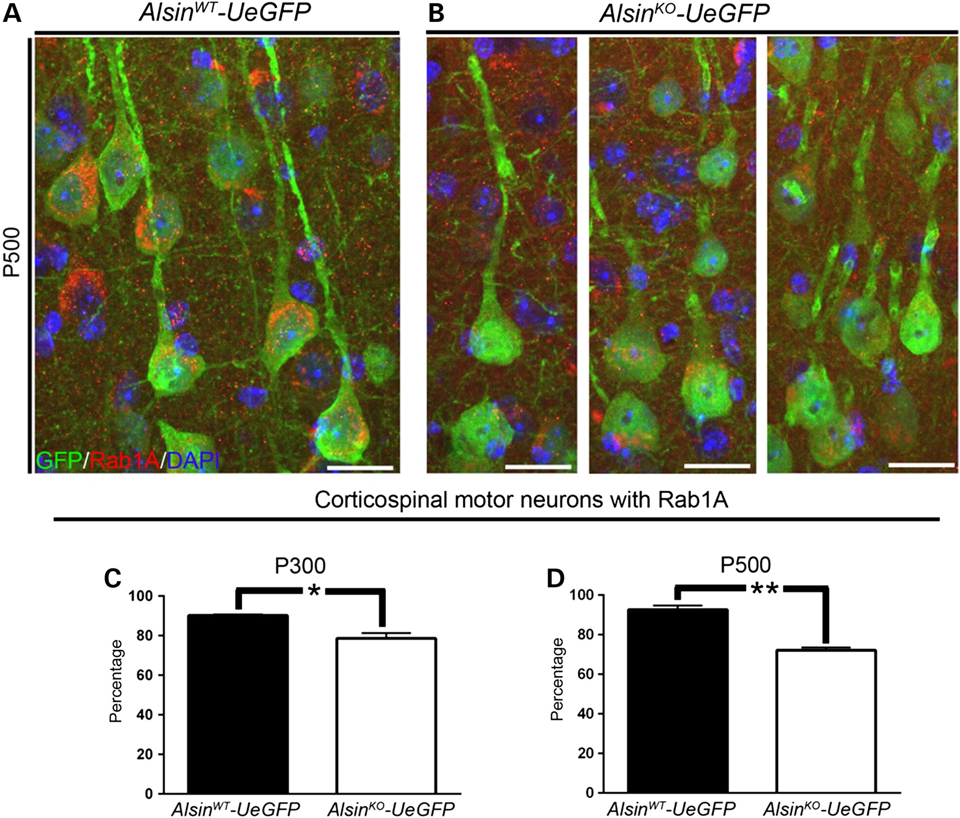
Figure 9. Rab1A expression is reduced in diseased CSMN. (A and B) Representative images of Rab1A expression in CSMN of ...
Notes:
Figure 9. Rab1A expression is reduced in diseased CSMN. (A and B) Representative images of Rab1A expression in CSMN of AlsinWT-UeGFP (A) and AlsinKO-UeGFP mice (B). (C and D) Percentage of CSMN with Rab1A is progressively reduced in the absence of alsin function at P300 (C) and P500 (D). Bar graph values are mean ± SEM. Student's t-test, *P < 0.01, **P < 0.001. Scale bar: 20 µm (A and B).
Unless provided in the caption above, the following copyright applies to the content of this slide: © The Author 2016. Published by Oxford University Press.This is an Open Access article distributed under the terms of the Creative Commons Attribution Non-Commercial License (http://creativecommons.org/licenses/by-nc/4.0/), which permits non-commercial re-use, distribution, and reproduction in any medium, provided the original work is properly cited. For commercial re-use, please contact journals.permissions@oup.com

