Slide 1
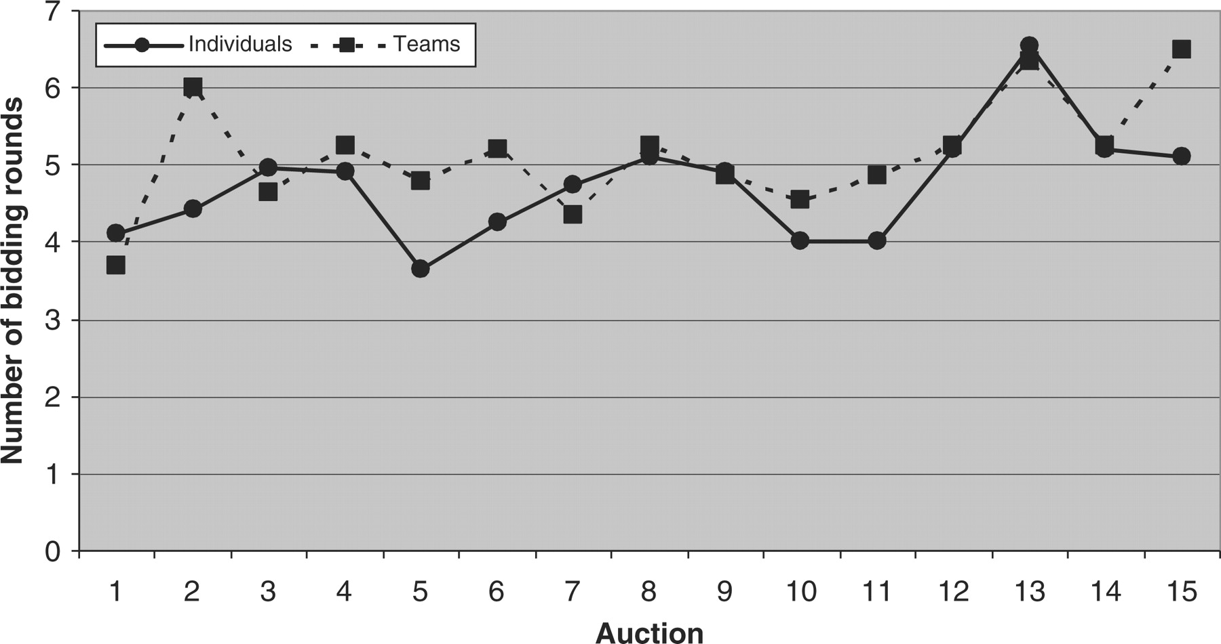
Fig. 1. Average number of bidding rounds
Notes:
Fig. 1. Average number of bidding rounds
Unless provided in the caption above, the following copyright applies to the content of this slide: © Oxford University Press 2008 All rights reserved

Slide 2
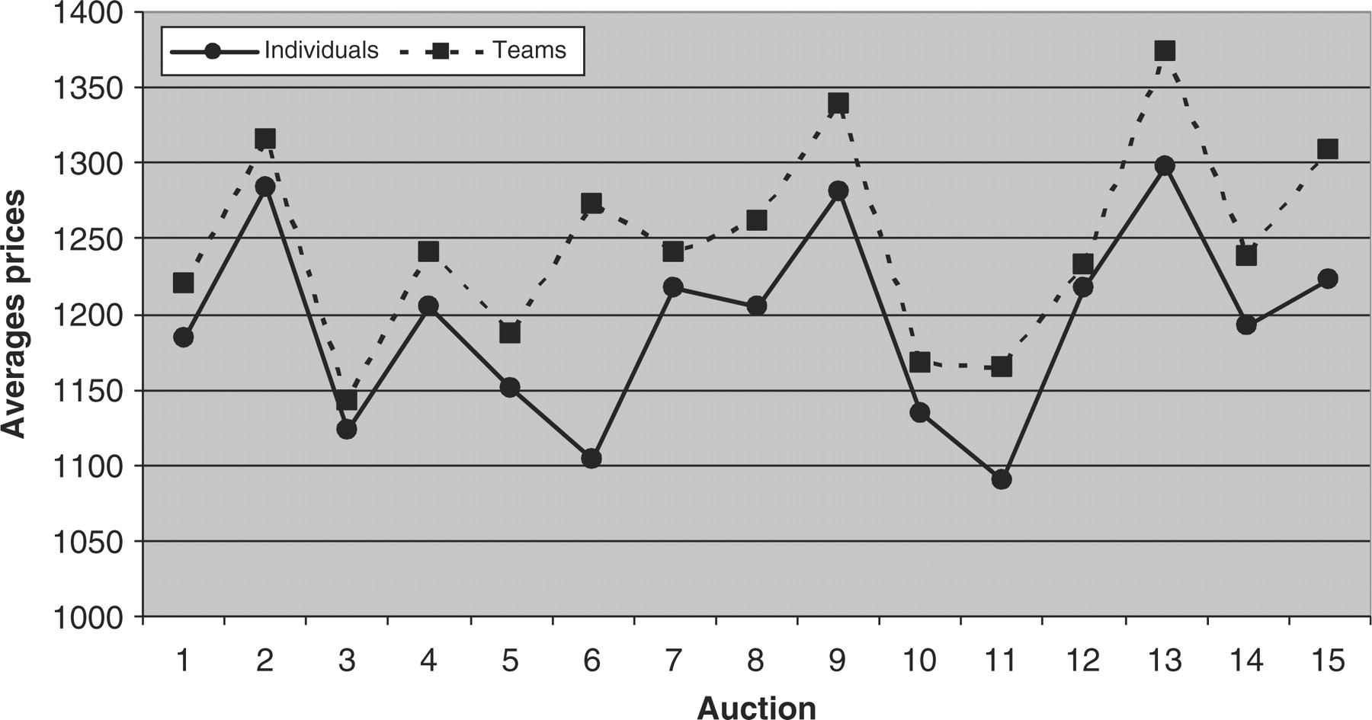
Fig. 2. Average prices
Notes:
Fig. 2. Average prices
Unless provided in the caption above, the following copyright applies to the content of this slide: © Oxford University Press 2008 All rights reserved

Slide 3
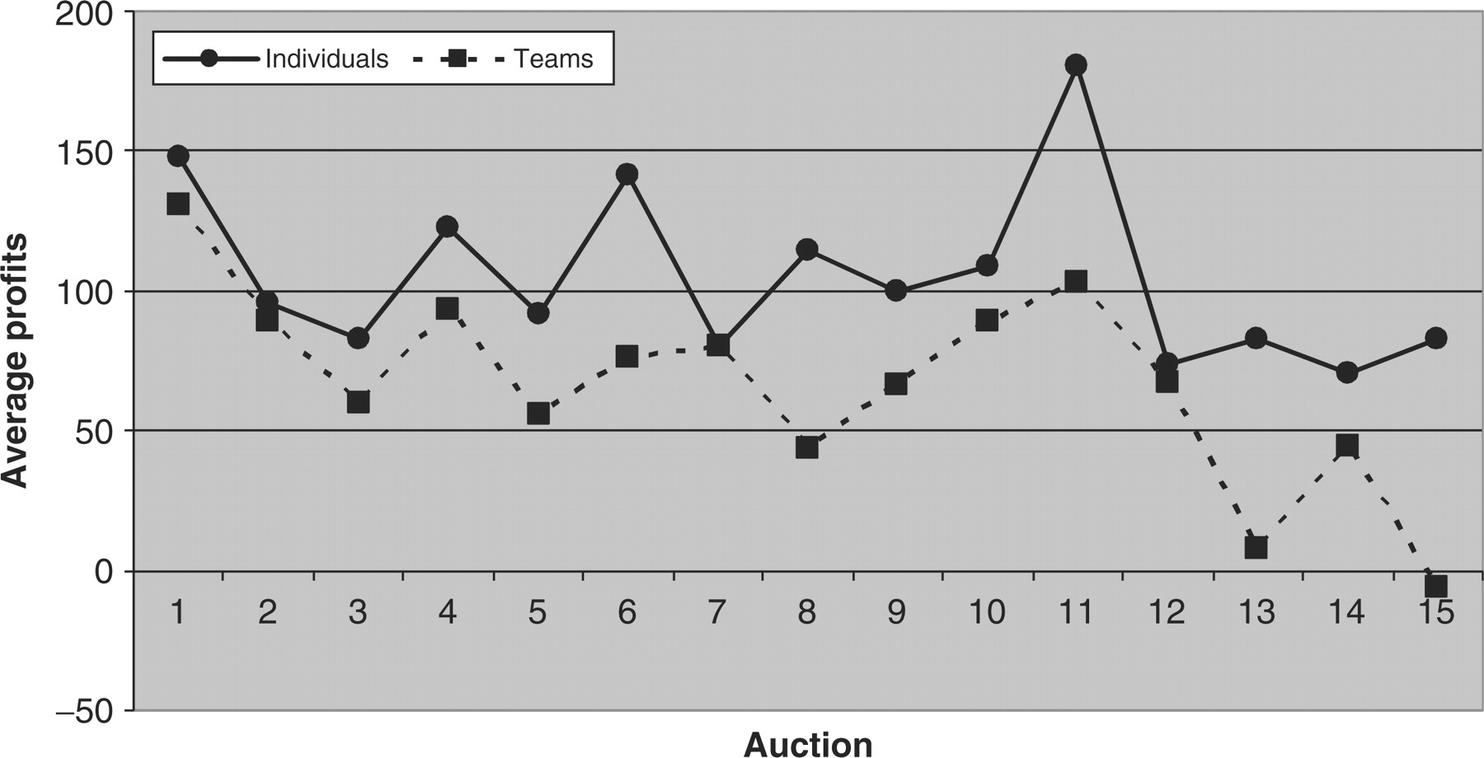
Fig. 3. Average profits
Notes:
Fig. 3. Average profits
Unless provided in the caption above, the following copyright applies to the content of this slide: © Oxford University Press 2008 All rights reserved

