Slide 1
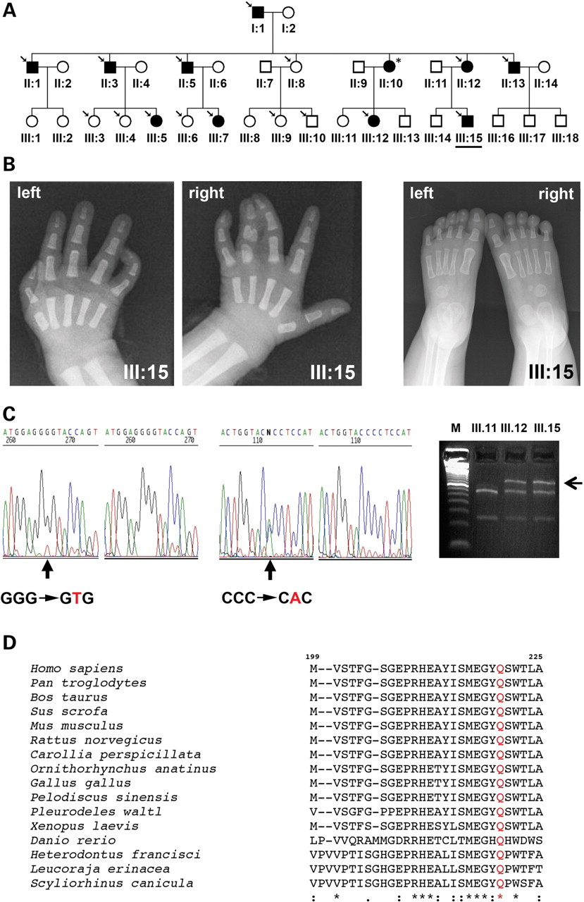
Figure 1. A novel missense mutation in HOXD13 causes a variant form of SPD. (A) Pedigree drawing of the family showing ...
Notes:
Figure 1. A novel missense mutation in HOXD13 causes a variant form of SPD. (A) Pedigree drawing of the family showing SPD. Black symbols represent affected individuals. The proband (III.15) is underlined. An arrow above pedigree symbols indicates individuals who provided a DNA sample. The asterisk indicates a clinically affected individual from whom no DNA sample could be obtained. (B) Radiographs of hands (palms up) and feet of the proband showing type II SPD in the right hand, clinodactyly of the right fifth finger and camptodactyly of the left fifth finger. No abnormalities were observed in the feet (right panel). (C) The SPD is associated with a point mutation at position 659 of the HOXD13 coding sequence that causes a G220V substitution. Electropherograms showing the sequences of a DNA sample obtained from individual III.15 (on the left) and of control DNA (on the right). Sequencing of the complementary strands confirmed the presence of the point mutation (electropherograms on the right). The G/T base change destroys a KpnI restriction site. Agarose gel electrophoresis showing a restriction enzyme digestion of amplified DNA from the indicated individuals (right panel). (D) ClustalW alignment of a portion of the HOXD13 protein in 16 different species showing the evolutionary conservation of the glycine residue in position 220 (highlighted in red). Accession numbers of the proteins (in the same order as they appear in the figure) are: AAC51635.1; XP_525967.2; XP_598665.4; XP_001926062.1; NP_032301.2; NP_001099356.1; AAW66480.1; XP_001511440.1; NP_990765.1; BAE78770.1; AAQ092345.1; AAH80434.1; CAA61031.1; AAF44637.1; ABK60305.1; ABI34476.1.
Unless provided in the caption above, the following copyright applies to the content of this slide: © The Author 2008. Published by Oxford University Press. All rights reserved. For Permissions, please email: journals.permissions@oxfordjournals.org

Slide 2
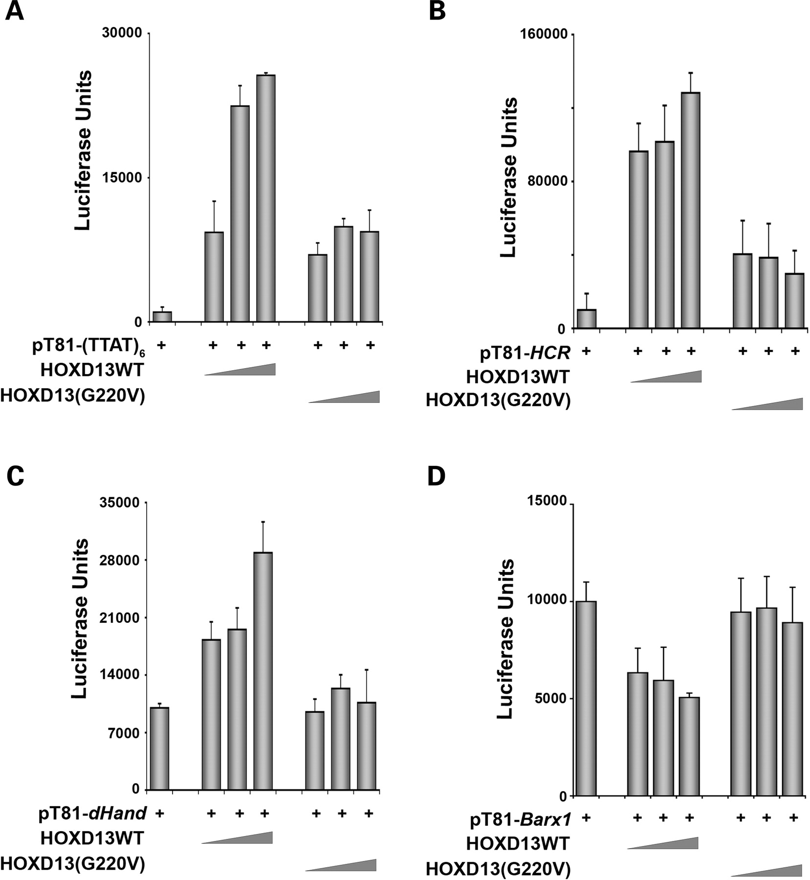
Figure 2. The G220V mutation impairs the transcription regulating functions of HOXD13. Luciferase activity assayed in ...
Notes:
Figure 2. The G220V mutation impairs the transcription regulating functions of HOXD13. Luciferase activity assayed in cell extracts of P19 cells, transiently transfected with increasing amounts of the pSGHOXD13 (HOXD13WT) or the pSGHOXD13(G220V) (HOXD13(G220V)) expression constructs together with three different reporter constructs. (A) pT81(TTAT)6 reporter construct (5 µg) containing six copies of the TTAT-containing HOXD13 optimal DNA-binding site (16). (B) Reporter construct (pT81-HCR) containing the HOXD9 promoter-derived HCR region (8 µg) (33). (C) Reporter construct (pT81-Hand2) containing the HOXD13 responsive element from the Hand2 locus (5 µg). (D) Reporter construct (pT81-Barx1) containing the HOXD13 responsive element from Barx1 locus (8 µg). Error bars represent the mean luciferase activity ± SEM of at least four independent experiments.
Unless provided in the caption above, the following copyright applies to the content of this slide: © The Author 2008. Published by Oxford University Press. All rights reserved. For Permissions, please email: journals.permissions@oxfordjournals.org

Slide 3
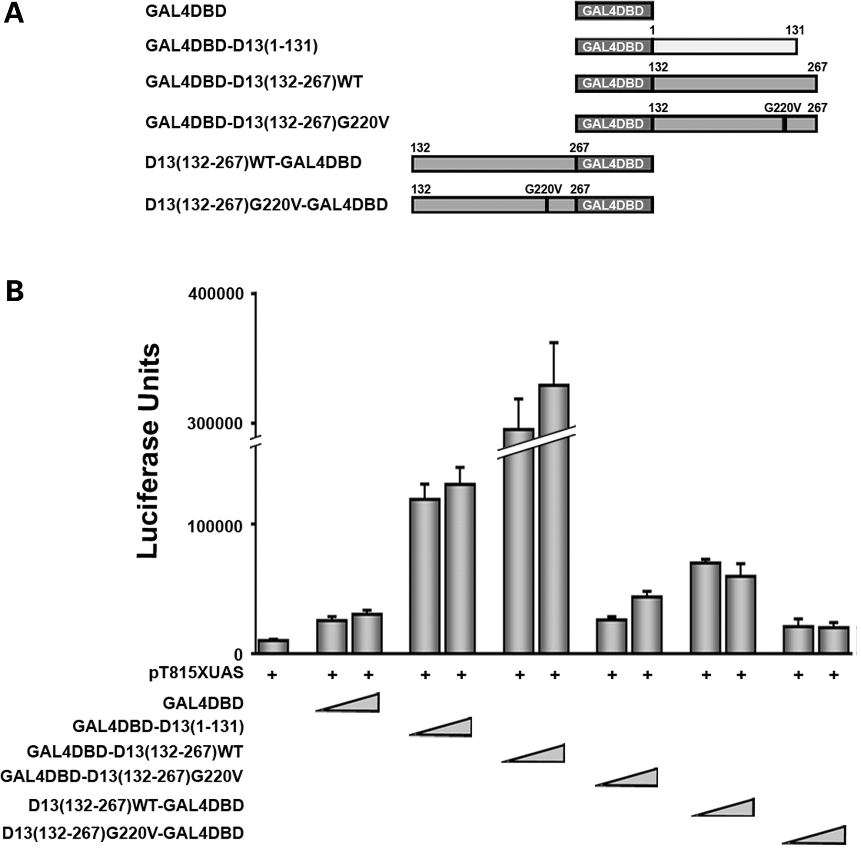
Figure 3. HOXD13 contains two separable activation functions within the region N-terminal to the homeodomain that are ...
Notes:
Figure 3. HOXD13 contains two separable activation functions within the region N-terminal to the homeodomain that are impaired by the G220V mutation. (A) Schematic representation of the HOXD13-GAL4DBD fusion proteins. HOXD13(WT) and HOXD13(G220V) deletion mutants (amino acids 1–131 and 132–256) were placed both at the C-terminus (top) and the N-terminus (bottom) of the GAL4DBD. Numbers indicate the position of aminoacid residues. (B) Luciferase activity assayed in cell extracts of P19 cells, transiently transfected with 8 µg of the pT81UAS reporter plasmid together with increasing amounts of the indicated GAL4DBD fusions. Bars represent the mean luciferase activity ± SEM of at least three independent experiments.
Unless provided in the caption above, the following copyright applies to the content of this slide: © The Author 2008. Published by Oxford University Press. All rights reserved. For Permissions, please email: journals.permissions@oxfordjournals.org

Slide 4
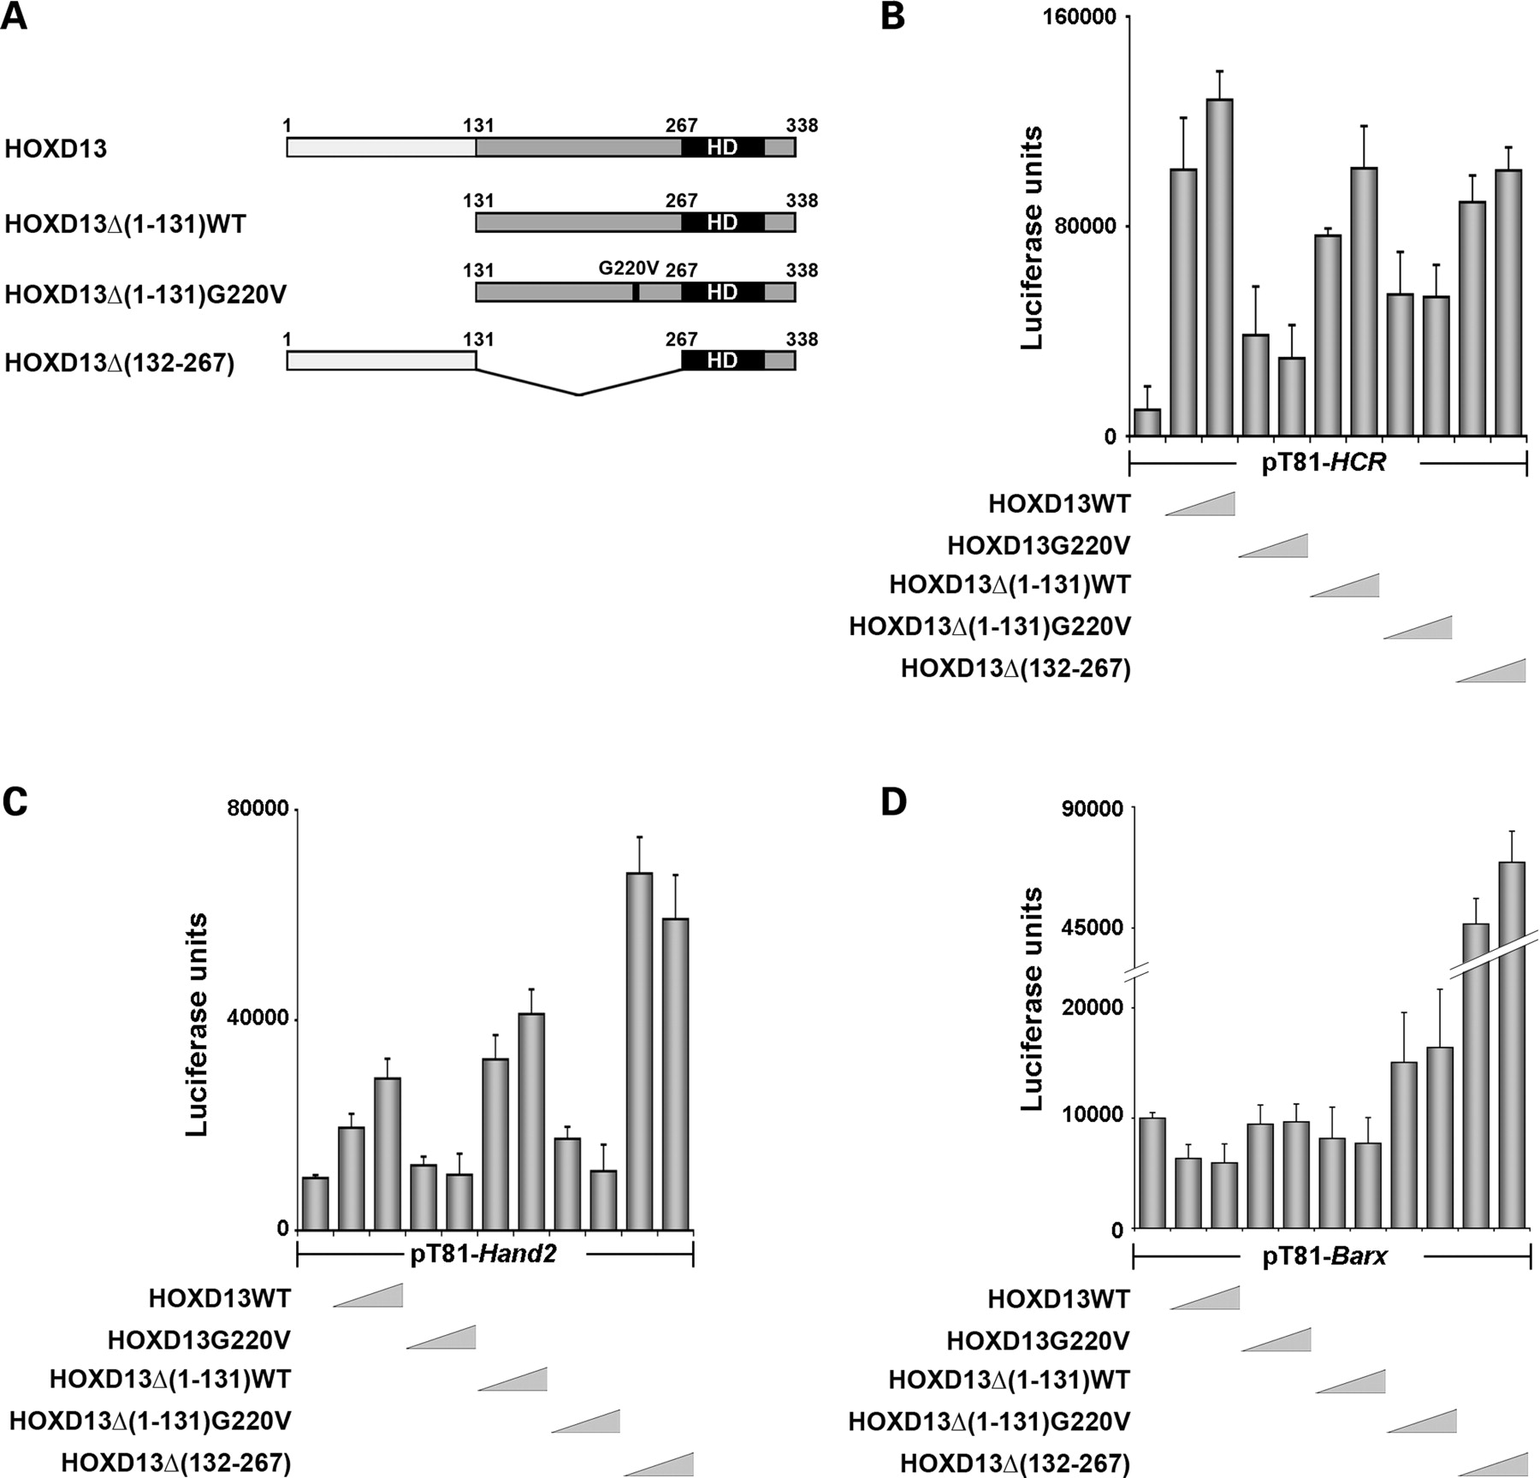
Figure 4. The G220V mutation affects the transcription regulating functions of HOXD13. (A) Schematic representation of ...
Notes:
Figure 4. The G220V mutation affects the transcription regulating functions of HOXD13. (A) Schematic representation of HOXD13 deletion mutants. Numbers indicate amino acid residues; a black box indicates the homeodomain (HD). (B) Luciferase activity assayed in cell extracts of P19 cells, transiently transfected with 8 µg of the pT81-HCR reporter and increasing amounts of expression constructs for the indicated HOXD13 mutant derivatives. (C) Luciferase activity of transient transfections as in (B) using 5 µg of the pT81-Hand2 reporter. (D) Luciferase activity of transient transfections as in (B) using 8 µg of the pT81-Barx1 reporter. The G220V mutation impairs both the activation as well as the repression functions of HOXD13.
Unless provided in the caption above, the following copyright applies to the content of this slide: © The Author 2008. Published by Oxford University Press. All rights reserved. For Permissions, please email: journals.permissions@oxfordjournals.org

Slide 5
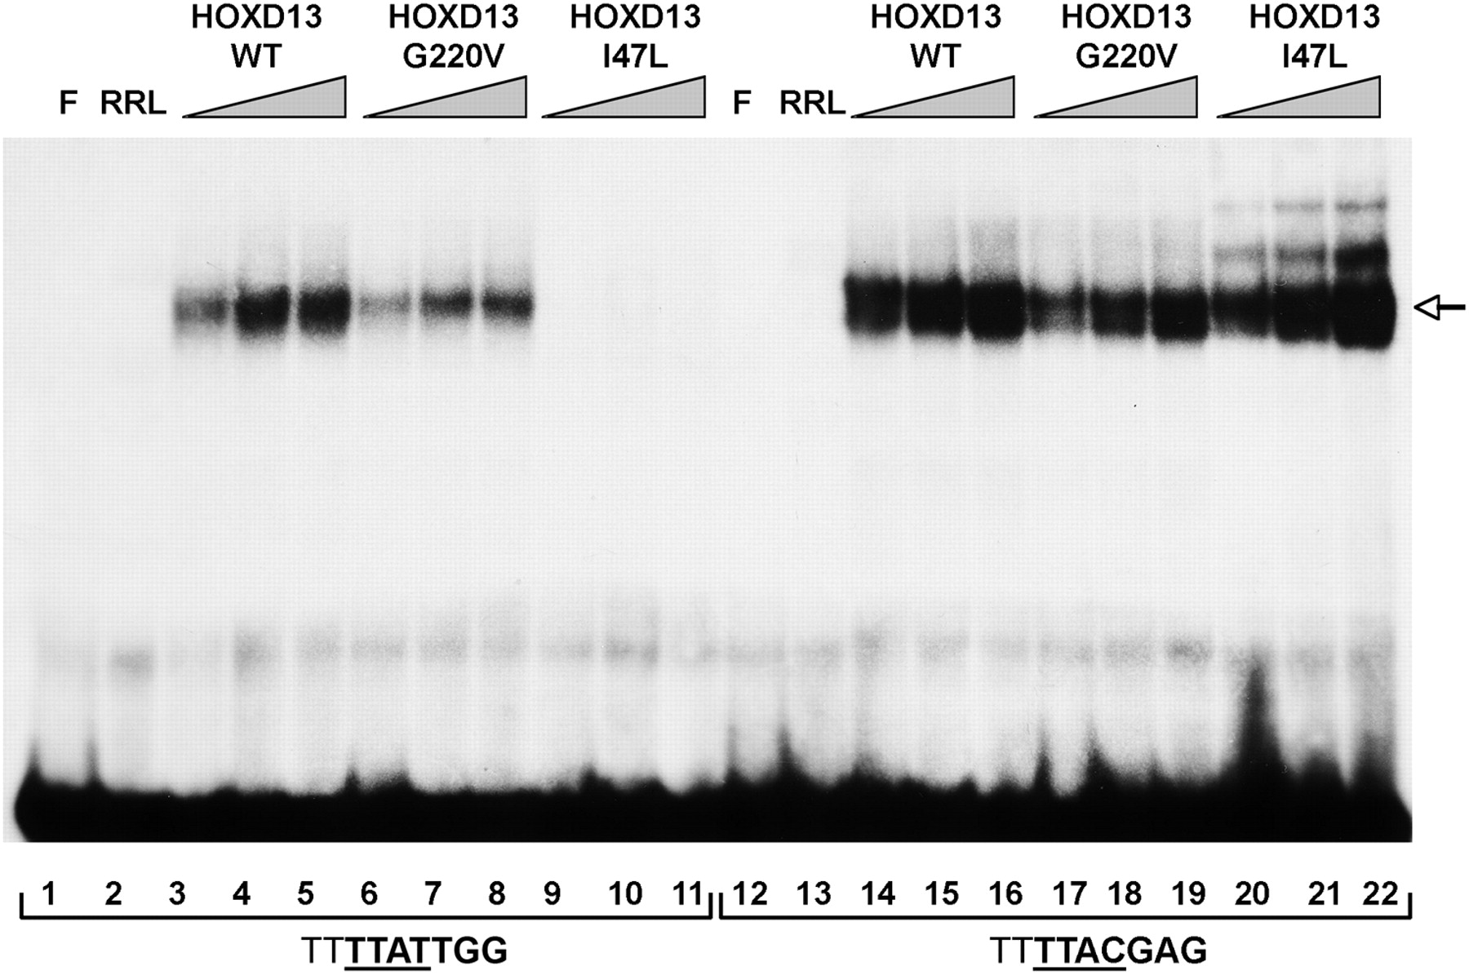
Figure 5. HOXD13(G220V) binds DNA less efficiently than HOXD13 wild-type. EMSA performed using the indicated in vitro ...
Notes:
Figure 5. HOXD13(G220V) binds DNA less efficiently than HOXD13 wild-type. EMSA performed using the indicated in vitro transcribed/translated proteins. Increasing amounts of in vitro-synthesized proteins were challenged with two different probes representing the two optimal DNA-binding consensus sequences of HOXD13 (16). An arrow indicates the main HOXD13 binding complex. (F, free probe; RRL, control empty rabbit reticulocyte lysate). HOXD13(G220V) binds to DNA less efficiently than HOXD13 wild-type, on both sequences tested. The HOXD13(I47L) protein, used as a control, conversely, shows a selective impairment of its DNA binding function (16).
Unless provided in the caption above, the following copyright applies to the content of this slide: © The Author 2008. Published by Oxford University Press. All rights reserved. For Permissions, please email: journals.permissions@oxfordjournals.org

Slide 6
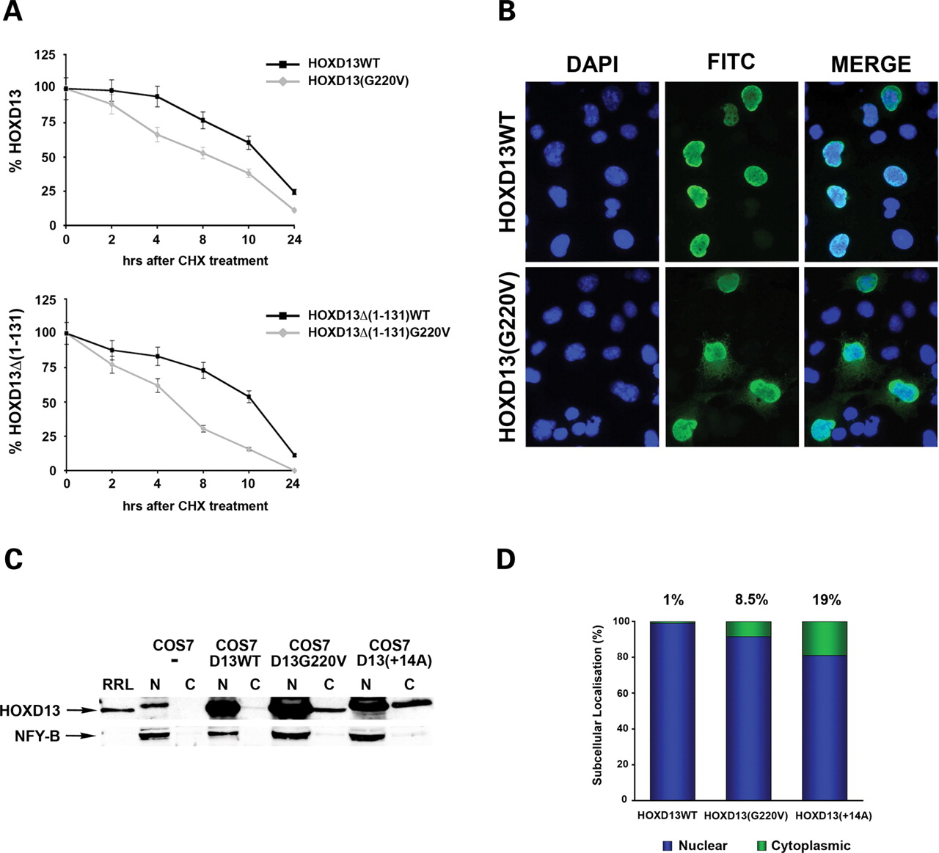
Figure 6. The G220V mutation affects the stability and subcellular localization of HOXD13. A) COS7 cells were ...
Notes:
Figure 6. The G220V mutation affects the stability and subcellular localization of HOXD13. A) COS7 cells were transiently transfected with 5 µg of pSGHOXD13 expression plasmid and 48 h after transfection treated with 200 µg/ml CHX. Cells were harvested at the indicated time points and total extracts were prepared. The amounts of expressed HA-tagged HOXD13 and its mutant derivatives were analysed by immunoblotting. Protein levels were determined by scanning densitometry and normalized against expression levels of β-actin, used as a loading control. Values at each time point of the graphs are given as a percent of the protein amount at time zero (100%). Upper panel, decays of HOXD13WT and HOXD13(G220V) after CHX treatment. Lower panel, decays of HOXD13Δ (1–131) and HOXD13Δ (1–131) G220V after CHX treatment. (B) COS7 were transiently transfected with 10 µg of pSGHOXD13 expression constructs and 48 h after transfection fixed and stained with anti-HA primary antibody and an FITC-conjugated secondary antibody (green). The nuclei are counterstained with DAPI (blue). (C) Immunoblot of the nuclear (N) and cytoplasmic (C) fractions extracted from COS7 cells transiently transfected with expression plasmids for the indicated HOXD13 proteins. HOXD13 was detected with anti-FLAG antibody. NFY-B, an antibody against the NFY-B nuclear transcription factor was used as a control for contamination in the cytoplasmic fraction. (D) Graph representing the quantification of the results shown in (C). Protein levels were determined by scanning densitometry. Blue bars indicate the nuclear fractions, green bars the cytoplasmic fractions. The indicated values represent the percentages of cytoplasmic HOXD13 proteins.
Unless provided in the caption above, the following copyright applies to the content of this slide: © The Author 2008. Published by Oxford University Press. All rights reserved. For Permissions, please email: journals.permissions@oxfordjournals.org

Slide 7
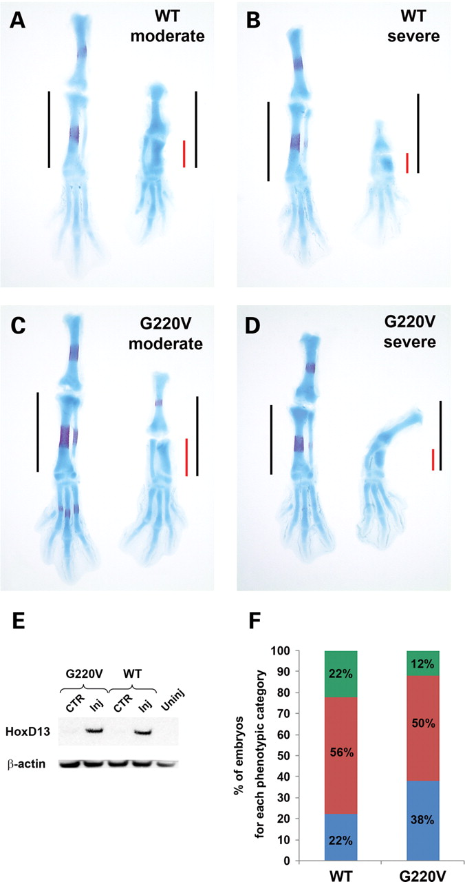
Figure 7. Misexpression of HOXD13(WT) and HOXD13(G220V) in developing chick limbs. (A–D) Dorsal views of stage HH34 ...
Notes:
Figure 7. Misexpression of HOXD13(WT) and HOXD13(G220V) in developing chick limbs. (A–D) Dorsal views of stage HH34 hind limbs stained with Alcian Blue and Alizarin Red. The injected right hind limb is on the right and the contralateral control limb on the left in every panel. Embryo injected with RCAS-HOXD13(WT) (A and B) or RCAS-HOXD13(G220V) (C and D) showing a predominant phenotype (left panels) or a severe phenotype (right panels), respectively. Red and black bars represent tibia length of injected and contralateral control hind limbs, respectively. (E) Western blot analysis of lysates of limbs injected with RCAS-HoxD13(WT) or (G220V) and their respective contralateral control limbs using anti-HA antibody. MW, molecular weight marker; CTR, contralateral control; Inj, injected limbs; Uninj, uninjected control limbs. (F) Distribution of phenotypes produced by misexpression of HOXD13(WT) and HOXD13(G220V). Phenotypes are classified as being mild (blue), moderate (red), or severe (green).
Unless provided in the caption above, the following copyright applies to the content of this slide: © The Author 2008. Published by Oxford University Press. All rights reserved. For Permissions, please email: journals.permissions@oxfordjournals.org

Slide 8
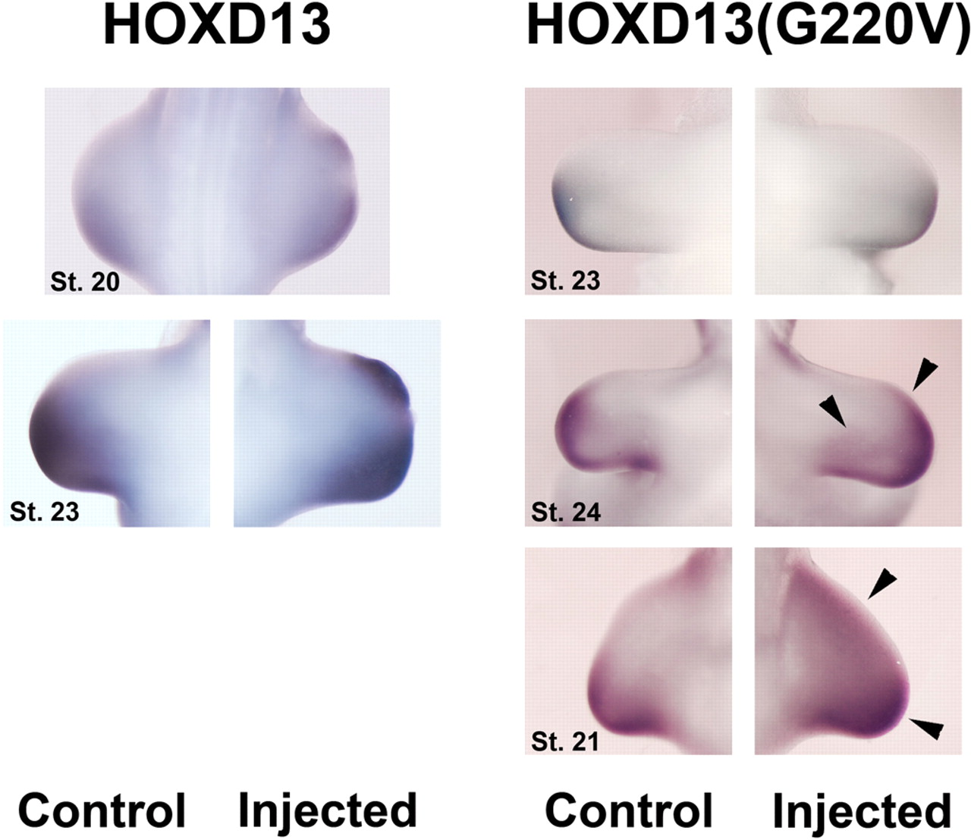
Figure 8. HOXD13(G220V) fails to strongly up-regulate Hand2 expression in developing chick limbs. Whole mount in situ ...
Notes:
Figure 8. HOXD13(G220V) fails to strongly up-regulate Hand2 expression in developing chick limbs. Whole mount in situ hybridization using a Hand2 probe on chick embryos misexpressing HOXD13 or HOXD13(G220V). Concentrated suspensions of the RCAS-HOXD13 or RCAS-HOXD13(G220V) recombinant replication-competent avian retroviruses was injected in ovo into the prospective right hindlimb field at HH stage 10 (see Materials and methods). Upper right panels show embryonic chick limbs representative of a mild activation of Hand2 expression. Middle right panels show an example of chick limbs representative of a moderate activation of Hand2 expression. Lower right panels show limbs representative of the strongest activation of Hand2 expression, obtained misexpressing HOXD13(G220V). Black arrowheads indicate sites of ectopic Hand2 expression. (Control), uninjected left limbs of the same embryos are shown as a control. Approximate embryonic stages (50) are indicated.
Unless provided in the caption above, the following copyright applies to the content of this slide: © The Author 2008. Published by Oxford University Press. All rights reserved. For Permissions, please email: journals.permissions@oxfordjournals.org

