Slide 1
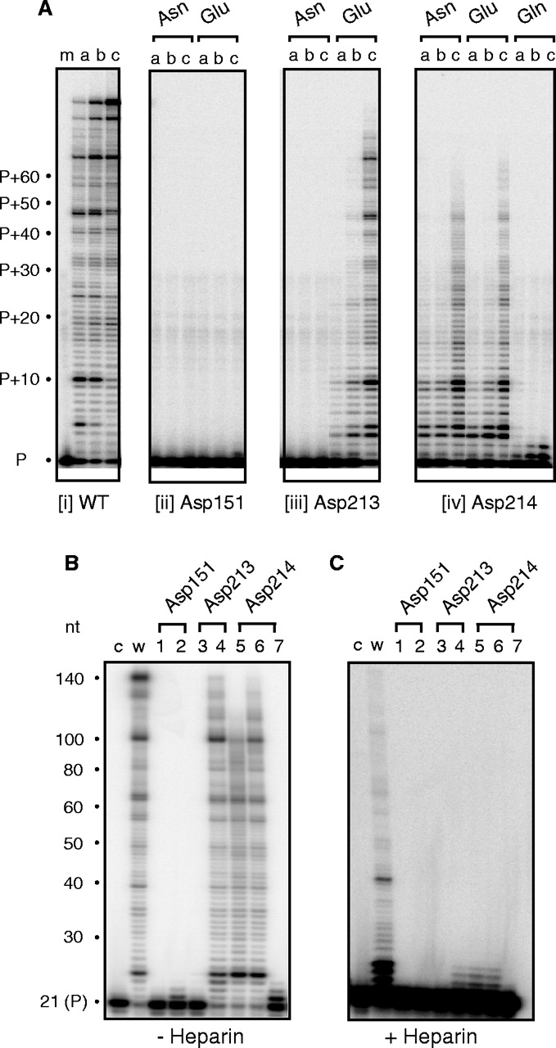
Figure 1 RNA-dependent DNA polymerase activity of Ty3 DNA polymerase active site mutants. ( A ) An aliquot of 50 nM ...
Notes:
Figure 1 RNA-dependent DNA polymerase activity of Ty3 DNA polymerase active site mutants. ( A ) An aliquot of 50 nM template/primer was incubated with 0.8 nM (lane a), 5 nM (lane b) and 35 nM Ty3 RT (lane c) for 5 min, respectively. The active site residues analyzed and nature of the mutation are indicated below and above each panel, respectively. P, unextended primer. ( B ) RNA-dependent DNA polymerase activity in the absence of competitor heparin. For this analysis, 50 nM template/primer was incubated with 200 nM RT for 5 min. Lane c, 32 P-end-labeled primer; lane w, wild-type Ty3 RT; lane 1, Asp151→Asn; lane 2, Asp151→Glu; lane 3, Asp213→Asn; lane 4, Asp213→Glu; lane 5, Asp214→Asn; lane 6, Asp214→Glu; and lane 7, Asp214→Gln. ( C ) RNA-dependent DNA polymerase activity in the presence of competitor heparin. Lane notations are as in (B).
Unless provided in the caption above, the following copyright applies to the content of this slide: © 2005, the authors Nucleic Acids Research, Vol. 33 No. 1 © Oxford University Press 2005; all rights reserved The online version of this article has been published under an open access model. Users are entitled to use, reproduce, disseminate, or display the open access version of this article for non-commercial purposes provided that: the original authorship is properly and fully attributed; the Journal and Oxford University Press are attributed as the original place of publication with the correct citation details given; if an article is subsequently reproduced or disseminated not in its entirety but only in part or as a derivative work this must be clearly indicated. For commercial re-use permissions, please contact journals.permissions@oupjournals.org .

Slide 2
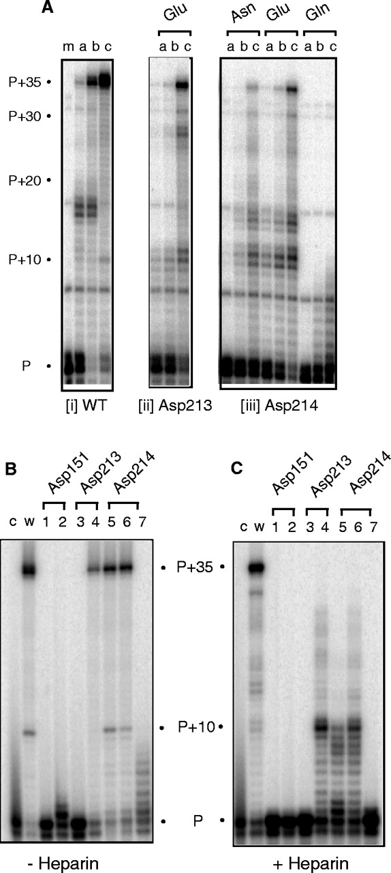
Figure 2 ( A ) DNA-dependent DNA polymerase activity of Ty3 DNA polymerase active site mutants Asp213→Glu, ...
Notes:
Figure 2 ( A ) DNA-dependent DNA polymerase activity of Ty3 DNA polymerase active site mutants Asp213→Glu, Asp214→Asn, Asp214→Glu and Asp214→Gln. Enzyme:substrate ratios and lane notations are as indicated in the legend to Figure 1A . ( B and C ) DNA-dependent DNA polymerase activity evaluated in the absence (B) and presence of heparin (C), respectively. Lane notations are as in the legend to Figure 1B .
Unless provided in the caption above, the following copyright applies to the content of this slide: © 2005, the authors Nucleic Acids Research, Vol. 33 No. 1 © Oxford University Press 2005; all rights reserved The online version of this article has been published under an open access model. Users are entitled to use, reproduce, disseminate, or display the open access version of this article for non-commercial purposes provided that: the original authorship is properly and fully attributed; the Journal and Oxford University Press are attributed as the original place of publication with the correct citation details given; if an article is subsequently reproduced or disseminated not in its entirety but only in part or as a derivative work this must be clearly indicated. For commercial re-use permissions, please contact journals.permissions@oupjournals.org .

Slide 3
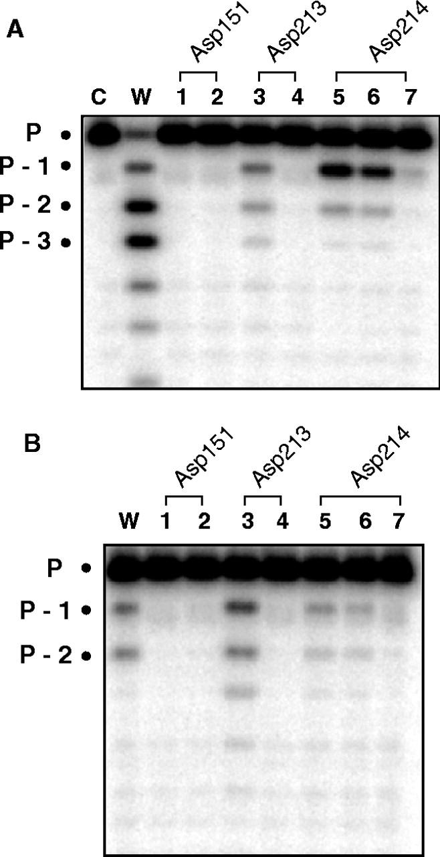
Figure 3 Pyrophosphorolysis activity of Ty3 RT active site mutants. ( A and B ) Incubation of Ty3 RT with substrate ...
Notes:
Figure 3 Pyrophosphorolysis activity of Ty3 RT active site mutants. ( A and B ) Incubation of Ty3 RT with substrate in the presence and absence of pyrophosphate, respectively. Lane C, no RT; lane w, wild-type Ty3 RT; lane 1, mutant Asp151→Asn; lane 2, mutant Asp151→Glu; lane 3, mutant Asp213→Asn; lane 4, mutant Asp213→Glu; lane 5, mutant Asp214→Asn; lane 6, mutant Asp214→Glu; and lane 7, mutant Asp214→Gln. Migration position of the intact primer is designated P.
Unless provided in the caption above, the following copyright applies to the content of this slide: © 2005, the authors Nucleic Acids Research, Vol. 33 No. 1 © Oxford University Press 2005; all rights reserved The online version of this article has been published under an open access model. Users are entitled to use, reproduce, disseminate, or display the open access version of this article for non-commercial purposes provided that: the original authorship is properly and fully attributed; the Journal and Oxford University Press are attributed as the original place of publication with the correct citation details given; if an article is subsequently reproduced or disseminated not in its entirety but only in part or as a derivative work this must be clearly indicated. For commercial re-use permissions, please contact journals.permissions@oupjournals.org .

Slide 4
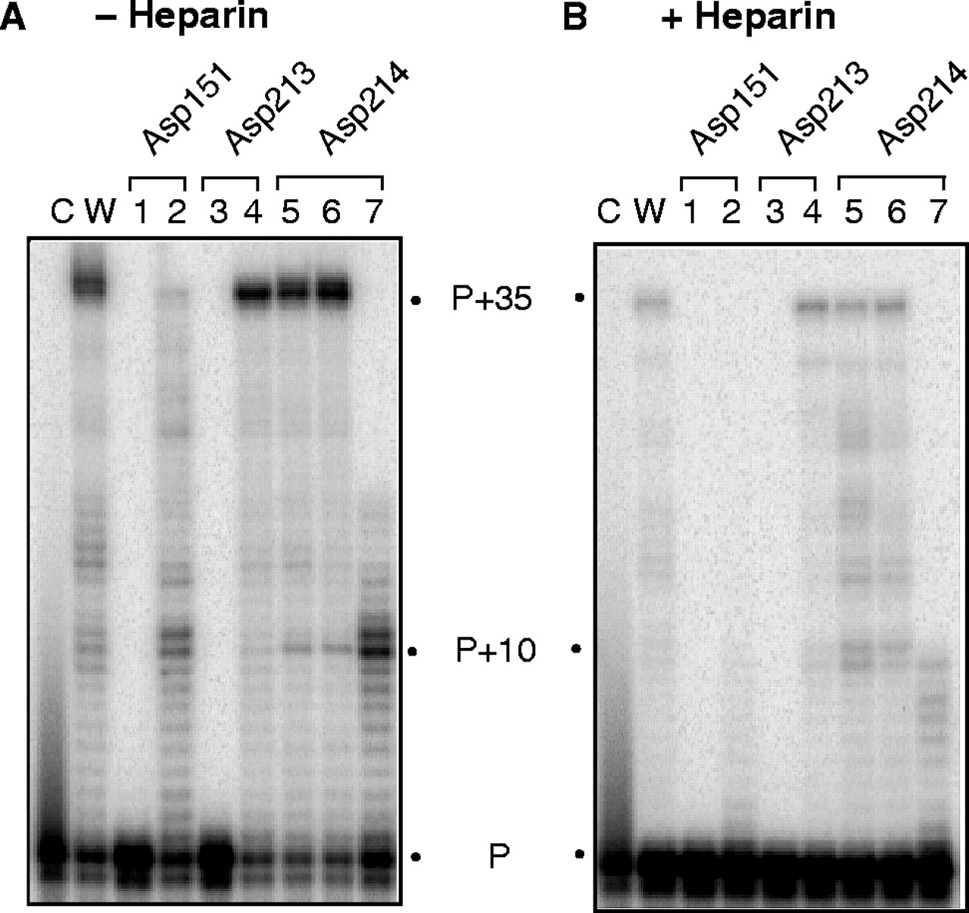
Figure 4 Mn ⁺⁺ -supported DNA-dependent DNA polymerase activity of wild-type (lane w) and mutant Ty3 ...
Notes:
Figure 4 Mn ++ -supported DNA-dependent DNA polymerase activity of wild-type (lane w) and mutant Ty3 derivatives (lanes 1–7). Lane c, no enzyme. Enzymes were analyzed in the absence ( A ) and presence of heparin ( B ). Substrate and lane notations are according to the legend of Figure 1B .
Unless provided in the caption above, the following copyright applies to the content of this slide: © 2005, the authors Nucleic Acids Research, Vol. 33 No. 1 © Oxford University Press 2005; all rights reserved The online version of this article has been published under an open access model. Users are entitled to use, reproduce, disseminate, or display the open access version of this article for non-commercial purposes provided that: the original authorship is properly and fully attributed; the Journal and Oxford University Press are attributed as the original place of publication with the correct citation details given; if an article is subsequently reproduced or disseminated not in its entirety but only in part or as a derivative work this must be clearly indicated. For commercial re-use permissions, please contact journals.permissions@oupjournals.org .

Slide 5
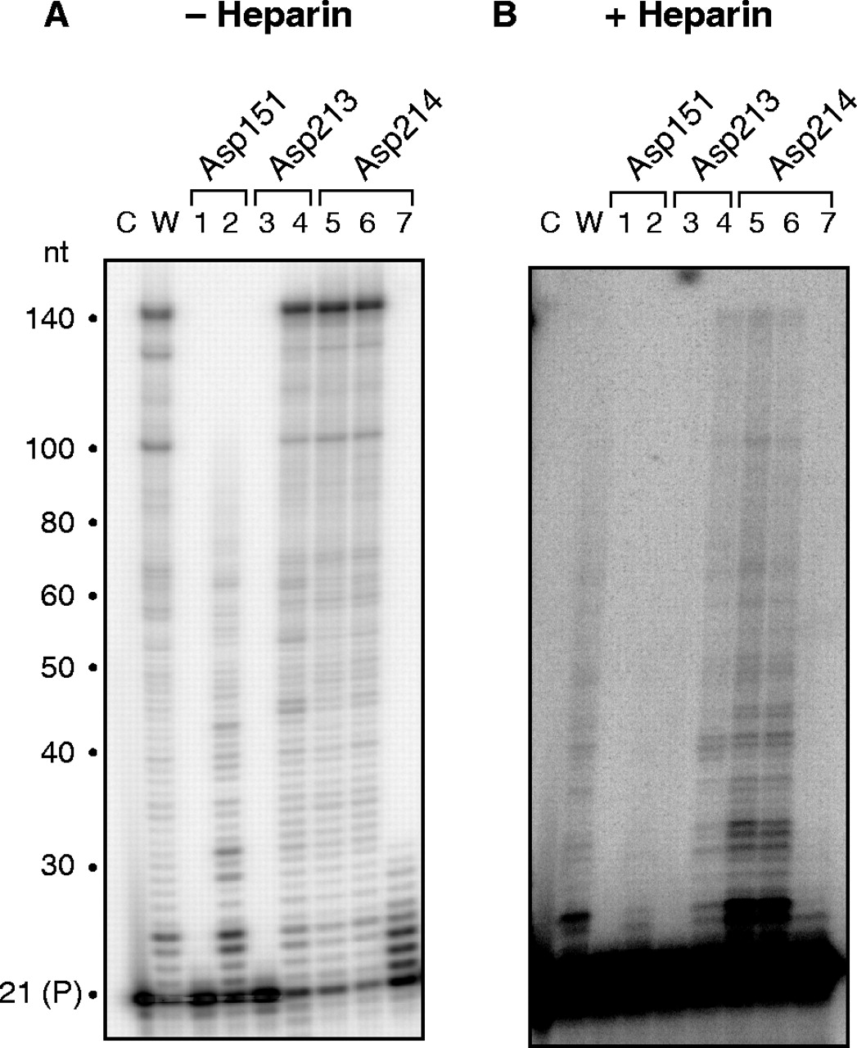
Figure 5 Mn ⁺⁺ -supported RNA-dependent DNA polymerase activity of wild-type (lane w) and mutant Ty3 ...
Notes:
Figure 5 Mn ++ -supported RNA-dependent DNA polymerase activity of wild-type (lane w) and mutant Ty3 derivatives (lanes 1–7). Lane c, no enzyme. Enzymes were analyzed in the absence ( A ) and presence of heparin ( B ). Substrate and lane notations are according to the legend of Figure 1B .
Unless provided in the caption above, the following copyright applies to the content of this slide: © 2005, the authors Nucleic Acids Research, Vol. 33 No. 1 © Oxford University Press 2005; all rights reserved The online version of this article has been published under an open access model. Users are entitled to use, reproduce, disseminate, or display the open access version of this article for non-commercial purposes provided that: the original authorship is properly and fully attributed; the Journal and Oxford University Press are attributed as the original place of publication with the correct citation details given; if an article is subsequently reproduced or disseminated not in its entirety but only in part or as a derivative work this must be clearly indicated. For commercial re-use permissions, please contact journals.permissions@oupjournals.org .

Slide 6
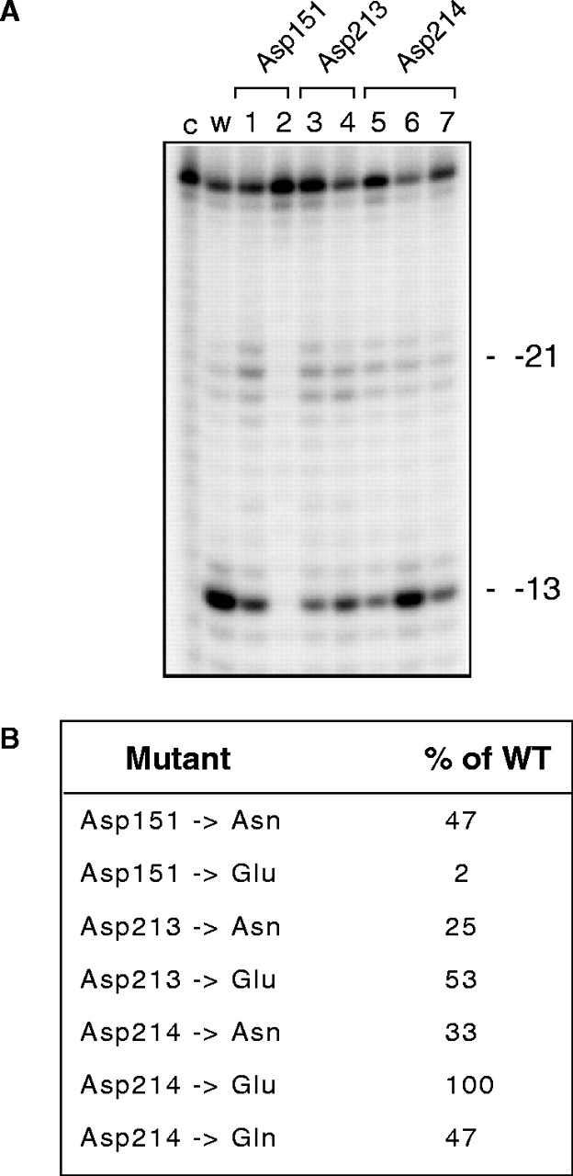
Figure 6 ( A ) RNase H activity of Ty3 RT DNA polymerase mutants. Lane notations are as described in the legend to ...
Notes:
Figure 6 ( A ) RNase H activity of Ty3 RT DNA polymerase mutants. Lane notations are as described in the legend to Figure 1B . Migration positions of the −21 and −13 RNase H cleavage products have been indicated. ( B ) Quantification of RNase H hydrolysis data. Total hydrolysis products are expressed as a percentage of the wild-type value.
Unless provided in the caption above, the following copyright applies to the content of this slide: © 2005, the authors Nucleic Acids Research, Vol. 33 No. 1 © Oxford University Press 2005; all rights reserved The online version of this article has been published under an open access model. Users are entitled to use, reproduce, disseminate, or display the open access version of this article for non-commercial purposes provided that: the original authorship is properly and fully attributed; the Journal and Oxford University Press are attributed as the original place of publication with the correct citation details given; if an article is subsequently reproduced or disseminated not in its entirety but only in part or as a derivative work this must be clearly indicated. For commercial re-use permissions, please contact journals.permissions@oupjournals.org .

Slide 7
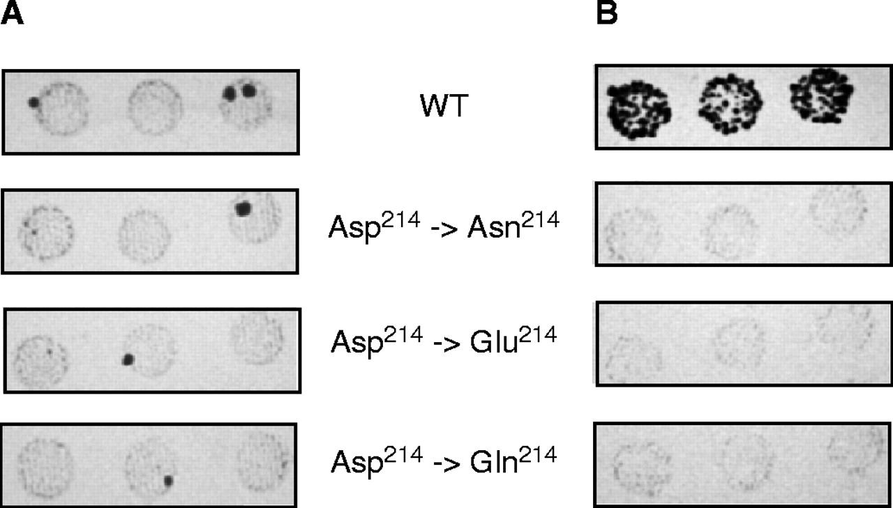
Figure 7 Transposition analysis of Ty3 mutants altered at codon 214 of the DNA polymerase active site. Transformants ...
Notes:
Figure 7 Transposition analysis of Ty3 mutants altered at codon 214 of the DNA polymerase active site. Transformants were patched onto selective (−His, −URA) SD to repress transposition, and grown for 2 days. Cells were then replica plated onto SD medium lacking lysine and adenine ( A ) or onto selective SG medium to induce transposition. Cells, grown on selective SG medium, were then replica plated onto SD medium lacking lysine and adenine. ( B ) Papillations on SD medium lacking lysine and adenine indicate transposition.
Unless provided in the caption above, the following copyright applies to the content of this slide: © 2005, the authors Nucleic Acids Research, Vol. 33 No. 1 © Oxford University Press 2005; all rights reserved The online version of this article has been published under an open access model. Users are entitled to use, reproduce, disseminate, or display the open access version of this article for non-commercial purposes provided that: the original authorship is properly and fully attributed; the Journal and Oxford University Press are attributed as the original place of publication with the correct citation details given; if an article is subsequently reproduced or disseminated not in its entirety but only in part or as a derivative work this must be clearly indicated. For commercial re-use permissions, please contact journals.permissions@oupjournals.org .

