Slide 1
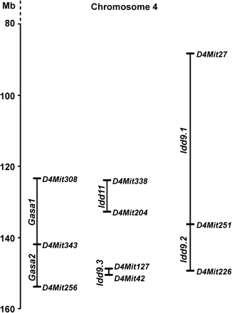
Fig. 1. Co-localization of gastritis susceptibility loci Gasa1/2 and diabetes susceptibility loci Idd9/11 on mouse ...
Notes:
Fig. 1. Co-localization of gastritis susceptibility loci Gasa1/2 and diabetes susceptibility loci Idd9/11 on mouse distal chromosome 4. Genetic positions of mouse polymorphic markers were obtained from the University of California, Santa Cruz genome database (February 2006 assembly). The positions indicated for Gasa1 and Gasa2 are as predicted from genetic linkage data (4). The positions of other loci were obtained from references (4, 17, 19).
Unless provided in the caption above, the following copyright applies to the content of this slide: © The Japanese Society for Immunology. 2007. All rights reserved. For permissions, please e-mail: journals.permissions@oxfordjournals.org

Slide 2
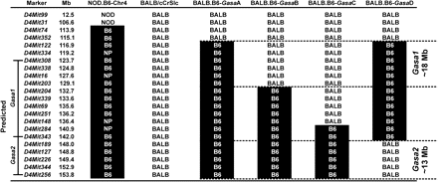
Fig. 2. BALB.B6-Gasa and NOD. B6-Chr4 congenic mice. Four different BALB.B6-Gasa congenic mouse strains and a NOD.B6 ...
Notes:
Fig. 2. BALB.B6-Gasa and NOD. B6-Chr4 congenic mice. Four different BALB.B6-Gasa congenic mouse strains and a NOD.B6 mouse strain were generated as tools to characterize autoimmune gastritis susceptibility loci. A library of polymorphic markers for chromosome 4 was used to genotype these mice to ensure the continuity of the C57BL/6 congenic region. Positions of mouse polymorphic markers were obtained from the University of California, Santa Cruz genome database (February 2006 assembly). “BALB” indicates the genotype at that locus to be BALB/c. “B6” indicates the genotype to be C57BL/6. “NOD” indicates the genotype to be NOD. The predicted positions of Gasa1 and Gasa2 were based on previous published work (4). The positions of Gasa1 and Gasa2 indicated on the right are from the analysis of the congenic mice described in this work. NOD.B6-Chr4 has been previously described (25). NP indicates that the markers were not polymorphic between strains.
Unless provided in the caption above, the following copyright applies to the content of this slide: © The Japanese Society for Immunology. 2007. All rights reserved. For permissions, please e-mail: journals.permissions@oxfordjournals.org

Slide 3
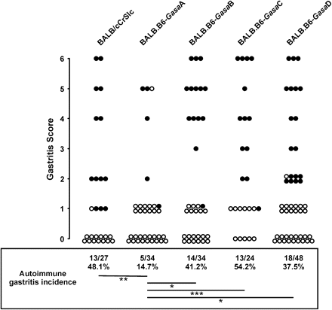
Fig. 3. Incidence of autoimmune gastritis in BALB/cCrSlc and BALB.B6-Gasa congenic mice after neonatal thymectomy. ...
Notes:
Fig. 3. Incidence of autoimmune gastritis in BALB/cCrSlc and BALB.B6-Gasa congenic mice after neonatal thymectomy. Mice were thymectomized at day 3 after birth. Autoimmune gastritis was assessed 12 weeks later by assaying anti-H+/K+ ATPase autoantibodies and histological examination of stained stomach sections. Mice were considered to have autoimmune gastritis if the individual animal presented with both anti-H+/K+-ATPase autoantibodies and gastric inflammation. Each circle represents a single mouse. Filled circles denote mice with titres of anti-H+/K+ ATPase autoantibodies ≥1:100. (*) represents P < 0.03, (**) represents P < 0.01 and (***) represents P < 0.005. Statistical analysis was performed using a two-tailed Fisher's exact test.
Unless provided in the caption above, the following copyright applies to the content of this slide: © The Japanese Society for Immunology. 2007. All rights reserved. For permissions, please e-mail: journals.permissions@oxfordjournals.org

Slide 4
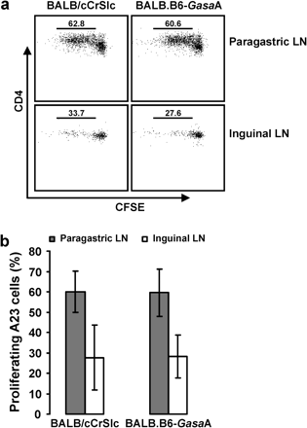
Fig. 4. H⁺/K⁺ ATPase-specific T cells proliferated to the same degree in BALB/cCrSlc and ...
Notes:
Fig. 4. H+/K+ ATPase-specific T cells proliferated to the same degree in BALB/cCrSlc and BALB.B6-GasaA mice. CFSE-labelled A23 T cells were injected into BALB/cCrSlc and BALB.B6-Gasa congenic mice (n = 3 per group). After 72 h, paragastric and inguinal lymph node cells from recipient mice were stained with antibodies and analysed by flow cytometry. (a) Representative plots showing CFSE fluorescence and anti-CD4 staining of A23 cells in the paragastric and inguinal lymph nodes of BALB/cCrSlc and BALB.B6-GasaA mice. (b) The mean percentage of cells that had lower levels of CFSE than the parental population (proliferating A23 cells) in the paragastric and inguinal lymph nodes of BALB/cCrSlc and BALB.B6-GasaA mice. Error bars represent standard deviation.
Unless provided in the caption above, the following copyright applies to the content of this slide: © The Japanese Society for Immunology. 2007. All rights reserved. For permissions, please e-mail: journals.permissions@oxfordjournals.org

Slide 5
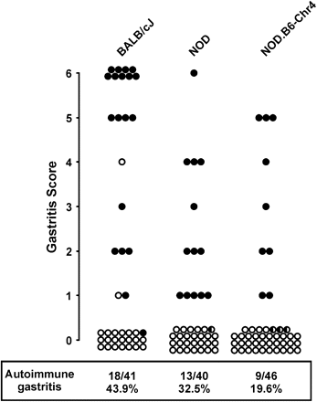
Fig. 7. Incidence of autoimmune gastritis in BALB/cJ, NOD and NOD.B6-Chr4 mice. Mice were thymectomized at day 3 ...
Notes:
Fig. 7. Incidence of autoimmune gastritis in BALB/cJ, NOD and NOD.B6-Chr4 mice. Mice were thymectomized at day 3 after birth. Autoimmune gastritis was assessed 12 weeks later by assaying anti-H+/K+ ATPase autoantibodies and histological examination of stained stomach sections. Mice were considered to have autoimmune gastritis if the individual animal presented with both anti-H+/K+-ATPase autoantibodies and gastric inflammation. Each circle represents a single mouse. Filled circles denote mice with titres of anti-H+/K+ ATPase autoantibodies ≥1:100. Half-filled circles denote mice with titres of anti-H+/K+ ATPase autoantibodies ≤1:50.
Unless provided in the caption above, the following copyright applies to the content of this slide: © The Japanese Society for Immunology. 2007. All rights reserved. For permissions, please e-mail: journals.permissions@oxfordjournals.org

Slide 6
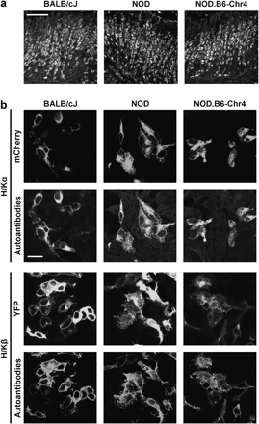
Fig. 6. Autoantibodies in gastritic BALB/cJ, NOD and NOD.B6-Chr4 mice are specific for the α and β subunits of the ...
Notes:
Fig. 6. Autoantibodies in gastritic BALB/cJ, NOD and NOD.B6-Chr4 mice are specific for the α and β subunits of the H+/K+ ATPase. (a) Stomach sections were incubated with sera from gastritic BALB/cJ, NOD and NOD.B6-Chr4 mice. Bound antibodies were detected with FITC-conjugated anti-mouse Ig. Bar = 100 μm and applies to all panels. (b) HEK293 cells were transfected with either mCherry-H+/K+ ATPase α (H/Kα) or YFP-H+/K+ ATPase β (H/Kβ) plasmids and incubated with sera from gastritic BALB/cJ, NOD and NOD.B6-Chr4 mice. Bound antibodies were detected with fluorochrome-conjugated anti-mouse Ig. Fluorescence due to the fluorescent protein tag on the H+/K+ ATPase subunit (mCherry or YFP) or due to the bound fluorochrome-conjugated anti-mouse Ig and thus bound autoantibodies (autoantibodies) in the same section is shown. Bar = 20 μm and applies to all panels.
Unless provided in the caption above, the following copyright applies to the content of this slide: © The Japanese Society for Immunology. 2007. All rights reserved. For permissions, please e-mail: journals.permissions@oxfordjournals.org

Slide 7
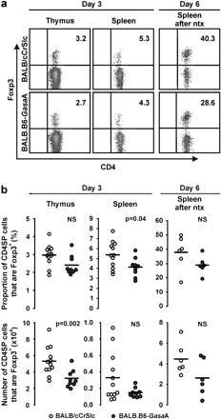
Fig. 5. Analysis of Foxp3⁺ T_{reg} in BALB/cCrSlc and BALB.B6-GasaA mice. Cell suspensions from ...
Notes:
Fig. 5. Analysis of Foxp3+ Treg in BALB/cCrSlc and BALB.B6-GasaA mice. Cell suspensions from thymi and spleens of 3-day-old mice and spleen of 6-day-old mice that were thymectomized on day 3 from BALB/cCrSlc and BALB.B6-GasaA mice were labelled with anti-CD3, anti-CD4, anti-CD8 and anti-Foxp3 mAb. CD3+CD4+CD8− cells were analysed for the expression of Foxp3. (a) Representative density plots displaying CD4 and Foxp3 staining. (b) Proportions and numbers of CD3+CD4+CD8− cells that were Foxp3+. Each circle represents a single mouse. Horizontal bar represents the mean proportion or number of Treg for each mouse cohort. Statistical analyses were performed using the two-tailed Mann–Whitney U test. Data were derived from three independent experiments.
Unless provided in the caption above, the following copyright applies to the content of this slide: © The Japanese Society for Immunology. 2007. All rights reserved. For permissions, please e-mail: journals.permissions@oxfordjournals.org

