Slide 1
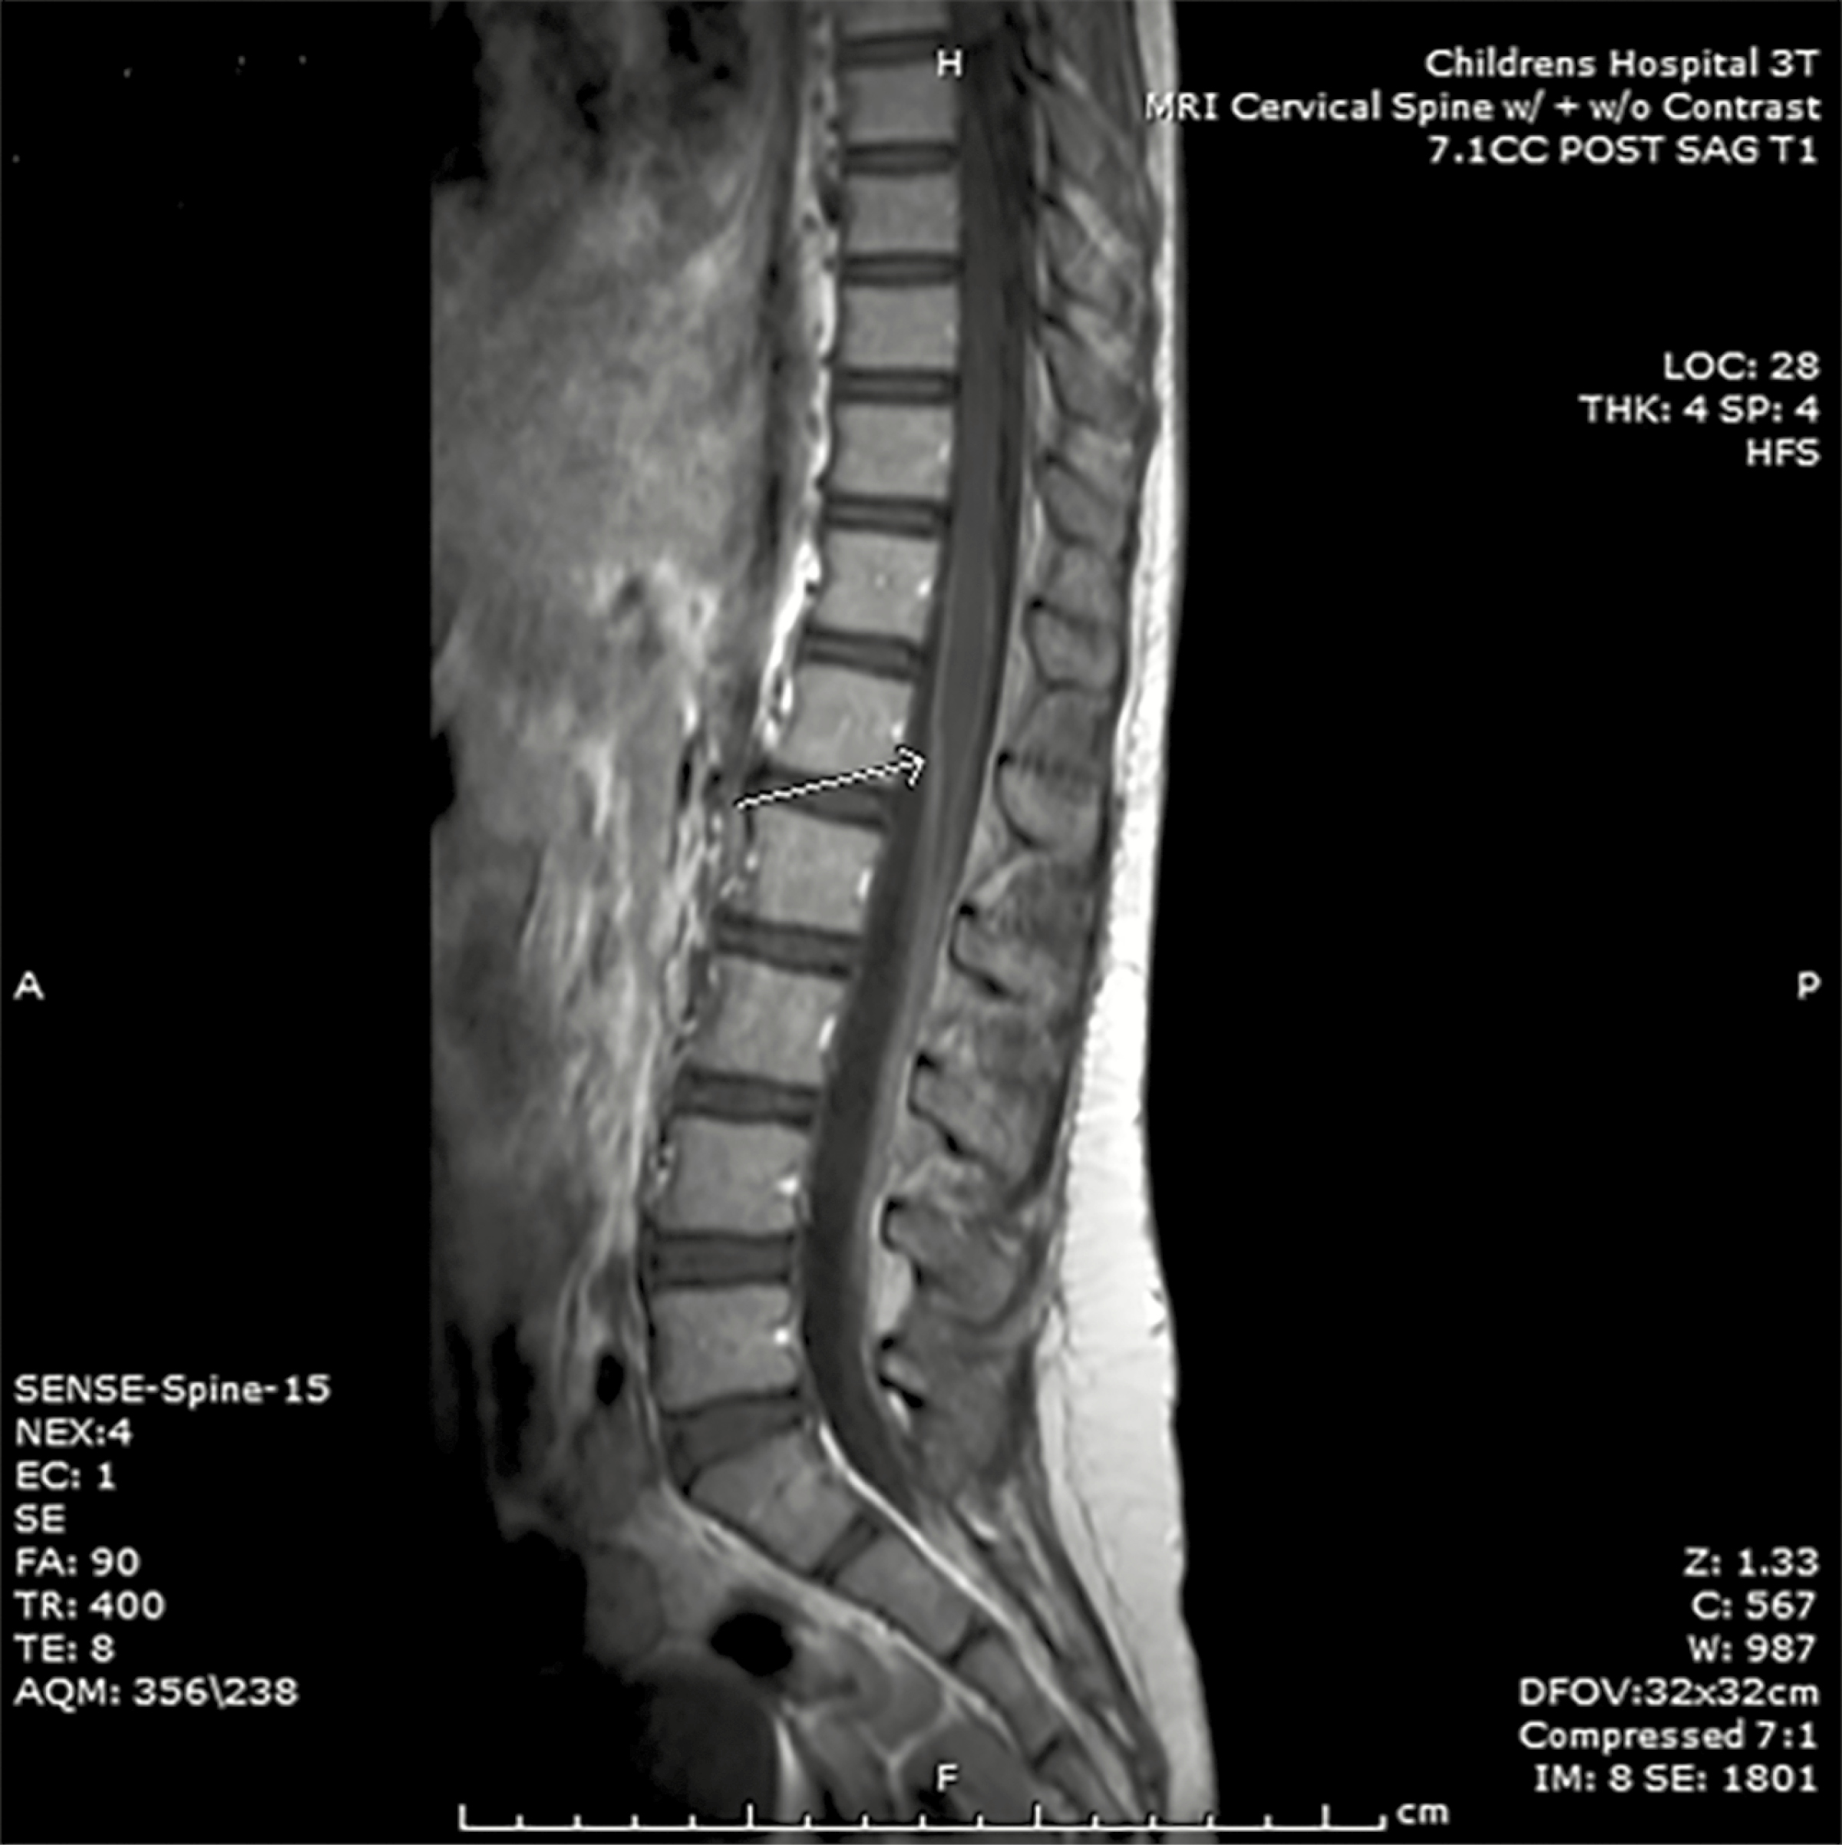
Figure 1. Contrast-enhanced T1-weighted magnetic resonance imaging of the lumbar spine from the case patient. Smooth ...
Notes:
Figure 1. Contrast-enhanced T1-weighted magnetic resonance imaging of the lumbar spine from the case patient. Smooth and linear leptomeningeal enhancement is observed along the margins of the conus medullaris (arrow) and involves the cauda equina without underlying signal abnormality of the spinal cord or vertebral bodies.
Unless provided in the caption above, the following copyright applies to the content of this slide: © The Author 2017. Published by Oxford University Press on behalf of The Journal of the Pediatric Infectious Diseases Society. All rights reserved. For permissions, please e-mail: journals.permissions@oup.com.

Slide 2
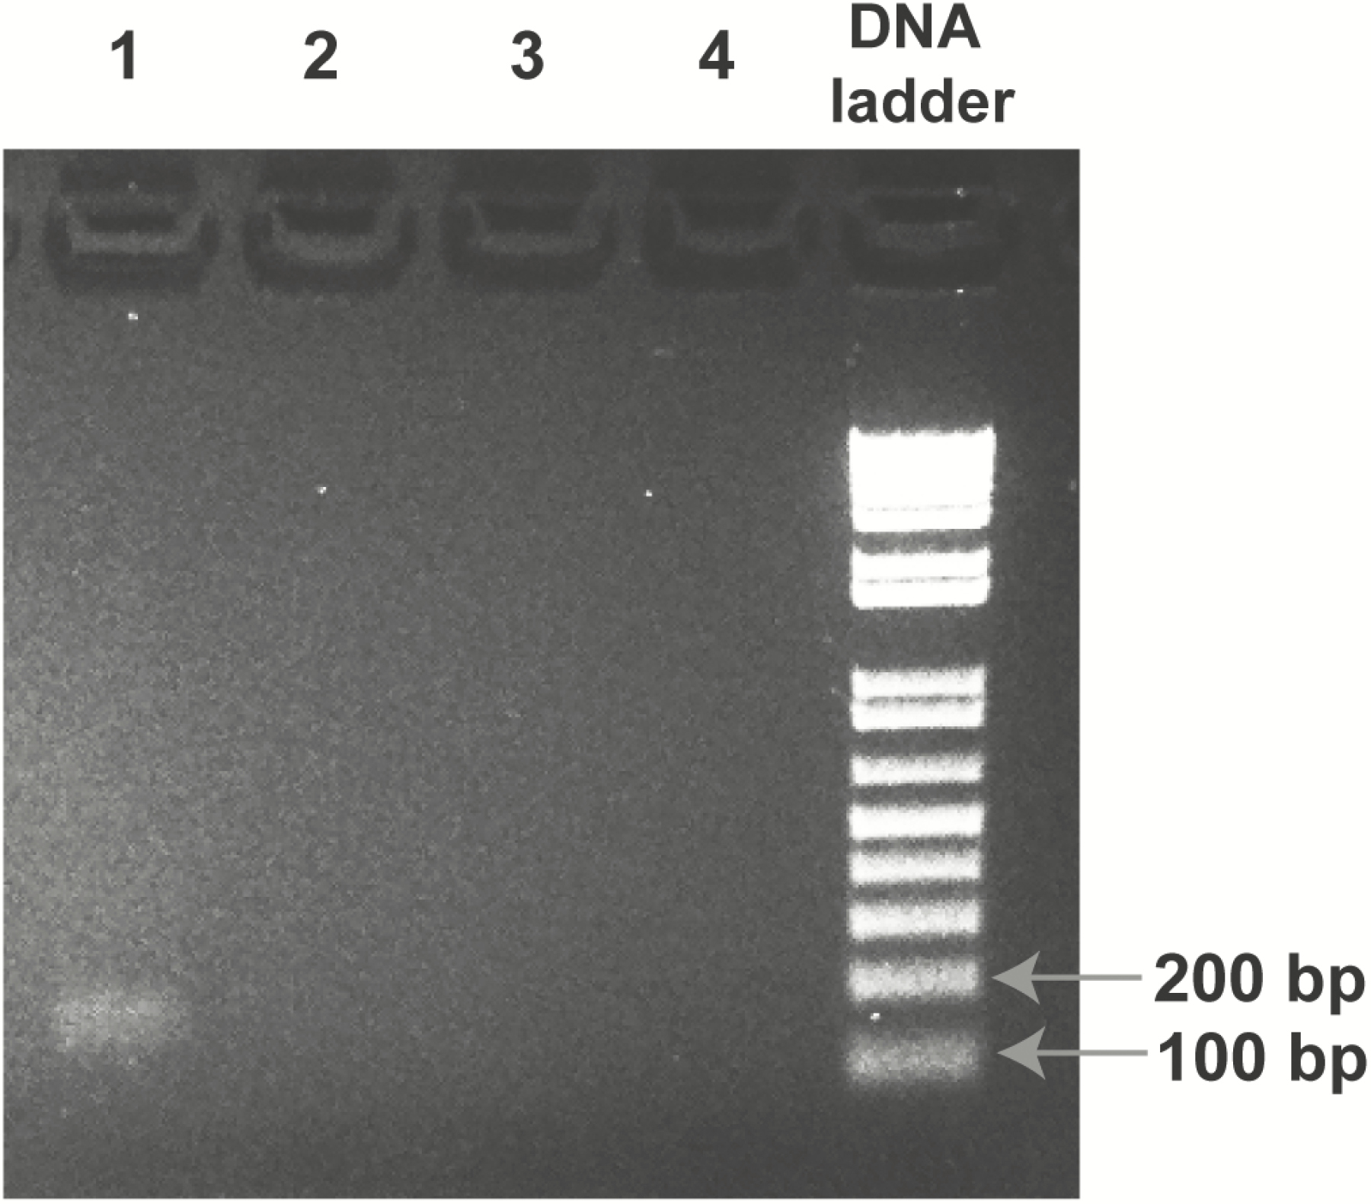
Figure 2. Polymerase chain reaction (PCR) confirmation of Brucella in the case patient’s cerebrospinal fluid (CSF). ...
Notes:
Figure 2. Polymerase chain reaction (PCR) confirmation of Brucella in the case patient’s cerebrospinal fluid (CSF). Shown is a globally contrast- enhanced image of the 2% agarose gel from Brucella PCR targeting a 177-base pair region of the IS711 gene. The lanes correspond to (1) patient CSF sample extract, (2) no-template control (NTC), (3) positive control (PC) mixture of 7 organisms, (4) water, and (“DNA ladder”) 1 kb Plus DNA ladder (Invitrogen). The PCR amplicon from the patient’s CSF extract was sequenced and identified as Brucella spp. Abbreviation: DNA, deoxyribonucleic acid.
Unless provided in the caption above, the following copyright applies to the content of this slide: © The Author 2017. Published by Oxford University Press on behalf of The Journal of the Pediatric Infectious Diseases Society. All rights reserved. For permissions, please e-mail: journals.permissions@oup.com.

