Slide 1
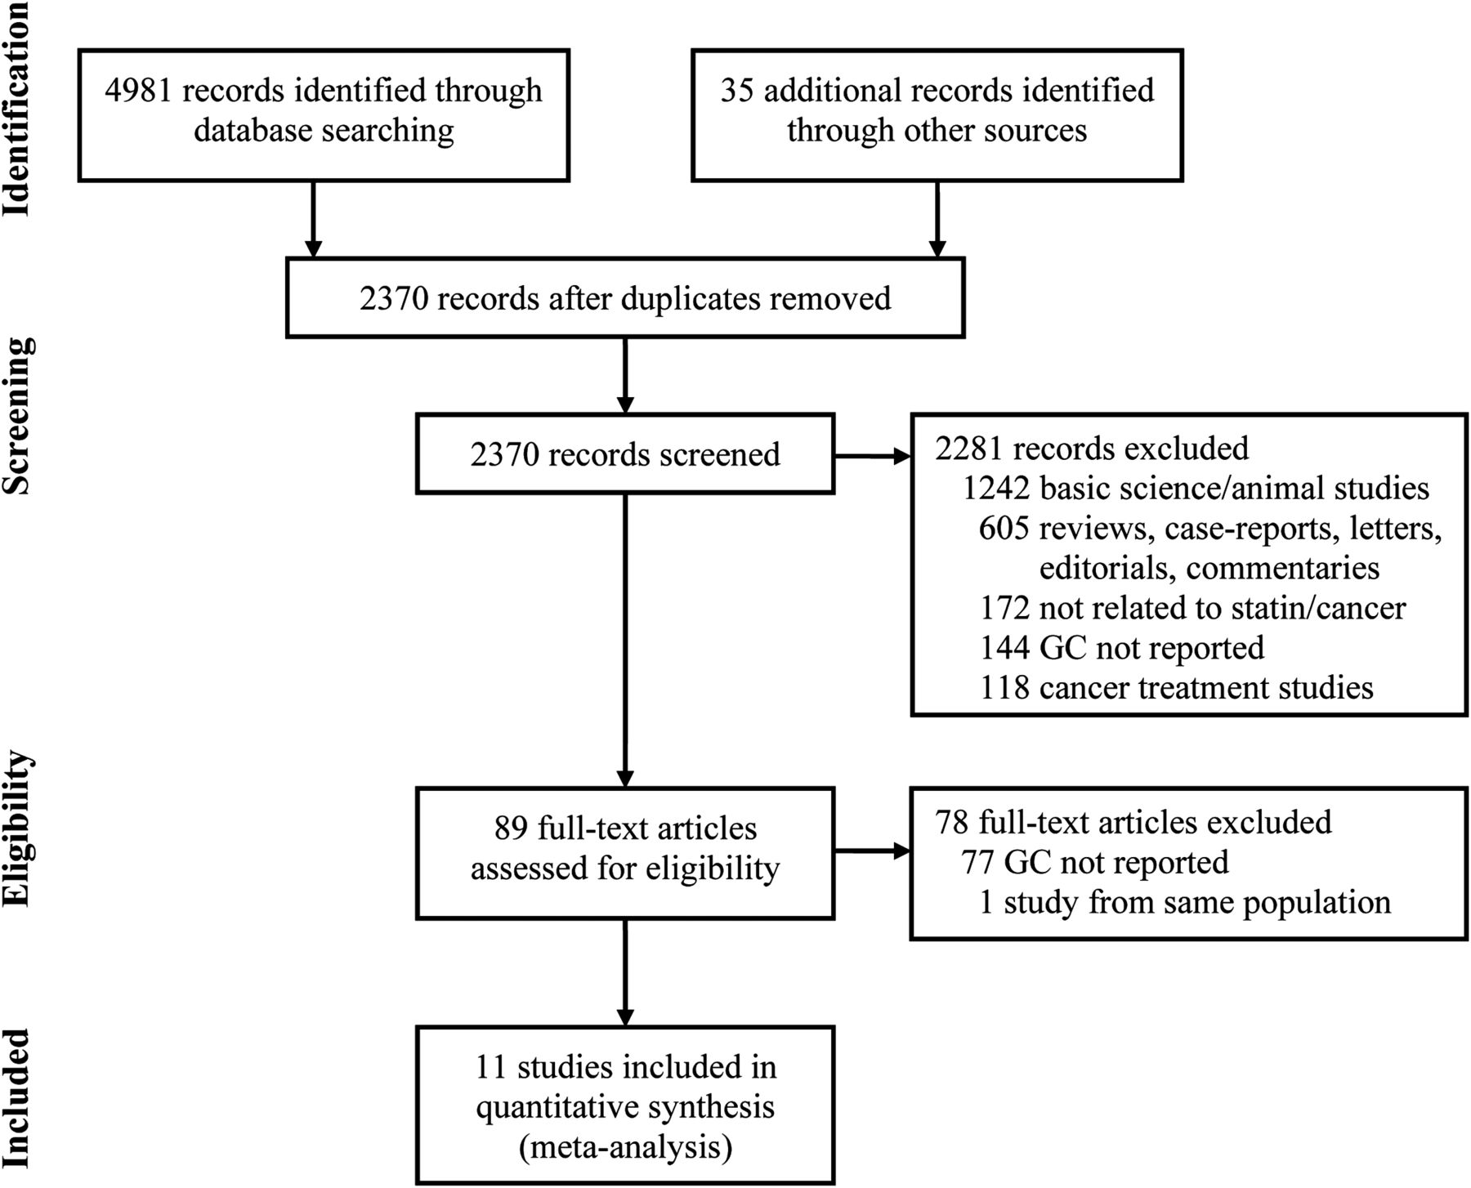
Figure 1. Flowsheet summarizing study identification and selection.
Notes:
Figure 1. Flowsheet summarizing study identification and selection.
Unless provided in the caption above, the following copyright applies to the content of this slide: © The Author 2013. Published by Oxford University Press on behalf of the European Society for Medical Oncology. All rights reserved. For permissions, please email: journals.permissions@oup.com.

Slide 2
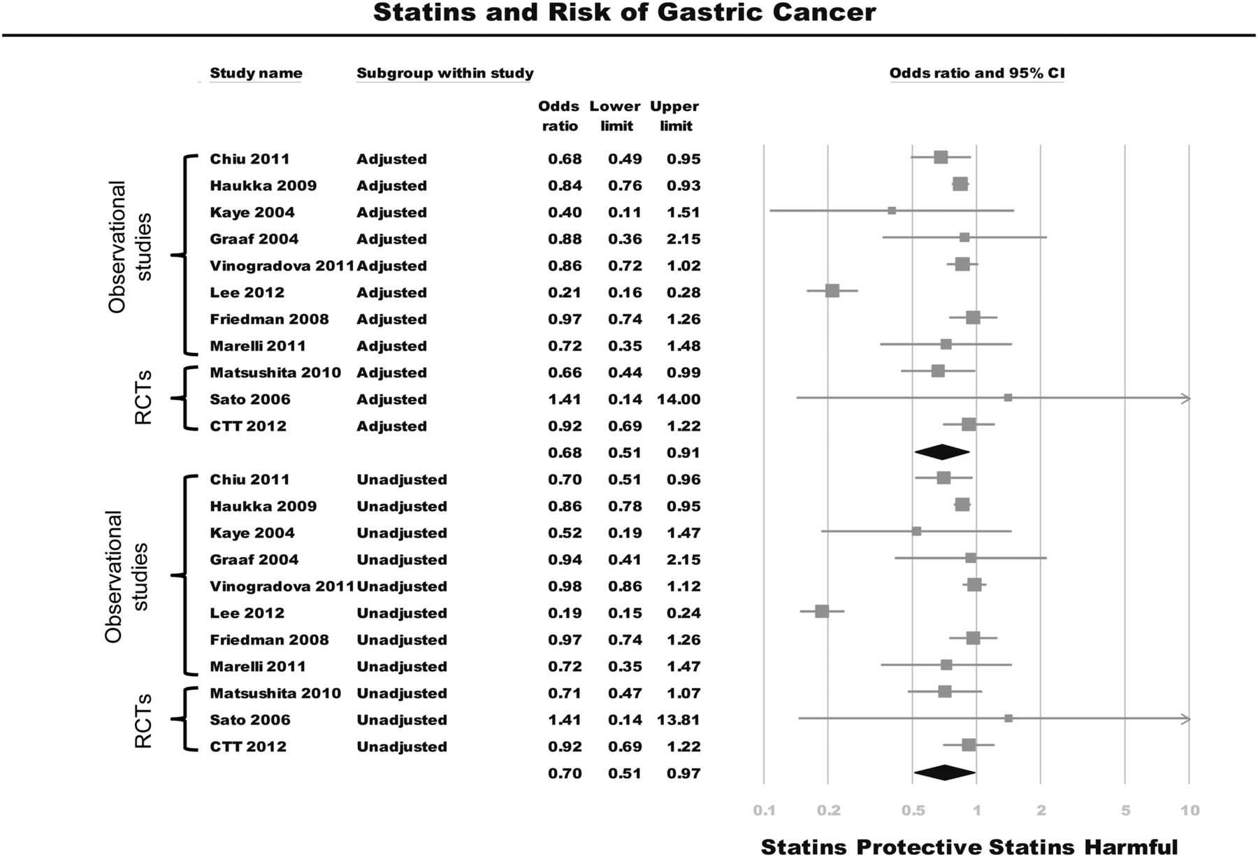
Figure 2. Summary of unadjusted and adjusted odds ratios (OR) assessing the risk of gastric cancer (GC) with statin ...
Notes:
Figure 2. Summary of unadjusted and adjusted odds ratios (OR) assessing the risk of gastric cancer (GC) with statin exposure. No significant differences were observed in the summary estimates of adjusted and unadjusted OR (Pinteraction = 0.70), suggesting the absence of significant confounding, and confirming an independent relationship between statin use and the risk of GC. Significant heterogeneity was observed in the overall analysis (Cochran's Q P < 0.01; I2 = 89%). This was primarily attributed to a single study by Lee et al., which was positive outlier. On exclusion of this study, the summary adjusted and unadjusted ORs were 0.84 (0.78–0.90) and 0.88 (0.83–0.95), respectively. After excluding this study, the previously observed heterogeneity resolved (Cochran's Q-test P = 0.76, I2 = 0%).
Unless provided in the caption above, the following copyright applies to the content of this slide: © The Author 2013. Published by Oxford University Press on behalf of the European Society for Medical Oncology. All rights reserved. For permissions, please email: journals.permissions@oup.com.

