Slide 1
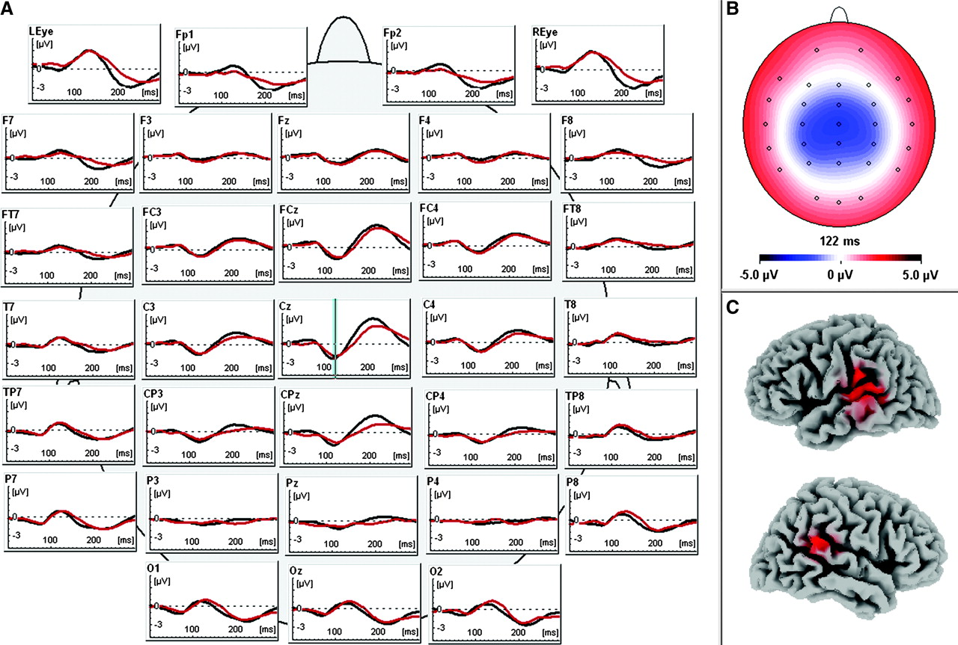
Figure 1. (A) Auditory ERP over all conditions for both groups (synesthetes = red, control = black); blue line ...
Notes:
Figure 1. (A) Auditory ERP over all conditions for both groups (synesthetes = red, control = black); blue line indicates the N1 component at Cz. (B) Right side shows the scalp potential topography of the N1 (122 ms after stimulus onset); blue color corresponds to negative potential values, red to positive potential values, small circles indicate electrode sites. (C) Cortical activation in primary and secondary auditory areas estimated with LORETA at N1 (122 ms) displayed in red. Enhanced activation in the left hemisphere corresponds to left-sided language processing. Upper image shows the left hemisphere; lower image shows the right hemisphere.
Unless provided in the caption above, the following copyright applies to the content of this slide: © 2007 The AuthorsThis is an Open Access article distributed under the terms of the Creative Commons Attribution Non-Commercial License (http://creativecommons.org/licenses/by-nc/2.0/uk/) which permits unrestricted non-commercial use, distribution, and reproduction in any medium, provided the original work is properly cited.

Slide 2
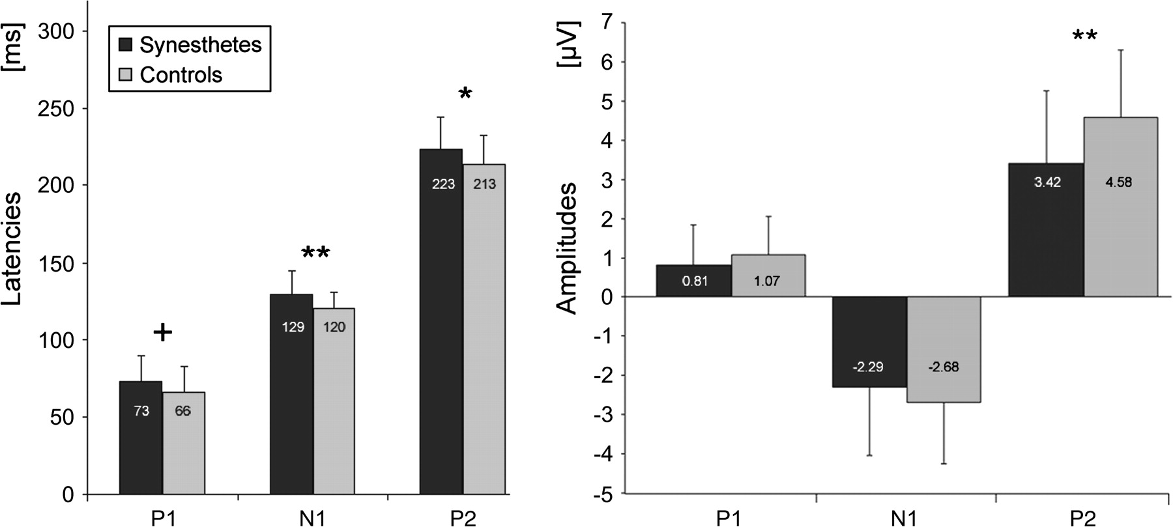
Figure 2. Latencies (left side) and amplitudes (right side) of the 3 grand-mean ERP components (P1, N1, P2) for ...
Notes:
Figure 2. Latencies (left side) and amplitudes (right side) of the 3 grand-mean ERP components (P1, N1, P2) for synesthetes and controls. Synesthetes show longer latencies and smaller amplitudes than controls in all 3 components; significant differences were found in N1 and P2 for latencies, and in P2 for amplitudes (+P < 0.1, *P < 0.05, **P < 0.01).
Unless provided in the caption above, the following copyright applies to the content of this slide: © 2007 The AuthorsThis is an Open Access article distributed under the terms of the Creative Commons Attribution Non-Commercial License (http://creativecommons.org/licenses/by-nc/2.0/uk/) which permits unrestricted non-commercial use, distribution, and reproduction in any medium, provided the original work is properly cited.

Slide 3
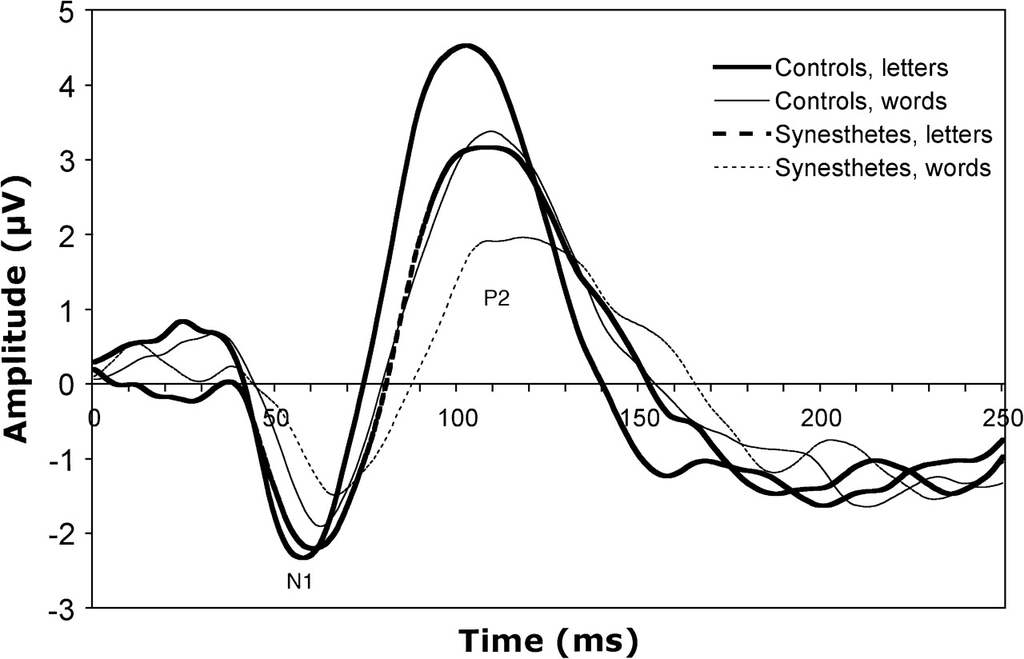
Figure 3. ERPs of letter and words conditions at Cz electrode show delayed reaction and reduced amplitudes for ...
Notes:
Figure 3. ERPs of letter and words conditions at Cz electrode show delayed reaction and reduced amplitudes for synesthetes (green and blue line), as compared with nonsynesthetes (black and red line). N1 = negative ERP components between 116–137 ms after stimulus onset, P2 = positive ERP components between 206–233 ms after stimulus onset. Significant latency delay at N1 (P < 0.01), P2 (P < 0.05), significant amplitude reduction at P2 (P < 0.01).
Unless provided in the caption above, the following copyright applies to the content of this slide: © 2007 The AuthorsThis is an Open Access article distributed under the terms of the Creative Commons Attribution Non-Commercial License (http://creativecommons.org/licenses/by-nc/2.0/uk/) which permits unrestricted non-commercial use, distribution, and reproduction in any medium, provided the original work is properly cited.

Slide 4
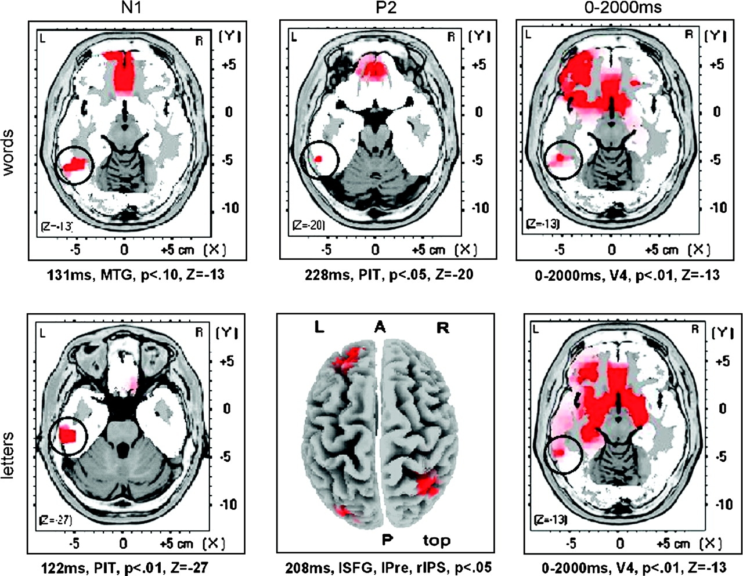
Figure 4. Significantly increased activation for synesthetes as compared with controls displayed in red, predominantly ...
Notes:
Figure 4. Significantly increased activation for synesthetes as compared with controls displayed in red, predominantly found in orbitofrontal areas and in the left temporo-occipital junction. L = left, R = right, A = anterior, P = posterior, MTG = medial temporal gyrus, V4 = visual association area in the fusiform gyrus. Enhanced brain activity in synesthetes when exposed to words and letters at N1 (first column) and P2 (second column) ERP components, and average activation in synesthetes as compared with controls over a 2000-ms time interval (third column) starting at stimulus presentation onset. Z values of axial slices are indicated under each figure, except for P2/letters, where a top view was chosen for best illustration of the results. In all axial slices, the location with maximal activation in temporo-occipital junction (encircled) is specified. Significance levels are indicated under each image.
Unless provided in the caption above, the following copyright applies to the content of this slide: © 2007 The AuthorsThis is an Open Access article distributed under the terms of the Creative Commons Attribution Non-Commercial License (http://creativecommons.org/licenses/by-nc/2.0/uk/) which permits unrestricted non-commercial use, distribution, and reproduction in any medium, provided the original work is properly cited.

